Slide 1
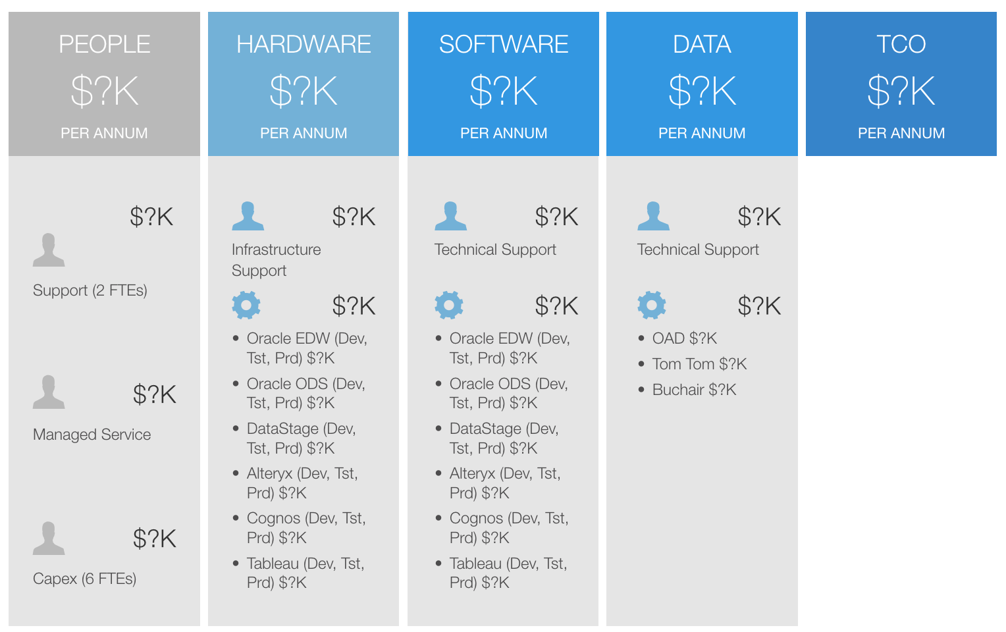
Business Insights TCO Sydney Airport has a strong desire to be data driven. This desire, combined with maturing technology options, means that now is the perfect time for investing in information driven initiatives.

