Slide 1
Flocking Simulation
Richard Salnikov
18.05.26

Slide 2
Introduction
Today I will present my flocking simulation project based on the Boids algorithm developed by Craig Reynolds.
The goal of this project was to simulate realistic group movement using simple behavioral rules and particle-based motion.

Slide 3
Motivation
I have chosen this topic because flocking behavior is an interesting example of emergent systems.
Even though the individual boids follow only simple local rules, complex and natural movement emerges from the interaction of the entire group.
This type of simulation is used in: video games, crowd simulation, robotics, artificial intelligence, animation, and visual effects

Slide 4
What are Boids?
Boids = Bird-oids (1986–1987 by Craig Reynolds)
Artificial life model that simulates realistic flocking behavior
Emergent behavior: Complex group movement arises from simple local rules
Applications: Games, CGI (Like Batman Returns, The Lion King), robotics, swarm intelligence
Key Idea: No central leader, each boid reacts only to its local neighbors.

Slide 5
Implementation
The project was implemented in Python using Pygame.
Each boid has: position, velocity and acceleration
The simulation uses Euler integration to update movement every frame.
On top of that I added: obstacle avoidance, a movable obstacle controlled by arrow keys, edge wrapping and smooth steering behavior

Slide 6
Core Idea
Separation
Boids avoid collisions with the nearby neighbors.
Alignment
Boids try to match the direction of the nearby boids.
Cohesion
Boids move toward the center of their local group, and together, these rules create realistic flocking behavior.

Slide 7
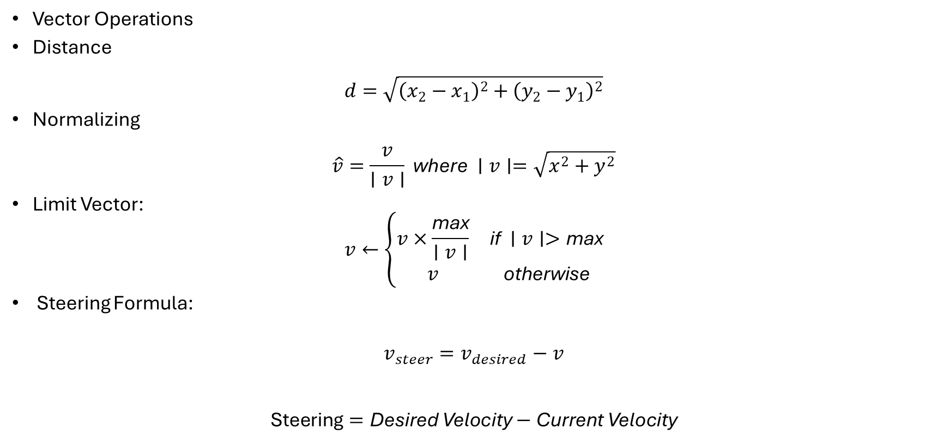
Core Mathematical Concepts
Vector Operations
Distance
$$d=\sqrt{{\left(x_{2}−x_{1}\right)}^{2}+{\left(y_{2}−y_{1}\right)}^{2}}$$
Normalizing
$$\hat{v}=\frac{v}{∣v∣} \text{where} ∣v∣=\sqrt{x^{2}+y^{2}}$$
Limit Vector:
$$v←\left\{\begin{matrix}v×\frac{\text{max}}{∣v∣} & \text{if} ∣v∣>\text{max} \\ v & \text{otherwise}\end{matrix}\right.$$
Steering Formula:
$$v_{steer}=v_{desired}−v$$
$$\text{Steering}=\text{Desired} \text{Velocity}−\text{Current} \text{Velocity}$$

Slide 8
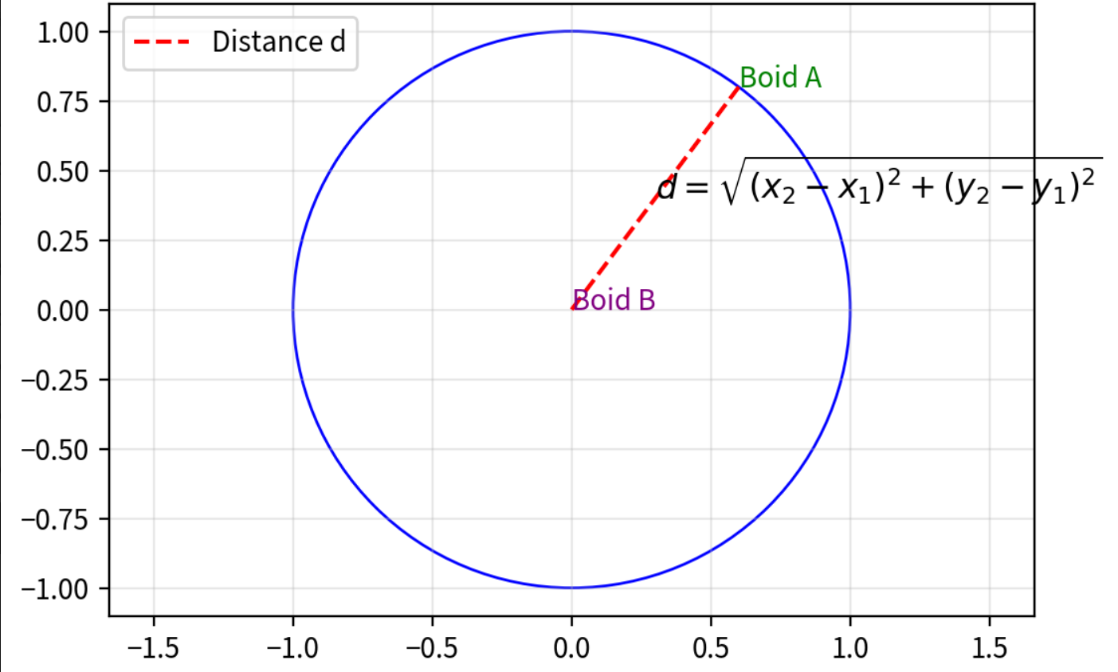
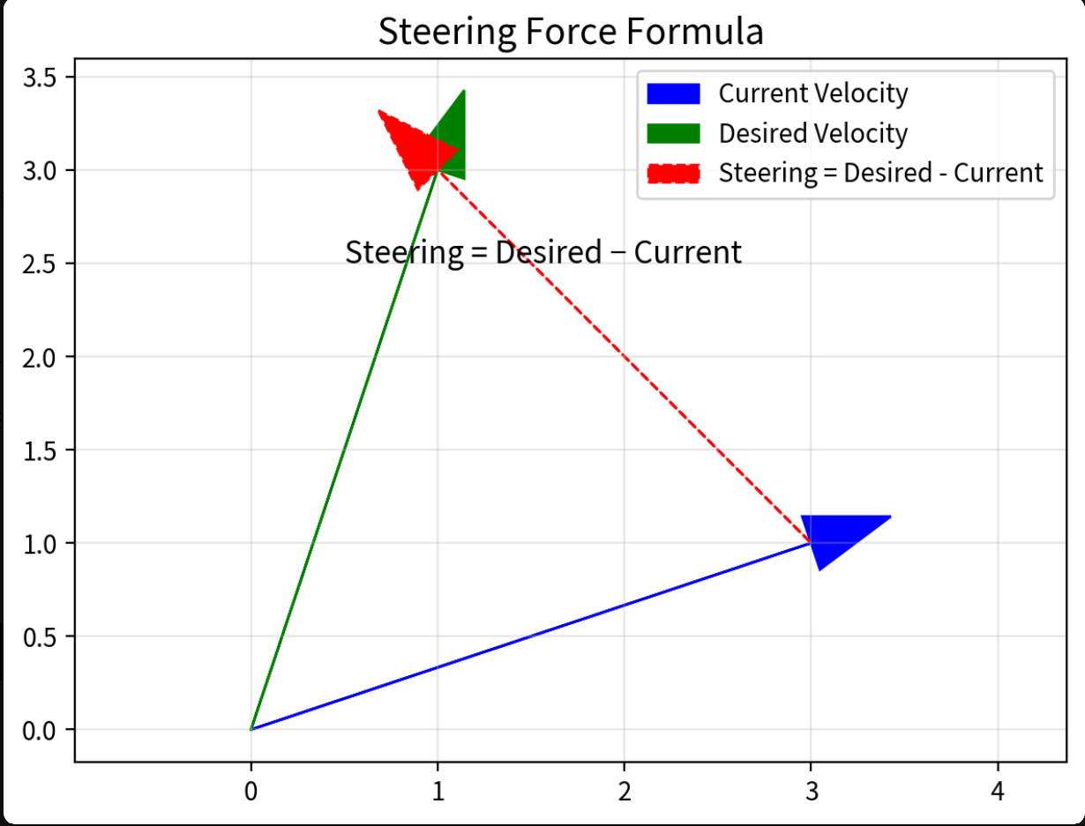
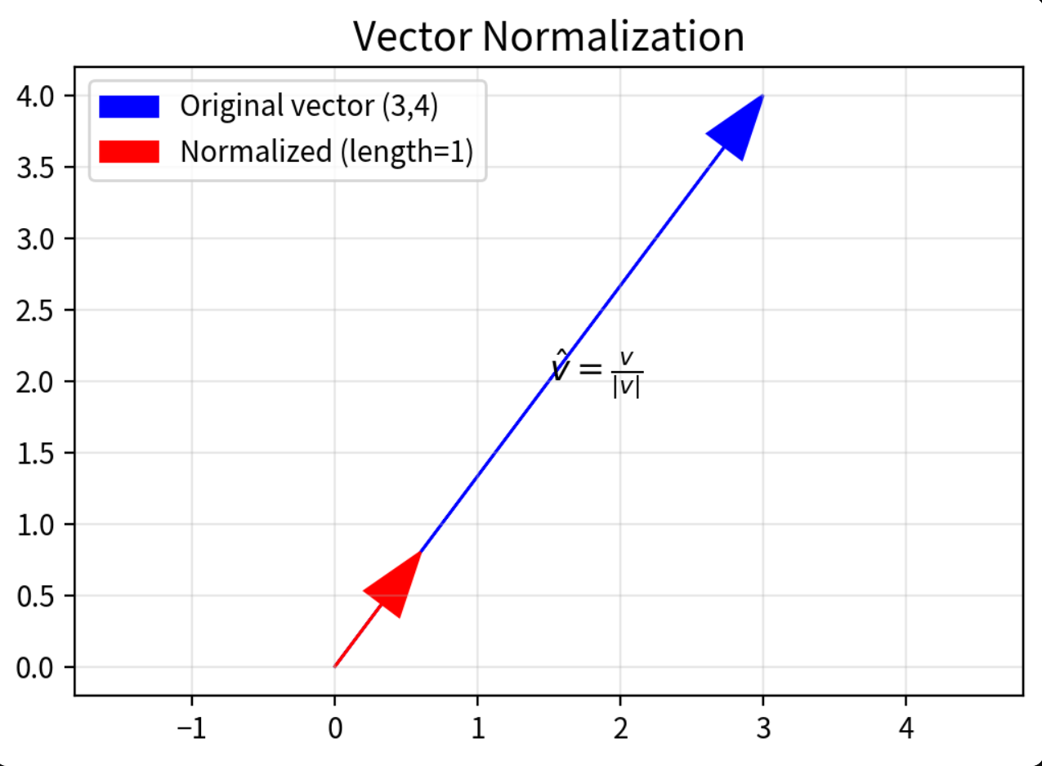

Slide 9
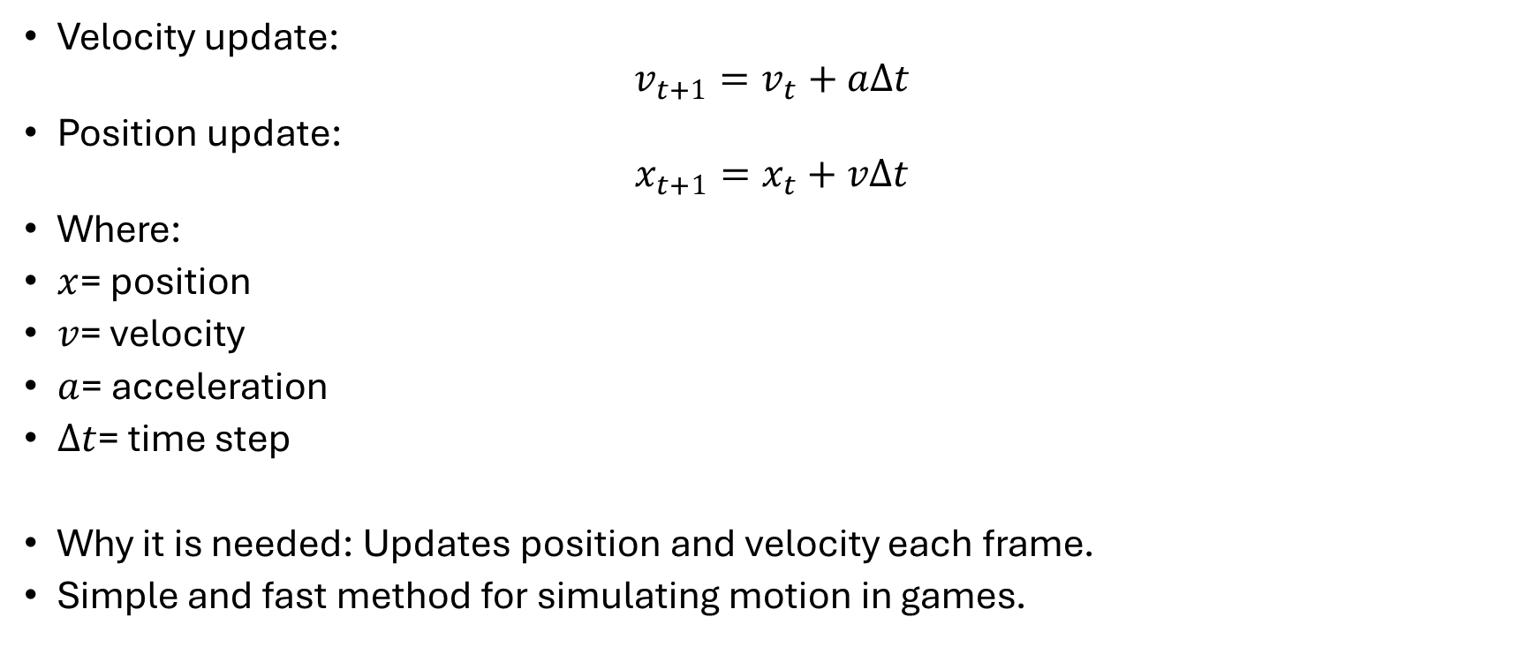
Core Euler Equations
Velocity update:
$$v_{t+1}=v_{t}+aΔt$$
Position update:
$$x_{t+1}=x_{t}+vΔt$$
Where:
$x$= position
$v$= velocity
$a$= acceleration
$Δt$= time step
Why it is needed: Updates position and velocity each frame.
Simple and fast method for simulating motion in games.

Slide 10
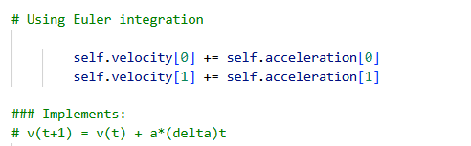
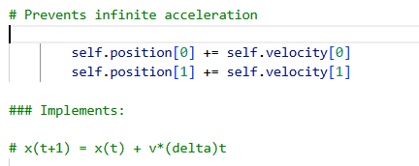

Slide 11
Separation Behavior
Prevents collisions and maintains personal space
Formula:
For each close neighbor:
diff = self.position - other.position
Normalizing diff (stronger when closer)
Sum all diff vectors → average → desired velocity
Weight: 1.5 (strongest of the three flocking rules)
Radius: Only 25 pixels (much smaller than alignment/cohesion)

Slide 12
Obstacle Avoidance
Activated: When distance < OBSTACLE_RADIUS + 60 (~75 px)
Formula:
steering = self.position - obstacle_pos
steering = normalize(steering) * MAX_SPEED
steering = steering - self.velocity
steering = limit(steering, MAX_FORCE * 3)

Slide 13
Purpose:
It calculates a strong repulsion force that pushes each boid away from the red movable obstacle.
What it calculates:
Compute distance d between the boid and the obstacle.
If the boid is close enough (d < 75 pixels):
  Create a vector pointing directly away from the obstacle (self.position - obstacle_pos).
  It normalizes (vector length = 1).
  Turns it into a desired velocity at full speed (* MAX_SPEED).
  Applies the classic steering formula:
  Steering = Desired Velocity − Current Velocity
  Limits the steering strength to MAX_FORCE * 3 .
If the boid is far away → returns [0, 0]
Result:
The boid turns away from the obstacle. The closer it gets, the stronger the push (because of the inverse-distance effect).

Slide 14
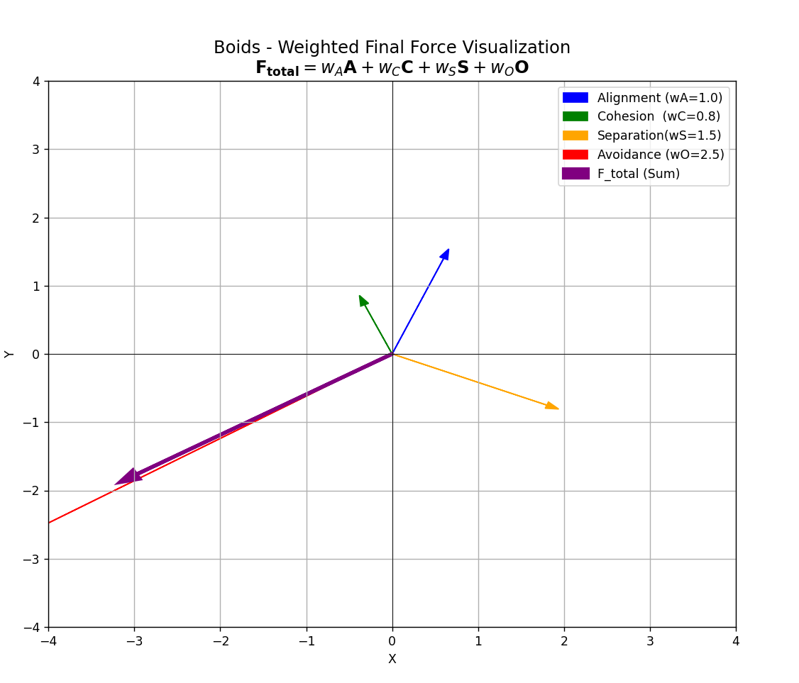
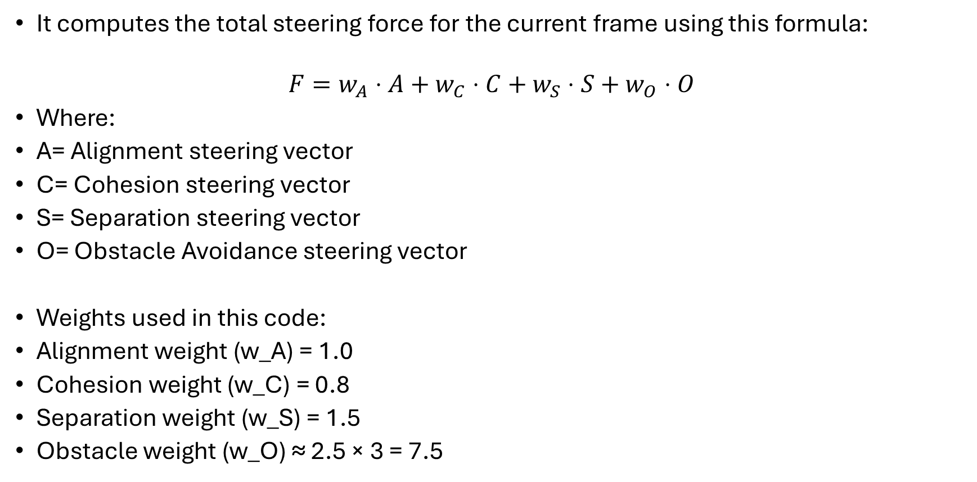
Weighted Final Force
It computes the total steering force for the current frame using this formula:
$$F=w_{A}⋅A+w_{C}⋅C+w_{S}⋅S+w_{O}⋅O$$
Where:
A= Alignment steering vector
C= Cohesion steering vector
S= Separation steering vector
O= Obstacle Avoidance steering vector
Weights used in this code:
Alignment weight (w_A) = 1.0
Cohesion weight (w_C) = 0.8
Separation weight (w_S) = 1.5
Obstacle weight (w_O) ≈ 2.5 × 3 = 7.5

Slide 15
Behavior | Weight | Effect if Weight is High | Effect if Weight is Low
Alignment | 1.0 | Very uniform group direction | Random chaotic directions
Cohesion | 0.8 | Tight, compact flocks | Loose, spread out groups
Separation | 1.5 | Boids keep good distance | Overlapping / colliding boids
Avoidance | ~7.5 | Boids strongly dodge obstacle | Boids crash into or ignore obstacle

Slide 16
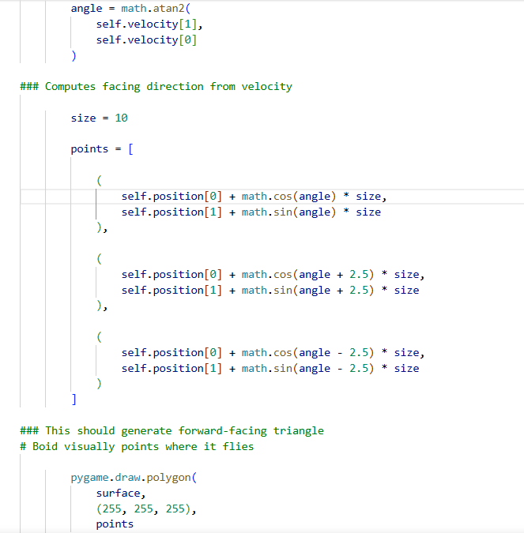
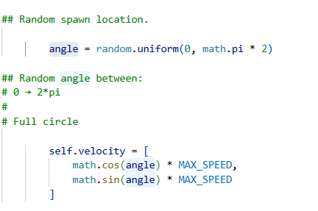

Slide 17
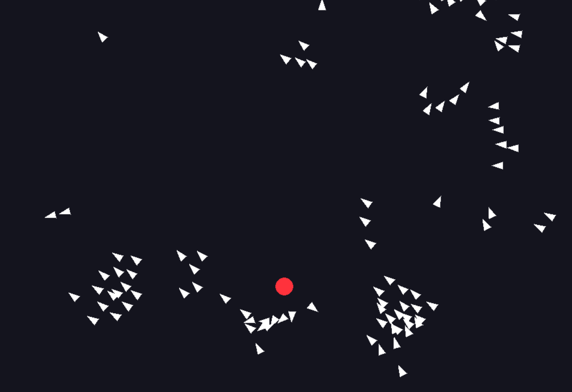

Slide 18
The Final Results
The final result is that we have an interactive flocking simulation where the boids:
move naturally as a group
avoid collisions
react dynamically to obstacles
reform after splitting around obstacles
The simulation demonstrates emergent behavior from decentralized rules.

Slide 19
In Conclusion
This project helped me to better understand: particle systems, steering behaviors, vector mathematics and the emergent AI systems
In the future, the simulation could be extended with: predator/prey behavior, obstacle maps, 3D flocking, more advanced physics, and rendering

