Slide 1


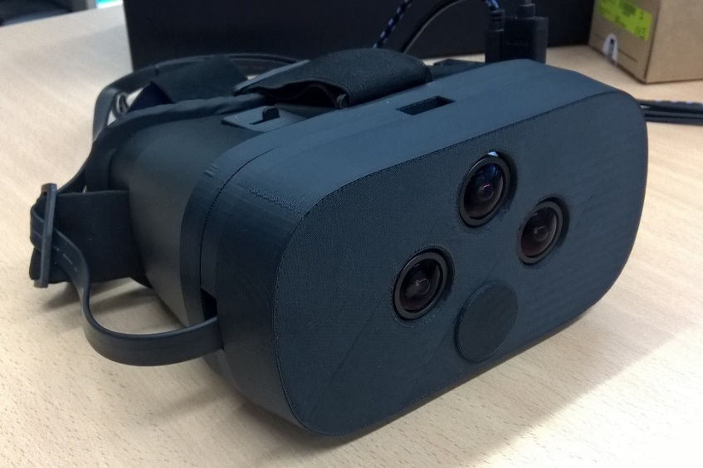
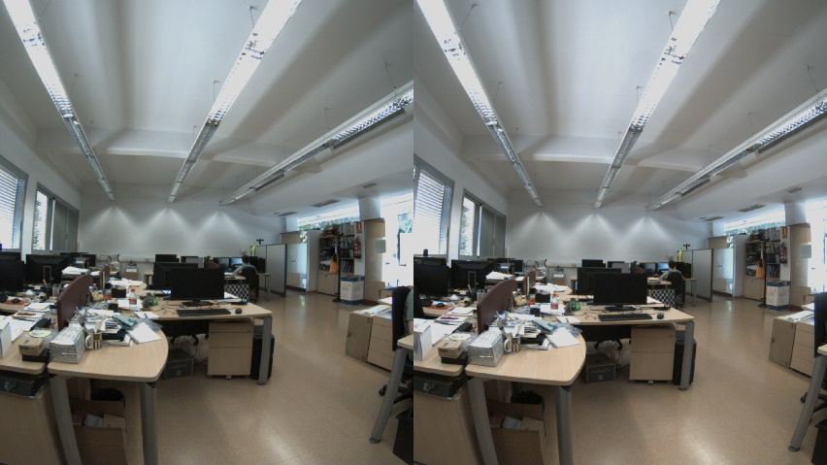


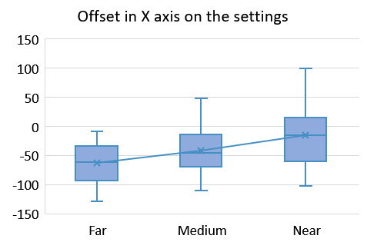
Reducing dizziness when using a video-see-through head mounted display
Richard Segovia Barreales
Treball Final de Grau Enginyeria Informàtica
Curs 2017 - 2018
Menció en computació
INTRODUCTION
PROBLEM
PIPELINE
Despite the great advances , users still feel dizzy when using Head Mounted Devices (HMD) :
Evaluate whether the user correctly perceives distances and sizes of the objects in 3D space.
Evaluate the user experience when using the HMD and determine whether the accommodation-vergence effect causes dizziness.
Develop a system capable of adapting the visualization to the viewed scene, using depth info .
Accommodation vergence conflict:
Occurs when looking at a screen that is close to the eyes.
Caused by the difference between accommodation distance and vergence distance.
Size issue:
Objects on the screen seem to be at different distances and have different sizes than the objects in the real world.
Caused by the difference between the position of the eyes and the position of the cameras.
Left
Right
RECTIFICATION
USER SETTINGS
DEPTH MAP
Users are able to determine one visualization setting for each distance. After two user testing sessions, one observed the following:
Users prefer a specific setting for a specific viewing distance.
Users do not feel comfortable using settings that belong to other distances.
The same thing happens when applying zoom to the image.
PROCESS
PROTOTYPE
THREAD ARCHITECTURE
CLASSIFY DISTANCE
A video-see-through prototype developed at the CVC was used in this project.
The depth map is generated using the images from two cameras on a stereo matcher.
Left
Right
CHANGE THE VISUALIZATION
Camera
Camera
SETTING
Grabbing
Grabbing
Thread 1
Thread 2
CONCLUSION
Grabs lastest image
Grabs lastest image
During the project a tool was developed to dynamically change the visualization settings.
Users felt that the software improves their user experience when using video-see-through devices
Future work
Depth map information can be used in AR applications.
Use Depth info to apply DoF blur in areas where the image cannot be not fused by the eye to reduce Accommodation Vergence conflict.
Preset
Displaying
ROI
transition
Classification
Displaying Thread
Grabs
value
image pair
Classification
LIBELAS
Undistort
Processing Thread
Tutor: Felipe Lumbreras Ruiz
Departament: Ciències de la Computació
Tutor: Coen Antens
Empresa: Computer Vision Center (CVC)

