Slide 1


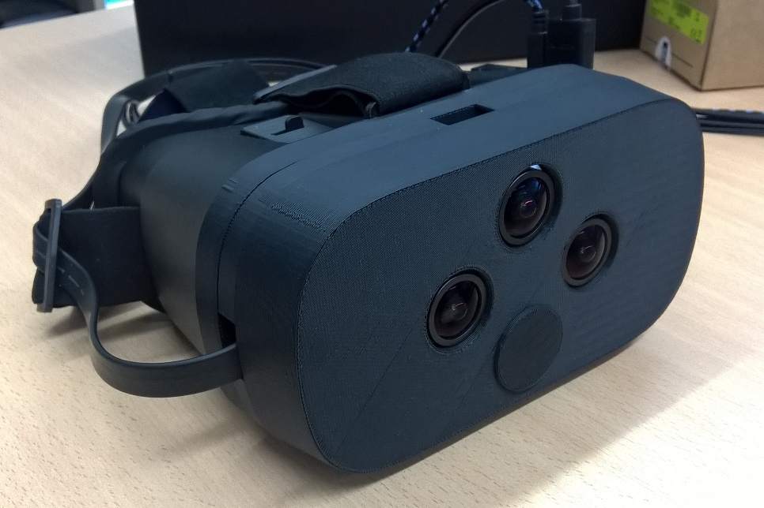


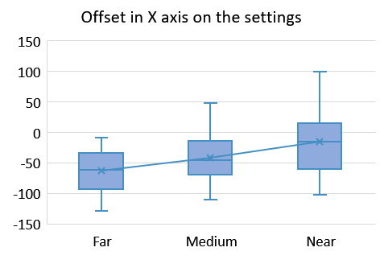
Reducing dizziness when using a video-see-through head mounted display
Richard Segovia Barreales
Treball Final de Grau Enginyeria Informàtica
Curs 2017 - 2018
Menció en computació
INTRODUCTION
PROBLEM
PIPELINE
Despite the great development of HMD technologies, users still feel dizzy when using them.
Evaluate if the user perceives incorrectly the distances and sizes of the objects.
Evaluate the user experience when using the HMD and determine whether the accommodation-vergence effect causes dizziness.
Develop using depth info a system capable of adapting the visualization to the viewed scene.
Accomodation vergence conflict:
Occurs when seeing through near eye screens.
Caused by the difference between accomodation distance and vergence distance.
Size issue:
Objects seem to be at different distances and have different sizes than real
Caused by the difference between the eyes position and cameras position
Left
Right
RECTIFICATION
USER SETTINGS
DEPTH MAP
Users are able to set one visualization setting for each distance. After two user testing sessions, it was observed the following:
Users prefer one setting for each viewing distance
Users do not feel comfortable using settings from other distances.
This also happens with the zooming of the image.
PROCESS
PROTOTYPE
THREAD ARCHITECTURE
CLASSIFY DISTANCE
A video-see-through prototype develop on the CVC was used in this project.
It allows the users to see the images captured by the cameras in real time.
The two cameras give the users a stereo experience.
The depth map are generated using the images from two cameras on a stereo matcher.
Left
Right
CHANGE THE VISUALIZATION
Camera
Camera
SETTING
Grabbing
Grabbing
Thread 1
Thread 2
CONCLUSION
Grabs lastest image
Grabs lastest image
A tool able to dynamically change the setting of visualization was successfully develop.
Users felt that this software improves their user experience when using video-see-through devices
Future work
Depth map information can be used in AR applications.
Use Depth info to apply DoF blur in areas where the image cannot be not fused by the eye to reduce Accomodation Vergence conflict.
Preset
Displaying
ROI
transition
Classification
Displaying Thread
Grabs
value
image pair
Classification
LIBELAS
Undistort
Processing Thread
Tutor: Felipe Lumbreras Ruiz
Departament: ciències de la computació
Tutor: Sr. Coen Antens
Empresa: Computer vision center (CVC)

