Slide 1
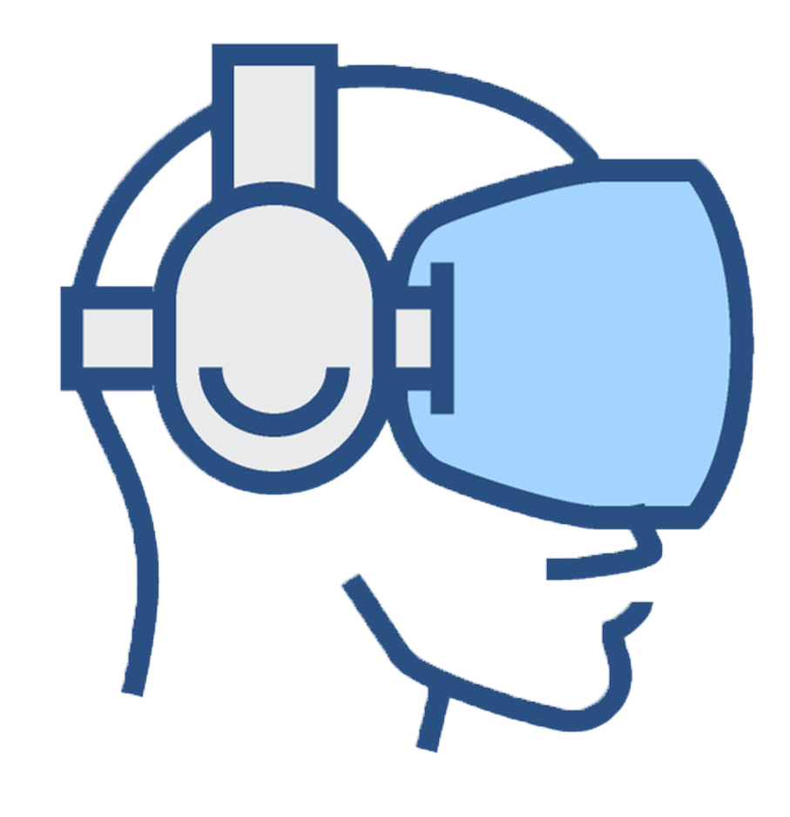
Reducing dizziness when using a video-see-through head-mounted display
Final grade project
Richard Segovia Barreales 1390282

Slide 2
Introduction

Slide 3
Dizziness issue

Slide 4
Objectives

Slide 5
Development: Calibration module

Slide 6
Development: LIBELAS

Slide 7
Development: Pipeline

Slide 8
Results: Performance issues

Slide 9
Results: Output stability

Slide 10
Results: First user testing

Slide 11
Results: Second user testing

Slide 12
Conclusions

