Slide 1
Bellabeat Activity Analysis
Presented by: Zach Richardson
Last Updated: 8/10/23

Slide 2
Table of Contents
Objective
Data Story
Conclusions
Recommendations
Further Reading

Slide 3
Objective
Analyze health-tracking device data in order to identify trends that can help guide Bellabeat marketing strategies

Slide 4
Analysis

Slide 5
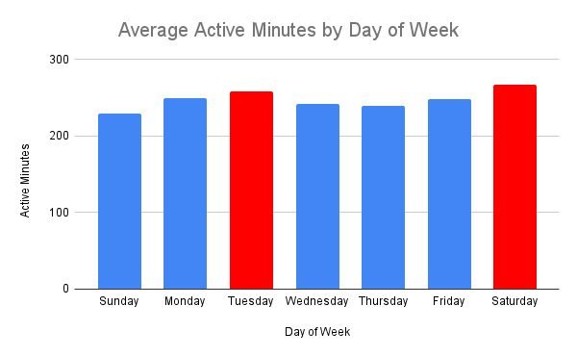
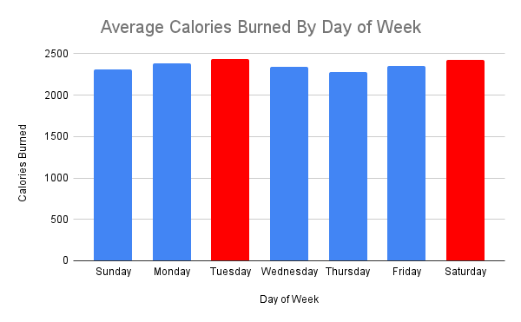
Weekly Exercise Patterns
The most active days for users are Tuesdays and Thursdays
Users are spending an average of 21.4 more minutes exercising and burning 4% more calories on these days
Users are doing the least amount of activity on Sundays

Slide 6
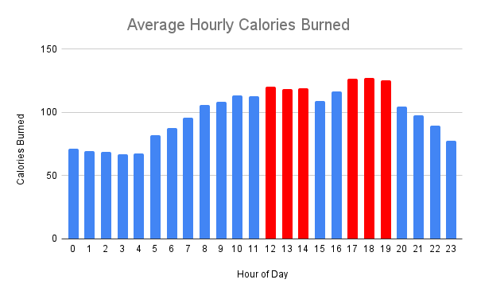
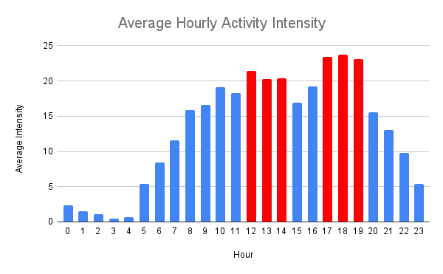
Hourly Exercise Patterns
Users are most active during the time frames of 12-3pm and 5-8pm
Burning 27% more calories in these time frames than in the remaining waking hours of 7am-10pm

Slide 7
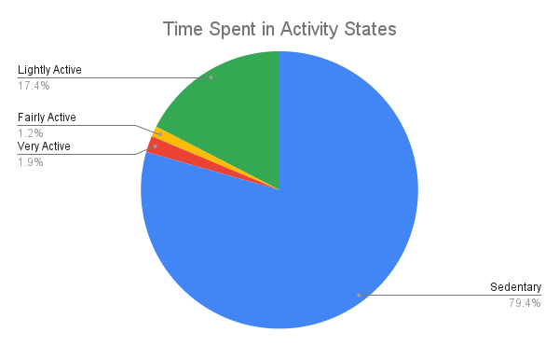
Activity States
Users are spending close to 80% of their time in a sedentary state
Only 3.1% of their time is spent doing relatively intensive exercise

Slide 8
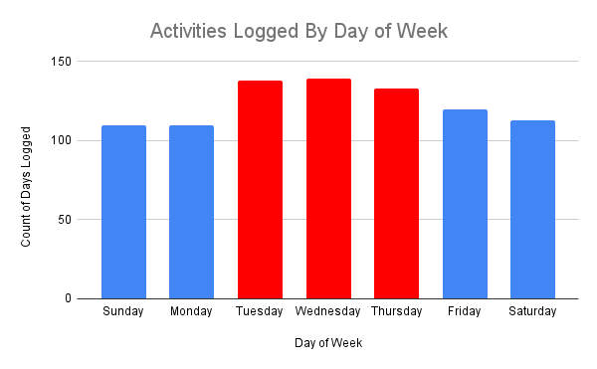
Device Usage
Users logged 17% more records on Tuesday, Wednesday, Thursday than on other days of the week

Slide 9
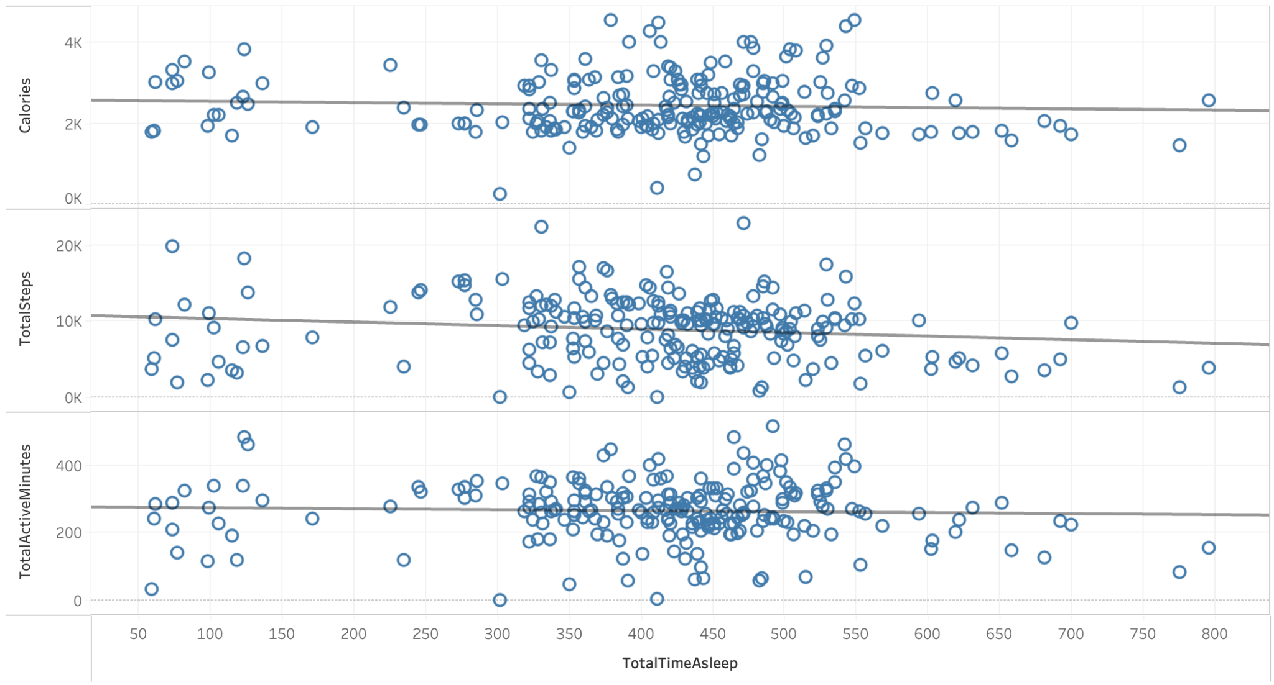
Sleep vs Exercise
Found no significant correlations between sleep and calories burned, total steps, or total active minutes

Slide 10
Conclusions
Users are most active on Tuesdays and Saturdays
Users are most active in the time spans of 12-3pm and 5-8pm
The vast majority of users time is spent in sedentary state
Users are more likely to log workouts mid-week
There is no evident correlation between sleep and exercise

Slide 11
Recommendations
Tailor scheduled activities to target the peak active days of Tuesday and Saturday
Target the peak active hours of 12-3pm and 5-8pm
Emphasize the uses of the device for time spent in sedentary state
Send reminders to users devices to track their workouts on weekends
Send notifications to encourage more physical activity on Sundays

Slide 12
Further Reading
Data source
Analysis Write-Up
Tableau Dashboard

Slide 13
Thank You

