Slide 1
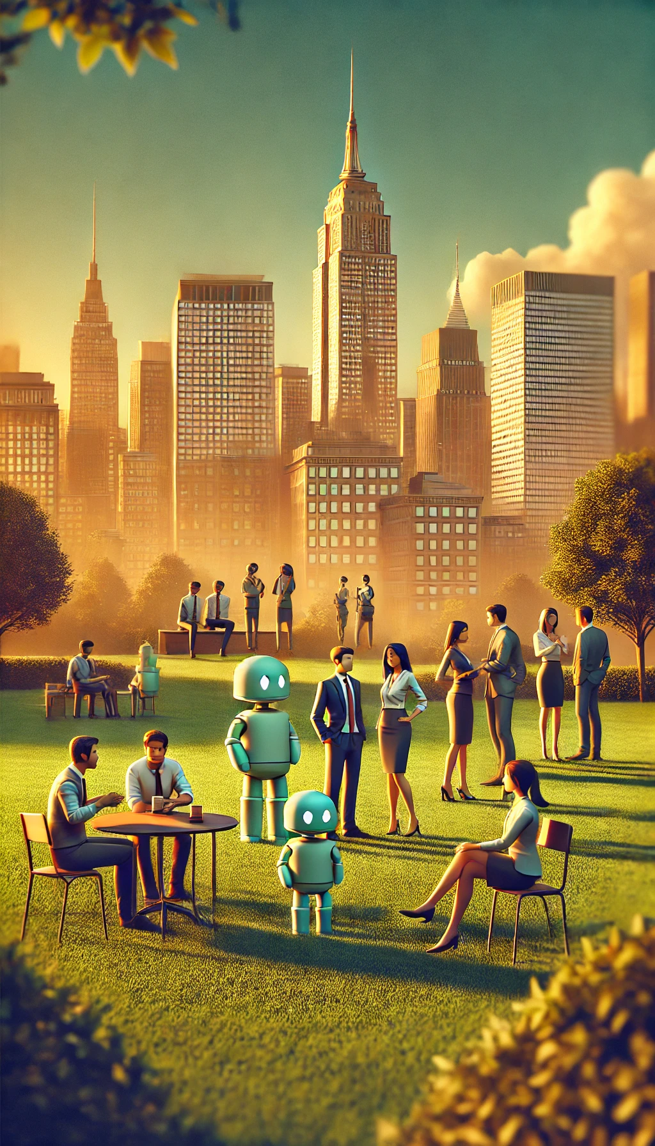
The Human Element
Why Human Judgment Becomes More Valuable, Not Less, in an AI World
Sami J Karam
Richard Sprague

