Slide 1
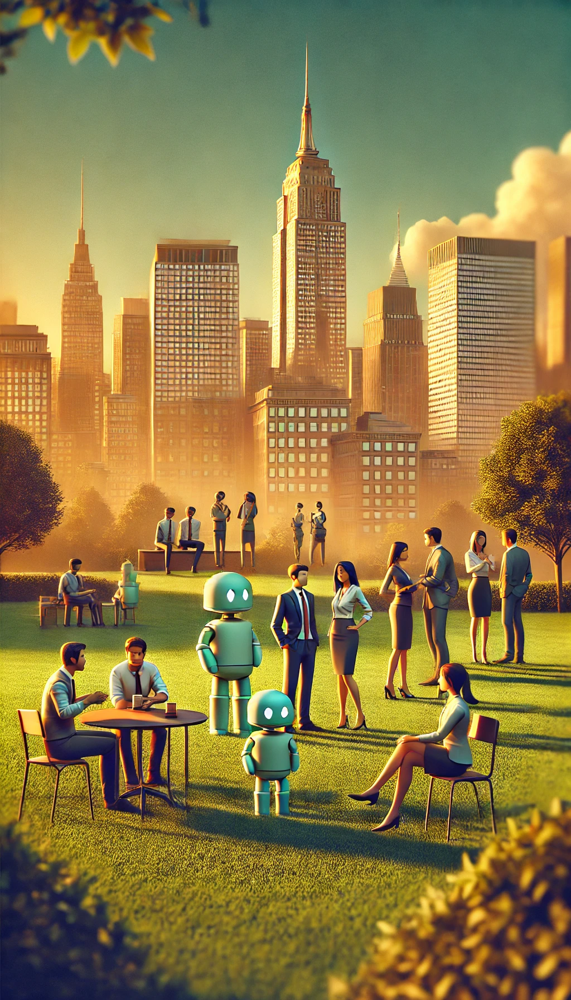
The Human Exception
Why Human Judgment Becomes More Valuable, Not Less, in an AI World
Sami J. Karam
Richard A. Sprague

Slide 2
