Slide 1
PPM Project Presentation
Practical Project Management & Professional Development
Richard Stone N0782914
Nathan Balfour N0784536
Irena Mileva N0783935
Sam Prince N0785380
Stephen Anderson N0786072
Emerson Darwin N0785398

Slide 2
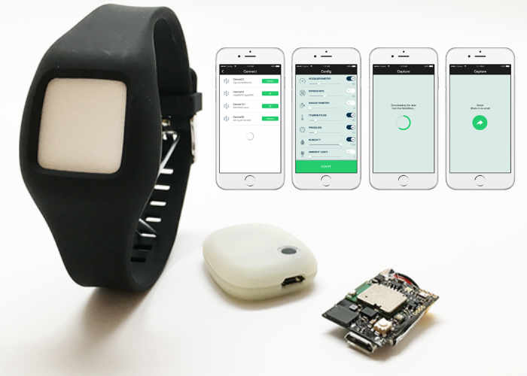
Project Idea
-The use of wearable technology in conjunction with modern smartphones for patients suffering from Alzheimer’s disease.
-Gather acceleration data from the MetaMotion R wrist device.
-Calibrate to the user, use their gathered acceleration data to detect an episode.
Figure 1 - MetaMotion R
-Report their location, and use a database to send a message from the patient’s device to their carer reporting their whereabouts.
-Currently, very little exists in the realms of applications which support this.

Slide 3
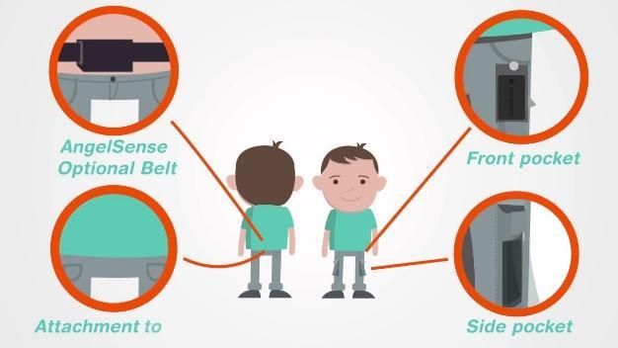
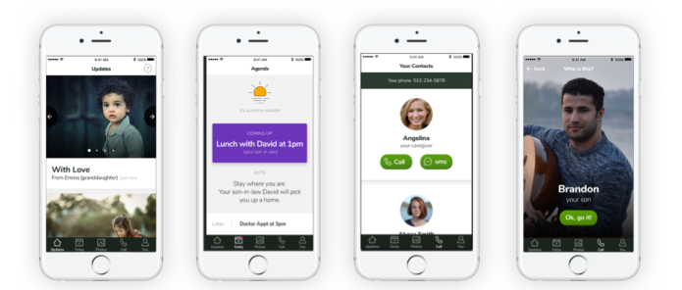
Background Research
- Literary review suggest it’s possible to detect episodes via an accelerometer
- Previous solutions include Timeless and AngelSense
- Existing solutions were insufficient
- We aimed to improve these previous solutions
Figure 2 - Timeless App
Figure 3 - AngelSense

Slide 4
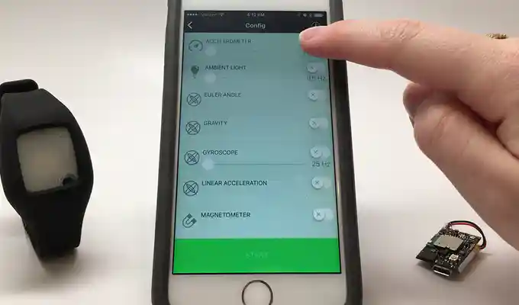
Calibration and Episode Detection
-Accelerometer data given in the form of comma separated values
-Patient should run the calibration function for roughly three hours for a thorough calibration
-Calculate the variance for each 10 second window of data
-Order the variances, find the 95th percentile value (p ≤ 0.05)
-Use this value as the threshold, if three consecutive values of variance exceed this threshold, an episode has been detected.
Figure 4 - The interface for gathering data from the MetaMotion device

Slide 5
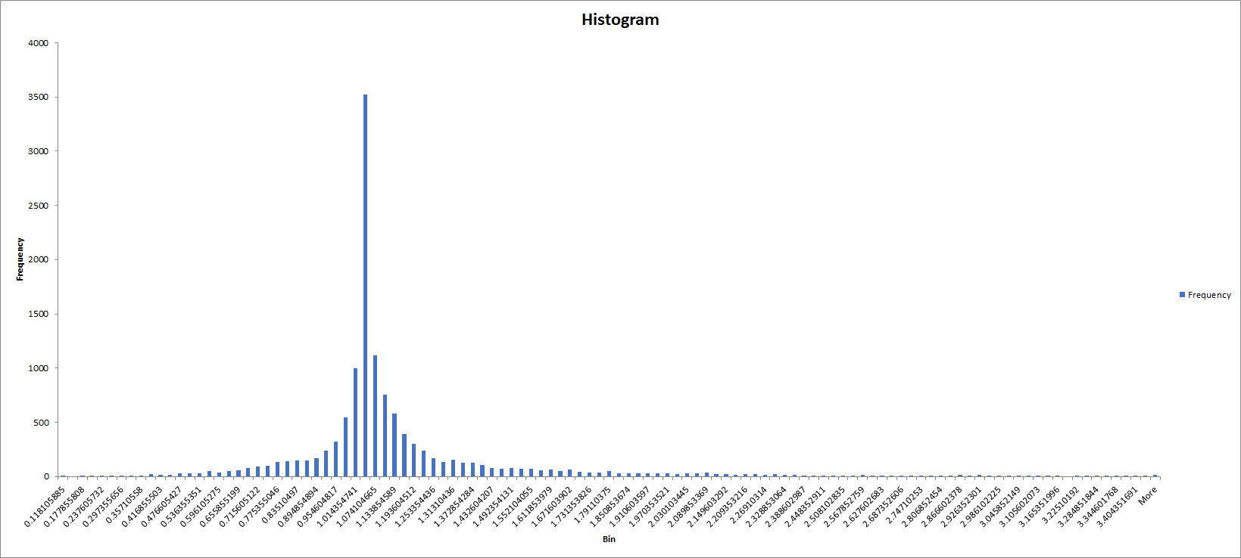
A Histogram to Show the Frequency of Movement Types an Individual Performs
Frequency
95th Percentile - 1.833172
Values over the threshold
Movement Variance
Figure 5 - Histogram of Movement Variance

Slide 6
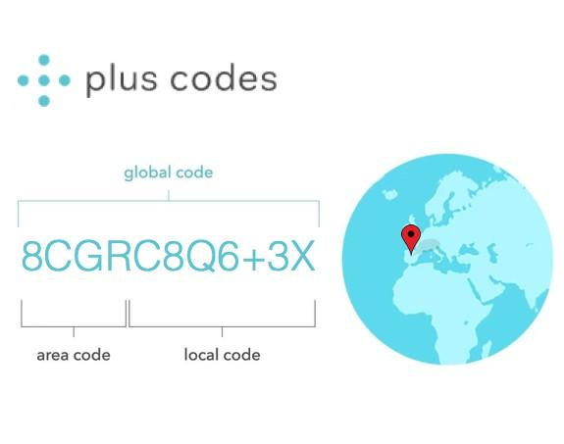
Location Reporting
-Plus codes are used to create a pinpoint location on Google Maps
-This is ideal because a carer would need to have the best information possible so that they can help the patient in need
-They are calculated using the plus.codes API (https://plus.codes/) which requires longitude and latitude coordinates that can be fetched from the patient’s mobile phone’s GPS
-Plus codes that are calculated using their API are accurate to within a 14x14m area
-They are a simple but effective way of allowing Google Maps to display a precise location without giving a street address
Figure 6 - plus codes

Slide 7
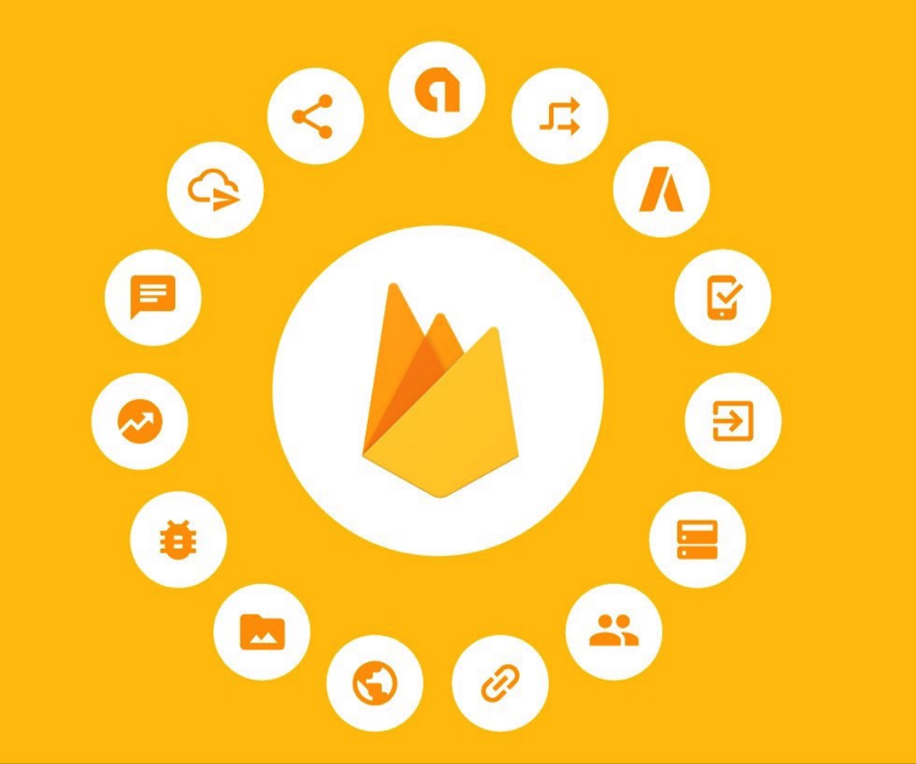
Database
Firebase was used to develop the account system for the application.
Why firebase?
Perfect compatibility with android and other features such as google maps as its developed by google.
It's allows for a cleaner solution to the overall project as it has multiple features needed for the application
It's a free service that's well documented and friendly for new developers.
Allows for a simple and secure way for users to sign in without having to develop our own security for the login process.

Slide 8
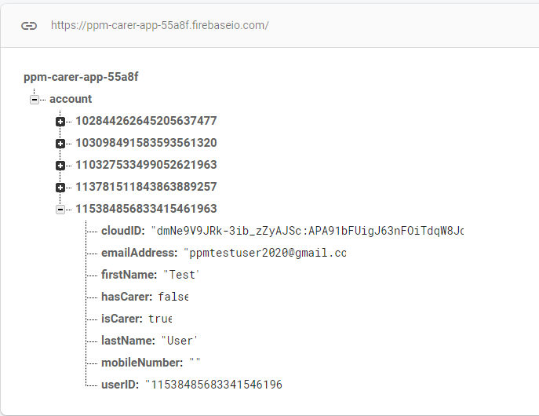
Database
Implementation
Firebase allows for authorisation through a google sign in
Used to store account data derived from google account
Each user is identified by their unique google account ID, not their email address
Stores the cloud ID of the user to send notifications through firebase cloud messaging system
When the user logs in to the application with their google account it will query the database to see if the user exists already, if not then it will allow them to create their account
One noticeable drawback of the database is that it works on a hierarchical system rather than a table based system.

Slide 9
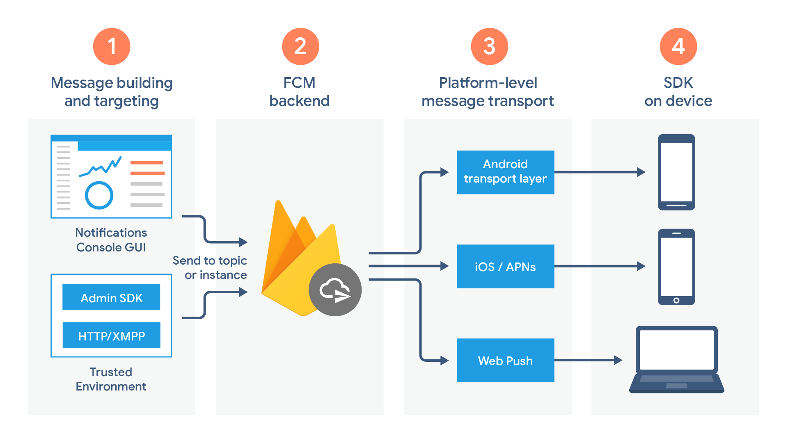
Messaging
Firebase Cloud Messaging is used to send data from one app instance to another
In order to send a message the registration token of the target device must be known
On app login the registration token of the device is recorded in the firebase database
When the ‘Help’ button is pressed by the patient, their respective carer’s registration token is retrieved and the FCM message is sent to the Google API where it is sent to the carer
When the carer receives a help message a push notification is triggered along with a sound/vibration

Slide 10
Overall Conclusions and Future Developments
-A foundation which can be built upon.
-Using live data rather than pre-recorded values.
-Using peer-reviewed data, rather than our own data.

Slide 11
References
Timeless, 2019. Timeless Care. [Online] Available at: https://www.timeless.care/ [Accessed 10 January 2020].
AngelSense, 2019. AngelSense. [Online] Available at: https://www.angelsense.com/uk/?utm_source=google&utm_campaign=sch_branded_UK&gclid=CjwKCAiA3uDwBRBFEiwA1VsajOxxsmOhJw3G5yMkTdgiwXOpE_6Dbcv1ojr4u_cv54_9IDyvIbAiDBoC1dUQAvD_BwE [Accessed 10 January 2020].

