Slide 1
LeCloud: Leyou Mall on Cloud with K8s
Introduction
Microservices
Nginx ingress
Rabbitmq cluster
Mysql cluster
Group 9
ZHENG KAISHENG HAO YUCHENG TANG YI ZHONG SHANGRUI
conclusion

Slide 2


Introduction
Open-source Online Shopping Mall System
Migrate to Cloud
Leverage K8s features

Slide 3
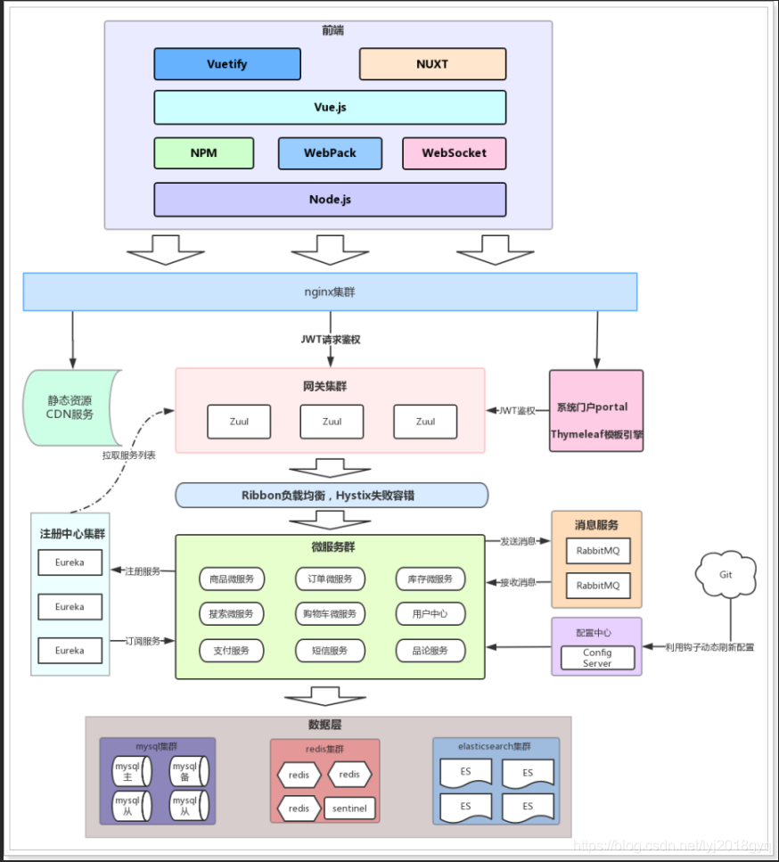
Introduction
Open-source Online Shopping Mall System
Migrate to Cloud
Leverage K8s features
Built upon: https://github.com/lyj8330328/leyou

Slide 4
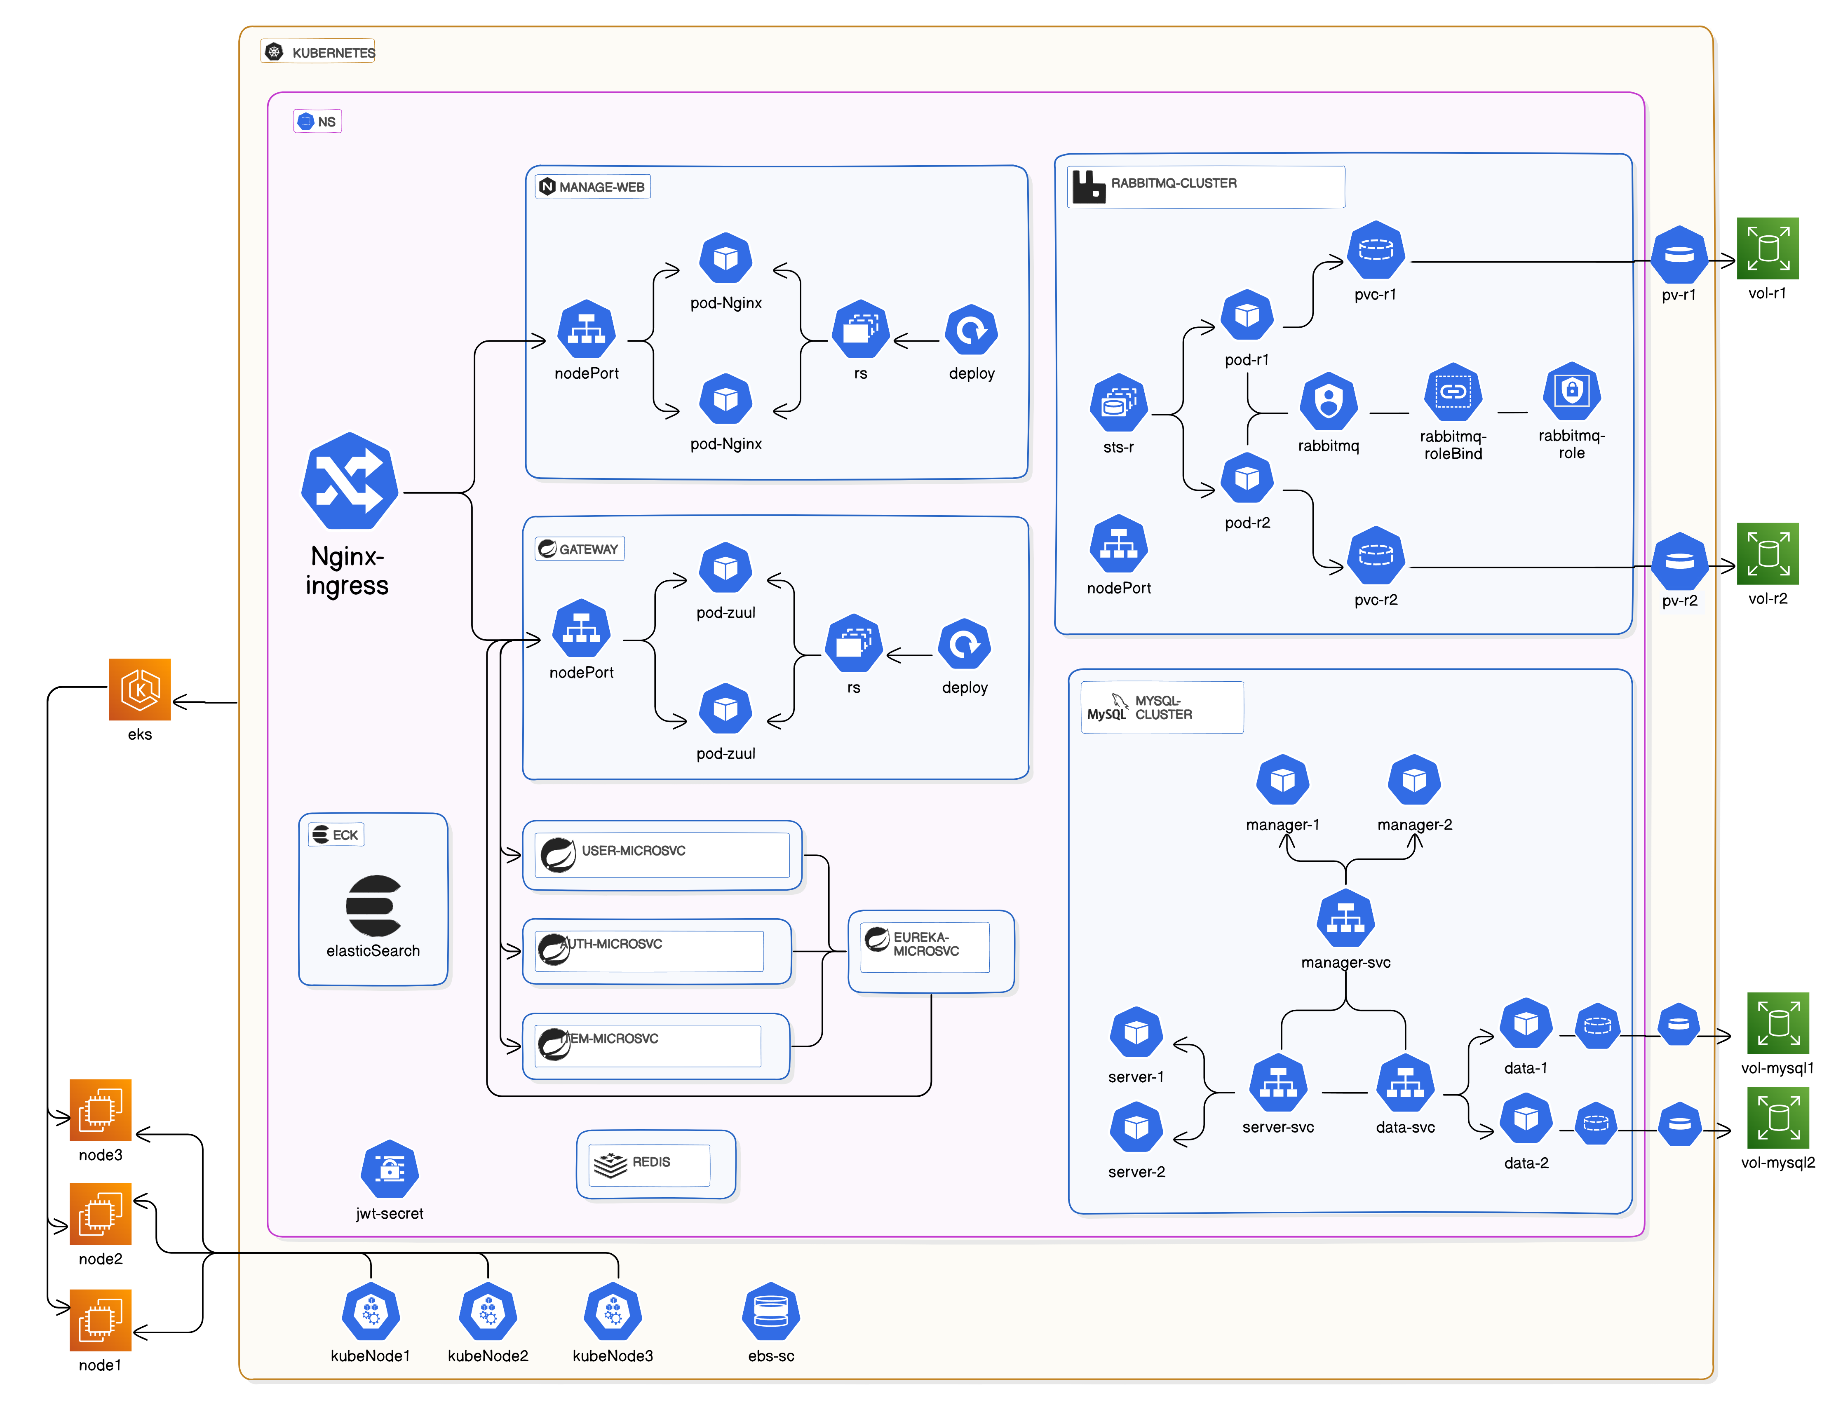

Slide 5

Micro-services
Service decoupling
Environment separation
Scaling on demand

Slide 6
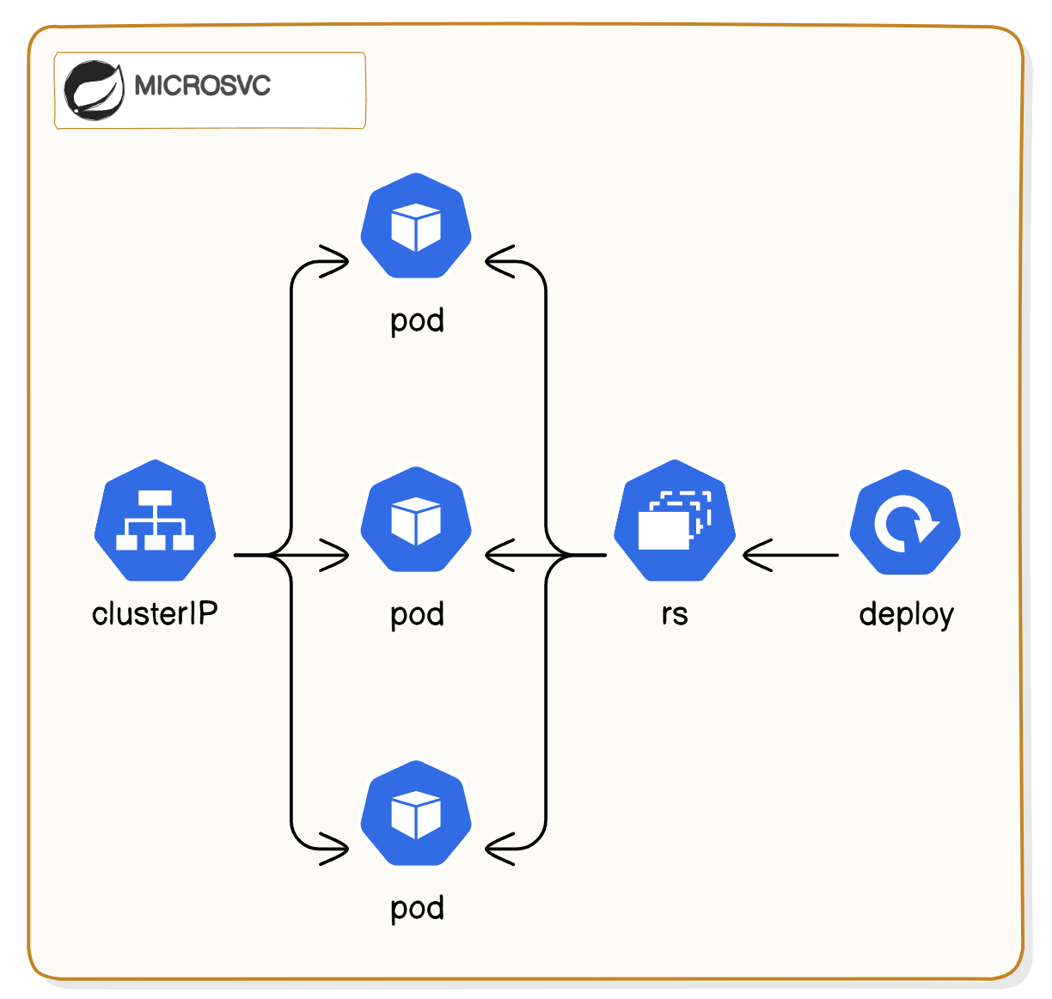
Micro-services
Service decoupling
Environment separation
Scaling on demand

Slide 7

Nginx Ingress
Consistent external IP
Router based on rules

Slide 8
Nginx Ingress
Consistent external IP
Router based on rules
Nginx cluster?

Slide 9
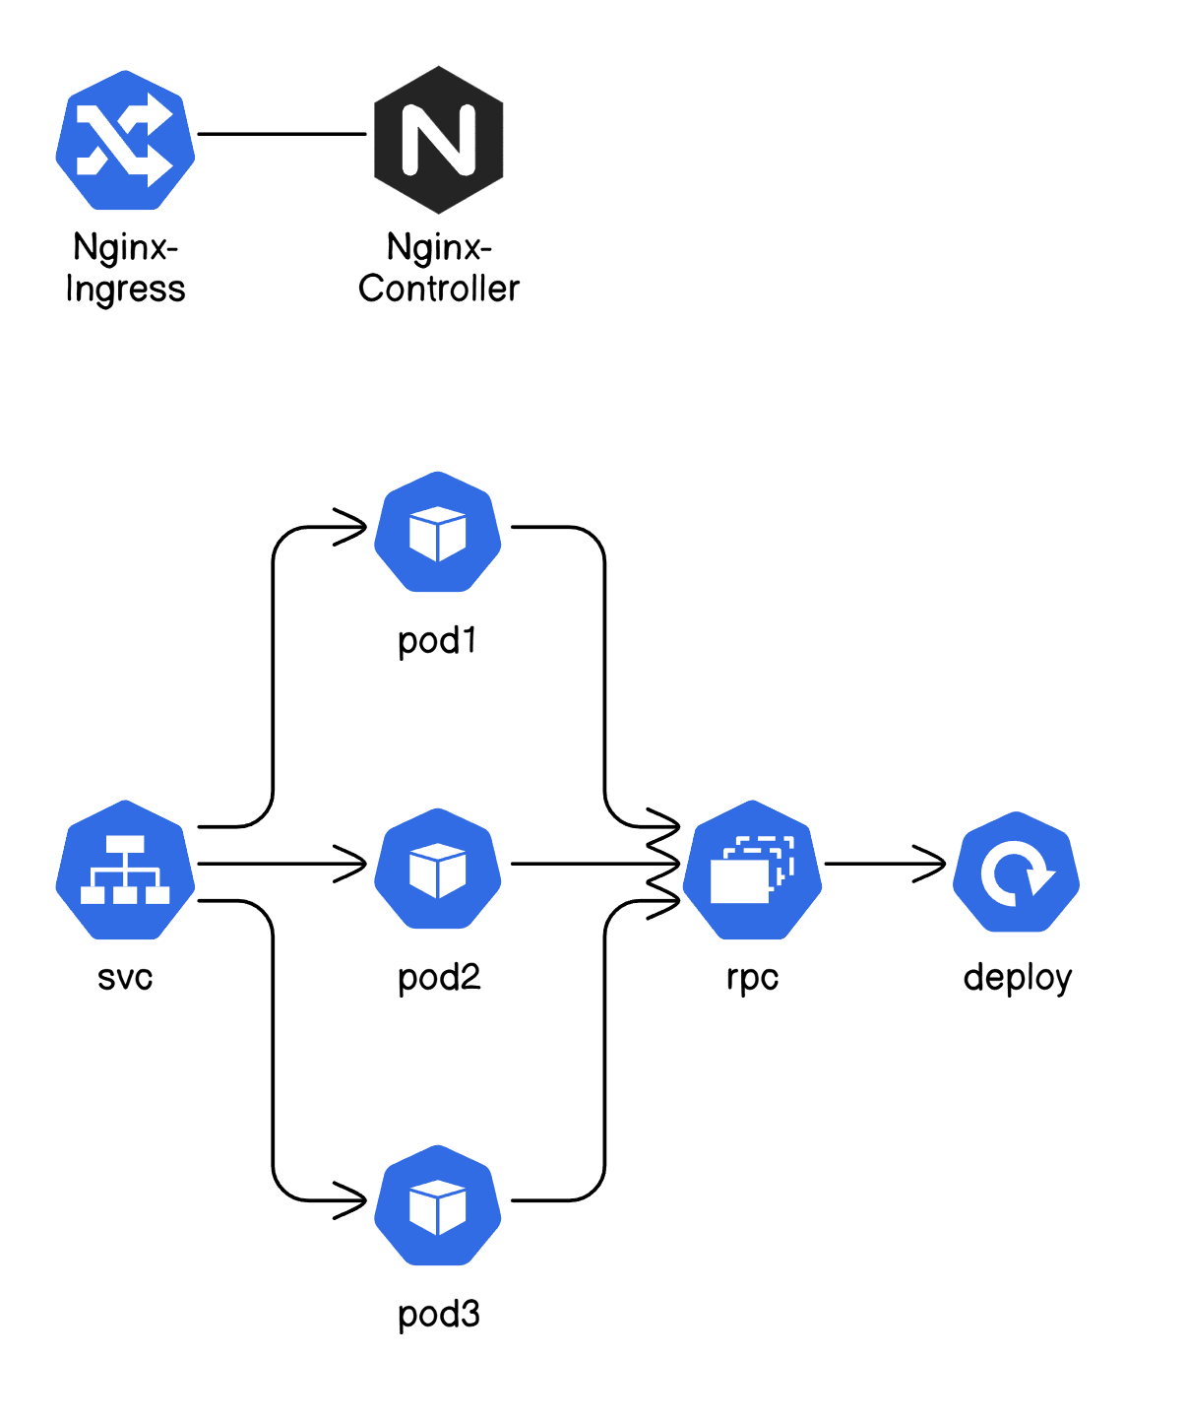
Nginx Ingress
OR

Slide 10
Nginx Ingress
Controller Patterns
An Nginx controller is:
- a daemon proc.
- a reverse proxy

Slide 11

Nginx Ingress
Controller Patterns
An Nginx controller is:
- a daemon proc.
- a reverse proxy

Slide 12
Nginx Ingress
Controller Patterns
Ingress: policy
Ingress Controller:
- implementation
- real-time update

Slide 13

RabbitMQ cluster
Message queue service

Slide 14
RabbitMQ cluster
Message queue service
Deploy RabbitMQ on K8s | liyongzhezz.github.io

Slide 15
RabbitMQ cluster
Message queue service
Single-node to Cluster
Deploy RabbitMQ on K8s | liyongzhezz.github.io

Slide 16
RabbitMQ cluster
Message queue service
Single-node to Cluster
Leveraging K8s features
Deploy RabbitMQ on K8s | liyongzhezz.github.io

Slide 17
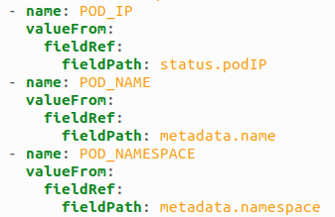
RabbitMQ cluster
Downward API

Slide 18
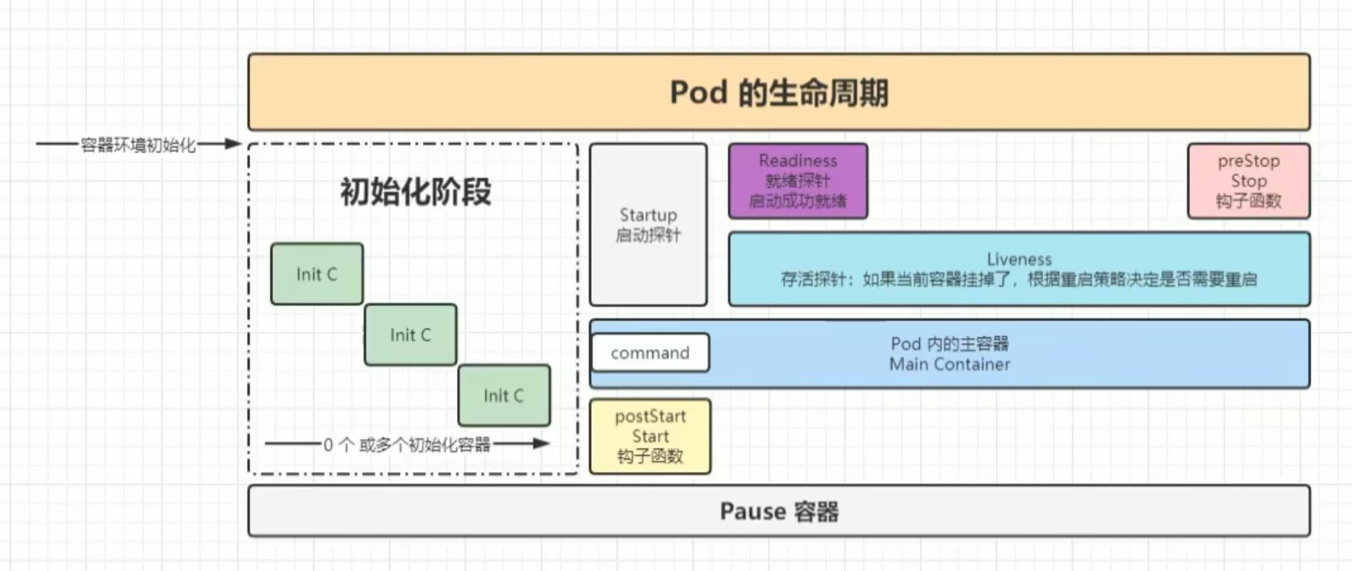
RabbitMQ cluster
Lifecycle Pattern

Slide 19

RabbitMQ cluster
Role Based Access Control
Limited access to K8s API server
access
serviceAccount

Slide 20
RabbitMQ cluster
Role Based Access Control
Limited access to K8s API server
Peer discovery
serviceAccount

Slide 21

MySQL cluster
Manager node
Data node
MySQL server node

Slide 22
MySQL cluster
Operator Pattern
Automatic deployment
Specify node’s number
on demand

Slide 23
Conclusion
Service decoupling
Ingress and controller pattern
RBAC and lifecycle pattern
MySQL operator

Slide 24
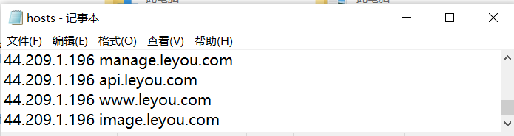
Play with it
Win: C:\System32\drivers\etc\hosts
Mac/Linux: /etc/hosts
www.leyou.com
username1 : abcdefg1
username170 : abcdefg170
(1~170)
manage.leyou.com
admin : admin
Try not delete things

