Slide 1
data
feeds
generates
algorithm
trains
questions
model
answers

Slide 2
train
data
test
data
feeds
algorithm
trains
model
validates

Slide 3
“Javascript is a cool language.”
“Be cool and mind your language.”
Javascript
is
a
cool
language
Be
cool
and
mind
your
language
= 2/4 = 0.5

Slide 4
“PHP is a cool language.”
“Be cool and mind your language.”
PHP
is
a
cool
language
Be
cool
and
mind
your
language
= 2/4 = 0.5

Slide 5
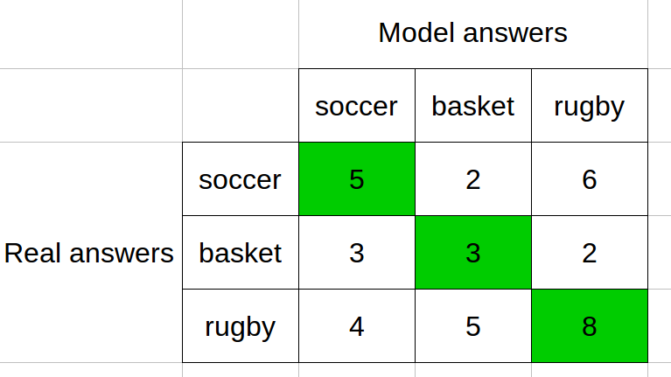

Slide 6
A
 | A | B | C
A | 1 | 0.1 | 0.8
B | 0.1 | 1 | 0.5
C | 0.8 | 0.5 | 1
C
B

