Slide 1
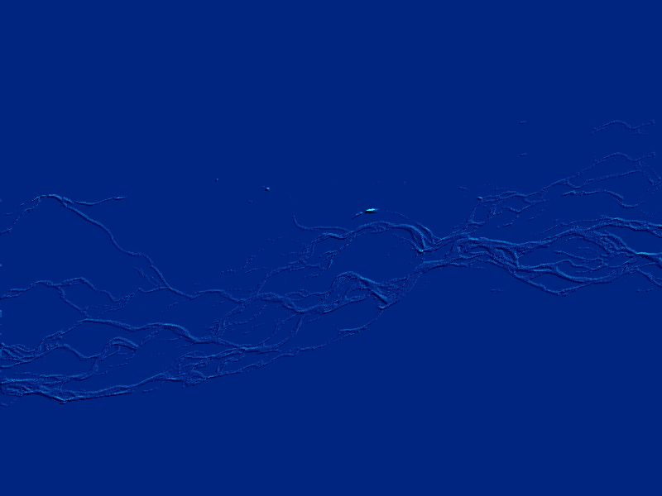
Virtual Poster Instructions
This virtual poster will automatically loop without any user intervention. The entire presentation takes 10 minutes.
There are three buttons displayed in the top right-hand corner of each slide. These can be activated by clicking the mouse over them:
Return to the previous slide
Go to the next slide
Start over from the beginning of the poster

Slide 2
Remote survey of large gravel riverbeds
Richard Westaway (University of Cambridge, UK)
Stuart Lane (University of Leeds, UK)
Murray Hicks (NIWA Christchurch, New Zealand)
Maurice Duncan (NIWA Christchurch, New Zealand)
Acknowledgements: NIWA, UK Natural Environment Research Council, NZ Foundation for Research, Science and Technology, Environment Canterbury and Air Logistics (NZ) Ltd

Slide 3
Introduction (1)
Gravel-bed rivers traditionally surveyed using cross-sections
Spacing based on factors like cost and riverbed access as much as geomorphology
Leads to unreliable estimates of morphological change

Slide 4
Introduction (2)
Alternative approach is to use ‘remote survey’: measurement/quantification of landform surfaces using remote sensing methods
One such technique is the use of digital photogrammetry to produce Digital Elevation Models (DEMs)
Successfully used in geology and civil engineering
Relatively untested in fluvial geomorphology at larger scales - can it be scaled up?

Slide 5
Introduction (3)
This work applies digital photogrammetry to the Waimakariri River, near Christchurch
Water turbidity means submerged bed cannot be surveyed photogrammetrically
Instead, empirical colour-depth relationship used to estimate water depth and ultimately submerged topography
Combined with photogrammetric dry-area DEM to give ‘total’ riverbed surface

Slide 6
Research aims
1 To examine research design necessary to yield high quality DEMs of the Waimakariri riverbed, given low vertical relief and large spatial extent;
2 To evaluate importance of DEM post-processing;
3 To develop empirical water colour - water depth relationship; and
4 To assess accuracy and precision of final riverbed surface

Slide 7
Study area
Study area is the Waimakariri River at Crossbank, about 15km from Christchurch
Crossbank reported to be current location of the ‘hinge-point’ between post-glacial down-cutting and aggradation (Carson and Griffiths, 1989)
The reach is around 3.3km long, 1.2km wide and has low vertical relief (<1m)

Slide 8
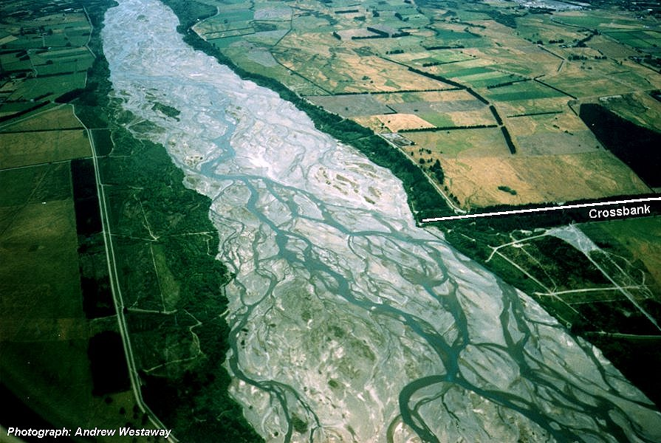
Waimakariri study area
3.3 km
1.2 km
Flow
©Andrew Westaway, 1999

Slide 9
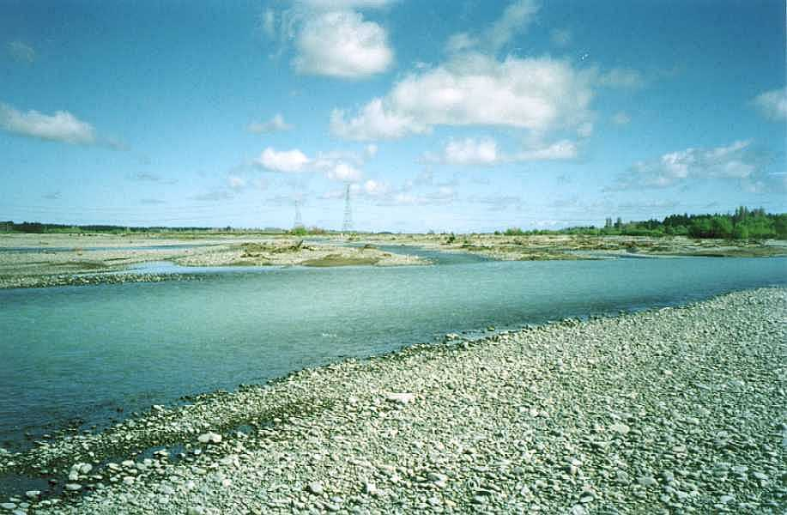
Typical relief at study reach
...or maybe lack of?

Slide 10
The research project
To obtain riverbed surfaces of the Waimakariri at Crossbank for 3 epochs:
  February 1999
  March 1999
  February 2000
Large (bankfull) flood event
Annual change
– Also May 2000 (Laser altimetry) - See poster paper by Hicks et al.

Slide 11
Method - Aim
Aerial photographs
Final riverbed surface (DEM)

Slide 12
Aerial photographs
Colour aerial photographs flown by Air Logistics (NZ) Ltd
  16 at 1:5000 in February 1999
  18 at 1:5000 in March 1999
  7 at 1:8000 and 24 at 1:4000 in February 2000
Mosaicked and georeferenced using the GCPWorks module of PCI Works, based on surveyed photo-control points

Slide 13
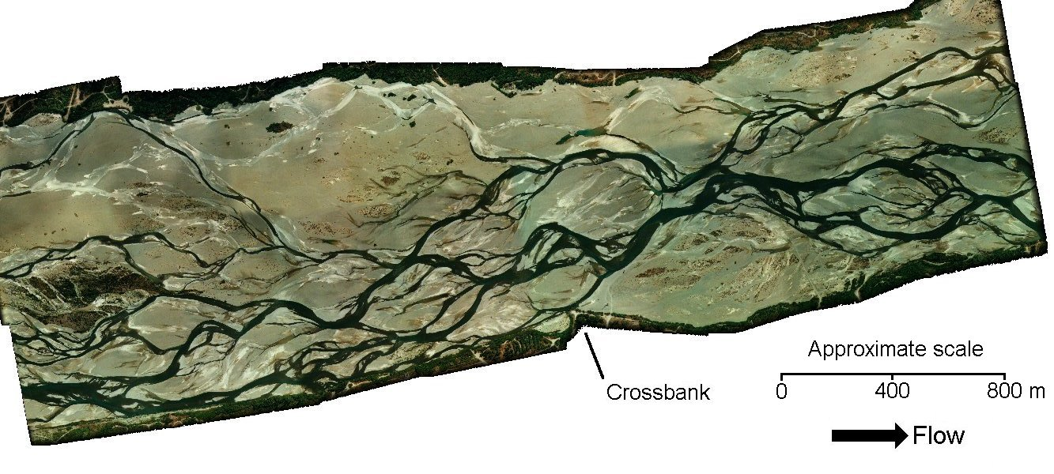
Aerial photographs - Feb 1999
©Air Logistics (NZ) Ltd, 1999

Slide 14
Method - Step 1
Aerial photographs
Georeferencing
DRY AREAS
Classified image
WET AREAS
Final riverbed surface (DEM)

Slide 15
Classification
Images classified using maximum likelihood supervised classification into ‘wet’ and ‘dry’ zones
Vegetation added semi-manually

Slide 16
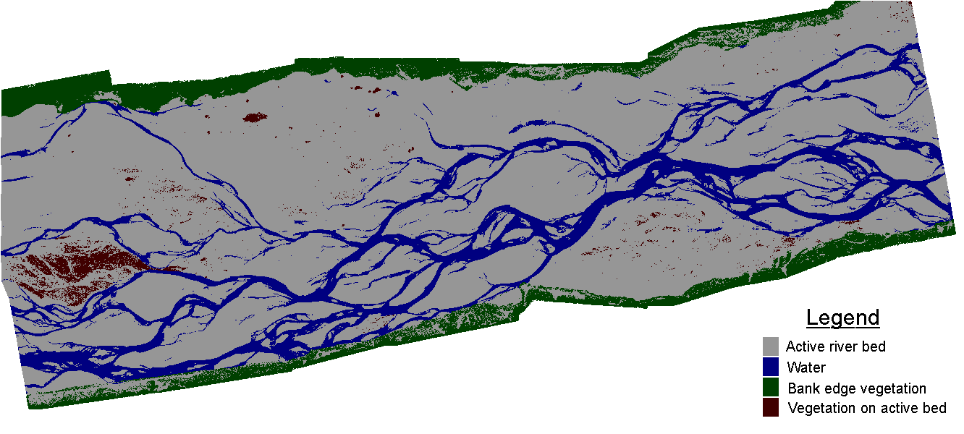
Classified image - Feb 1999

Slide 17
Method - Step 2
Aerial photographs
Automated photogrammetry
Georeferencing
DRY AREAS
Classified image
WET AREAS
Manual editing
Final riverbed surface (DEM)

Slide 18
Photogrammetric method (1)
Individual DEMs generated using the OrthoMAX module of ERDAS Imagine
  14 for February 1999
  16 for March 1999 } Number of photo overlaps
  22 for February 2000
DEMs collected with ground spacing of 1m
Photo-control provided by targets surveyed using Trimble GPS system and visible on the photographs

Slide 19
Photogrammetric method (2)
Each individual DEM was post-processed:
  1. Initial DEM surface
  2. Elimination of wet areas and vegetation
  3. Automated blunder filter based on elevation deviation
  4. Manual removal of gross errors and addition of breaklines using stereo-viewing

Slide 20
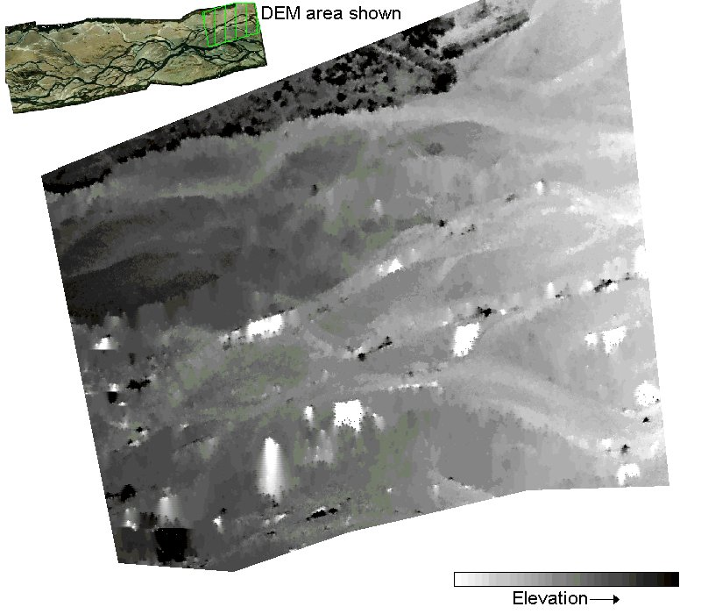
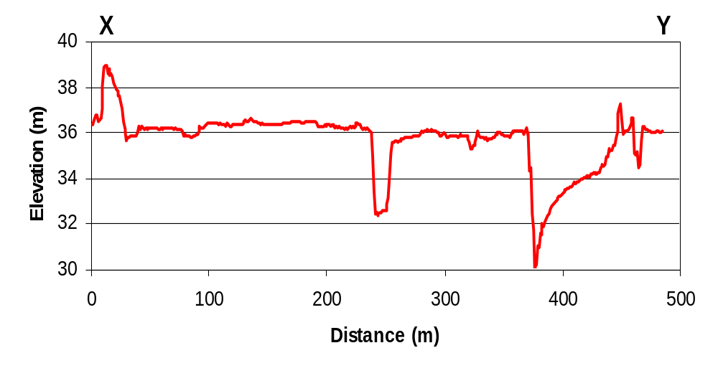
Post-processing stage 1:
Initial DEM surface
X
Errors
Y

Slide 21
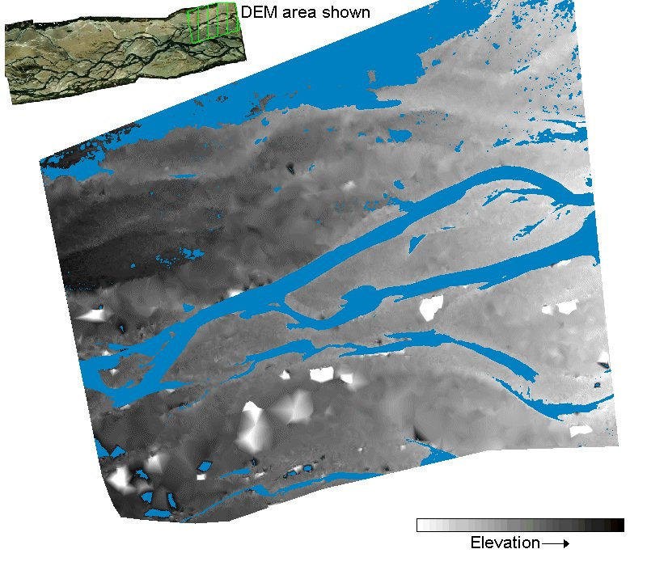
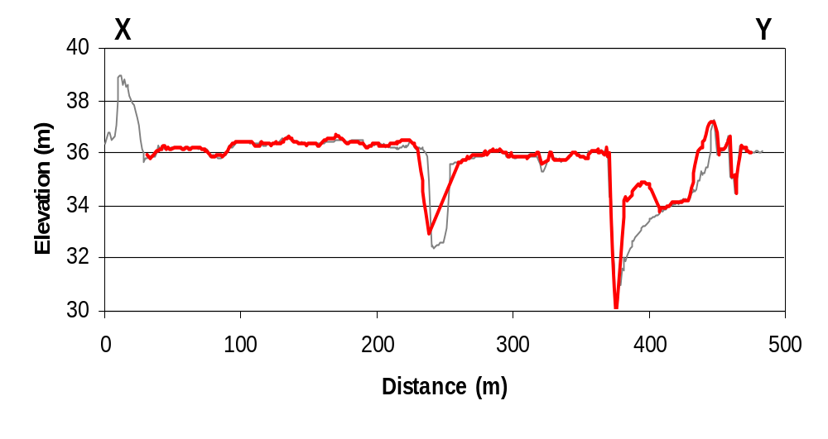
Post-processing stage 2:
Removal of water & vegetation
X
Previous profile in grey
Y

Slide 22
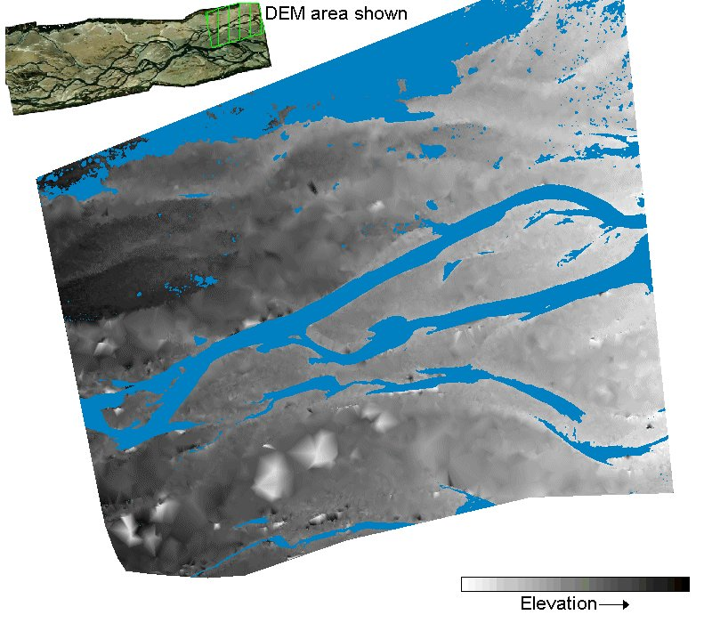
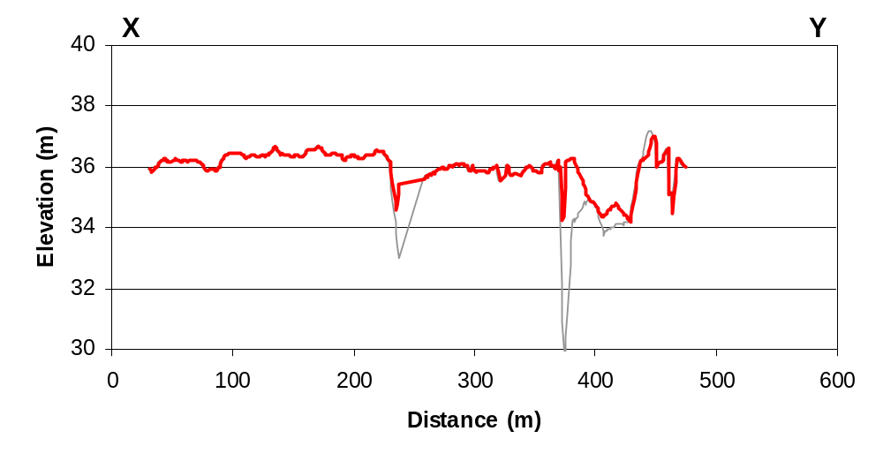
Post-processing stage 3:
Automated blunder editing
X
Previous profile in grey
Y

Slide 23
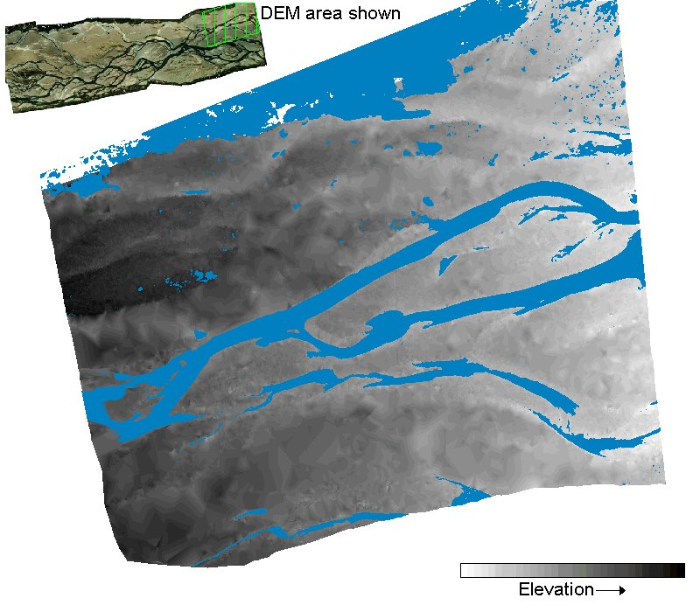
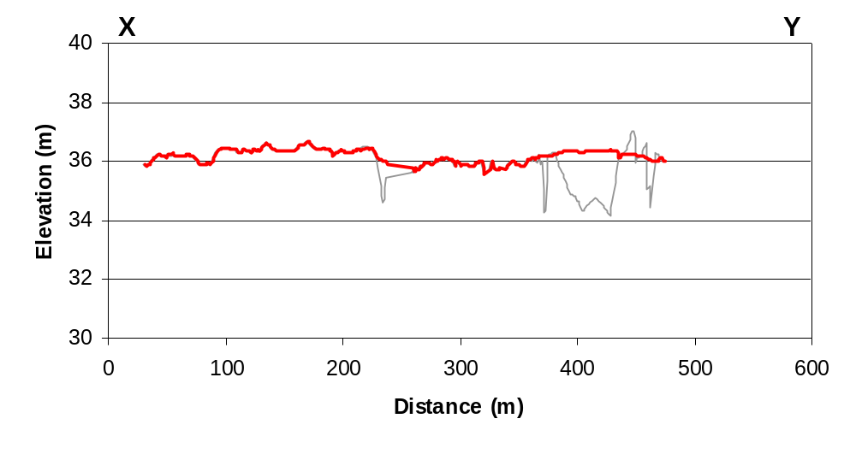
Post-processing stage 4:
Manual editing
X
Previous profile in grey
Y

Slide 24
Photogrammetric method (3)
Finally the post-processed DEMs were mosaicked together to give the final dry-bed map of the study reach

Slide 25
Method - Step 3
Aerial photographs
Automated photogrammetry
Georeferencing
DRY AREAS
Classified image
WET AREAS
Manual editing
Dry-bed elevation map
Final riverbed surface (DEM)

Slide 26
Method - Step 4
Aerial photographs
Image analysis of colour-depth relationship
Automated photogrammetry
Georeferencing
DRY AREAS
Classified image
WET AREAS
Manual editing
Dry-bed elevation map
Final riverbed surface (DEM)

Slide 27
Water colour-depth relationship (1)
In turbid water, water colour determined by relative proportions of light reflected from bed and from within the water column:
  When all light reflected from bed, water depth is zero
  When all light reflected from water column, maximum predictable depth reached
  Between these end points, colour-depth relationship may be determined empirically

Slide 28
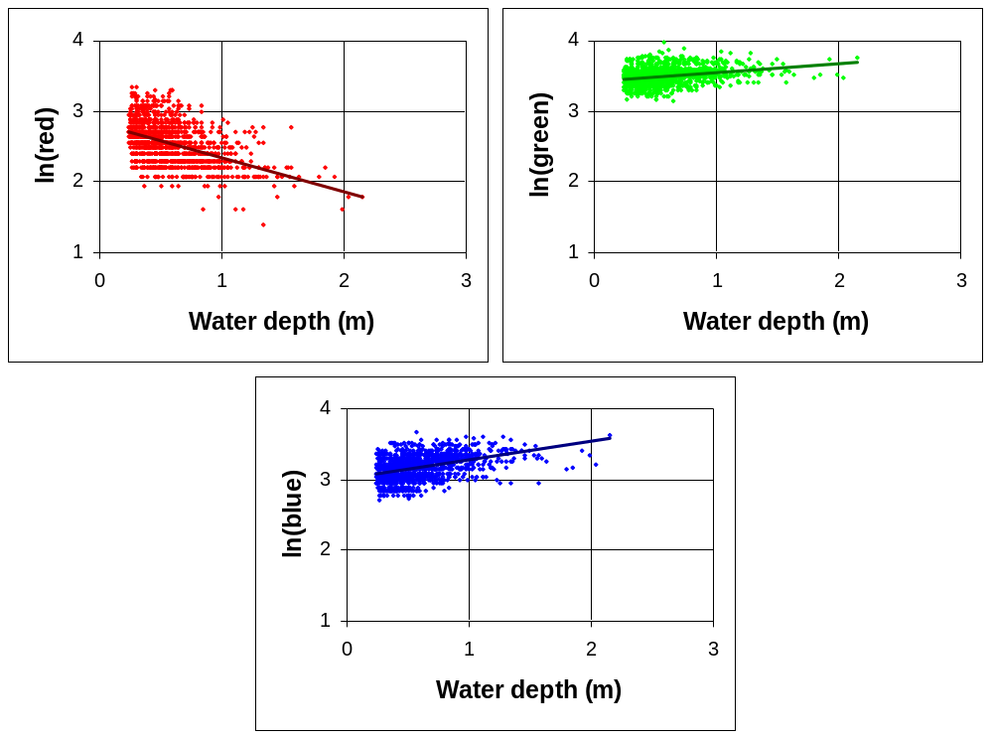
Water colour-depth relationship (2)
At each epoch, a large number of water depth measurements made by Environment Canterbury & NIWA
Red, green and blue values of wet pixels ‘matched’ to nearest surveyed water depth
Red
Green
Blue

Slide 29
Water colour-depth relationship (3)
Empirical relationship derived of the form depth = ln(RGB value) (after Lyzenga, 1981)
Depth prediction model validated using independent test data-set

Slide 30
Depth prediction model validation
‘Best’ predictors
No. of test points
Mean error (m)
Standard error (m)
R² (%)
Epoch
Feb’99
RB
12996
-0.015
0.199
48
Mar’99
RB
2026
-0.008
0.192
61
Feb’00
RG
14303
+0.002
0.168
57
May’00
G
2513
-0.002
0.178
56
Differences explained by turbidity changes

Slide 31
Method - Step 5
Aerial photographs
Image analysis of colour-depth relationship
Automated photogrammetry
Georeferencing
DRY AREAS
Classified image
WET AREAS
Manual editing
Water depth map
Dry-bed elevation map
Final riverbed surface (DEM)

Slide 32
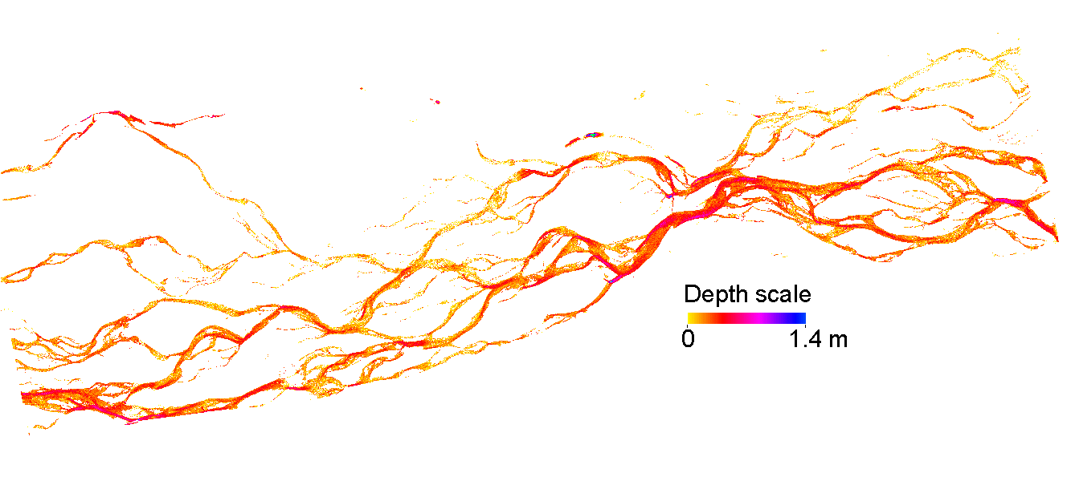
Water depth map - Feb 1999

Slide 33
Wet-bed elevation map
To convert water depth to wet-bed elevation map, water surface elevation must be modelled
Achieved by blanking out wetted channels on the dry-bed elevation map, and interpolating from bank to bank
Water depths then subtracted to give wet-bed elevation map

Slide 34
Method - Step 6
Aerial photographs
Image analysis of colour-depth relationship
Automated photogrammetry
Georeferencing
DRY AREAS
Classified image
WET AREAS
Manual editing
Water depth map
Estimated water surface elevation map
Dry-bed elevation map
Final riverbed surface (DEM)
Wet-bed elevation map

Slide 35
Method - Step 7
Aerial photographs
Image analysis of colour-depth relationship
Automated photogrammetry
Georeferencing
DRY AREAS
Classified image
WET AREAS
Manual editing
Water depth map
Estimated water surface elevation map
Dry-bed elevation map
Final riverbed surface (DEM)
Wet-bed elevation map

Slide 36
Final riverbed surface
Finally, dry-bed and wet-bed elevation maps were combined to produce a final riverbed surface of the study reach

Slide 37
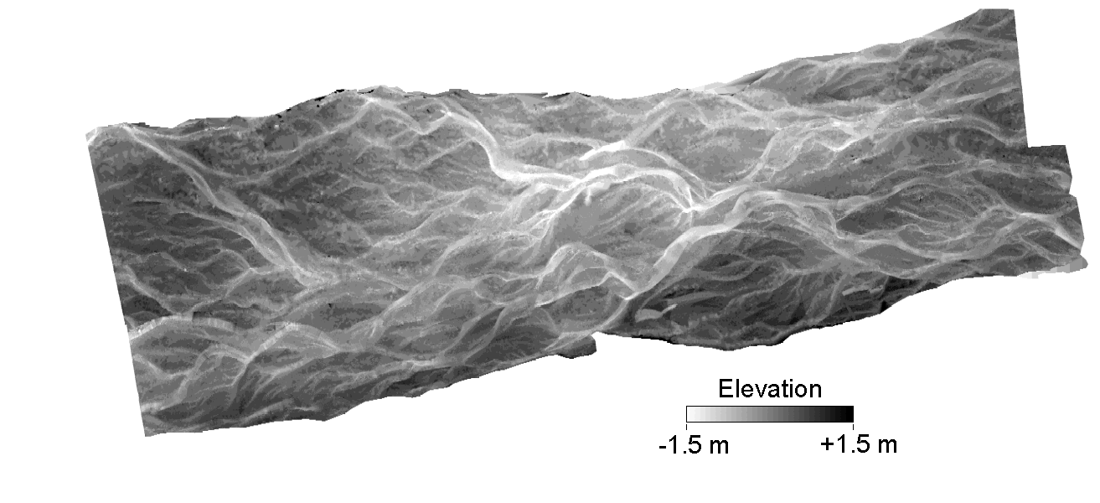
Final riverbed surface
(detrended) - Feb 1999

Slide 38
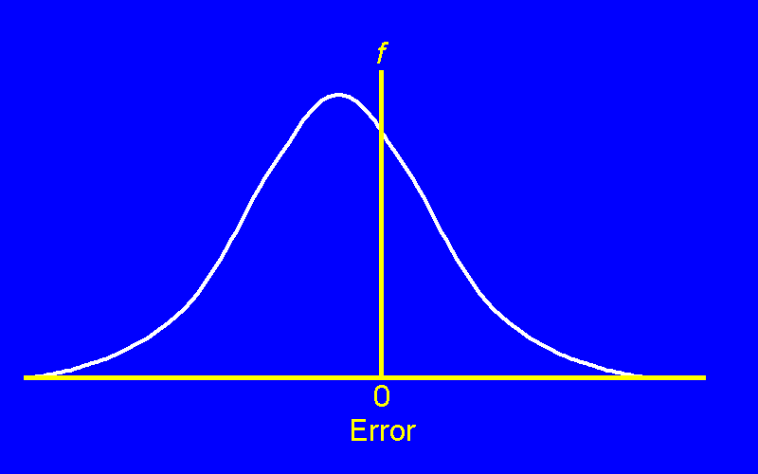
Quality of final riverbed surface (1)
Quality assessed in terms of:
  Accuracy - Systematic error; calculated using mean error (ME)
  Precision - Random error; calculated using standard deviation of error (SDE)
-SDE
ME
+SDE

Slide 39
Quality of final riverbed surface (2)
Assessed by comparing DEM elevations with check data-set collected by Environment Canterbury & NIWA
Check data collected using Total Station and roving GPS, concurrent with photogrammetric surveys

Slide 40
Quality assessment - Feb 1999
Riverbed zone
Number of points assessed
ME (cm)
SDE (cm)
Dry
3703
+16
25
Wet
11232
+34
28
Wet points have greater systematic error
  probably due to underestimation of water depths
Dry points also have bias
  this only becomes a problem if error is spatially variable
  this issue is still being investigated

Slide 41
Progress to date
Manual editing
Depth estimates
Final surface
Epoch
Photogrammetry
Feb’99




Mar’99



Oct 2000
Feb’00



Dec 2000
To date, a final surface obtained only for Feb 1999
The remaining two epochs should be completed by the end of the year

Slide 42
Substantive issues (1)
Final surfaces will allow a range of substantive issues to be investigated:
‘At epoch’ issues:
2D and 3D topography
Drainage patterns
Location of active channels
Importance of upstream water routing
Scaling analyses

Slide 43
Substantive issues (2)
Final surfaces will allow a range of substantive issues to be investigated:
‘Between epoch’ issues:
Quantification of planform changes
Patterns of erosion and deposition
Estimation of ‘step length’
Volumetric calculations of change
Morphological estimation of bedload transport rate

Slide 44
Conclusions
Digital photogrammetry and image analysis represent an effective way of surveying large gravel riverbeds
…but there are unresolved issues
  Systematic bias
  ‘Banding effect’ found - See paper by Lane
…and other (better?) technologies now exist
  Laser altimetry - See poster paper by Hicks et al.

Slide 45
End of virtual poster
Presentation will restart shortly
Email: rmw21@cam.ac.uk

