Slide 1
Jim Cloud and Dick Xu

Slide 2
Blue Print
1) tell story of jim losing dogs, got data
2) Early troubles
Data is self submitted, missing or inconsistent
Couldn’t use as csv, looked at other sources for data
3) aggregate
4)stacked bar
scatter
5) trend
7) what we’d do next time
8) summarization

Slide 3
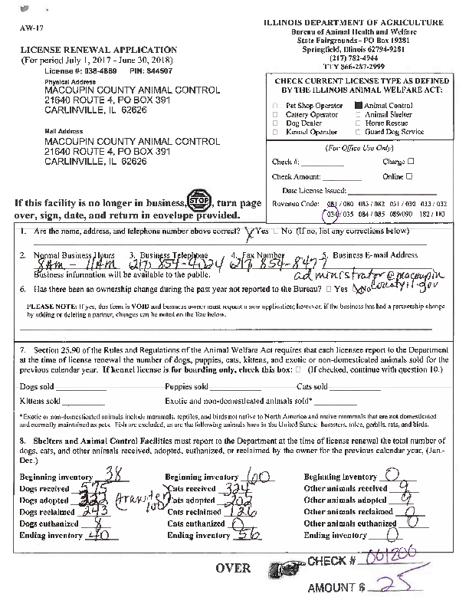
- Jim created an Excel spreadsheet with over 2,000 entries - Entry records something something something
An example of Illinois Department of Agriculture Shelter License Renewal Form

Slide 4
Early Obstacles
Difficulty importing from Excel and utilizing CSV
Self-submitted information

Slide 5
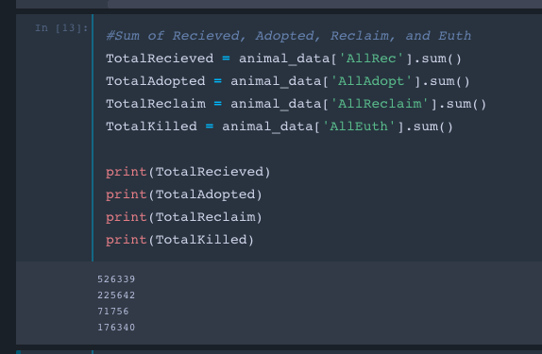
Step 1: Top-Down View
Total Animals Received = 526,339 Animals
Total Adopted = 225, 642 Animals
Total Reclaimed = 71,756 Animals
Total Euthanized = 176,340 Animals

Slide 6
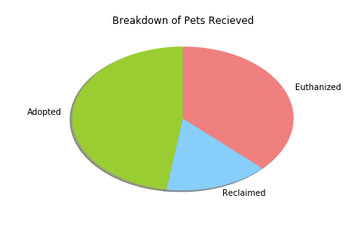
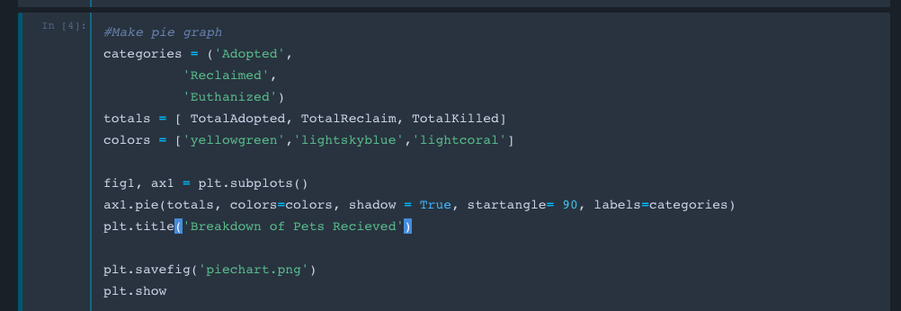
Step 2: Pie Chart

Slide 7
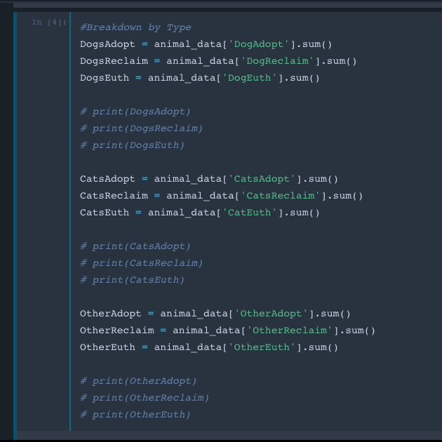
Step 3: Breakdown by Species
 | Adopted | Reclaimed | Euthanized
Dogs | 132,242 | 64,481 | 62,852
Cats | 87,496 | 6,835 | 100,565
Other | 5,904 | 440 | 12,923

Slide 8
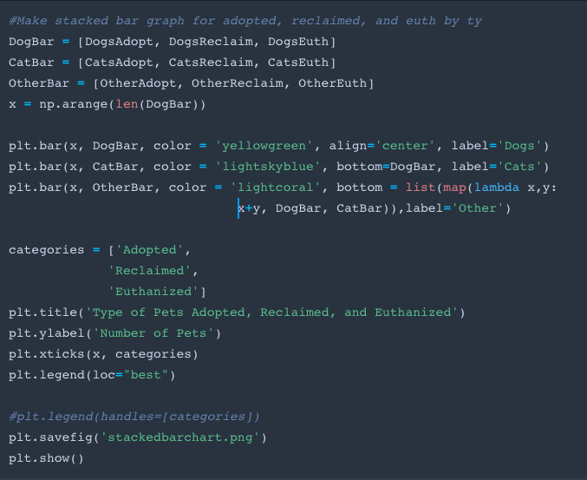
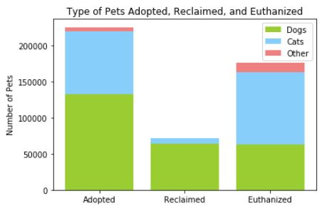
Step 4: Stacked Bar Graph

Slide 9
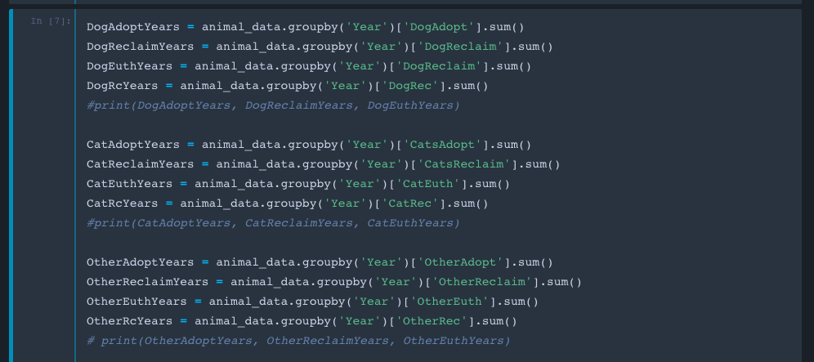
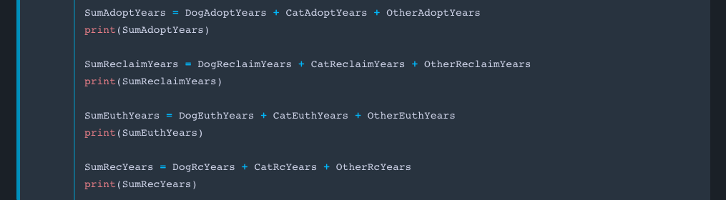
Step 5: Yearly Breakdown

Slide 10
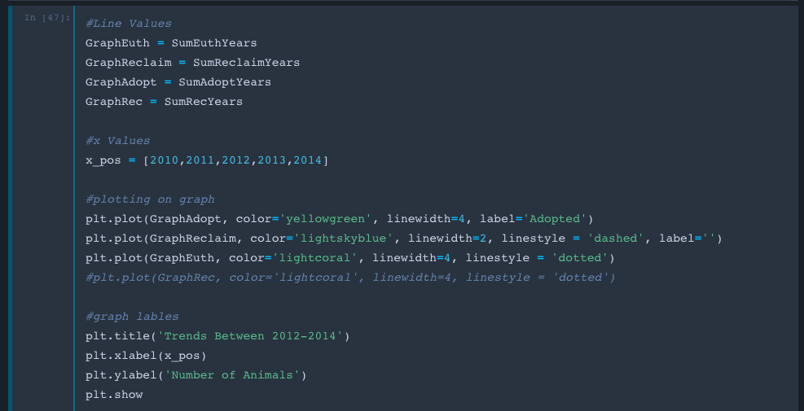
Step 6: Trendline Code

Slide 11
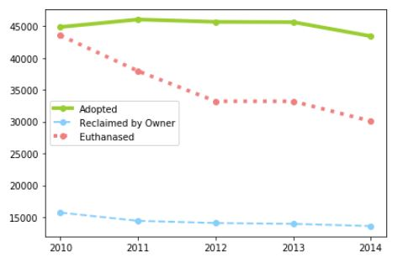
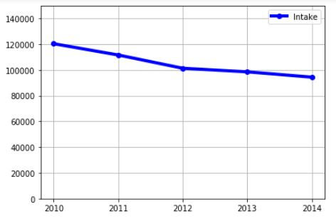
Step 7: Trendline Charts

Slide 12
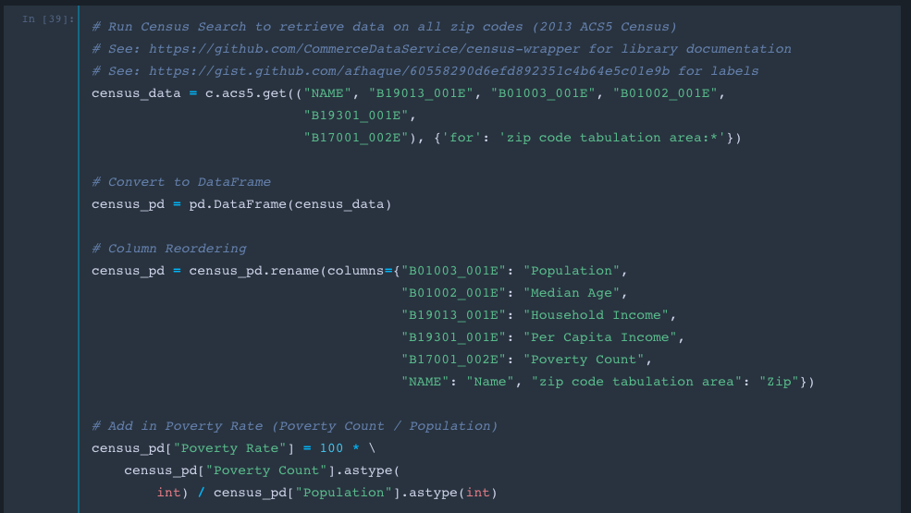
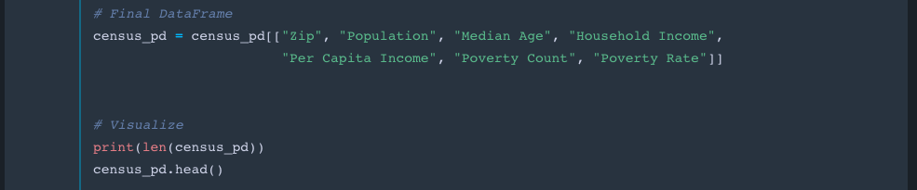
Step 8:
Census API

Slide 13
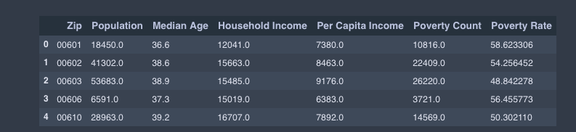
Step 9: Merge

Slide 14
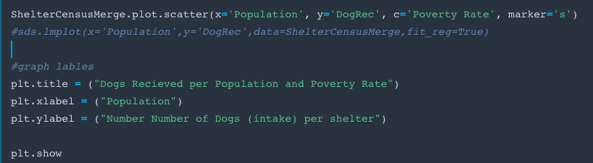
Step 10: Grey Scale and Regression

Slide 15
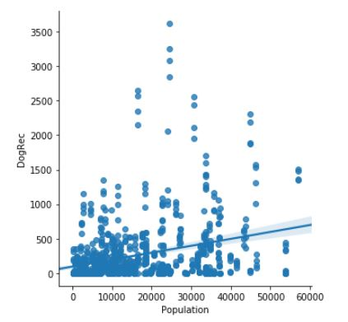
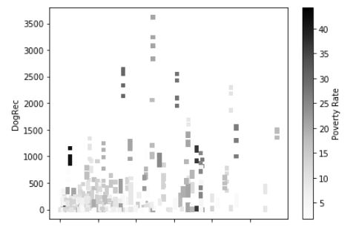
Step 11: Regression and Grey Scale Chart

Slide 16
Conclusion

