Slide 1
PREDICTIVE MAINTENANCE · CASE STUDY
Predictive maintenance could cut maintenance cost by 18% versus the best fixed schedule
Early warning, remaining-life ranges and cost-chosen alerts, tested on NASA turbofan simulation data
18%
100/100
0
cheaper per engine than the best fixed schedule (95% range 9–25%)
engines warned before failure; 90% of them at least 55 cycles ahead
test engines failed before their predicted lower bound (of 100)
Stand-in data: NASA C-MAPSS FD001 turbofan simulation, not real field data. All costs are assumptions (configs/costs.yaml).
Notes:
Answer first: under assumed costs, acting on the model's lower bound costs 18% less per engine than the best fixed schedule (95% range 9–25%). The rest of the deck shows how, and where it breaks.

Slide 2
Unplanned breakdowns cost 5× a planned replacement, and fixed schedules throw away 79 cycles of good life per engine
$150k
$30k
THE QUESTION
Can sensor data warn us early enough, and reliably enough, to save money?
unplanned failure: repair plus 10 cycles of downtime
planned replacement: parts plus 2 cycles of downtime
Breakdowns stop operations and cost far more than planned work
Fixed schedules avoid most breakdowns by replacing parts early
Both waste money: the goal is to replace just in time
79 cycles
of remaining life discarded per engine by the best fixed schedule (replace every 127 cycles), because no engine may fail before its turn
Costs are ASSUMED placeholders (configs/costs.yaml), not real company or industry figures. Wasted life: Phase 5 simulation on held-out engines.
Notes:
Assumed costs: a failure is $150k with downtime, a planned job $30k, a 5× gap. The best fixed schedule avoids failures by replacing at cycle 127, so most engines still had life left.

Slide 3
Three questions decide whether sensor data pays for itself
Can we see failure coming?
Yes. A simple health index warns 100 of 100 engines, 90% of them at least 55 cycles ahead, with 4% false alarms.
Can sensor data warn early enough, and reliably enough, to save money?
Can we say how long is left, with a range?
Yes. Error of about 13 cycles on unseen engines; 89% of ranges hold the truth.
Does acting on it save money?
Yes, under assumed costs: 18% cheaper than the best fixed schedule, when the alert threshold is chosen by cost.
Answers from engine-grouped validation on the FD001 training engines and the official test set.
Notes:
The case rests on three questions. Each answer is backed by one of the next three findings and the money slide.

Slide 4
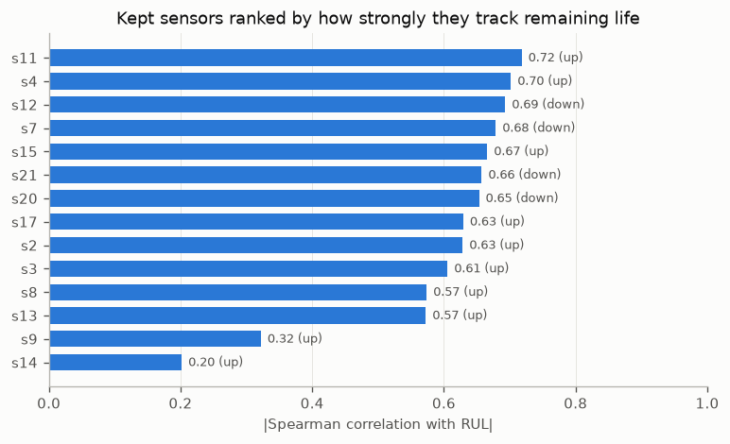
NASA turbofan data is a fair stand-in for rotating equipment, with clear limits
100
100
engines run to failure (training)
engines stopped early, true life known (test)
14 of 21
128–362
sensors used; 7 barely change and were dropped
cycles to failure in training
Use with care: one simulated fault mode, no early-life failures (shortest life 128 cycles), and only 100 run-to-failure engines.
Stand-in data: NASA C-MAPSS FD001 turbofan simulation, not real field data. Sensor names from NASA's C-MAPSS documentation.
Notes:
100 training engines run until failure; 100 test engines stop early with their true remaining life published. Twelve sensors trend strongly toward failure. The lack of early failures flatters fixed schedules.

Slide 5
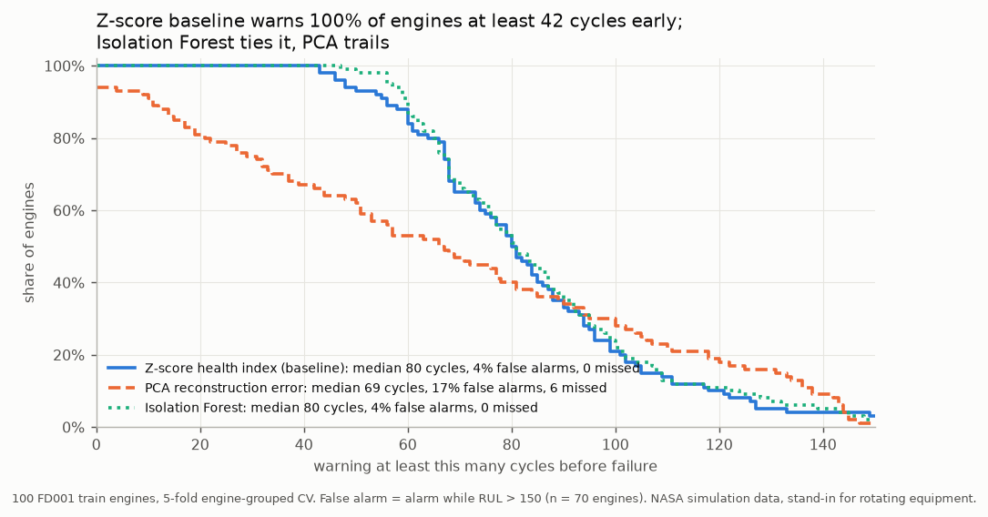
Sensors warn all 100 engines before failure, 90% of them at least 55 cycles ahead, with 4% false alarms
80 cycles
median warning before failure (z-score health index)
4%
false alarms: 3 of 70 engines with a clearly healthy period
A simple method wins. Isolation Forest ties it (median 80 cycles); PCA misses 6 engines.
5-fold engine-grouped cross-validation on the FD001 training engines (each engine scored by models that never saw it).
Notes:
Each engine is compared with its own first cycles. The alarm fires for all 100 engines; 90% get at least 55 cycles of warning. Isolation Forest ties; PCA reaches 17% false alarms.

Slide 6
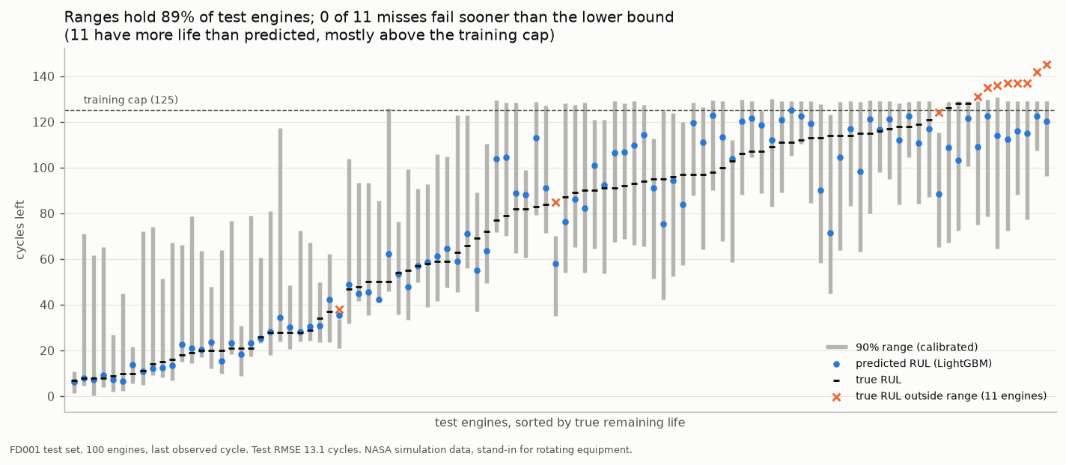
Remaining life is predicted within about 13 cycles, and no test engine failed before its lower bound
13.1 cycles
typical error on unseen engines (linear model on the same features 17.7, average 43.1)
89%
of test engines inside their 90% range (91% in cross-validation)
0 of 11
range misses fail sooner than the lower bound
Official FD001 test set, last observed cycle of each of 100 engines; ranges calibrated with cross-conformal prediction.
Notes:
LightGBM on rolling features: RMSE 13.1 on the test set, 12.2 in cross-validation. Raw quantile ranges were overconfident; calibration brings them to 89% on test. All 11 misses had more life than predicted. Without engine age as an input the test RMSE is 14.8: the model reads wear, not just age.

Slide 7
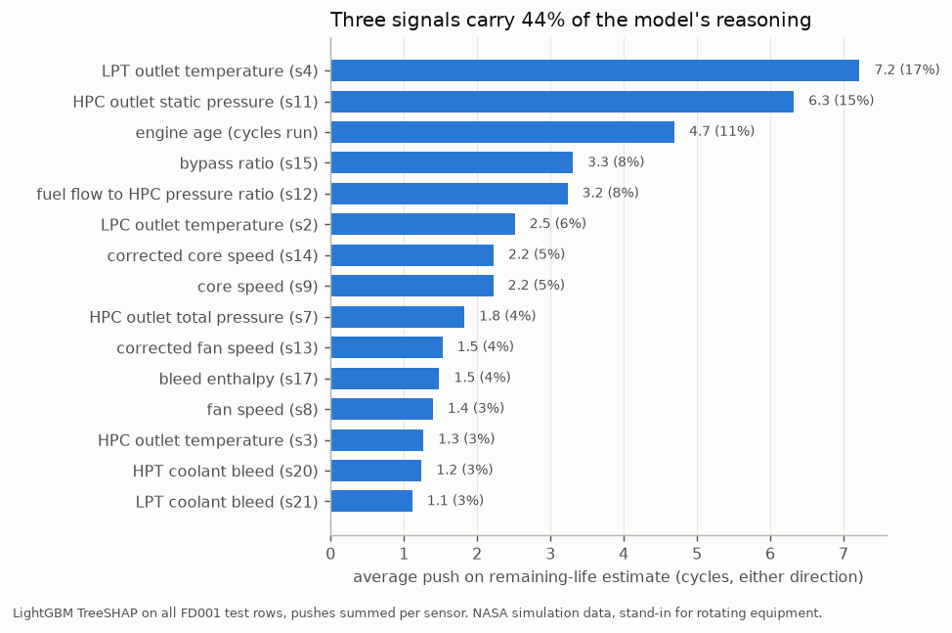
Two sensors drive most estimates, and every alert comes with a plain-language note
17% + 15%
of all pushes on the estimate come from LPT outlet temperature (s4) and HPC outlet static pressure (s11)
FIELD NOTE · ENGINE 81 · WRITTEN BY THE API
Engine 81, after 213 cycles: about 7 cycles of life left (90% range 0 to 61). ALARM: sensors have drifted from this engine's healthy start. Main reason: LPT outlet temperature (s4) is 26.6 degR above this engine's healthy start; this shortens the estimate by 23.0 cycles compared with the average engine. Replace now: the lower bound has reached 0 cycles, at or below the 5-cycle threshold; allow about 5 cycles to replace.
SHAP pushes from the LightGBM model on all test rows, summed per sensor. They explain the model, not the physics.
Notes:
Every prediction lists its top three drivers in plain words. The note above is the deterministic template; with an API key an LLM writes it, and every number it uses is checked against the model output.

Slide 8
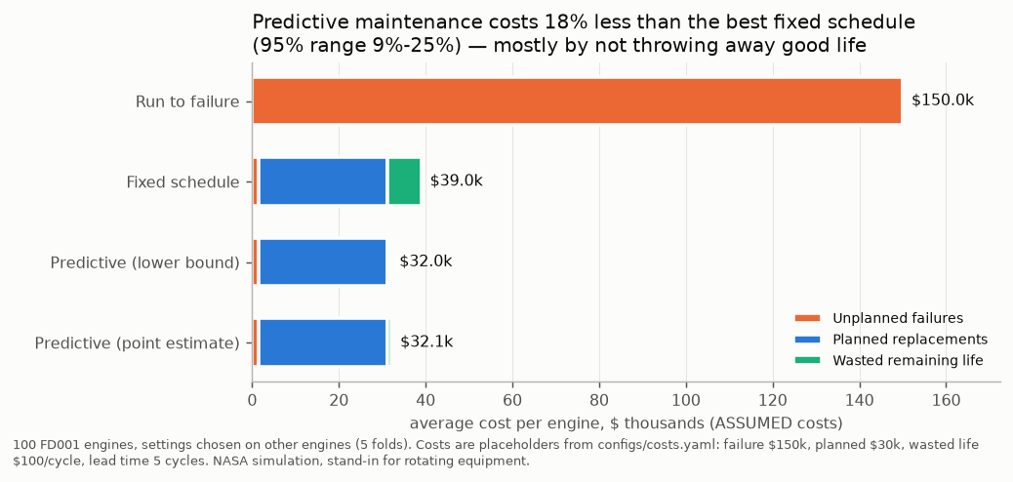
Predictive maintenance is cheapest: $32.0k per engine versus $39.0k for the best fixed schedule
18%
cheaper than the best fixed schedule (95% range 9–25%)
35%
cheaper per operating cycle, a check that needs no price on wasted life
8 vs 79
Rule: replace when the lower bound of the 90% range reaches 5 cycles, then allow 5 cycles to act. Best fixed schedule: replace every 127 cycles.
cycles of life thrown away per engine
ALL COSTS ASSUMED: failure $150k and planned $30k (downtime included), wasted life $100/cycle, lead time 5 cycles. Settings chosen on other engines (5-fold).
Notes:
Run to failure costs $150.0k per engine, the best fixed schedule $39.0k, predictive $32.0k (79% below run to failure). Using the point estimate instead of the lower bound gives 17.6% vs 18.1%: once the threshold is chosen by cost (15 vs 5 cycles) the two are nearly tied. Redoing the threshold choice inside every bootstrap resample widens the range to 7–28%, still above zero.

Slide 9
Recommendation: pilot predictive maintenance on one fleet, then roll out
Pilot
Validate costs
Roll out
Run the pipeline on real sensor history from one fleet
Success: warnings at least 55 cycles ahead for 90% of machines, false alarms near 4%, ranges holding about 90% of outcomes
Replace placeholder costs with finance figures
Re-run the sensitivity: the case weakens if wasted life is worth under $50 per cycle or replacing takes 20+ cycles after an alert
Daily triage in the dashboard: replace now, plan, monitor
Demo fleet today: 7 replace now, 46 plan, 47 monitor
The ask: approve a pilot on one fleet's sensor history, with this deck's results as the bar to clear.
Pilot targets are the validated results in this deck; dates and budgets are left to the operator.
Notes:
Pilot first on real data, with this deck's results as the bar to clear. Then replace the assumed costs and re-run the sensitivity before scaling up. The dashboard and field notes already support daily triage.

Slide 10
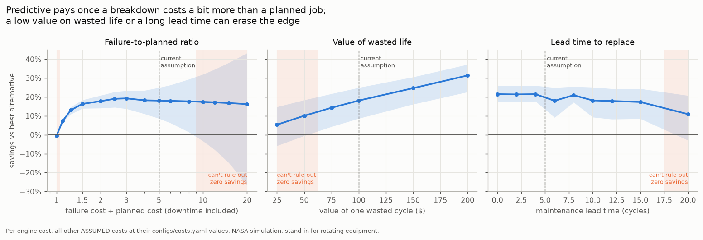
The case holds unless wasted life is cheap or replacement is slow
RISKS
NEXT STEPS
Wasted life under $50/cycle: savings 10% or less, not certain
Replacing takes 20+ cycles: savings 11%, 3 failures
Failures 10× a planned job: one failure can decide it
Per-condition calibration (FD004 ranges: 84%)
Pilot on real sensor data and real costs
Alarm thresholds from early-life data only
Sensitivity: each point re-chooses the settings on other engines; band = 95% bootstrap range. All costs assumed.
Notes:
Predictive pays once a breakdown costs at least 1.1× a planned job (downtime included); from there up to 20×, savings stay between 7% and 19%. The real risks are a low value on wasted life and slow replacement. On the harder FD004 subset (6 operating conditions, 2 fault types, 249 engines) the same pipeline saves 28% against the best fixed schedule (22–30% with settings re-chosen in each resample), but its ranges hold only 84% of test rows and 15 test engines failed before the lower bound: calibrate per operating condition before a multi-condition pilot.

