Slide 1
Richa Singh
Prediction of Apply Rate
02-19-2019

Slide 2
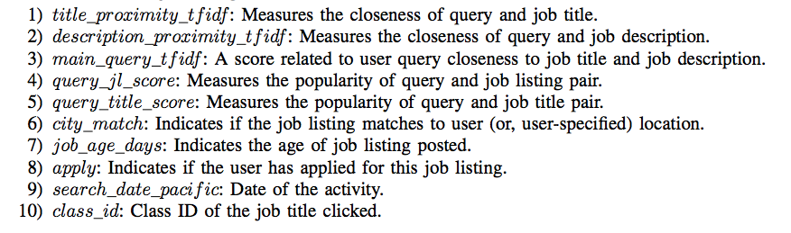
Dataset
This Click through rate dataset contains 1200890 observations and 10 variables
Aim: To classify the Test data correctly
Their are 9 Quantitative and 1 Qualitative Variables
Challenge: To find the model that best classifies the test data

Slide 3
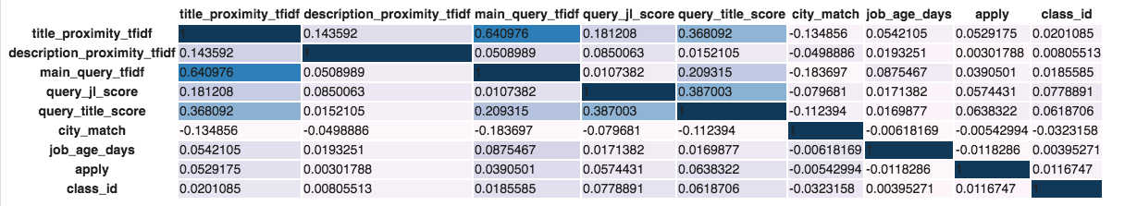
Correlation Plot
Correlation plot only captures linear relationship between quantitative data and it ranges from 0 to 1. 1 being the highest correlation.
From the plot you can see that their is high correlation between main_query_tfidf and title_proximity_tfidf , query_title_score and title_proximity_tfidf etc.
Possibility of performing some feature Engineering here like adding the first three columns to create a new feature known as average_tfidf_value

Slide 4
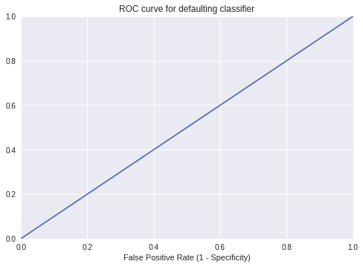
When we run the baseline Random forest classification model initially on the dataset the AUC-ROC score comes out to be 0.5 and in the confusion-matrix groups are misclassified indicating that the dataset is IMBALANCED.
CHALLENGES: Our first challenge is to balance the dataset else due to the imbalance the model will never show proper classification. Out of 1200890 people who viewed the Job description on Glassdoor only 108003 actually applied on the website which is approximately 8% of the total dataset which means that the dataset is heavily imbalanced. So, even if we try to model the dataset without balancing, the precision would come out to be higher because of the Accuracy Paradox.

Slide 5
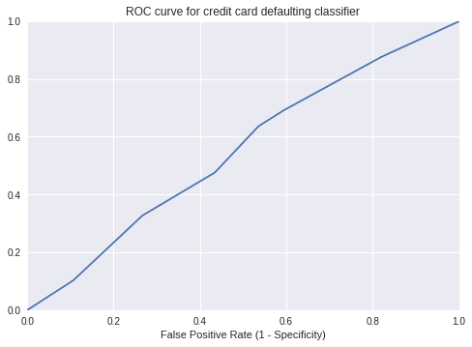
OVERCOME THE CHALLENGES : We can use different techniques to balance the dataset like: UPSAMPLING , DOWNSAMPLING, SMOTE (Synthetic Minority Oversampling Technique ) . The one that I am using here is SMOTE technique which uses KNN to generate synthetic samples of the minority class
Part 1
Splitting the data according to the timestamps mentioned. SMOTE technique used for balancing the dataset. The model is not performing well on the test dataset, ROC comes out to be 0.55 . The model used here for classification is lightGBM.

Slide 6
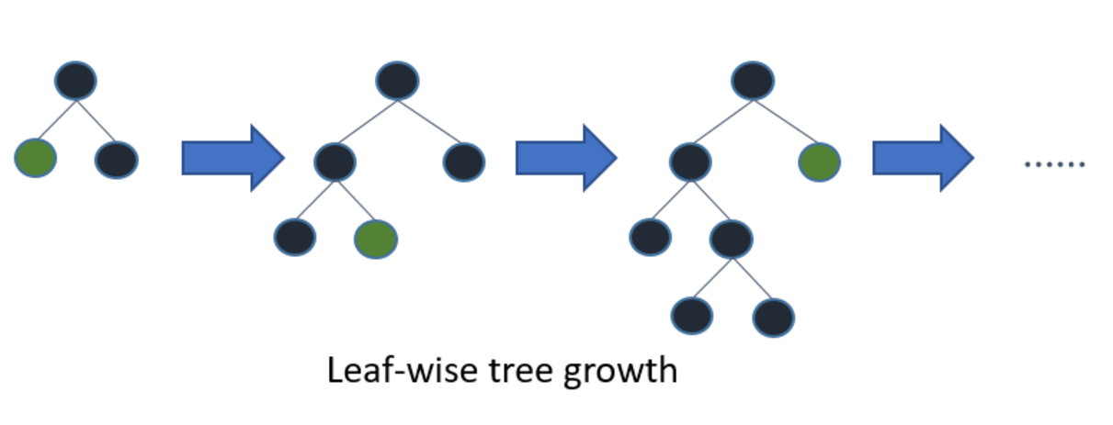
LightGBM Model
Light GBM is a gradient boosting framework that uses tree based learning algorithm.
Light GBM grows tree vertically while other algorithm grows trees horizontally meaning that Light GBM grows tree leaf-wise while other algorithm grows level-wise. It will choose the leaf with max delta loss to grow. When growing the same leaf, Leaf-wise algorithm can reduce more loss than a level-wise algorithm.
Light GBM is prefixed as ‘Light’ because of its high speed. Light GBM can handle the large size of data and takes lower memory to run. Another reason of why Light GBM is popular is because it focuses on accuracy of results.

Slide 7
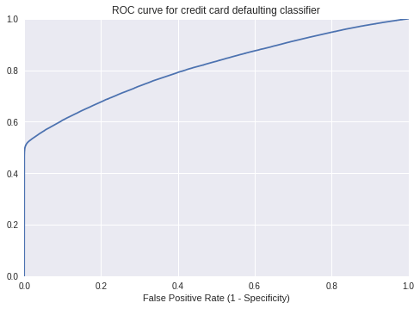
When splitting is not done via timestamp and is done with train_test_split from Model Selection sklearn (test_size=0.2) , ROC value increases to 0.81 . SMOTE technique used for balancing the dataset. The model used here for classification is lightGBM.
So, the reason why the model is not working so well/under fitting on mentioned date train-test split is not so clear. The test data on 27th Feb is just 9.7% of the whole data which performs poorly and on the contrary the same model is performing moderately well on test-train split of 20%.

Slide 8
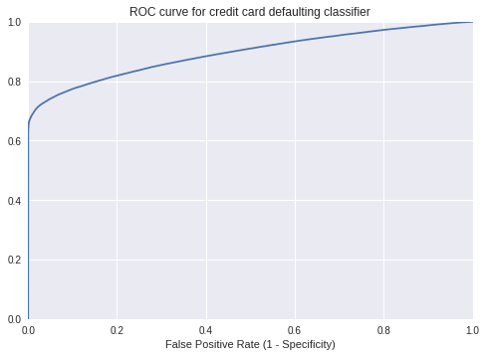
Part 2
When class_id is added to the feature set and the splitting is done with train_test_split from Model Selection sklearn (test_size=0.2), the classification performance increases and the ROC value comes out to be 0.89 . SMOTE technique used for balancing the dataset. The model used here for classification is lightGBM.
In class_id their are 157 unique Job types. Since, they are not unique id’s I can’t use class_id as a metric for splitting the dataset. So, I made a split normally using model selection under sklearn.

Slide 9
Improvement
Test split of 25% would give an improved accuracy I assume, also some more balanced data would make the model perform better as more training data would be available.
Could perform an EDA on the timestamped training data(from 21st-26th) to see why the model is not learning the training data so well. Is there any different trend for test data on 27th.
Could do an ensemble learning of different models/algorithm by dividing the train data into equal number of test data and averaging the performance.
Could apply different technique for balancing the dataset like Upsampling, Downsampling etc.
Could estimate a DGP( Data Generating Process) function which matches the current dataset closely by Maximum likelihood estimation, assuming that the data comes from a particular Gaussian distribution/or any other distribution.
Perform some more feature engineering if want improved accuracy by digging in the research papers/articles of calculating click through rate/apply rate and devising new features accordingly.

