Slide 1

Introduction to NumPy
Original Slides by Bryan Van de Ven

Slide 2
What is NumPy
NumPy is the foundation of the python scientific stack

Slide 3
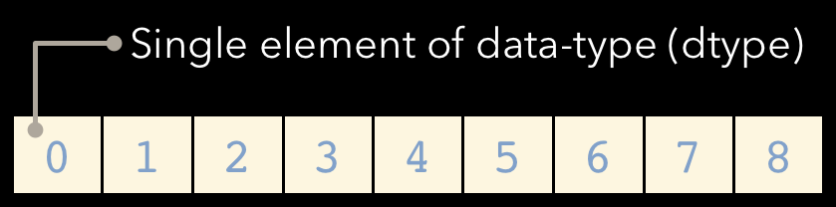
NumPy is a Python C extension library for array-oriented computing Efficient
In-memory
Contiguous (or Strided)
Homogeneous (but types can be algebraic)
NumPy is suited to many applications Image processing
Signal processing Linear algebra
A plethora of others

Slide 4
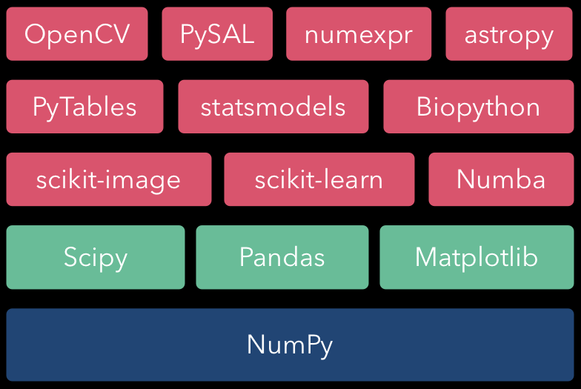
NumPy Ecosystem

Slide 5
Quick Start
In [1]: import numpy as np
In [2]: a = np.array([1,2,3,4,5,6,7,8,9]) In [3]: a
Out[3]: array([1, 2, 3, 4, 5, 6, 7, 8, 9])
In [4]: b = a.reshape((3,3)) In [5]: b
Out[5]:
array([[1, 2, 3],
[4, 5, 6],
[7, 8, 9]])
In [6]: b * 10 + 4 Out[6]:
array([[14, 24, 34],
[44, 54, 64],
[74, 84, 94]])

Slide 6
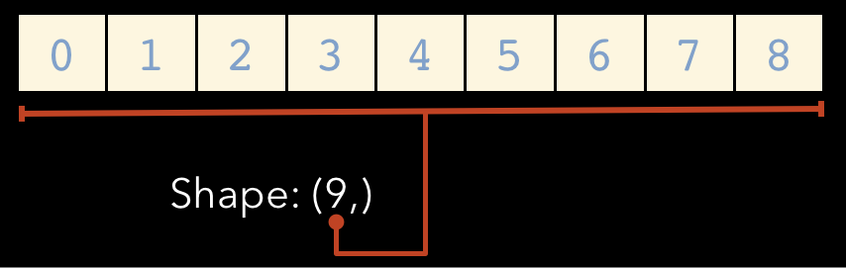
Array Shape
One dimensional arrays have a 1-tuple for their shape

Slide 7
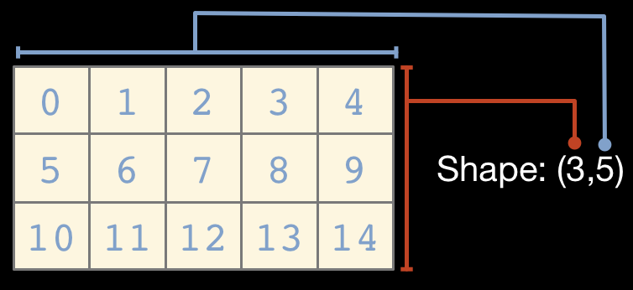
...Two dimensional arrays have a 2-tuple

Slide 8
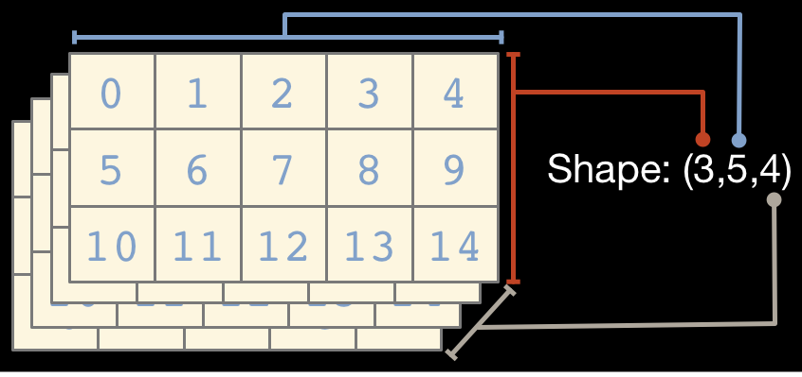
...And so on

Slide 9
Array Element Type (dtype)
NumPy arrays comprise elements of a single data type The type object is accessible through the .dtype attribute
Here are a few of the most important attributes of dtype objects dtype.byteorder — big or little endian dtype.itemsize — element size of this dtype
dtype.name — a name for this dtype object
dtype.type — type object used to create scalars
There are many others...

Slide 10
Array dtypes are usually inferred automatically
In [16]: a = np.array([1,2,3]) In [17]: a.dtype
Out[17]: dtype('int64')
In [18]: b = np.array([1,2,3,4.567])
In [19]: b.dtype
Out[19]: dtype('float64')
But can also be specified explicitly
In [20]: a = np.array([1,2,3], dtype=np.float32) In [21]: a.dtype
Out[21]: dtype('int64')
In [22]: a
Out[22]: array([ 1., 2., 3.], dtype=float32)

Slide 11
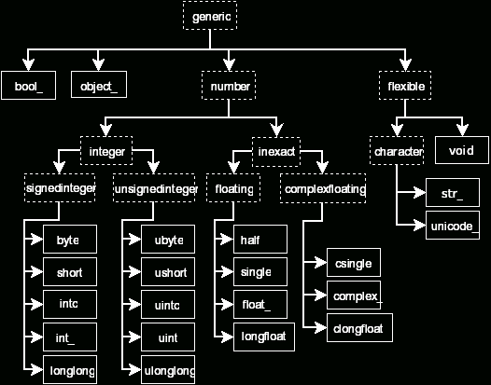
NumPy Builtin dtype Hierarchy
np.datetime64 is a new addition in NumPy 1.7

Slide 12
Array Creation
Explicitly from a list of values
In [2]: np.array([1,2,3,4])
Out[2]: array([1, 2, 3, 4])
As a range of values
In [3]: np.arange(10)
Out[3]: array([0, 1, 2, 3, 4, 5, 6, 7, 8, 9])
By specifying the number of elements
In [4]: np.linspace(0, 1, 5)
Out[4]: array([ 0. , 0.25, 0.5 , 0.75, 1. ])

Slide 13
Zero-initialized
In [4]: np.zeros((2,2)) Out[4]:
array([[ 0., 0.],
[ 0., 0.]])
One-initialized
In [5]: np.ones((1,5))
Out[5]: array([[ 1., 1., 1., 1., 1.]])
Uninitialized
In [4]: np.empty((1,3))
Out[4]: array([[ 2.12716633e-314,
2.12716633e-314,
2.15203762e-314]])

Slide 14
Constant diagonal value
In [6]: np.eye(3) Out[6]:
array([[ 1., 0.,
0.],
[ 0., | 1., | 0.],
[ 0., | 0., | 1.]])
Multiple diagonal values
In [7]: np.diag([1,2,3,4]) Out[7]:
array([[1, 0, 0, 0],
[0, | 2, | 0, | 0],
[0, | 0, | 3, | 0],
[0, | 0, | 0, | 4]])

Slide 15
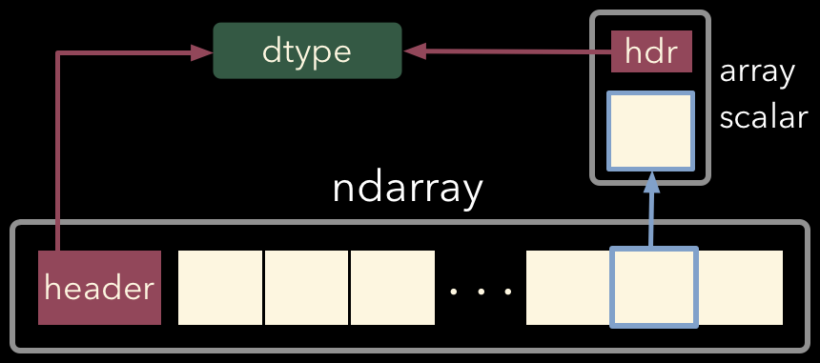
Array Memory Layout

Slide 16
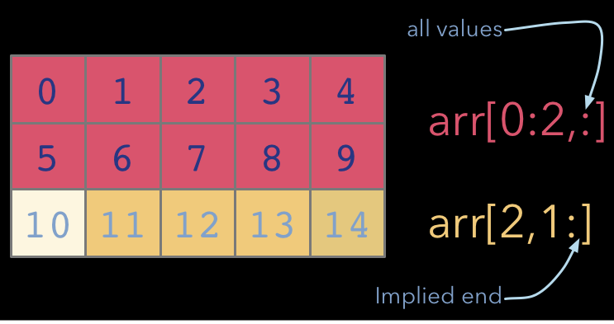
Indexing and Slicing

Slide 17
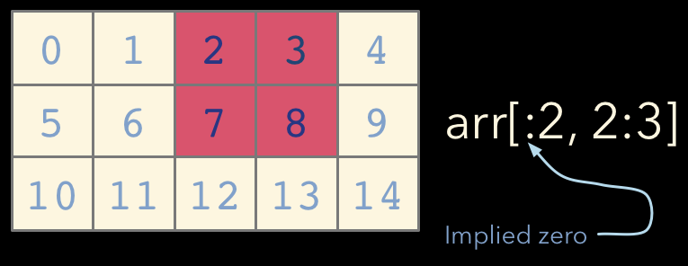

Slide 18
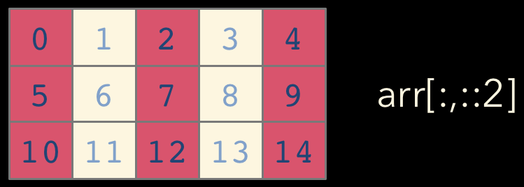
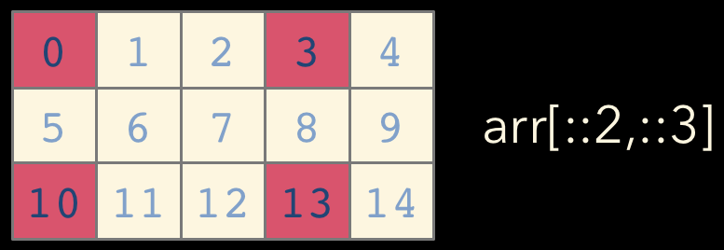
NumPy array indices can also take an optional stride

Slide 19
Array Views
Simple assigments do not make copies of arrays (same semantics as
Python). Slicing operations do not make copies either; they return views on the original array.
In [2]: a = np.arange(10) In [3]: b = a[3:7]
In [4]: b
Out[4]: array([3, 4, 5, 6])
In [5]: b[:] = 0
In [6]: a
Out[6]: array([0, 1, 3, 0, 0, 0, 0, 7, 8, 9])
In [7]: b.flags.owndata Out[7]: False
Array views contain a pointer to the original data, but may have different shape or stride values. Views always have flags.owndata equal to False.

Slide 20
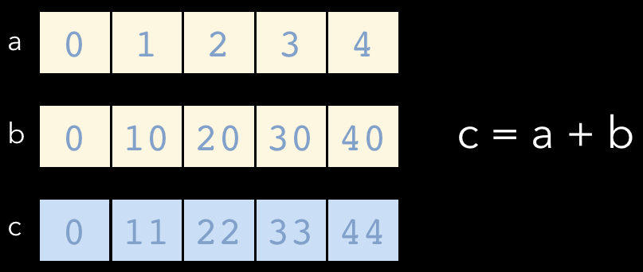
Universal Functions (ufuncs)
NumPy ufuncs are functions that operate element-wise on one or more arrays
ufuncs dispatch to optimized C inner-loops based on array dtype

Slide 21
NumPy has many built-in ufuncs
comparison: <, <=, ==, !=, >=, >
arithmetic: +, -, *, /, reciprocal, square
exponential: exp, expm1, exp2, log, log10, log1p, log2, power, sqrt
trigonometric: sin, cos, tan, acsin, arccos, atctan hyperbolic: sinh, cosh, tanh, acsinh, arccosh, atctanh bitwise operations: &, |, ~, ^, left_shift, right_shift
logical operations: and, logical_xor, not, or
predicates: isfinite, isinf, isnan, signbit
other: abs, ceil, floor, mod, modf, round, trunc
sinc,
sign,

Slide 22
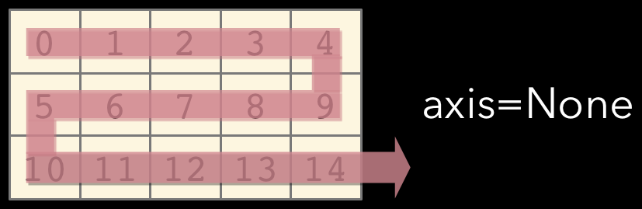
Axis
Array method reductions take an optional axis parameter that specifies over which axes to reduce
axis=None reduces into a single scalar
In [7]: a.sum ()
Out[7]: 105

Slide 23
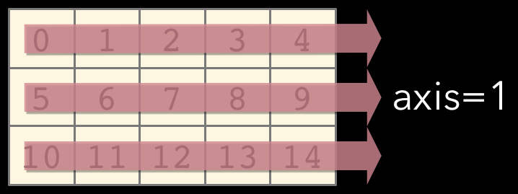
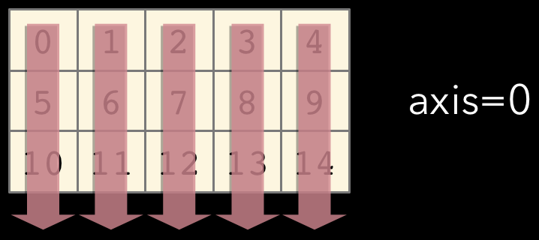
axis=0 reduces into the zeroth dimension
In [8]: a.sum(axis=0)
Out[8]: array([15, 18, 21, 24,
27])
axis=0 reduces into the first dimension
In [9]: a.sum(axis=1)
Out[9]: array([10, 35, 60])

Slide 24
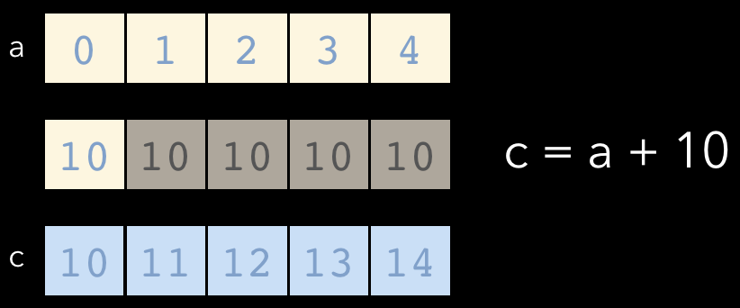
Broadcasting
A key feature of NumPy is broadcasting, where arrays with different, but compatible shapes can be used as arguments to ufuncs
In this case an array scalar is broadcast to an array with shape (5, )

Slide 25
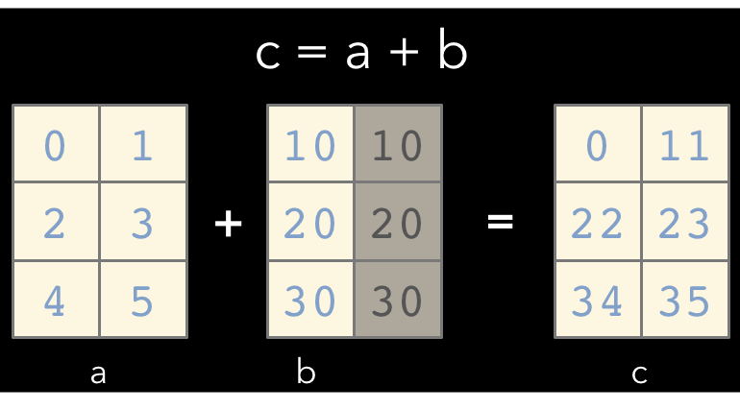
A slightly more involved broadcasting example in two dimensions
Here an array of shape (3,
1) is broadcast to an array with shape
(3, 2)

Slide 26

Broadcasting Rules
In order for an operation to broadcast, the size of all the trailing dimensions for both arrays must either:
be equal OR be one
A | (1d | array): |  |  |  |  |  |  | 3
B | (2d | array): |  |  |  |  | 2 | x | 3
Result | (2d | array): |  |  |  |  | 2 | x | 3
A | (2d | array): |  |  |  |  | 6 | x | 1
B | (3d | array): |  |  | 1 | x | 6 | x | 4
Result | (3d | array): |  |  | 1 | x | 6 | x | 4
A | (4d | array): | 3 | x | 1 | x | 6 | x | 1
B | (3d | array): |  |  | 2 | x | 1 | x | 4
Result | (4d | array): | 3 | x | 2 | x | 6 | x | 4

Slide 27
Square Peg in a Round Hole
If the dimensions do not match up, np.newaxis may be useful
In [16]: a = np.arange(6).reshape((2, 3))
In [17]: b = np.array([10, 100]) In [18]: a * b
---------------------------------------------------------------------------
ValueError Traceback (most recent call last) in ()
----> 1 a * b
ValueError: operands could not be broadcast together with shapes (2,3) (2) In [19]: b[:,np.newaxis].shape
Out[19]: (2, 1)
In [20]: a *b[:,np.newaxis] Out[20]:
array([[ 0, 10, 20],
[300, 400, 500]])

Slide 28
Array Methods
Predicates
a.any(),
Reductions
a.mean(),
a.all()
a.argmin(), a.argmax(),
a.trace(),
a.cumsum(),
Manipulation
a.argsort(),
a.cumprod()
a.transpose(), a.reshape(...),
a.ravel(), a.fill(...), a.clip(...)
Complex Numbers
a.real, a.imag,
a.conj()

Slide 29
Fancy Indexing
NumPy arrays may be used to index into other arrays
In [2]: a = np.arange(15).reshape((3,5))
In [3]: a
Out[3]:
array([[ | 0, | 1, | 2, | 3, | 4],
[ 5, 6, | 7, | 8, | 9],
[10, 11, 12, 13, 14]])
In [4]: i = np.array([[0,1], [1, 2]])
In [5]: j = np.array([[2, 1], [4, 4]])
In [6]: a[i,j] Out[6]:
array([[ 2, 6],
[ 9, 14]])

Slide 30
Boolean arrays can also be used as indices into other arrays
In [2]: a = np.arange(15).reshape((3,5))
In [3]: a
Out[3]:
array([[ | 0, | 1, | 2, | 3, 4],
[ 5, 6, | 7, | 8, | 9],
[10, 11, 12, 13, 14]])
In [4]: b = (a % 3 == 0)
In [5]: b
Out[5]:
array([[ True, False, False, [False, True, False, False,
True, False], True],
[False, False, True, False, False]], dtype=bool)
In [6]: a[b]
Out[6]: array([ 0,
3, 6, 9, 12])

Slide 31
NumPy Functions
Data I/O
fromfile, genfromtxt,
Mesh Creation
load,
loadtxt,
save,
savetxt
mgrid, meshgrid, ogrid
Manipulation
einsum, hstack,
take,
vstack

Slide 32
Array Subclasses
numpy.ma — Masked arrays numpy.matrix — Matrix operators numpy.memmap — Memory-mapped arrays numpy.recarray — Record arrays

Slide 33
Other Subpackages
numpy.fft — Fast Fourier transforms
numpy.polynomial — Efficient polynomials
numpy.linalg — Linear algebra
cholesky, det, eig, eigvals, inv, lstsq, norm, qr, svd
numpy.math — C standard library math functions
numpy.random — Random number generation beta, gamma, geometric, hypergeometric, normal, poisson, uniform, weibull
lognormal,

Slide 34
Resources
http://docs.scipy.org/doc/numpy/reference/
http://docs.scipy.org/doc/numpy/user/index.html http://www.scipy.org/Tentative_NumPy_Tutorial http://www.scipy.org/Numpy_Example_List
These slides are currently available at
https://www.slideshare.net/PyData/introduction-to-numpy
https://github.com/ContinuumIO/tutorials/blob/master/IntrotoNumPy.pdf

