Slide 1
Linear Inequalities – Unit Reflection
Richard Corrado
EDUC 71700-10 Supervised Clinical Experience 1

Slide 2
Unit Outline
Intro Lesson
Drill on when to use <, >, ≤, ≥
Graphing one-variable inequalities using open and closed circles
Solving with inverse operations
Word Problems and Solving
Graphing Linear Inequalities
Graph a dividing line and locate side that is the solution set
Introduce calculator skills as support
Graphing Systems of Inequalities

Slide 3
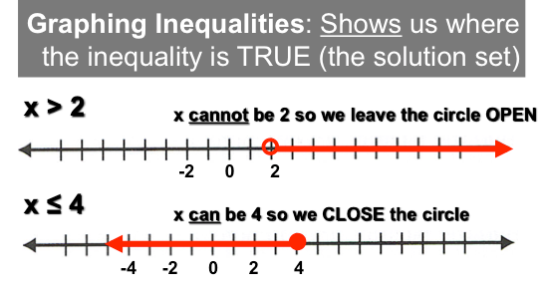
Challenges
Local curriculum is highly procedural
With my presentation of topics, many students did not develop a strong conceptual understanding of the solution set for an inequality.

Slide 4
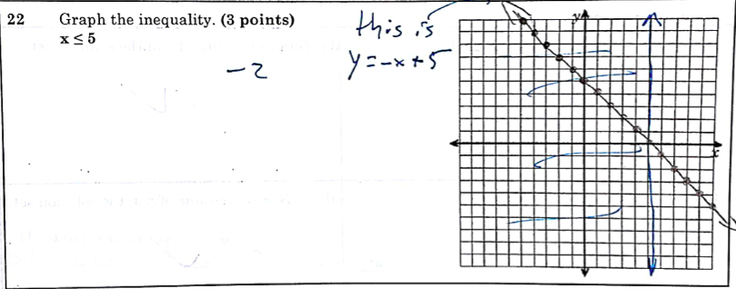
Student Sample

Slide 5
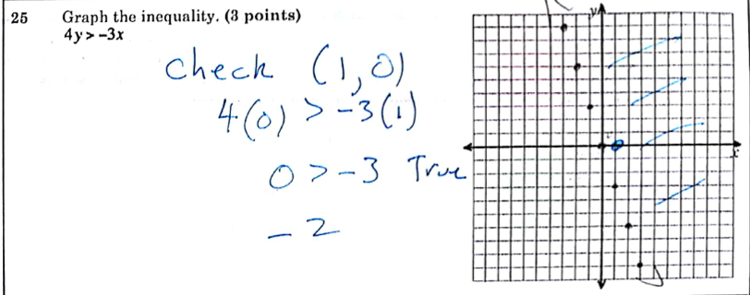
Student Sample

Slide 6
Reflection
After teaching the unit and seeing the exam results, I have a much better idea of where students will be confused
I can better support these areas in the future
I need to help students make better conceptual connections
This would help them reason out problems even if they aren’t immediately sure how to solve them: graphing solution set means finding out where the equation or inequality is true, so they might try that before giving up.

