Slide 1

GRASSOLINE
FAST GROWING GRASS FOR CELLULOSIC BIOFUELS AND ANIMAL FEED
Dr. Carl Kukkonen, CEO VIASPACE Inc.
Irvine, California USA
E-mail: Kukkonen@VIASPACE.com
Phone: +1-626-695-9250
Website: www.VIASPACE.com
Stock Symbol VSPC on OTC BB

Slide 2
Company Background
VIASPACE founded 1998 as spin-off from Caltech/NASA Jet Propulsion Laboratory
Became public company in 2005
Traded on the U.S. OTC bulletin board with stock symbol VSPC
Safe Harbor Statement: Information in this presentation includes forward-looking statements which relate to future events or performance, and involve known and unknown risks, uncertainties and other factors that may cause our actual results, levels of activity, performance or achievements to be materially different from those expressed or implied by these forward-looking statements. Such factors include, without limitation, risks outlined in our periodic filings with the U.S. Securities and Exchange Commission, including Annual Report on Form 10-K for the year ended December 31, 2008, as well as general economic and business conditions; and other factors over which VIASPACE has little or no control.

Slide 3
VIASPACE
An Alternative Energy Company
Renewable Energy—Giant King Grass
  Feedstock for cellulosic, low-carbon liquid biofuels such as ethanol
  Replacement for coal in electricity generating power plants
Clean Energy—Fuel Cell Cartridges
  Disposable methanol fuel cartridges for fuel cell powered portable electronics such as notebook computers and mobile phones

Slide 4
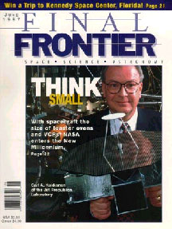
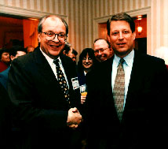
CEO Background
Dr. Carl Kukkonen
2005 – present VIASPACE Inc. CEO
-Publicly traded on the OTC BB symbol VSPC
1998-2005 ViaSpace Technologies (incubator)
- Founded and led 7 startup companies
1984-1998 NASA/Caltech Jet Propulsion Laboratory
Director, Center for Space Microelectronics & Manager of Supercomputing
- Led staff of 250 with annual budget of $70M
- On review boards of 14 leading universities
1977-1984 Ford Motor Company,
Principal Research Scientist and Engineer
- Ford's expert on hydrogen as an
alternative motor fuel
- Developed new direct injection diesel engine
1975-1977 Purdue University
Postdoctoral Research Fellow
1975 Cornell University
PhD, Physics
Kukkonen with Al Gore

Slide 5
Renewable Low-Carbon Energy: Grassoline
Grassoline is a term for renewable, low-carbon liquid fuel made from grass
Grassoline and other cellulosic biofuels do not use food crops such as corn for production
  Does not cause high food prices and resulting world hunger
  Cellulosic ethanol is a form of grassoline
Grassoline emits carbon dioxide when it is burned, but the next grass crop 60 days later absorbs the carbon dioxide—a green alternative to oil and gas

Slide 6
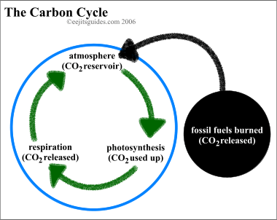
Grassoline Can Be Carbon Neutral
Burning
grassoline
releases CO₂
New grass crop
absorbs CO₂

Slide 7
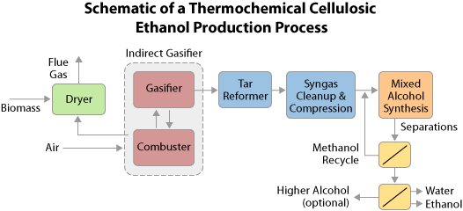
Grass to Ethanol, Methanol & Green Gasoline by Gasification
Source: US Department of Energy

Slide 8
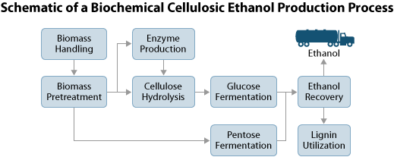
Grass to Ethanol by Enzyme Fermentation

Slide 9
Grass in a Coal-Fired Power Plant
Substitute grass bricks/pellets for 10-30% of coal in existing power or heat plant (co-firing)
  Co-firing grass with coal is cost-effective and fastest way to use bioenergy on a large scale
  Use existing power plant with minor modifications
FirstEnergy plans to convert a coal power plant in Ohio , USA to 100% biomass
Dragon Power Cleantech & NBE have nineteen 100% biomass fueled power plants in China
  Significant government incentives for biomass
  Currently use agricultural waste as feedstock, but need dedicated energy crops such as grass
Biomass power plants are a major opportunity in China

Slide 10
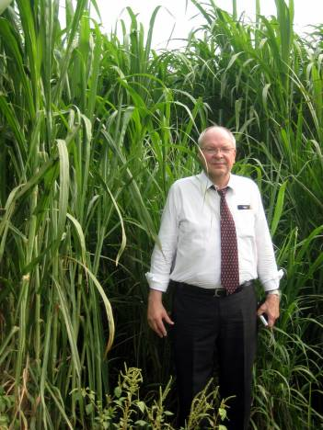
Renewable Energy Feedstock:
Giant King Grass
Fast-growing natural hybrid grass suitable for cellulosic low carbon biofuels including ethanol, methanol and green gasoline
Four harvests per year in tropical and subtropical regions
  Grows to 4m high in 60 days
  Up to 350 tonnes per hectare
Developed originally as animal feed

Slide 11
Advantages of Giant King Grass
Supports national priorities in China
  Alternative renewable energy
  Agriculture to feed population
  Cleaner environment with low-carbon emissions
Fast growth produces much higher crop yields per hectare of land
  Land can support both food and fuel
  Higher productivity than switchgrass or miscanthus
Can be used as feedstock for liquid grassoline for transportation, replacement for coal in electricity generation, and as animal feed

Slide 12
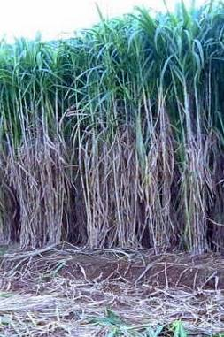
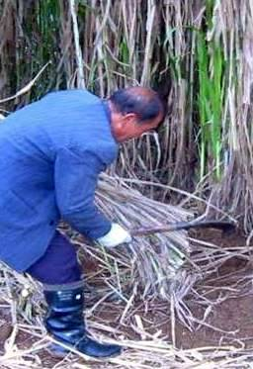
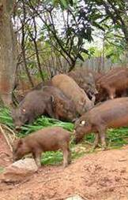
Giant King Grass

Slide 13
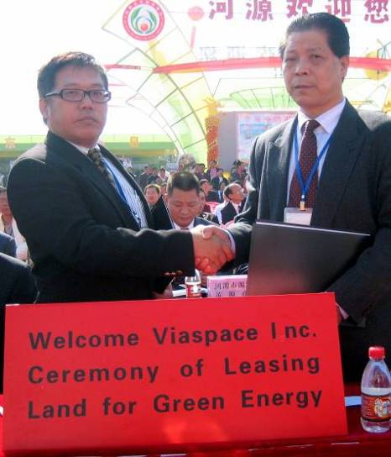
Giant King Grass: Update
1.2 million seedlings planted in China
Land leased in Guangdong Province, China
Additional planting underway
Discussions to grow grass in other regions and countries
  Tropical or subtropical with water availability

Slide 14
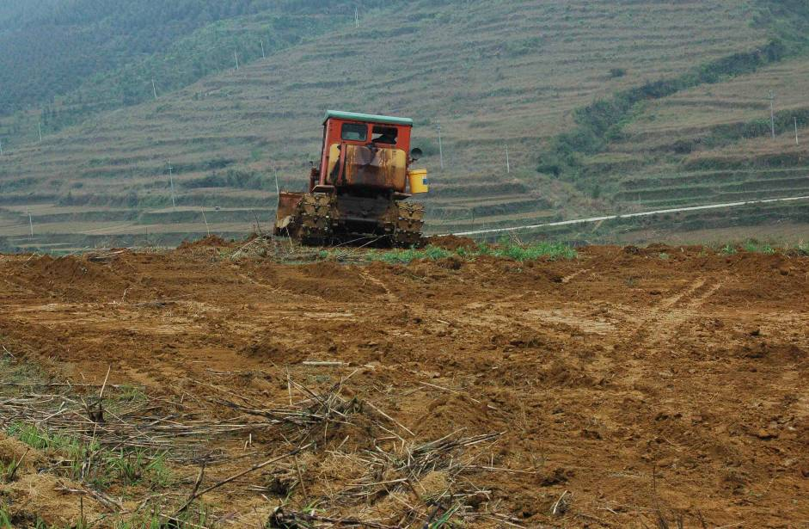
Preparing for New Planting

Slide 15
Worldwide Trend to Cellulosic Biofuels
BP (formerly British Petroleum) announced plans to build a cellulosic ethanol plant in Florida using grass as feedstock
Toyota says that its new hybrid vehicles can be even greener using cellulosic biofuels
Obama administration calling for national low- carbon fuel standard
State of California pursuing legislation to promote low-carbon biofuels made from switchgrass and other nonfood plants

Slide 16
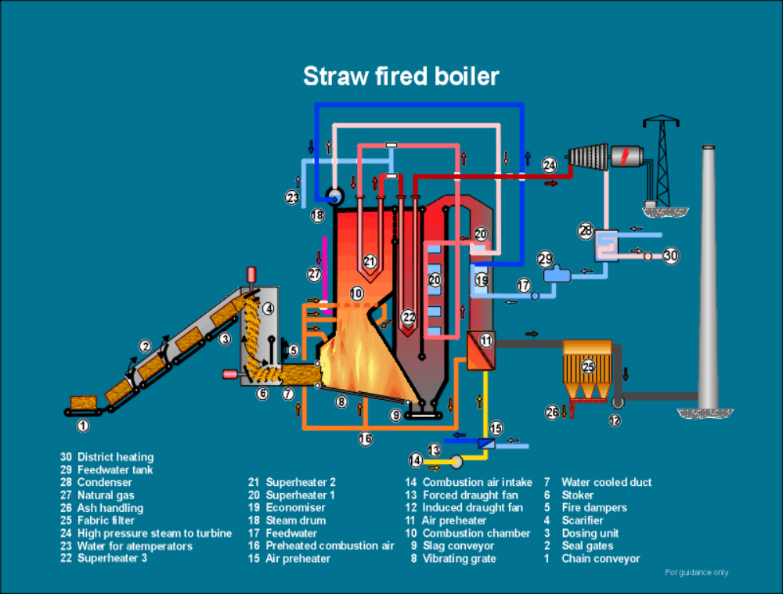

Slide 17
Giant King Grass as Dedicated Energy Crop
30 MW grass-fired electricity generating plant needs 460 tonnes of biomass every day
Requires 960 hectares of land (Giant King grass at 350 tonnes/hectare wet/175 mt/ha dry)
Average household in Shanghai uses 1200 kWh/year or average power of 0.14 kW
  Average household in US uses 11,200 kWh/year—1.3 kW
30 MW plant can supply 214,000 Chinese households
1 hectare (100m x 100m) of Giant King Grass can support average electricity needs of 220 households in China

Slide 18


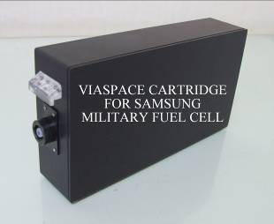
Clean Energy: Fuel Cells
VIASPACE subsidiary Direct Methanol Fuel Cell Corporation produces disposable fuel cartridges for portable electronics powered by fuel cells.
VIASPACE is cartridge provider to Samsung & other companies

Slide 19
VIASPACE Business Strategy
Renewable Energy: Cellulosic Low Carbon Biofuels
  VIASPACE focused on growing and supplying the feedstock for producing biofuels
  Expand land under cultivation
  Initial sales as animal feed
    Build up capacity and capability
    Immediate opportunity for revenue
  Target is feedstock for cellulosic biofuels
    Set up strategic partnerships with biofuel producers
Clean Energy: direct methanol fuel cell cartridges
  Expand partnerships with major OEMS

Slide 20
Financial Opportunities with VIASPACE
Investment in future of alternative energy
  Purchase stock in open-market transaction
  Direct investment in the company to receive stock
  2008 VIASPACE annual report on Form 10K available at http://www.viaspace.com/sec filings.php
Business partnerships
  Grass cultivation in other regions or countries
  Grass supply contract for biofuels or animal feed

Slide 21
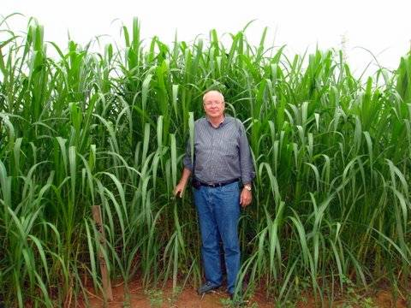
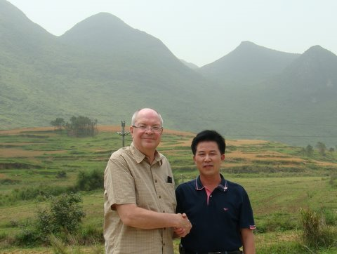
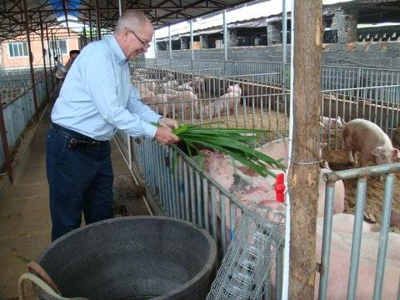
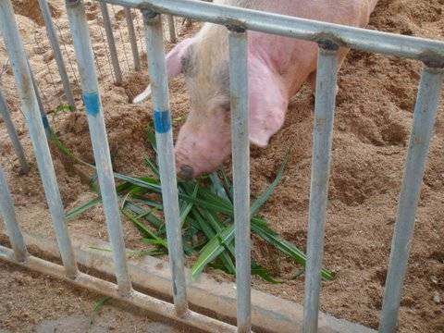

Slide 22
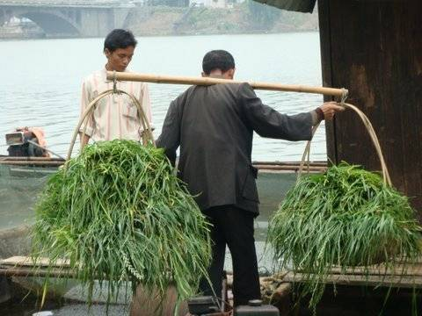
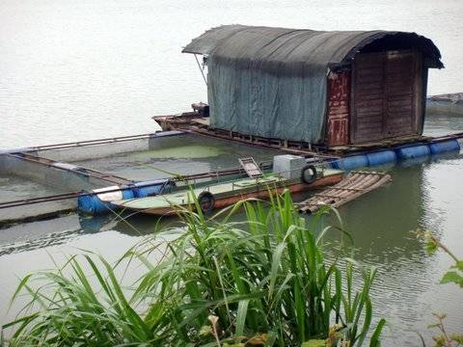
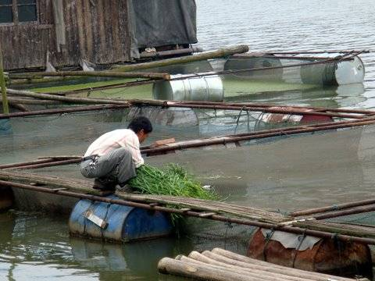
GIANT KING GRASS
FOR FISH FOOD

