Slide 1

Credit Card Fraud Detection: A Machine Learning Approach
Presented by Riché FLEURINORD – Akademi Education (2025)

Slide 2
Overview
Context: Credit card fraud costs millions of dollars and damages customer trust.
Objective: Use transaction data to identify fraudulent transactions.
Method: Exploratory analysis, data preparation, and classification models.
Expected Impact: Reduce financial losses and improve customer safety.

Slide 3

Business Understanding
Problem: How can we automatically detect fraud in real time?
Stakeholders: Banks, risk management teams, customers.
Benefits:
Reduced financial losses
Fewer false positives (legitimate customers not wrongly blocked)
Increased customer confidence

Slide 4
Data Understanding
Data Source: Kaggle/Credit Card Fraud Detection/creditcard.csv (284,807 records, 492 frauds → 0.17%).
Key Features:
Amount = transaction amount
Time = time sequence
V1-V28 = anonymized variables (PCA components)
Main Challenge: Highly imbalanced dataset (fraud ≈ 1 in 600 transactions).

Slide 5
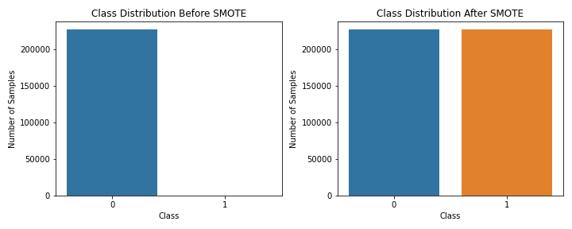
Data Preparation
Key Steps:
Removed duplicates (1,081 dropped).
Normalized variables for comparison.
Split into training and testing sets.
Applied SMOTE to balance fraud vs. non-fraud (synthetic frauds added).
Impact: Models can learn fraud detection more effectively.

Slide 6
Modeling Approach
Models Tested:
Logistic Regression
Decision Tree
Two Scenarios:
Baseline (imbalanced)
Resampled (balanced with SMOTE)

Slide 7
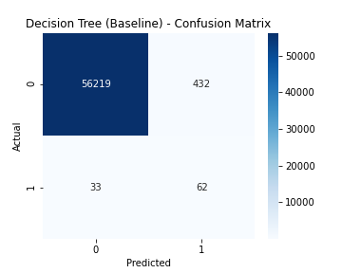
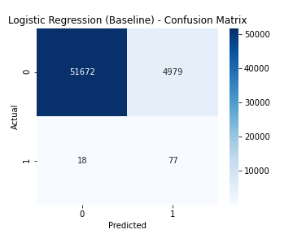
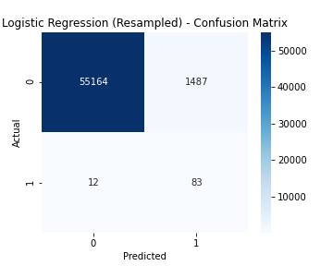
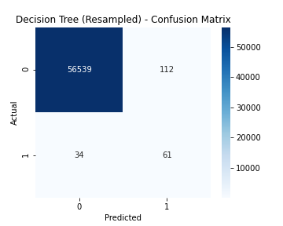
Evaluation

Slide 8
Evaluation Metrics Explained
Accuracy alone is misleading (~99% but misses rare frauds).
Key Metrics:
Precision = % of flagged frauds that are truly frauds.
Recall = % of all frauds that the model successfully detected.
ROC-AUC = overall performance score.

Slide 9
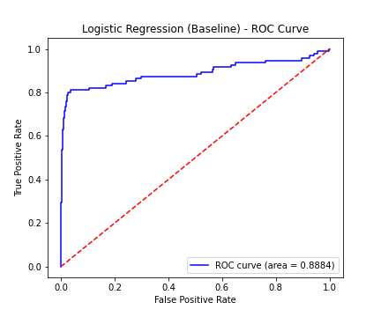
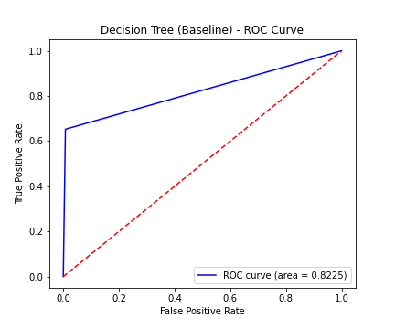
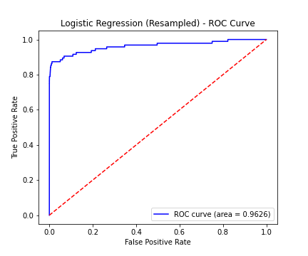
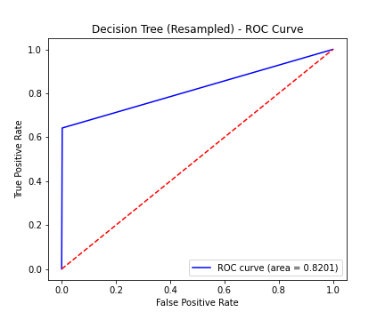
Evaluation Metrics Explained

Slide 10
Results Comparison
Model | Accuracy | Recall (Fraud) | Precision (Fraud) | ROC-AUC
Logistic (Baseline) | 91% | 81% | 1.5% | 0.89
Decision Tree (Baseline) | 99% | 65% | 12% | 0.82
Logistic (Resampled) | 97% | 87% | 5% | 0.96
Decision Tree (Resampled) | 99.7% | 64% | 35% | 0.82
Key Insights:
Logistic Regression (resampled) → very strong recall (detects most frauds).
Decision Tree (resampled) → higher precision (fewer false alerts).

Slide 11
Recommendations
Use a hybrid approach:
Logistic Regression for recall (catching most frauds).
Decision Tree for precision (reducing false positives).
Deploy as a real-time fraud alert system.
Continuously monitor and retrain with new data.

Slide 12
Next Steps
Collect and analyze more recent data.
Test advanced models: Random Forest, XGBoost.
Integrate results into a production banking system.
Work with business teams to fine-tune fraud alert thresholds.

Slide 13
Thank You
Together we can make financial transactions safer.
📘Project: 3rd Project_ MACHINE LEARNING FUNDAMENTALS - Phase 3 👨🏫Instructors: Wedter JEROME & Geovany Batista Polo LAGUERRE �GitHub Repository: https://github.com/richefleuriord/Ds_Fraud_Detection_Project.git

