Slide 1
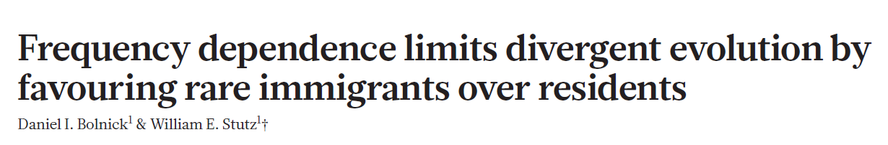
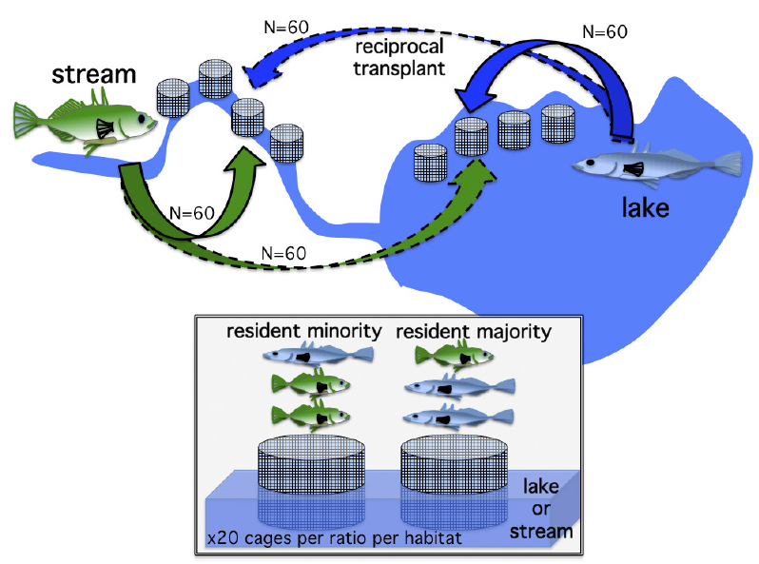

Slide 2
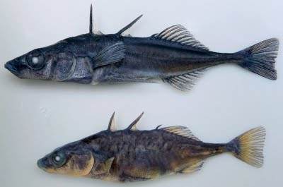
The stickle-situation
Parapatric lake and stream sticklebacks
Lake
Stream
(image taken from Bruce Deagle’s homepage
https://sites.google.com/site/brucedeagleresearch/home)

Slide 3
The stickle-situation
Parapatric lake and stream sticklebacks
Balance between diversifying effect of divergent selection and homogenizing effect of gene flow
(image taken from Bruce Deagle’s homepage
https://sites.google.com/site/brucedeagleresearch/home)

Slide 4
The stickle-situation
Parapatric lake and stream sticklebacks
Balance between diversifying effect of divergent selection and homogenizing effect of gene flow
Concurrent effect of divergent selection (DS) and negative frequency dependent selection (NFDS)
(image taken from Bruce Deagle’s homepage
https://sites.google.com/site/brucedeagleresearch/home)
Survival after 6 weeks : estimate of fitness
Notes:
Due to habitat preference, etc
Difference in hydrodynamic / prey availability
Stream:more productive habitat

Slide 5
Balance between DS and NFDS
NFDS: Rare
Ecotype (immigrant)
Bodymass
MHC type

Slide 6
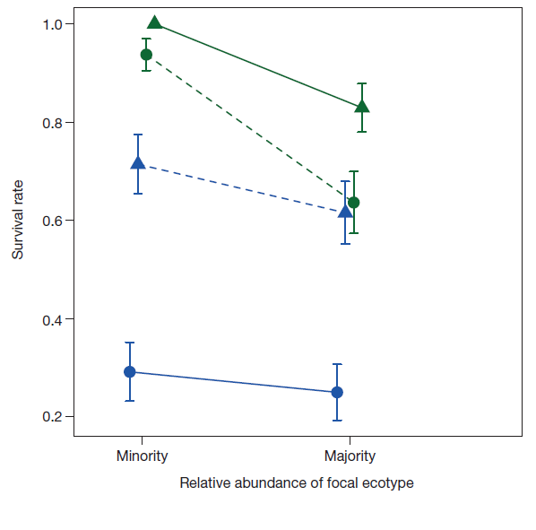
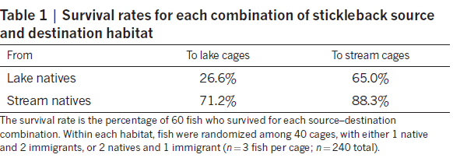
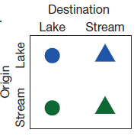
1. Rare ecotype survival was on average 1.26-fold higher than common ecotype survival
S-S
S-L
No evidence of directional selection
Directional selection favoring stream individuals over lake in both habitats
L-S
L-L

Slide 7
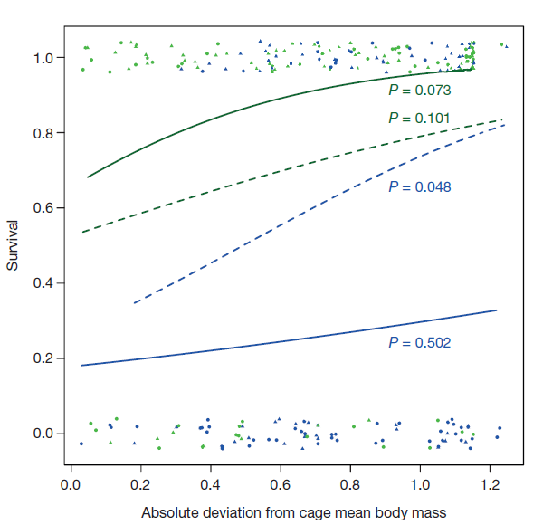
2. Survival is higher for atypically sized individuals within cages
S-S
S-L
L-S
L-L

Slide 8
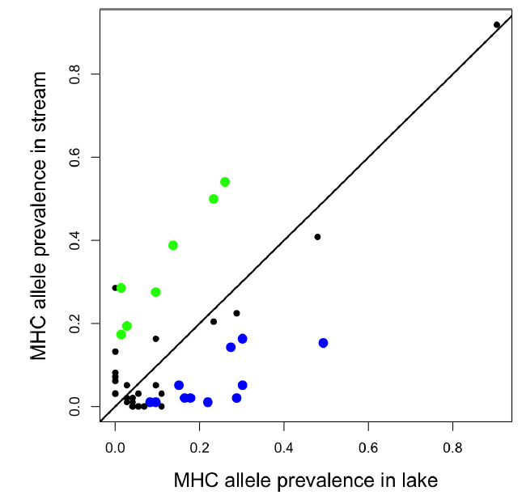
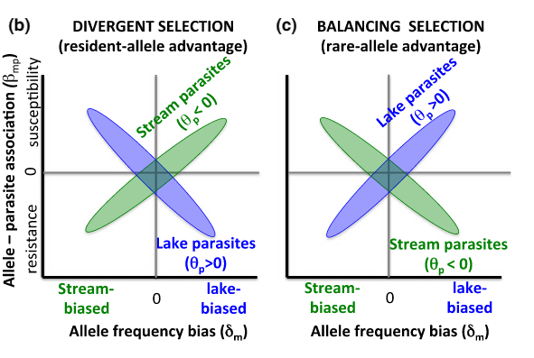
3. Host-parasite interactions : MHC IIb (hypervariable exon 2)
DS: Immigrants should carry more parasite load
NFDS: selection favors parasites that exploit locally common host genotype
Stutz, W. E., & Bolnick, D. I. (2017). Molecular Ecology.

Slide 9
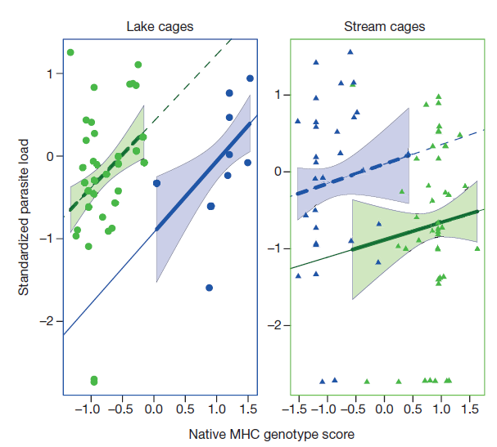
Effect of native/immigrant status on parasite load
S-L
Parasite load higher for fish with more native MHC
Best chance of survival: Majority ecotype with minority MHC
L-S
L-L
S-S
Rare Common

Slide 10
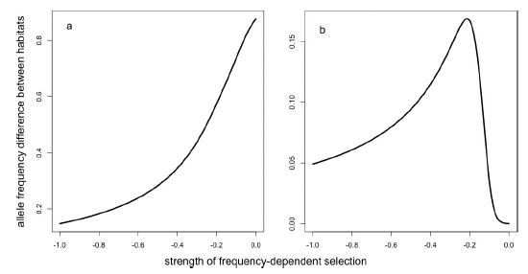
What about directional selection favoring stream fish
Simulations showing outcome of population divergences
Divergent selection + NFDS
Directional selection + NFDS

Slide 11
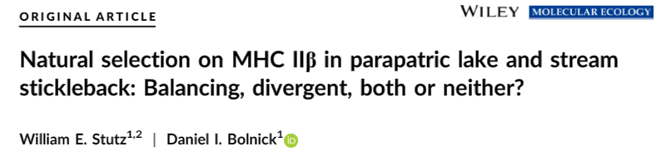
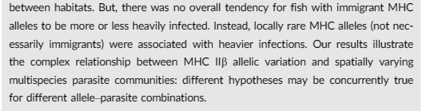
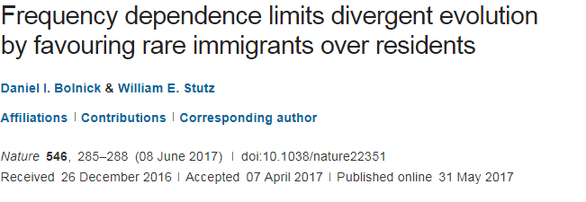
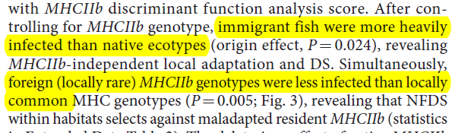
26 May 2017
31 May 2017

