Slide 1
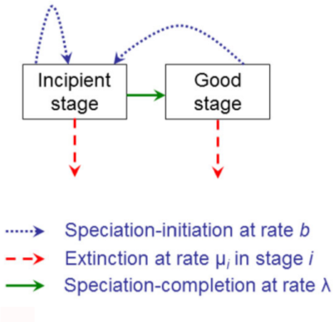
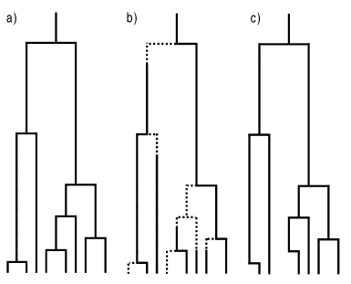
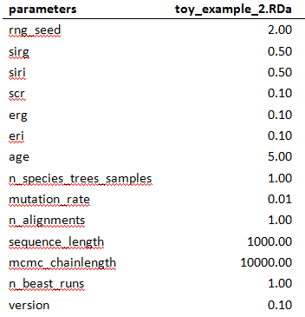
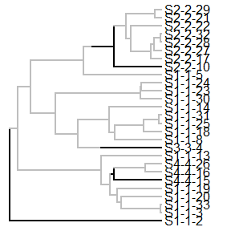
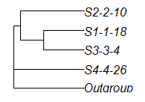
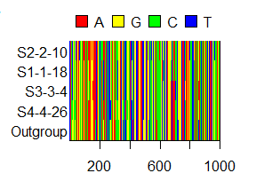

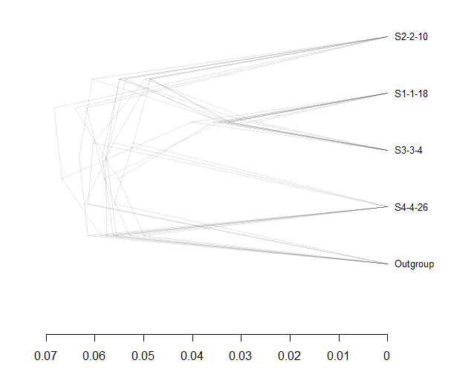
Inferring Phylogenies:
BEAST2 and the Protracted Birth-Death Model
In nature, speciation takes time. However, many phylogenetic inference programs use models that assume speciation to happen instantly. The pure Birth-Death model (BD) assumes instant speciation. However, data from nature shows a slowdown in lineage accumulation towards the present, despite model assumptions. An extention of this model, the Protracted BD model (PBD), allows for speciation to take time.
PBD ( λ = ∞)
PBD
Phylogeny
Method
Results
Step 1: Simulate desired parameter files
Step 2: Simulate 1 incipient species tree per parameter file
Step 3: Sample 2 monophyletic species trees per incipient tree
Step 4: Simulat 2 DNA alignments per sampled species tree
Step 5: Run BEAST2 two times per alignment to get posteriors (eight in total per parameter file)
References
Etienne, R. S., & Rosindell, J. (2012). Prolonging the past counteracts the pull of the present: protracted speciation can explain observed slowdowns in diversification. Systematic Biology, 61(2), 204-213.

