Slide 1


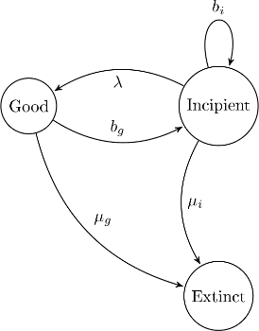
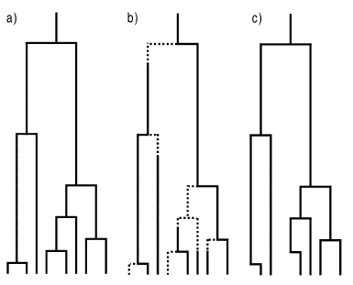

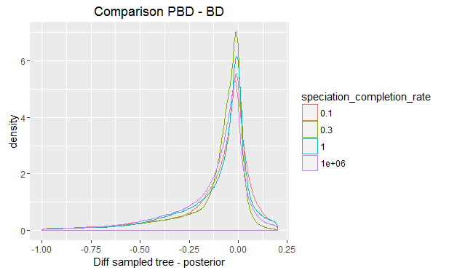
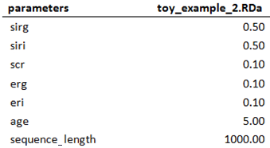
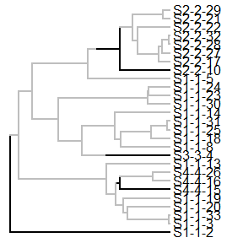
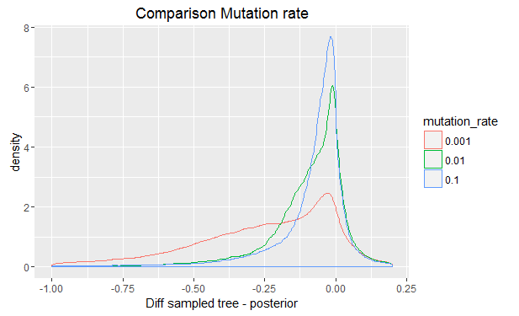
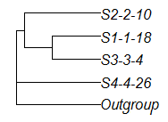
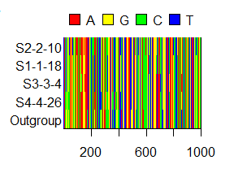

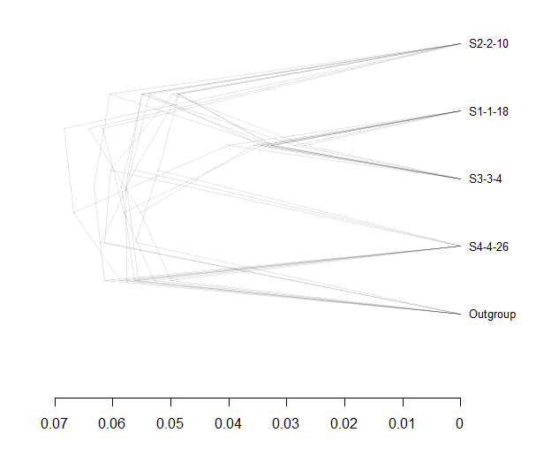
Inferring Phylogenies:
BEAST2 and the Protracted Birth-Death Model
In nature, speciation takes time. Despite this, many phylogenetic inference programs use models that assume speciation to happen instantly. One such model is the Birth – Death model (BD). One model which does take speciation time into account is Portracted Birth – Death (PBD.
PBD with ( λ = ∞)
a.k.a BD
So, an explanation of what these trees are in a few fields here. Lots of space, yay!
PBD adds an incipient stage before a species becomes a good species. In this research, we test if BEAST2, a phylogenetic inference program based on BD, can accurately recover trees that were simulated using the assumptions of PBD.
b = birth
λ = speciation completion
μ = extinction
Method
Results
Something about the graphs, and how the speciation completion rate (SCR) seems to have less impact on the correct recovery of the tree than other parameters, like the mutation rate. Also, we need to explain the gamma statistic somewhere.
Step 1: Simulate desired parameter files
Step 2: Simulate 1 incipient species tree per parameter file
Step 3: Sample 2 monophyletic species trees per incipient tree
Discussion & Conclusion
Other parameters seem to have more impact on the correct recovery of a PBD tree than the SCR, and with that portractedness. For this reason, with the results we have now, we think it is not necessary to include PBD in BEAST2. However, the gamma statistic is a summery of the tree in one number – there might well be other problems that gamma doesn’t detect. This is why it would be prudent to look at other methods of comparing the sampled species trees and the posterior before being too certain about this conclusion.
General idea – can be expanded. Also, if we don’t need that much room here… maybe we could make a field above the results where we explain the gamma statistic?
Step 4: Simulat 2 DNA alignments per sampled species tree
Step 5: Run BEAST2 two times per alignment to get posteriors (eight in total per parameter file)
References
Etienne, R. S., & Rosindell, J. (2012). Prolonging the past counteracts the pull of the present: protracted speciation can explain observed slowdowns in diversification. Systematic Biology, 61(2), 204-213.

