Slide 1


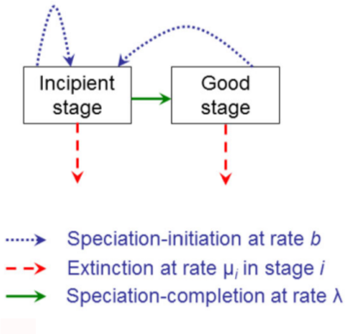
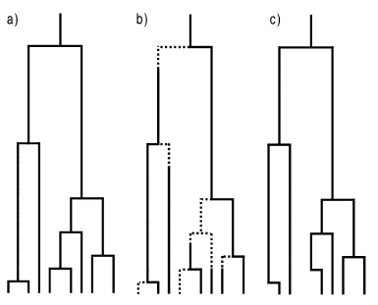

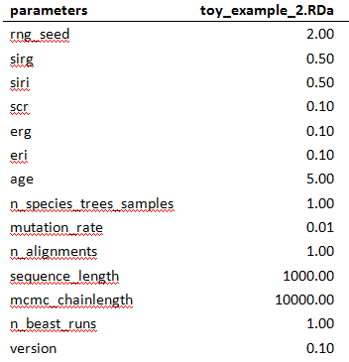
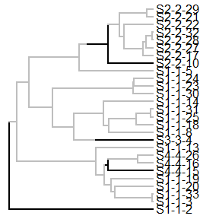

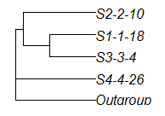
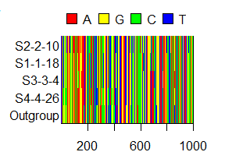

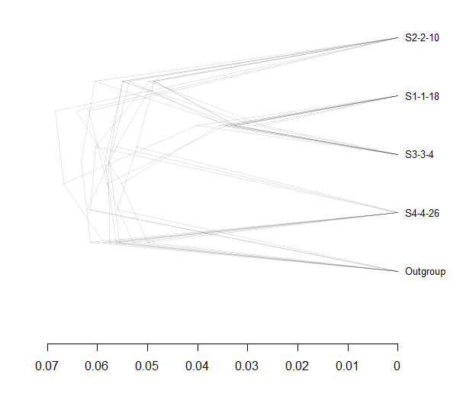
Inferring Phylogenies:
BEAST2 and the Protracted Birth-Death Model
In nature, speciation takes time. However, many phylogenetic inference programs, like BEAST2, use models that assume speciation to happen instantly. One of those models is the pure Birth-Death model (BD), which predicts a steady increase in lineages over time . However, data from nature shows a slowdown in lineage accumulation towards the present, despite model assumptions. An extention of this model, the Protracted BD model (PBD), allows for speciation to take time. The effect this protractednes has on reconstructing phylogenies is currently unknown. By generating PBD parameter estimates and letting BEAST2 infer phylogenies from it, we can estimate the error BEAST2 makes.
PBD ( λ = ∞)
PBD
Phylogeny
Method
Results
Step 1: Simulate desired parameter files
Step 2: Simulate 1 incipient species tree per parameter file
Step 3: Sample 2 monophyletic species trees per incipient tree
Step 4: Simulat 2 DNA alignments per sampled species tree
Step 5: Run BEAST2 two times per alignment to get posteriors (eight in total per parameter file)
References
Etienne, R. S., & Rosindell, J. (2012). Prolonging the past counteracts the pull of the present: protracted speciation can explain observed slowdowns in diversification. Systematic Biology, 61(2), 204-213.

