Slide 1


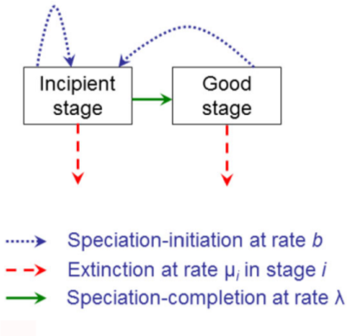
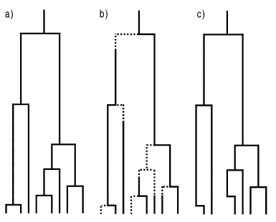

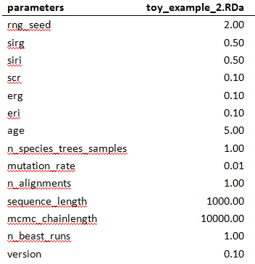
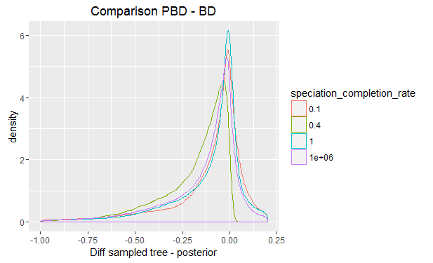
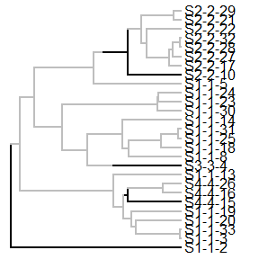
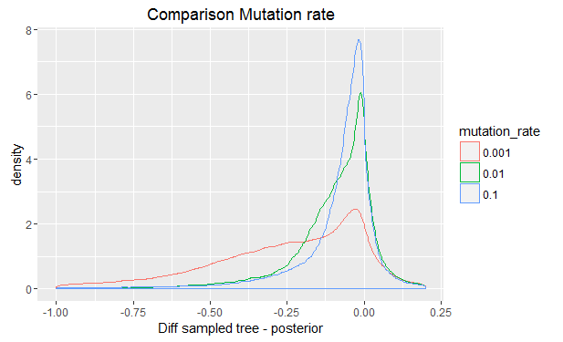

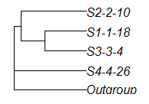
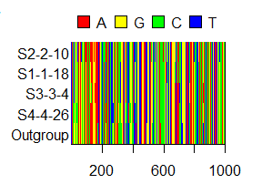

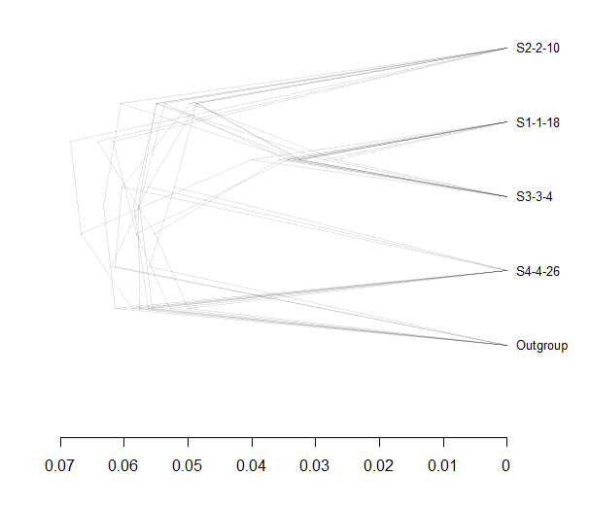
Inferring Phylogenies:
BEAST2 and the Protracted Birth-Death Model
In nature, speciation takes time. Despite this, many phylogenetic inference programs, like BEAST2 use models that assume speciation to happen instantly. One of those models is the pure Birth-Death model (BD), which predicts an increase in lineages over time at a constant rate. However, experimental data show a slowdown in lineage accumulation towards the present, contrary to the assumptions of BD. An extension of this model, the Protracted BD model (PBD), allows for speciation to take time, adding an incipient stage before a species becomes a good species. The effect this protractedness has on reconstructing phylogenies is currently unknown. In this research, we test if BEAST2, a popular phylogenetic inference program based on BD, can accurately recover trees that were simulated using the assumptions of PBD.
PBD ( λ = ∞)
PBD
Phylogeny
Method
Results
Step 1: Simulate desired parameter files
Something about the graphs, and how the speciation completion rate (SCR) seems to have less impact on the correct recovery of the tree than other parameters, like the mutation rate. Also, we need to explain the gamma statistic somewhere.
Step 2: Simulate 1 incipient species tree per parameter file
Step 3: Sample 2 monophyletic species trees per incipient tree
Discussion & Conclusion
Other parameters seem to have more impact on the correct recovery of a PBD tree than the SCR, and with that portractedness. For this reason, with the results we have now, we think it is not necessary to include PBD in BEAST2. However, the gamma statistic is a summery of the tree in one number – there might well be other problems that gamma doesn’t detect. This is why it would be prudent to look at other methods of comparing the sampled species trees and the posterior before being too certain about this conclusion.
General idea – can be expanded. Also, if we don’t need that much room here… maybe we could make a field above the results where we explain the gamma statistic?
Step 4: Simulat 2 DNA alignments per sampled species tree
Step 5: Run BEAST2 two times per alignment to get posteriors (eight in total per parameter file)
References
Etienne, R. S., & Rosindell, J. (2012). Prolonging the past counteracts the pull of the present: protracted speciation can explain observed slowdowns in diversification. Systematic Biology, 61(2), 204-213.

