Slide 1
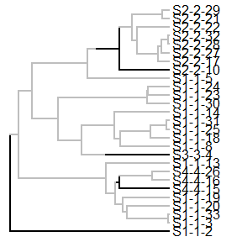
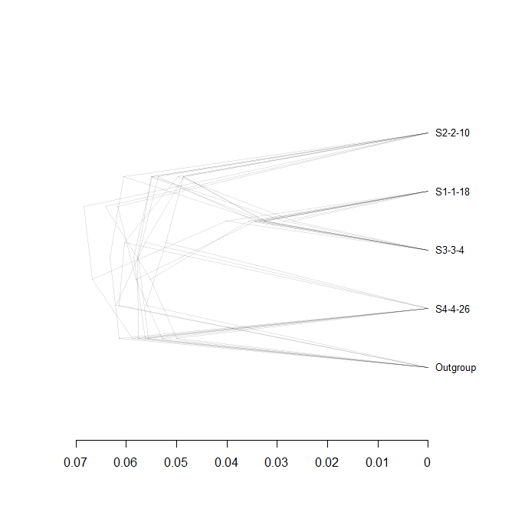
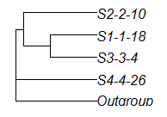
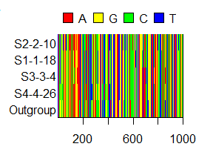
Inferring Phylogenies:
BEAST2 and the Protracted Birth-Death Model
By Femke Thon & Jolien Gay
Introduction
Results
Material & Method
Discussion & Conclusions
References
Etienne, R. S., & Rosindell, J. (2012). Prolonging the past counteracts the pull of the present: protracted speciation can explain observed slowdowns in diversification. Systematic Biology, 61(2), 204-213.

