Slide 1
Array versus container classes
Richel Bilderbeek

Slide 2
Goal
Why should one prefer a container class over a plain array?
  Why arrays?
  Why use container classes?
  What are the problems with arrays?
  Benchmark of arrays versus std::vector [1]
[1] In C++11, one would use std::array

Slide 3
The history of arrays

Slide 4
Why use container classes?
...

Slide 5



Because the literature says so ...
Bjarne Stroustrup. A tour of C++. 2014. ISBN: 978-0-321-958310. Chapter 11.7.11: 'Prefer array over built-in arrays'
Bjarne Stroustrup. The C++ Programming Language (3rd edition). ISBN: 0-201-88954-4 Chapter 5.8.4 'Use vector and valarray rather than built-in (C-style) arrays'
Bjarne Stroustrup. The C++ Programming Language (4th edition). 2013. ISBN: 978-0-321-56384-2. Chapter 7.8. Advice. page 199: '[6] Use containers (e.g., vector, array, and valarray) rather than built-in (C-style) arrays'
Herb Sutter and Andrei Alexandrescu. C++ coding standards: 101 rules, guidelines, and best practices. ISBN: 0-32-111358-6. Chapter 77: 'Use vector and string instead of arrays'
Bjarne Stroustrup
Herb Sutter
Andrei Alexandrescu
Notes:
Bjarne Stroustrup. The C++ Programming Language (3rd edition). ISBN: 0-201-88954-4 Chapter 5.8.4 'Use vector and valarray rather than built-in (C-style) arrays'
Herb Sutter and Andrei Alexandrescu. C++ coding standards: 101 rules, guidelines, and best practices. ISBN: 0-32-111358-6. Chapter 76: 'Use vector by default. Otherwise choose an appropriate container'
Marshall Cline, Greg Lomow and Mike Girou. C++ FAQs. ISBN: 0-201-3098301, FAQ 28.02: 'Are arrays good or evil?' (Answer: 'Arrays are evil'
Bjarne Stroustrup. The C++ Programming Language (3rd edition). ISBN: 0-201-88954-4 Chapter C.14.11 'Prefer vector over array'
Bjarne Stroustrup. The C++ Programming Language (3rd edition). ISBN: 0-201-88954-4 5.8.2: 'Take care not to write beyond the bounds of an array'
Joint Strike Fighter Air Vehicle C++ Coding Standards for the System Development and Demonstration Program. Document Number 2RDU00001 Rev C. December 2005. AV Rule 97: 'Arrays shall not be used in interfaces. Instead, the Array class should be used.'
Bjarne Stroustrup. The C++ Programming Language (4th edition). 2013. ISBN: 978-0-321-56384-2. Chapter 7.8. Advice. page 199: '[3] Take care not to write beyond the bounds of an array'
Bjarne Stroustrup. The C++ Programming Language (4th edition). 2013. ISBN: 978-0-321-56384-2. Chapter 7.8. Advice. page 199: '[4] Avoid multidimensional arrays; define suitable containers instead'
Bjarne Stroustrup. The C++ Programming Language (4th edition). 2013. ISBN: 978-0-321-56384-2. Chapter 7.8. Advice. page 199: '[6] Use containers (e.g., vector, array, and valarray) rather than built-in (C-style) arrays'
Bjarne Stroustrup. The C++ Programming Language (4th edition). 2013. ISBN: 978-0-321-56384-2. Chapter 7.8. Advice. page 199: '[7] Use string rather than zero-terminated arrays of chars'
Bjarne Stroustrup. The C++ Programming Language (4th edition). 2013. ISBN: 978-0-321-56384-2. Chapter 12.7. Advice. page 341: '[15] Avoid passing arrays as pointers'
Scott Meyers. C++ And Beyond 2012 session: 'Initial thoughts on Effective C++11'. 2012. 'Prefer std::array to Built-in Arrays'
Scott Meyers. Effective Modern C++ (1st Edition). 2014. ISBN: 978-1-491-90399-5. Item 1, page 17: 'Of course, as a modern C++ developer, you'd naturally preder a std::array to a built-in array'
Bjarne Stroustrup. A tour of C++. 2014. ISBN: 978-0-321-958310. Chapter 11.7.11: 'Prefer array over built-in arrays'
Herb Sutter and Andrei Alexandrescu. C++ coding standards: 101 rules, guidelines, and best practices. ISBN: 0-32-111358-6. Chapter 77: 'Use vector and string instead of arrays'
Bjarne Stroustrup. The C++ Programming Language (4th edition). 2013. ISBN: 978-0-321-56384-2. Chapter 34.7. Advice. page 1007: '[2] Prefer array over built-in arrays'

Slide 6

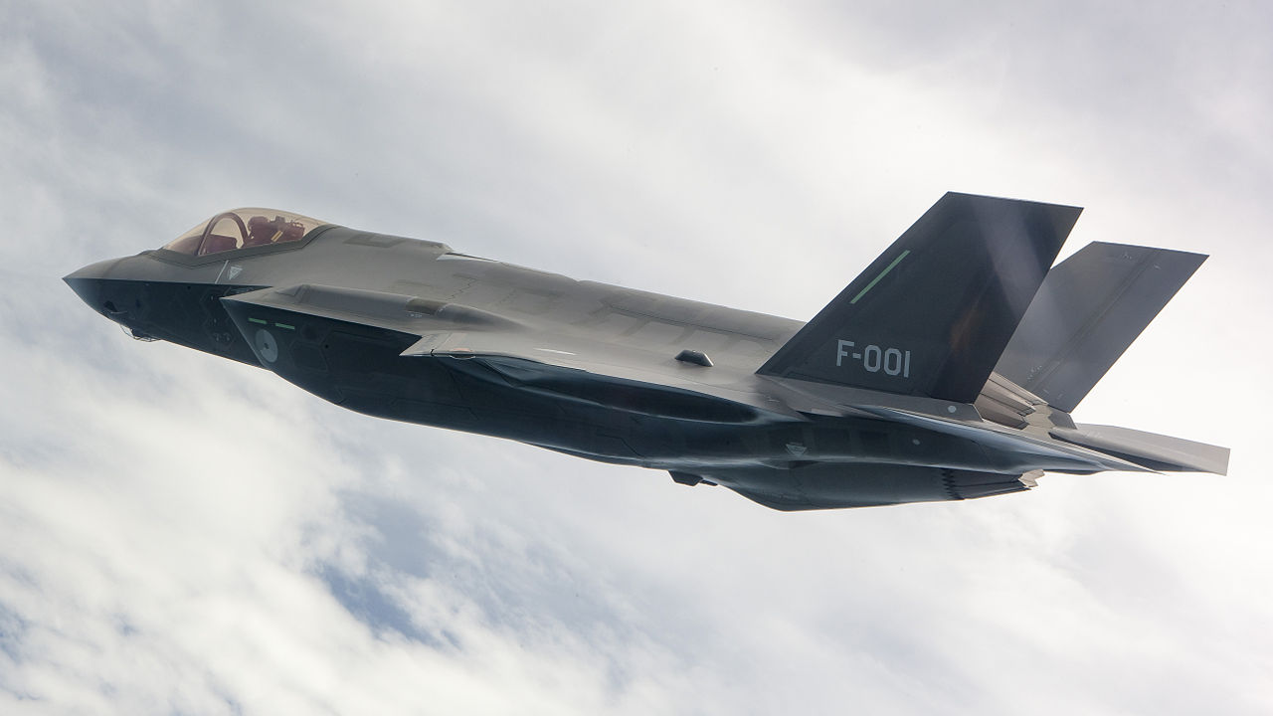
Because the literature says so ...
Marshall Cline, Greg Lomow and Mike Girou. C++ FAQs. ISBN: 0-201-3098301, FAQ 28.02: 'Are arrays good or evil?' (Answer: 'Arrays are evil'
Joint Strike Fighter Air Vehicle C++ Coding Standards for the System Development and Demonstration Program. Document Number 2RDU00001 Rev C. December 2005. AV Rule 97: 'Arrays shall not be used in interfaces. Instead, the Array class should be used.'
Scott Meyers. C++ And Beyond 2012 session: 'Initial thoughts on Effective C++11'. 2012. 'Prefer std::array to built-in Arrays'
Scott Meyers. Effective Modern C++ (1st Edition). 2014. ISBN: 978-1-491-90399-5. Item 1, page 17: 'Of course, as a modern C++ developer, you'd naturally prefer a std::array to a built-in array'
Scott Meyers
F-35 Lightning II
Notes:
Bjarne Stroustrup. The C++ Programming Language (3rd edition). ISBN: 0-201-88954-4 Chapter 5.8.4 'Use vector and valarray rather than built-in (C-style) arrays'
Herb Sutter and Andrei Alexandrescu. C++ coding standards: 101 rules, guidelines, and best practices. ISBN: 0-32-111358-6. Chapter 76: 'Use vector by default. Otherwise choose an appropriate container'
Marshall Cline, Greg Lomow and Mike Girou. C++ FAQs. ISBN: 0-201-3098301, FAQ 28.02: 'Are arrays good or evil?' (Answer: 'Arrays are evil'
Bjarne Stroustrup. The C++ Programming Language (3rd edition). ISBN: 0-201-88954-4 Chapter C.14.11 'Prefer vector over array'
Bjarne Stroustrup. The C++ Programming Language (3rd edition). ISBN: 0-201-88954-4 5.8.2: 'Take care not to write beyond the bounds of an array'
Joint Strike Fighter Air Vehicle C++ Coding Standards for the System Development and Demonstration Program. Document Number 2RDU00001 Rev C. December 2005. AV Rule 97: 'Arrays shall not be used in interfaces. Instead, the Array class should be used.'
Bjarne Stroustrup. The C++ Programming Language (4th edition). 2013. ISBN: 978-0-321-56384-2. Chapter 7.8. Advice. page 199: '[3] Take care not to write beyond the bounds of an array'
Bjarne Stroustrup. The C++ Programming Language (4th edition). 2013. ISBN: 978-0-321-56384-2. Chapter 7.8. Advice. page 199: '[4] Avoid multidimensional arrays; define suitable containers instead'
Bjarne Stroustrup. The C++ Programming Language (4th edition). 2013. ISBN: 978-0-321-56384-2. Chapter 7.8. Advice. page 199: '[6] Use containers (e.g., vector, array, and valarray) rather than built-in (C-style) arrays'
Bjarne Stroustrup. The C++ Programming Language (4th edition). 2013. ISBN: 978-0-321-56384-2. Chapter 7.8. Advice. page 199: '[7] Use string rather than zero-terminated arrays of chars'
Bjarne Stroustrup. The C++ Programming Language (4th edition). 2013. ISBN: 978-0-321-56384-2. Chapter 12.7. Advice. page 341: '[15] Avoid passing arrays as pointers'
Scott Meyers. C++ And Beyond 2012 session: 'Initial thoughts on Effective C++11'. 2012. 'Prefer std::array to Built-in Arrays'
Scott Meyers. Effective Modern C++ (1st Edition). 2014. ISBN: 978-1-491-90399-5. Item 1, page 17: 'Of course, as a modern C++ developer, you'd naturally preder a std::array to a built-in array'
Bjarne Stroustrup. A tour of C++. 2014. ISBN: 978-0-321-958310. Chapter 11.7.11: 'Prefer array over built-in arrays'
Herb Sutter and Andrei Alexandrescu. C++ coding standards: 101 rules, guidelines, and best practices. ISBN: 0-32-111358-6. Chapter 77: 'Use vector and string instead of arrays'
Bjarne Stroustrup. The C++ Programming Language (4th edition). 2013. ISBN: 978-0-321-56384-2. Chapter 34.7. Advice. page 1007: '[2] Prefer array over built-in arrays'

Slide 7
Problems according to the literature
An array does not know its size
Cannot assign plain arrays
Implicit conversion to pointer

Slide 8
Example, adapted from [1]
void iota(int a[], const int sz) {
for (int i=0; i!=sz; ++i) {
a[i] = i;
}
}
int main() {
int v[20];
int w[10];
iota(v,20);
iota(w,20); //Oops
}
[1] https://isocpp.org/wiki/faq/containers

Slide 9
Example, adapted from [1]
int main()
{
int v[] = {1,2};
int w[] = {3,4};
v = w; //Invalid array assignment
//Cannot be fixed by std::memcpy
//for non-PODs
}
[1] https://isocpp.org/wiki/faq/containers

Slide 10
Example, adapted from [1]
void f()
{
Derived v[3];
Base * const w = v; //Disaster waiting to happen
std::cout << w[1];
}
[1] Stroustrup, 'A Tour of C++, 2014, page 123
Notes:
Example adapted from Stroustrup, 'A Tour of C++, 2014, page 123

Slide 11
Example, adapted from [1]
struct Base { int m_base; };
struct Derived : public Base { int m_derived; };
void f() {
const int sz = 3;
Derived v[sz];
//Initialize
for (int i=0; i!=sz; ++i) { v[i].m_base = i+1; v[i].m_derived = i+4; }
//Display
for (int i=0; i!=sz; ++i) {
std::cout << v[i].m_base << " " << v[i].m_derived << '\n'; }
Base * const w = v; //Disaster waiting to happen
//Display
for (int i=0; i!=sz; ++i) { std::cout << w[i].m_base << '\n'; }
}
1 4
2 5
3 6
1
4
2
Base has a different offset than Derived
[1] Stroustrup, 'A Tour of C++, 2014, page 123
Notes:
Example adapted from Stroustrup, 'A Tour of C++, 2014, page 123

Slide 12
My definition of the problem
You abandon compile-time and run-time checking
I do not like long nights of debugging

Slide 13
My example
void f(const int * const p, const int sz)
{
//Cannot check if p indeed has size sz
}
void g()
{
/* ... */
//Cannot check if i is a valid index from v only
v[i] = 42;
}

Slide 14
Alternative
void f(const std::vector<int>& v)
{
//Can get the true size of v
}
void g()
{
/* ... */
//Checks if i is a valid index
v.at(i) = 42;
}

Slide 15
Speed
Common misconception: arrays are faster
Many benchmarks compare array and C++ containers incorrectly using those containers

Slide 16
Experiment
Google for 'std::vector slower than array'
Compile the first benchmark
Measure
Improve the benchmark
Measure again

Slide 17
Benchmark
Found post on Stack Overflow
Benchmark on Travis CI with this GitHub
Measured these results:
UseArray completed in 6.191 seconds
UseVector completed in 44.706 seconds
Notes:
http://stackoverflow.com/questions/3664272/stdvector-is-so-much-slower-than-plain-arrays

Slide 18
Original code
std::vector<Pixel> pixels;
pixels.resize(dimension * dimension);
for(int i = 0; i!=dimension * dimension; ++i)
{
pixels[i].r = 255;
pixels[i].g = 0;
pixels[i].b = 0;
}

Slide 19
Original code
Writes Pixels twice!
std::vector<Pixel> pixels;
pixels.resize(dimension * dimension);
for(int i = 0; < dimension * dimension; ++i)
{
pixels[i].r = 255;
pixels[i].g = 0;
pixels[i].b = 0;
}
Indexed access

Slide 20
Equivalent code
std::vector<Pixel> pixels(
dimension * dimension,
Pixel(255,0,0)
);

Slide 21
Second benchmark
In debug mode:
UseArray completed in 6.965 seconds
UseVector completed in 19.794 seconds

Slide 22
Third benchmark
In release mode:
UseArray completed in 2.438 seconds
UseVector completed in 2.437 seconds

Slide 23
Conclusion
The literature advises to use container classes
Use of arrays can result in errors that cannot be discovered at compile-time nor run-time
Speed benchmarks incorrectly suggest array is faster, due to naive author
  Do not forget to benchmark in release mode

