Slide 1






Professional C++ development
using git, GitHub, Travis CI, Boost.Test, gcov and OCLint
© 2016 Richel Bilderbeek
http://www.github.com/richelbilderbeek/CppPresentations

Slide 2
What? Why? Mastery?
What: follow all good practices by default
Why: proven to pay off
Mastery: set up tools to follow all good practices by default

Slide 3
Setup
Version control
Code hosting
Continuous integration
Testing framework
Code coverage
Static code analysis

Slide 4
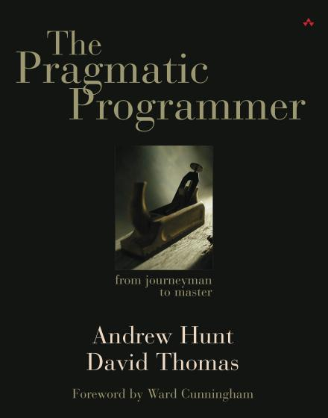
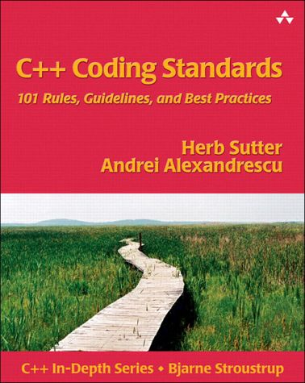
Version control
Keeps a history of code
Tip 23: Always Use
Source Code Control
Chapter 3.
Use a version control system

Slide 5
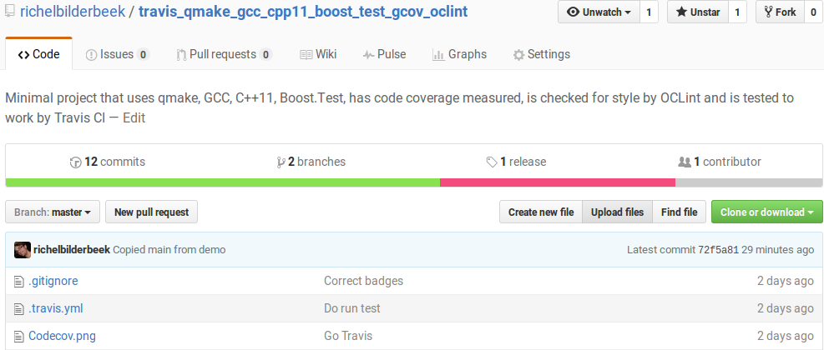
Code hosting
Host your (version controlled) code
Using GitHub is good practice [1]
[1] Perez-Riverol, Yasset, et al. "Ten Simple Rules for Taking Advantage of git and GitHub." bioRxiv (2016): 048744.

Slide 6

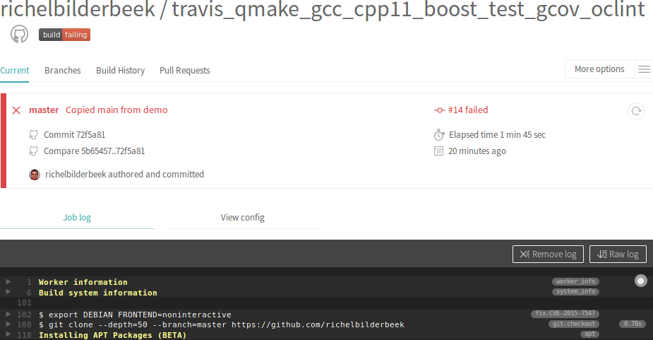
Continuous integration
Run scripts upon pushing new code
Automate the running of your tests
through a makefile or similar tool
Tip 61: Don’t Use
Manual Procedures

Slide 7
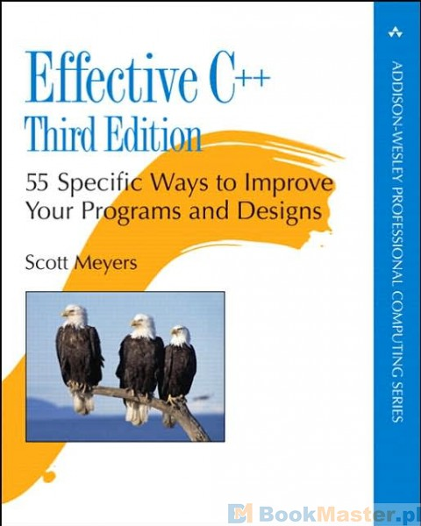

Testing framework
To test your code
Tip 62: Test Early.
Test Often. Test Automatically
Item 55:
Familiarize yourself with Boost

Slide 8
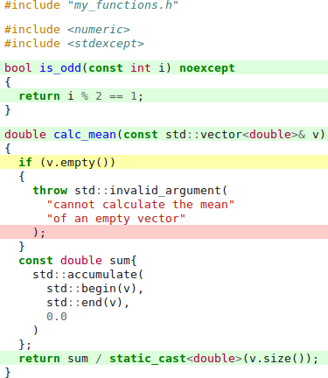
Code coverage
Measures code that is actually used
Correlates with quality [1]
[1] Del Frate, Fabio, et al. "On the correlation between code coverage and software reliability." Software Reliability Engineering, 1995. Proceedings., Sixth International Symposium on. IEEE, 1995.

Slide 9
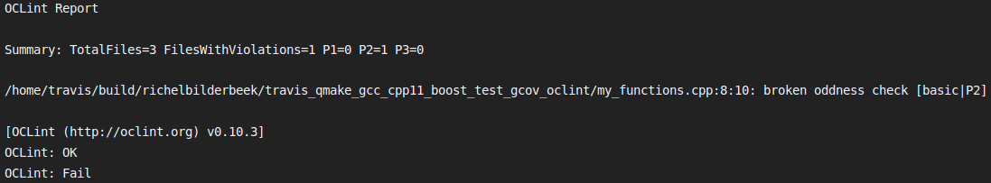
Static code analysis
Checks code beyond the compiler

Slide 10
This presentation
Shows two functions and their tests
Shows the detection of errors in those functions

Slide 11
Setup
my_functions.h
my_functions_test.cpp
my_functions.cpp
main.cpp
main_test.cpp

Slide 12
main.cpp
#include "my_functions.h"
#include <iostream>
int main() {
std::cout
<< is_odd(42) << '\n'
<< calc_mean( { 41.0, 42.0,43.0 } )
<< '\n';
}

Slide 13
my_functions.h
#ifndef MY_FUNCTIONS_H
#define MY_FUNCTIONS_H
#include <vector>
///Calculate the mean.
///Will throw if the input is empty
double calc_mean(const std::vector<double>& v);
///Determine if a number is odd
bool is_odd(const int i) noexcept;
#endif // MY_FUNCTIONS_H

Slide 14
my_functions.cpp 1/2
#include "my_functions.h"
#include <numeric>
#include <stdexcept>
bool is_odd(const int i) noexcept
{
return i % 2 == 1;
}

Slide 15
my_functions.cpp 2/2
double calc_mean(const std::vector<double>& v) {
if (v.empty()) {
throw std::invalid_argument(
"cannot calculate the mean"
"of an empty vector"
);
}
const double sum{
std::accumulate(
std::begin(v), std::end(v), 0.0
)
};
return sum / static_cast<double>(v.size());
}

Slide 16
main_test.cpp
#define BOOST_TEST_DYN_LINK
#define BOOST_TEST_MODULE my_functions_test_module
#include <boost/test/unit_test.hpp>
//No main needed, BOOST_TEST_DYN_LINK creates it

Slide 17
my_functions_test.cpp 1/2
#include <boost/test/unit_test.hpp>
#include "my_functions.h"
BOOST_AUTO_TEST_CASE(test_is_odd)
{
BOOST_CHECK(!is_odd(0));
BOOST_CHECK( is_odd(1));
}

Slide 18
my_functions_test.cpp 1/2
BOOST_AUTO_TEST_CASE(test_calc_mean)
{
const double measured{
calc_mean( {1.0, 2.0, 3.0} )
};
const double expected{2.0};
BOOST_CHECK_EQUAL(measured, expected);
}

Slide 19
Output
Running 2 test cases...
*** No errors detected

Slide 20
Detection

Slide 21
Detection
BOOST_AUTO_TEST_CASE(
test_calc_mean_needs_nonempty_vector
)
{
std::vector<double> empty;
BOOST_CHECK_THROW(
calc_mean(empty),
std::invalid_argument
);
}

Slide 22
Detection
bool is_odd(const int i) noexcept
{
return i % 2 == 1;
}
bool is_odd(const int i) noexcept
{
return i % 2 != 0;
}

Slide 23
Replicating this setup
Download (not clone) the files from https://github.com/richelbilderbeek/travis_qmake_gcc_cpp11_boost_test_gcov_oclint

Slide 24
My experiences
Due to this setup, I have
  Responded to bugs faster
  Found and removed dead code
  Reduced complexity of working code
  Learned new things

Slide 25
Conclusion
This setup was known to be useful beforehand
This setup is easy to replicate
I think this setup is useful for
  C++ newbies
  C++ pros

Slide 26
Discussion
Creating this setup from scratch is tricky
Other tools are just as fine
Need a related C++ setup? https://github.com/richelbilderbeek/travis_cpp_tutorial
Need a related R setup? https://github.com/richelbilderbeek/travis_r_tutorial

