Slide 1

Boost.Graph
Richel Bilderbeek

Slide 2

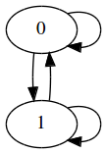
Graphs
Vertices/nodes and edges
Directed or undirected

Slide 3
Application of graphs
Fundamental mathematical concept
Neural networks
Reinforcement learning
Path-finding
Order of complex tasks

Slide 4
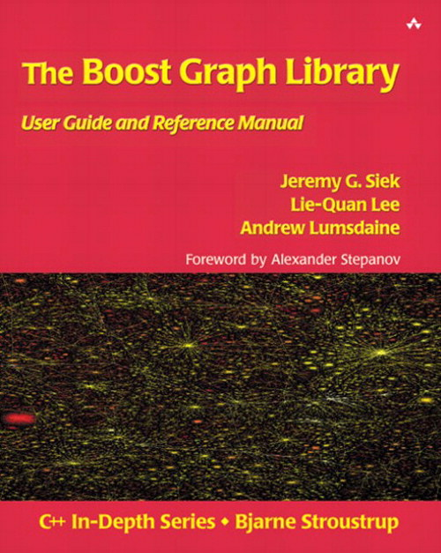
Boost.Graph
Part of the Boost libraries
Flexibility by templates
Steep learning curve
Scott Meyers. Effective C++ (3rd edition). Item 54: Familiarize yourself with Boost

Slide 5
Problem
Compile errors are unreadable
Documentation:
  Is not ordered non-chronologically
  Does not increase gradually in complexity
  Offers few complete code snippets

Slide 6
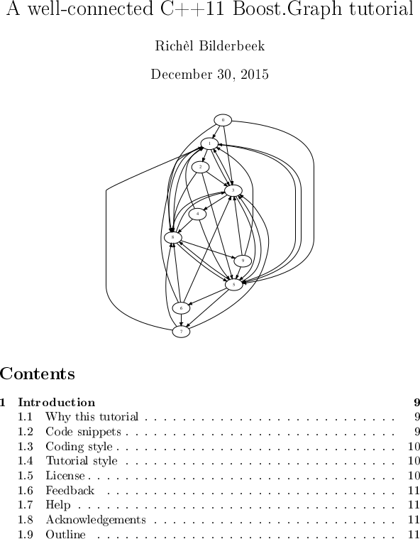
My work
Chronologically ordered
Starts simple
Short and complete code snippets
Following the C++ Core Guidelines
Well received by the community
>300 pages

Slide 7
Steps
Create an empty graph
Add a vertex
Add an edge
Check if graphs are isomorphisms

Slide 8
Create an empty directed graph
#include <boost/graph/adjacency_list.hpp>
boost::adjacency_list<>
create_empty_directed_graph() noexcept
{
return {};
}

Slide 9
Create an empty directed graph
#include "create_empty_directed_graph.h"
void create_empty_directed_graph_demo() noexcept
{
const auto g = create_empty_directed_graph();
}

Slide 10
Create an empty undirected graph
#include <boost/graph/adjacency_list.hpp>
boost::adjacency_list<
boost::vecS,
boost::vecS,
boost::undirectedS
>
create_empty_undirected_graph() noexcept
{
return {};
}

Slide 11
Create an empty undirected graph
#include "create_empty_undirected_graph.h"
void create_empty_undirected_graph_demo() noexcept
{
const auto g
= create_empty_undirected_graph();
}

Slide 12
Recap
Creating an empty graph = defining its type
C++11 '{}' and 'auto' comes in handy!
boost::adjaceny_list has six template arguments
  How to store the vertices, out edges, edges
  Properties of vertices, edges and graph

Slide 13
Add a vertex
#include <type_traits>
#include <boost/graph/adjacency_list.hpp>
template <typename graph>
typename boost::graph_traits<
graph
>::vertex_descriptor
add_vertex(graph& g) noexcept
{
static_assert(!std::is_const<graph>::value,
"graph cannot be const"
);
const auto vd = boost::add_vertex(g);
return vd;
}

Slide 14
Add a vertex
#include "add_vertex.h"
#include "create_empty_directed_graph.h"
#include "create_empty_undirected_graph.h"
void add_vertex_demo() noexcept
{
auto g = create_empty_undirected_graph();
add_vertex(g);
assert(boost::num_vertices(g) == 1);
auto h = create_empty_directed_graph();
add_vertex(h);
assert(boost::num_vertices(h) == 1);
}

Slide 15
Recap
Vertices can be added to any type of graph
  All graphs have vertices!
Vertex (or edge) descriptors → work on graph

Slide 16
Add an edge
#include <cassert>
#include <type_traits>
#include <boost/graph/adjacency_list.hpp>
template <typename graph>
typename boost::graph_traits<graph>::edge_descriptor
add_edge(graph& g) noexcept
{
static_assert(!std::is_const<graph>::value,
"graph cannot be const"
);
const auto vd_a = boost::add_vertex(g);
const auto vd_b = boost::add_vertex(g);
const auto aer = boost::add_edge(
vd_a, vd_b, g
);
assert(aer.second);
return aer.first;
}

Slide 17
Add an edge
#include "add_edge.h"
#include "create_empty_directed_graph.h"
#include "create_empty_undirected_graph.h"
void add_edge_demo() noexcept
{
auto g = create_empty_undirected_graph();
add_edge(g);
assert(boost::num_vertices(g) == 2);
assert(boost::num_edges(g) == 1);
auto h = create_empty_directed_graph();
add_edge(h);
assert(boost::num_vertices(h) == 2);
assert(boost::num_edges(h) == 1);
}

Slide 18
Recap
To add an edge one needs vertex descriptors

Slide 19
Check for isomorphism
#include <boost/graph/isomorphism.hpp>
template <typename graph1, typename graph2>
bool is_isomorphic(
const graph1 g,
const graph2 h
) noexcept
{
return boost::isomorphism(g,h);
}

Slide 20
Check for isomorphism
#include <cassert>
#include "create_path_graph.h"
#include "create_k3_graph.h"
#include "is_isomorphic.h"
void is_isomorphic_demo() noexcept
{
const auto g = create_path_graph(3);
const auto h = create_k3_graph();
assert( is_isomorphic(g,g));
assert(!is_isomorphic(g,h));
}

Slide 21
Conclusion
Simple things are already template-heavy
Complex things are available
Complex things do not fit on a slide

Slide 22
Discussion
Still unknown how to save and load a graph with a name

