Slide 1
Test-driven development
Richèl Bilderbeek

Slide 2
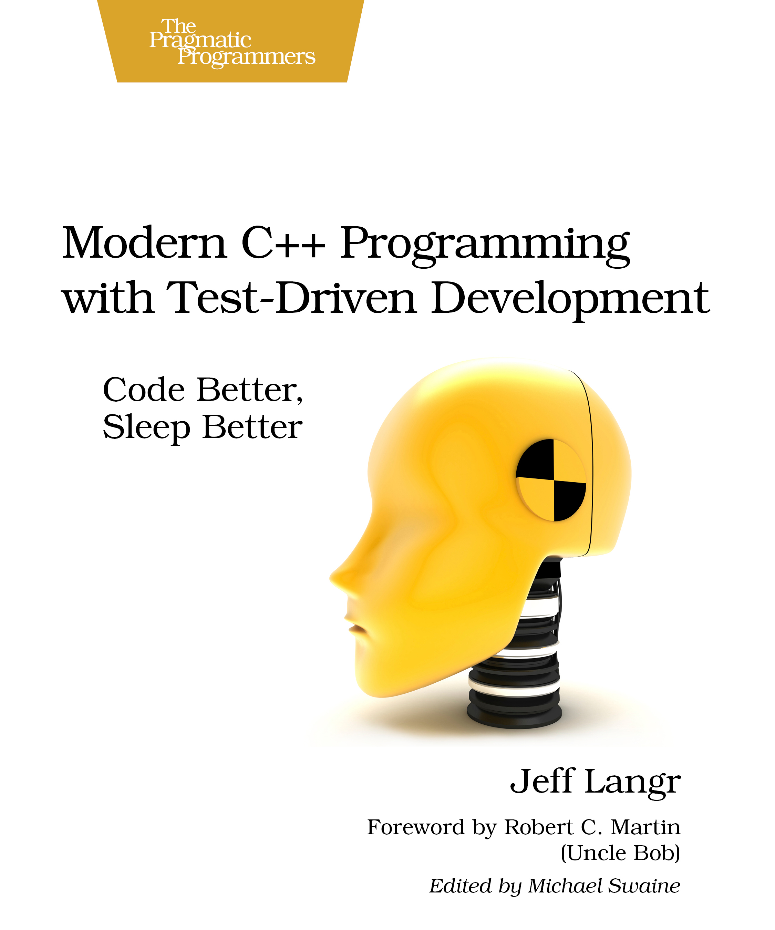
What is test-driven development?
Developing code with the right amounts of tests

Slide 3
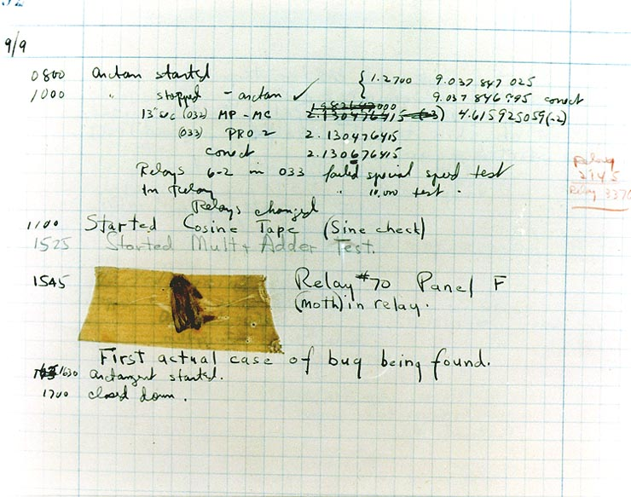
Why tests?
Goal: code without bugs
Untested code easily develops an error
Code that cannot be tested has more errors

Slide 4
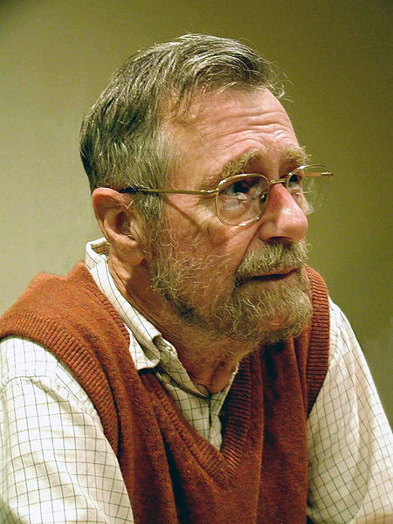
How much tests?
“Testing can be used to show the presence of errors, never their absence!” Edsger Dijkstra
Too few: many errors are not discovered
Too much: many correctnesses are checked multiple times
What is the balance?

Slide 5
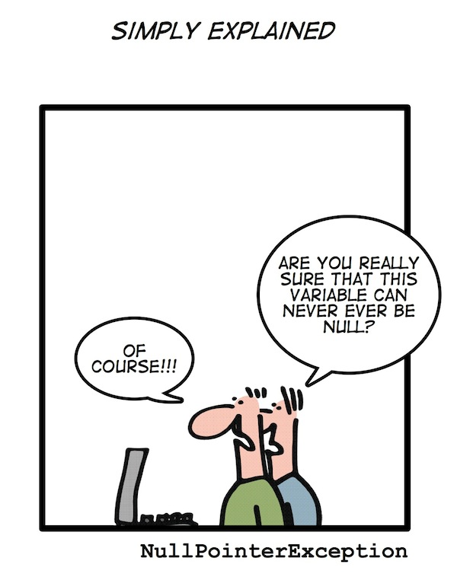
What is an error?
Logic error
  The programmer makes an incorrect reasoning
  Example: a division by zero
Runtime error
  Hardware encounters a limit
  Example: memory is full

Slide 6
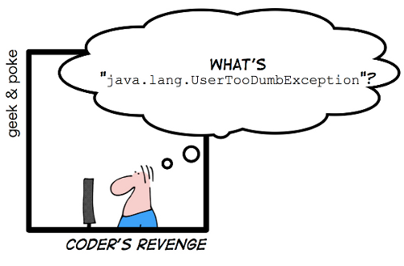
What is not an error?
The user gives incorrect/nonsense input
Example: a command that does not exist

Slide 7
Logic error
The programmer makes an incorrect reasoning
Example: a function that returns the wrong answer
Test:
  call the function with different arguments
  see if it returns the expected results

Slide 8
Example
bool IsPrime(const int x)
{
/* calculation */
/* return true or false */
}

Slide 9
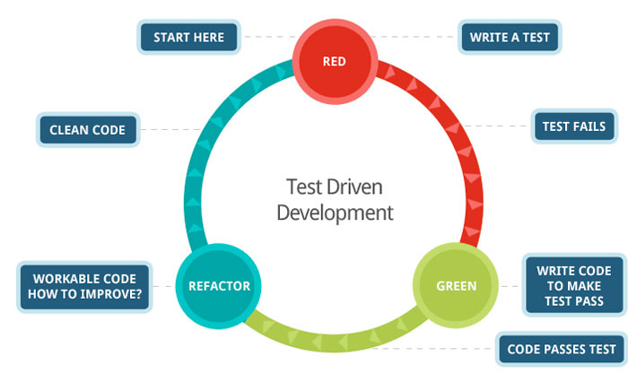
Developing IsPrime
Cycle test-driven development:
  Red: write a test that fails
  Green: pass the test
  Refactor: improve the new code, clean up mess, check in code

Slide 10

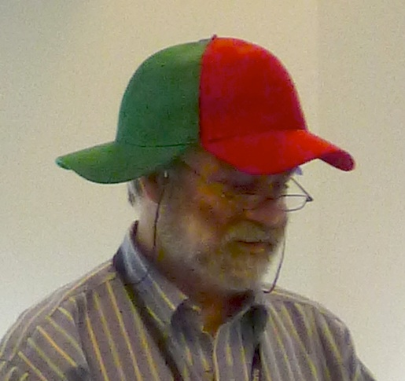
Development IsPrime
As small steps as possible
One step at a time

Slide 11
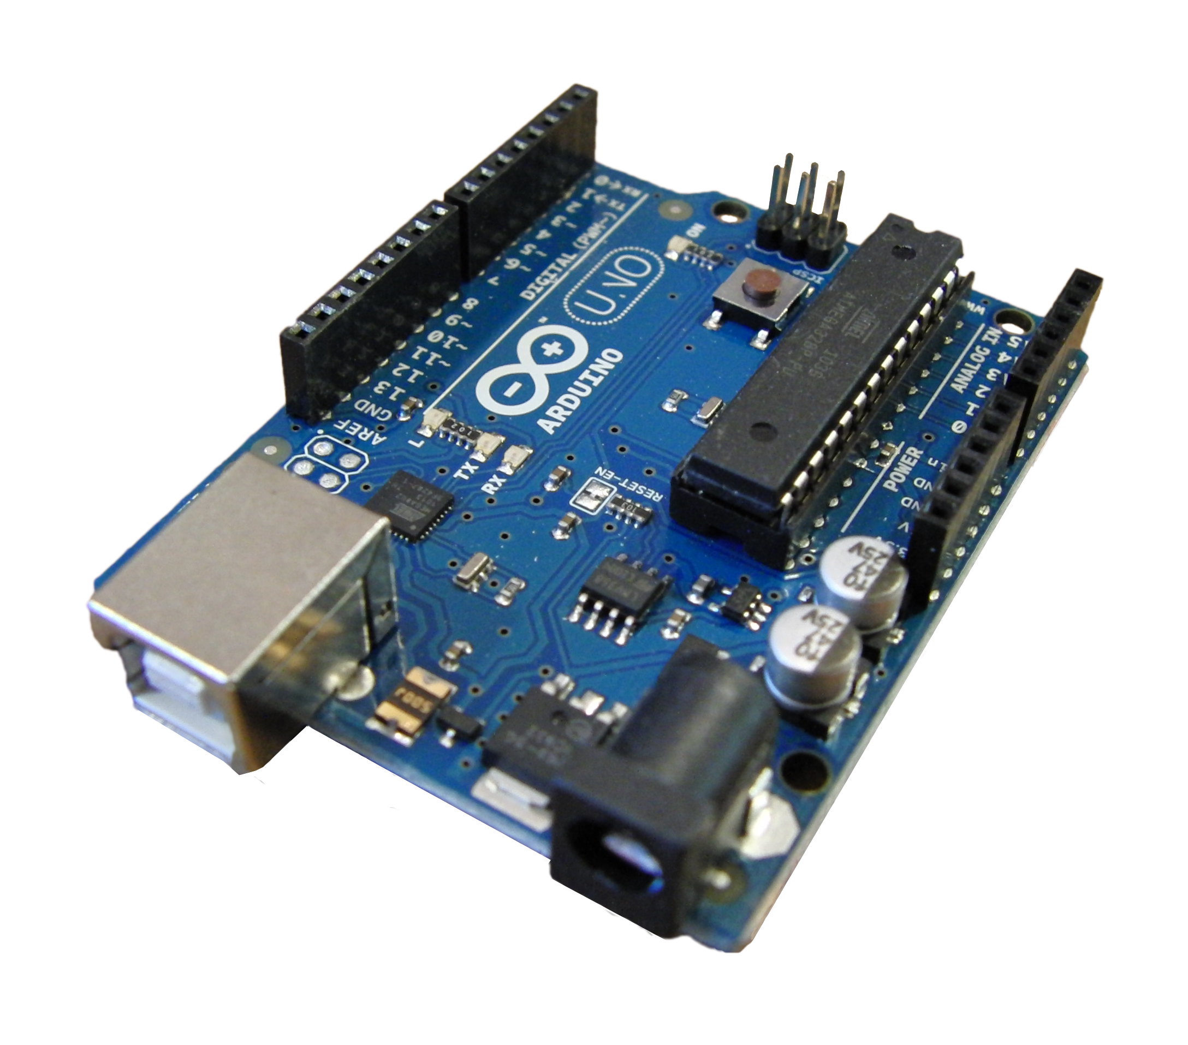
C++ on Arduino

Slide 12
Testing environment Arduino
void setup()
{
Serial.begin(9600);
if (/* */) {
Serial.println(“Test failed!”);
}
}

Slide 13
Red: write a test that fails
void setup() {
Serial.begin(9600);
if (!IsPrime(2)) {
Serial.println(
“Two must be prime”
);
}
}

Slide 14
Green: pass the test
bool IsPrime(const int x) {
return true;
}
void setup() {
Serial.begin(9600);
if (!IsPrime(2)) {
Serial.println(“Two must be prime”);
}
}

Slide 15
Refactor
Checking in
git add --all :/
git commit -m “IsPrime: 2 is prime”

Slide 16
Red: write a test that fails
void setup() {
/* Previous code */
if (IsPrime(4)) {
Serial.println(
“Four is not prime”
);
}
}

Slide 17
Green: pass the test
bool IsPrime(const int x) {
for (int i=2; i!=x; ++i)
{
if (x % i == 0) return false;
}
return true;
}
void setup() { /* */ }

Slide 18
Refactor
Check in
git add --all :/
git commit -m
“IsPrime: 4 is not prime”

Slide 19
Red: write a test that fails
void setup() {
/* Previous code */
if (IsPrime(1)) {
Serial.println(
“One is not prime”
);
}
}

Slide 20
Green: pass the test
bool IsPrime(const int x) {
if (x == 1) return false;
/* rest of the code */
}

Slide 21
Refactor
Check in
git add --all :/
git commit -m
“IsPrime: 1 is not prime”

Slide 22
Red: write a test that fails
void setup() {
/* Previous code */
if (IsPrime(0)) {
Serial.println(
“Zero is not prime”
);
}
}

Slide 23
Green: pass the test
bool IsPrime(const int x) {
if (x <= 1) return false;
/* rest of the code */
}

Slide 24
Refactor
Check in
git add --all :/
git commit -m
“IsPrime: zero and lower not prime”

Slide 25

C++ on a desktop PC

Slide 26
Testing environment desktop
#include <cassert>
int main()
{
assert(/* something */);
}

Slide 27
Red: write a test that fails
#include <cassert>
int main()
{
assert(IsPrime(2));
}

Slide 28
Green: pass the test
bool IsPrime(const int x) {
return true;
}
int main()
{
assert(IsPrime(2));
}

Slide 29
Refactor
Checking in
git add --all :/
git commit -m “IsPrime: 2 is prime”

Slide 30
Red: write a test that fails
int main()
{
/* Previous code */
assert(!IsPrime(4));
}

Slide 31
Green: pass the test
bool IsPrime(const int x) {
for (int i=2; i!=x; ++i)
{
if (x % i == 0) return false;
}
return true;
}
int main() { /* */ }

Slide 32
Refactor
Check in
git add --all :/
git commit -m
“IsPrime: 4 is not prime”

Slide 33
Red: write a test that fails
int main()
{
/* Previous code */
assert(!IsPrime(1));
}

Slide 34
Green: pass the test
bool IsPrime(const int x) {
if (x == 1) return false;
/* rest of the code */
}

Slide 35
Refactor
Check in
git add --all :/
git commit -m
“IsPrime: 1 is not prime”

Slide 36
Red: write a test that fails
int main()
{
/* Previous code */
assert(!IsPrime(0));
}

Slide 37
Green: pass the test
bool IsPrime(const int x) {
if (x <= 1) return false;
/* rest of the code */
}

Slide 38
Refactor
Check in
git add --all :/
git commit -m
“IsPrime: zero and lower not prime”

Slide 39

Run-time speed
“It is far, far easier to make a correct program fast than it is to make a fast program correct.” Herb Sutter
The speed of a function can be measured
The speed of a (possibly) improved function should be higher
The (possibly) improved function should return the same correct answers

Slide 40
Possible C++ end result
bool IsPrime(const int x) {
if (x <= 1) return false;
const int max = static_cast<int>(
sqrt(static_cast<double>(x))
) + 1
};
for (int i=2; i!=max; ++i) {
if (x % i == 0) return false;
}
return true;
}

Slide 41
Limitations on Arduino
You cannot test everything on Arduino:
  Is the text displayed on the LCD screen?
  Is the servo motor moving?
What you can test:
  What is the text I send to the LCD screen?
  What is the angle I send to the servo motor?
It is not doable to add sensors to test everything, as these sensors must also be tested

Slide 42
Limitations on desktop PC
Few

Slide 43
Conclusion
Test-driven development
  uses a systematic approach
  delivers testable code
  delivers code that has been tested to be correct
  does not test more than needed
  allows rapid development

