Slide 1
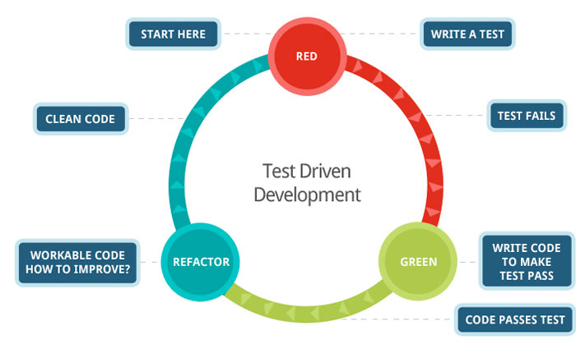

Test-driven development
Richèl Bilderbeek
http://github.com/richelbilderbeek/CppPresentations

Slide 2
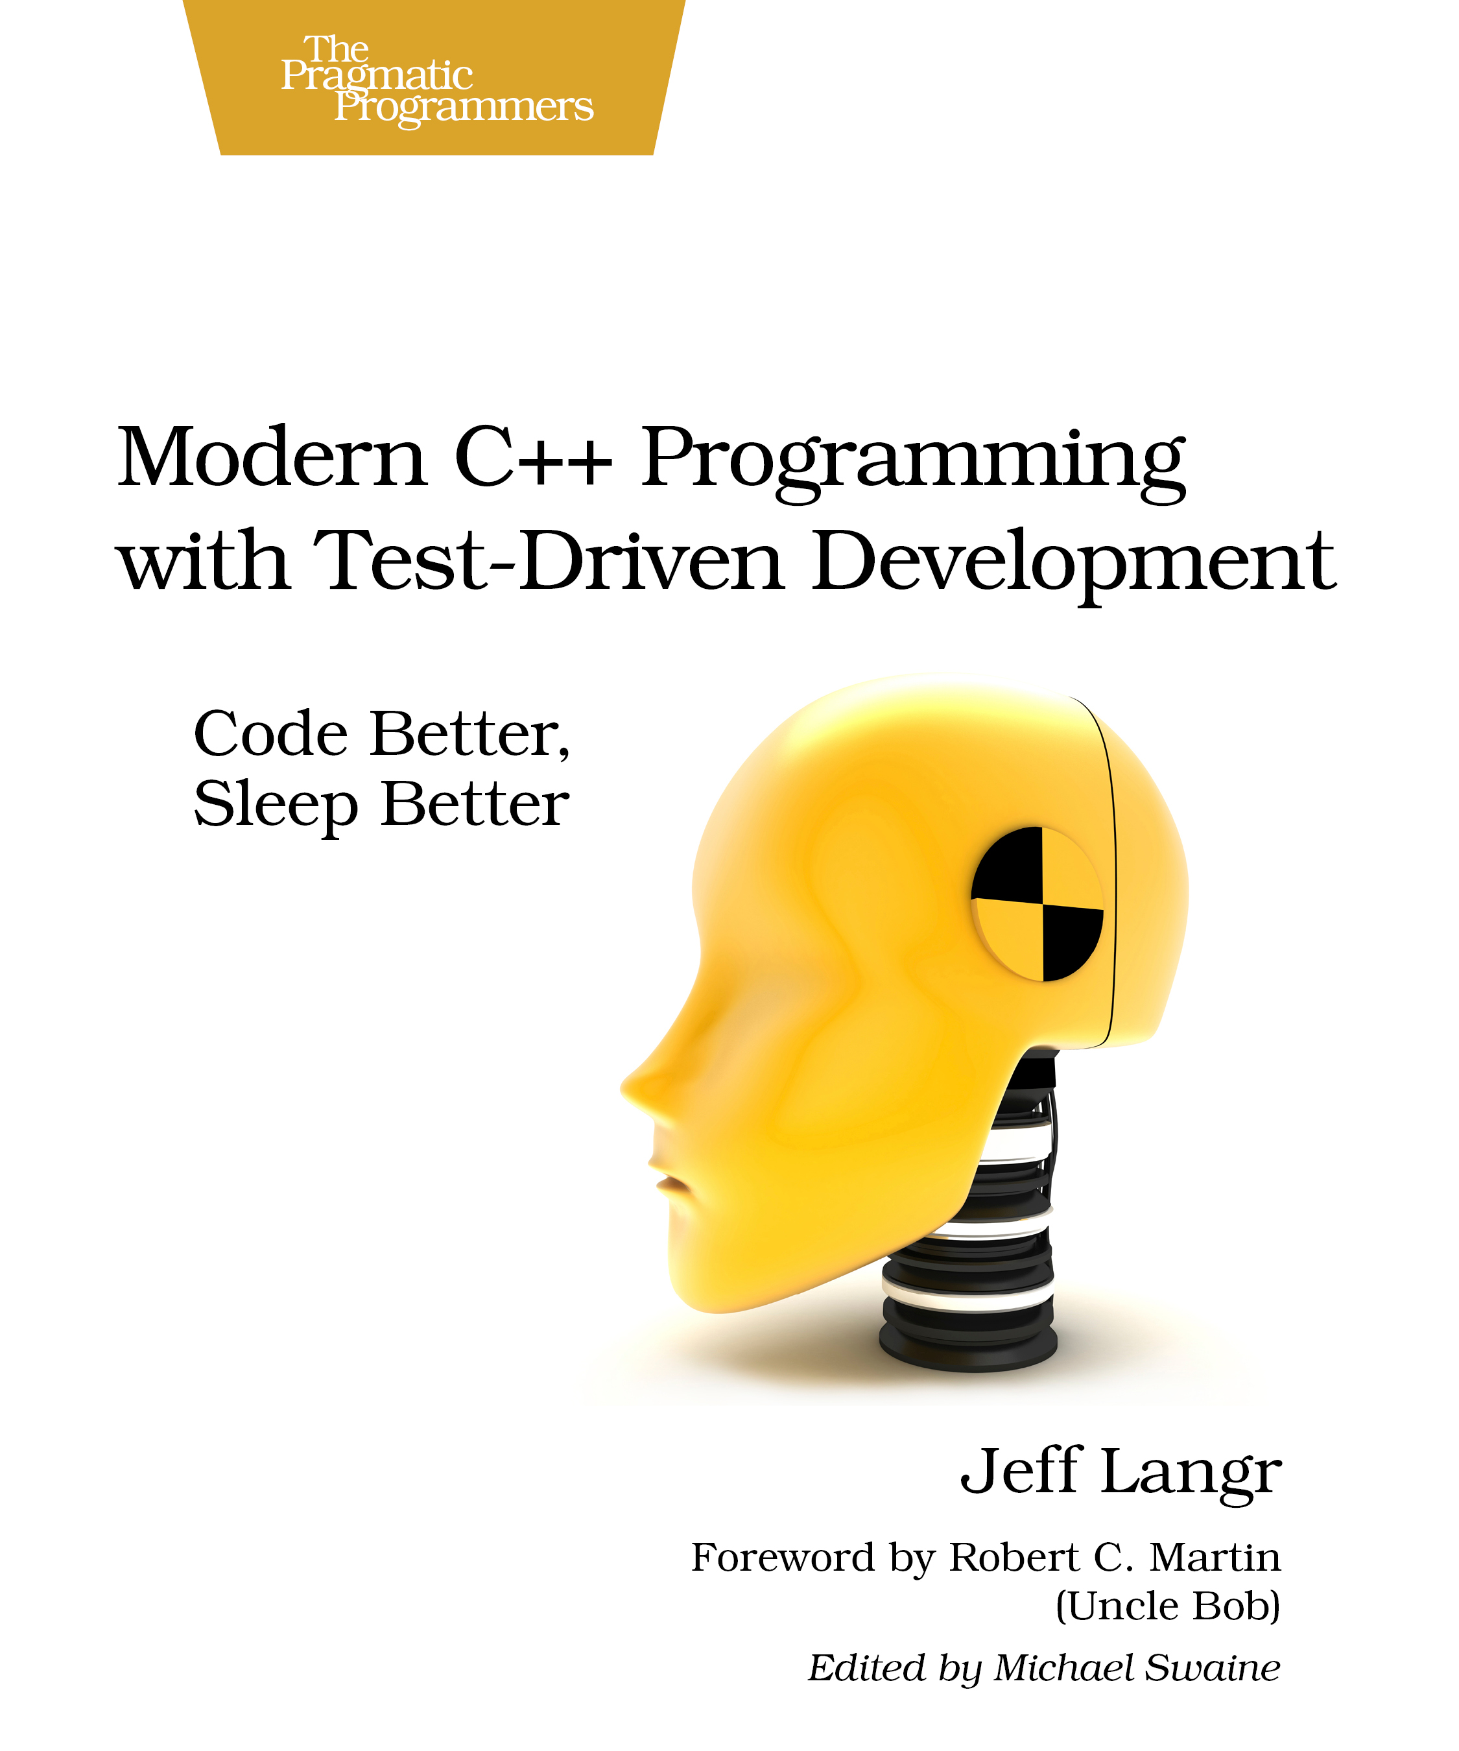
What is test-driven development?
Developing code with the right amounts of tests

Slide 3

Why tests?
Goal: code without bugs
Untested code easily develops an error
Code that cannot be tested has more errors

Slide 4
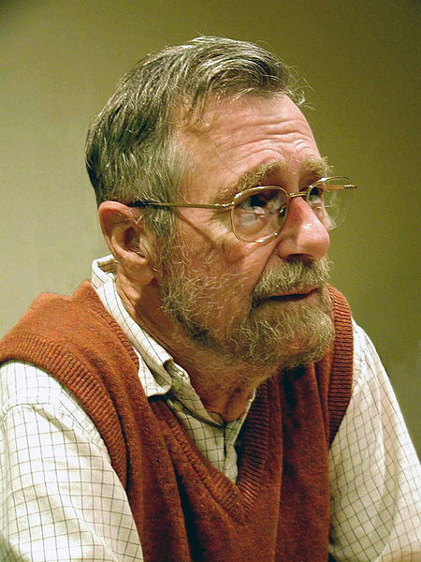
How much tests?
“Testing can be used to show the presence of errors, never their absence!” Edsger Dijkstra
Too few: many errors are not discovered
Too much: many correctnesses are checked multiple times
What is the balance?

Slide 5
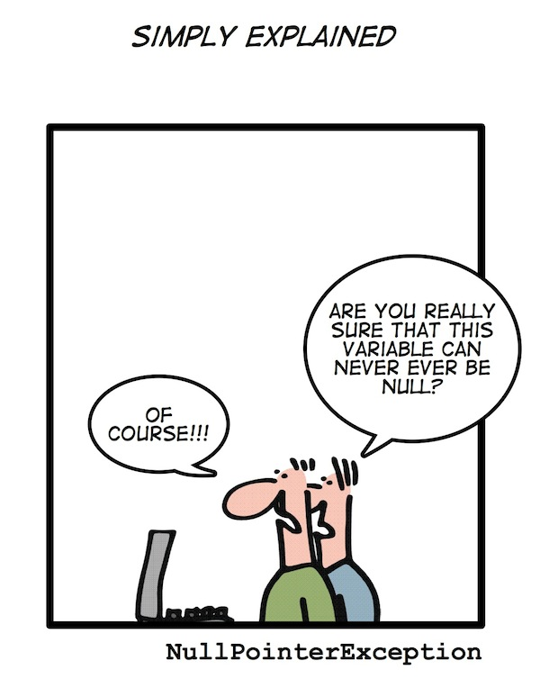
What is an error?
Logic error
  The programmer makes an incorrect reasoning
  Example: a division by zero
Runtime error
  Hardware encounters a limit
  Example: memory is full

Slide 6
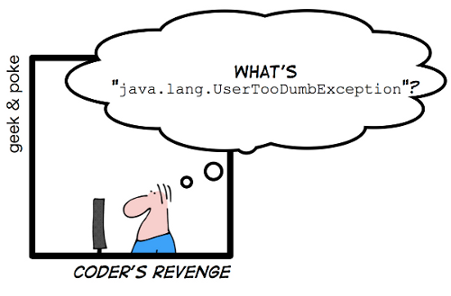
What is not an error?
The user gives incorrect/nonsense input
Example: a command that does not exist

Slide 7
Logic error
The programmer makes an incorrect reasoning
Example: a function that returns the wrong answer
Test:
  call the function with different arguments
  see if it returns the expected results

Slide 8


Example
bool IsPrime(const int x)
{
/* calculation */
/* return true or false */
}
IsPrime <- function(x)
{
# calculation
# return TRUE or FALSE
}

Slide 9
Developing IsPrime
Cycle test-driven development:
  Red: write a test that fails
  Green: pass the test
  Refactor: improve the new code, clean up mess, check in code

Slide 10

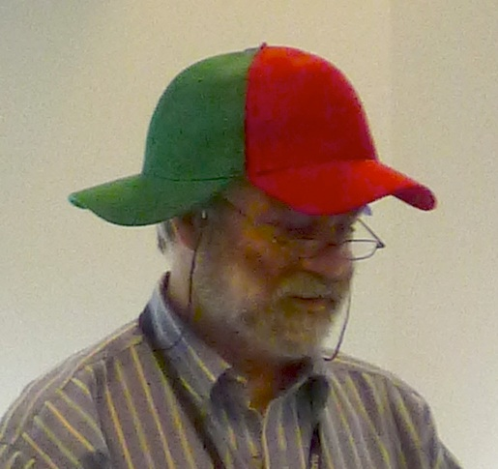
Development IsPrime
As small steps as possible
One step at a time

Slide 11
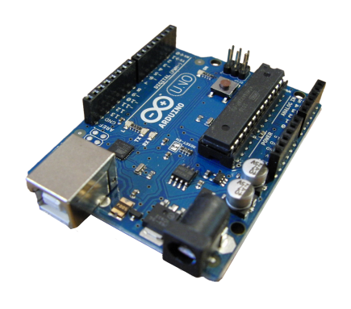
C++ on Arduino

Slide 12
Testing environment Arduino
void setup()
{
Serial.begin(9600);
if (/* */) {
Serial.println(“Test failed!”);
}
}

Slide 13
Red: write a test that fails
void setup() {
Serial.begin(9600);
if (!IsPrime(2)) {
Serial.println(
“Two must be prime”
);
}
}

Slide 14
Green: pass the test
bool IsPrime(const int x) {
return true;
}
void setup() {
Serial.begin(9600);
if (!IsPrime(2)) {
Serial.println(“Two must be prime”);
}
}

Slide 15

Refactor
Checking in
git add --all :/
git commit -m
“IsPrime: 2 is prime”

Slide 16
Red: write a test that fails
void setup() {
/* Previous code */
if (IsPrime(4)) {
Serial.println(
“Four is not prime”
);
}
}

Slide 17
Green: pass the test
bool IsPrime(const int x) {
for (int i=2; i!=x; ++i)
{
if (x % i == 0) return false;
}
return true;
}
void setup() { /* */ }

Slide 18
Refactor
Check in
git add --all :/
git commit -m
“IsPrime: 4 is not prime”

Slide 19
Red: write a test that fails
void setup() {
/* Previous code */
if (IsPrime(1)) {
Serial.println(
“One is not prime”
);
}
}

Slide 20
Green: pass the test
bool IsPrime(const int x) {
if (x == 1) return false;
/* rest of the code */
}

Slide 21
Refactor
Check in
git add --all :/
git commit -m
“IsPrime: 1 is not prime”

Slide 22
Red: write a test that fails
void setup() {
/* Previous code */
if (IsPrime(0)) {
Serial.println(
“Zero is not prime”
);
}
}

Slide 23
Green: pass the test
bool IsPrime(const int x) {
if (x <= 1) return false;
/* rest of the code */
}

Slide 24
Refactor
Check in
git add --all :/
git commit -m
“IsPrime: zero and lower not prime”

Slide 25
IsPrime end result
bool IsPrime(const int x) {
if (x <= 1) return false;
for (int i=2; i!=x; ++i)
{
if (x % i == 0) return false;
}
return true;
}

Slide 26
All IsPrime tests
void setup()
{
if (!IsPrime(2)) { /* ERROR */ }
if ( IsPrime(4)) { /* ERROR */ }
if ( IsPrime(1)) { /* ERROR */ }
if ( IsPrime(0)) { /* ERROR */ }
}

Slide 27

C++ on a desktop PC

Slide 28
Testing environment desktop
#include <cassert>
int main()
{
assert(/* something */);
}

Slide 29
Red: write a test that fails
#include <cassert>
int main()
{
assert(IsPrime(2));
}

Slide 30
Green: pass the test
bool IsPrime(const int x) {
return true;
}
int main()
{
assert(IsPrime(2));
}

Slide 31
Refactor
Checking in
git add --all :/
git commit -m
“IsPrime: 2 is prime”

Slide 32
Red: write a test that fails
int main()
{
/* Previous code */
assert(!IsPrime(4));
}

Slide 33
Green: pass the test
bool IsPrime(const int x) {
for (int i=2; i!=x; ++i)
{
if (x % i == 0) return false;
}
return true;
}
int main() { /* */ }

Slide 34
Refactor
Check in
git add --all :/
git commit -m
“IsPrime: 4 is not prime”

Slide 35
Red: write a test that fails
int main()
{
/* Previous code */
assert(!IsPrime(1));
}

Slide 36
Green: pass the test
bool IsPrime(const int x) {
if (x == 1) return false;
/* rest of the code */
}

Slide 37
Refactor
Check in
git add --all :/
git commit -m
“IsPrime: 1 is not prime”

Slide 38
Red: write a test that fails
int main()
{
/* Previous code */
assert(!IsPrime(0));
}

Slide 39
Green: pass the test
bool IsPrime(const int x) {
if (x <= 1) return false;
/* rest of the code */
}

Slide 40
Refactor
Check in
git add --all :/
git commit -m
“IsPrime: zero and lower not prime”

Slide 41
IsPrime end result
bool IsPrime(const int x) {
if (x <= 1) return false;
for (int i=2; i!=x; ++i)
{
if (x % i == 0) return false;
}
return true;
}

Slide 42
All IsPrime tests
int main()
{
assert( IsPrime(2));
assert(!IsPrime(4));
assert(!IsPrime(1));
assert(!IsPrime(0));
}

Slide 43
R on a desktop PC

Slide 44
Testing environment desktop
library(testit)
assert(/* something */)

Slide 45
Red: write a test that fails
library(testit)
assert(IsPrime(2))

Slide 46
Green: pass the test
library(testit)
IsPrime <- function(x)
{
return (TRUE)
}
assert(IsPrime(2))

Slide 47
Refactor
Checking in
git add --all :/
git commit -m
“IsPrime: 2 is prime”

Slide 48
Red: write a test that fails
/* Previous code */
assert(!IsPrime(4))

Slide 49
Green: pass the test
IsPrime <- function(x)
{
if (x == 2) return (TRUE)
for (i in seq(2,x-1))
{
if (x %% i == 0) return (FALSE);
}
return (TRUE)
}

Slide 50
Refactor
Check in
git add --all :/
git commit -m
“IsPrime: 4 is not prime”

Slide 51
Red: write a test that fails
assert(!IsPrime(“Two”))

Slide 52
Green: pass the test
is_integer <- function(N){
!grepl(
"[^[:digit:]]",
format(N, digits = 20, scientific = FALSE)
)
}
IsPrime <- function(x)
{
if (!is_integer(x)) return (FALSE)
# Rest of code
}

Slide 53
Refactor
Check in
git add --all :/
git commit -m
“IsPrime: words are not prime”

Slide 54
IsPrime end result
library(testit)
is_integer <- function(N) {
!grepl("[^[:digit:]]", format(N, digits = 20, scientific = FALSE))
}
IsPrime <- function(x)
{
if (!is_integer(x)) return (FALSE)
if (x == 2) return (TRUE)
for (i in seq(2,x-1))
{
if (x %% i == 0) return (FALSE);
}
return (TRUE)
}

Slide 55
All IsPrime tests
assert(IsPrime(2))
assert(!IsPrime(4))
assert(!IsPrime(“Two”))

Slide 56
Final remarks
Run-time speed
Collaboration
Limitation

Slide 57

Run-time speed
It is far, far easier
to make a correct program fast
than it is
to make a fast program correct.
You can test if your new function is faster and gives the same correct results
Herb Sutter, C++ expert

Slide 58

Collaboration
Tests can be used as a mean to let others contribute
Example:
  I implemented a Wilcoxon's signed rank test, especially a function to get the rank of each value, following Heath
  Later, Senbong G contacted me and helped us fix my function
In this example, syntax is not important

Slide 59
C++ tests
values = { 10.0, 20.0, 30.0 };
expected = { 1.0, 2.0, 3.0 };
results = GetRanks(values);
assert(AreAboutEqual(expected,results));
values = { 30.0, 10.0, 20.0 };
expected = { 3.0, 1.0, 2.0 };
results = GetRanks(values);
assert(AreAboutEqual(expected,results));

Slide 60
C++ tests
//From Heath, page 263
values = { 0.6, 1.4, 4.0, 13.0, 14.5, 9.4, 11.4, 12.6, 4.0 };
expected = { 1.0, 2.0, 3.5, 8.0, 9.0, 5.0, 6.0, 7.0, 3.5 };
results = GetRanks(values);
// Heath, page 263, no zero value
assert(AreAboutEqual(expected,results));
//From Heath, page 263, now with zero added
values = { 0.6, 1.4, 0.0, 4.0, 13.0, 14.5, 9.4, 11.4, 12.6, 4.0 };
expected = { 1.0, 2.0, 0.0, 3.5, 8.0, 9.0, 5.0, 6.0, 7.0, 3.5 };
results = GetRanks(values);
// Heath, page 263, with zero value
assert(AreAboutEqual(expected,results));

Slide 61
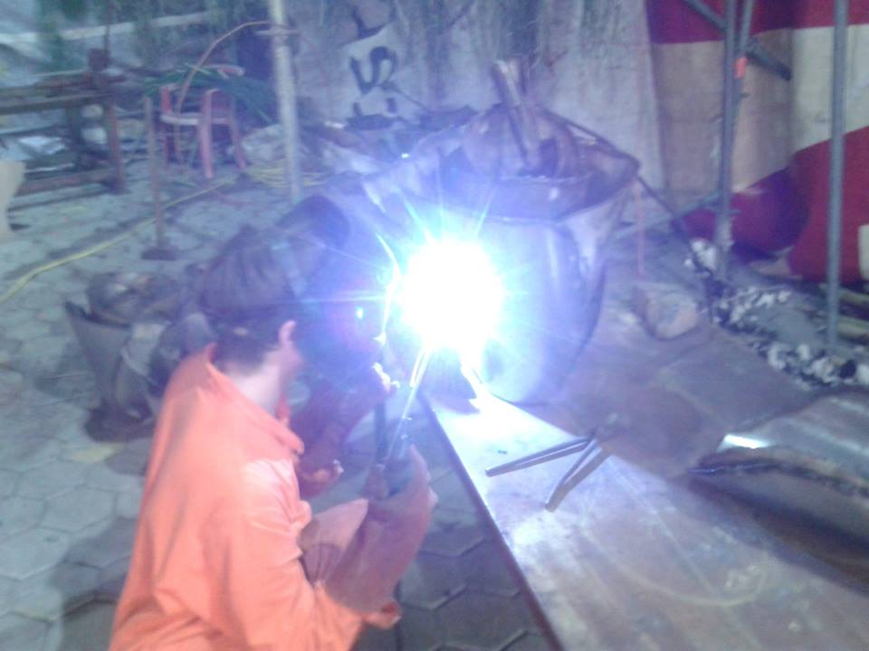

Email from Senbong G
I think I found a bug
How can that be?
Can you convince me with a test?
Sure, the tests on the
next slide all fail
Richel Bilderbeek
Senbong G

Slide 62
C++ tests
values = { 1.0, 1.0, 1.0, 2.0, 2.0, 3.0, 3.0, 3.0};
expected = { 2.0, 2.0, 2.0, 4.5, 4.5, 7.0, 7.0, 7.0};
results = GetRanks(values);
assert(AreAboutEqual(expected,results));
values = { 0.0, 0.0, 0.0 };
expected = { 0.0, 0.0, 0.0 };
results = GetRanks(values);
assert(AreAboutEqual(expected,results));

Slide 63
Email from Senbong G
Blimey, you're right!
I'll fix it within a week
No need to,
I already did,
here is the code
Thanks!
Richel Bilderbeek
Senbong G

Slide 64
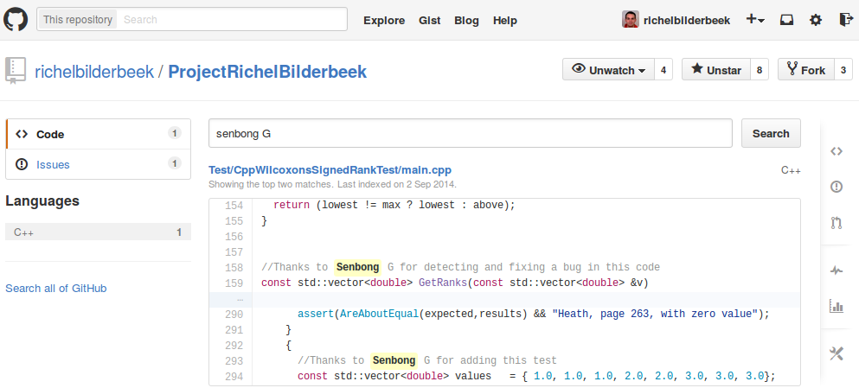
Eternal glory

Slide 65
Limitations on Arduino
You cannot test everything on Arduino:
  Is the text displayed on the LCD screen?
  Is the servo motor moving?
What you can test:
  What is the text I send to the LCD screen?
  What is the angle I send to the servo motor?
It is not doable to add sensors to test everything, as these sensors must also be tested

Slide 66
Limitations C++ on desktop PC
Few
So it is too easy to make brute force tests, just to be sure
Solution:
  Limit tests to 100 msec per class

Slide 67
Limitations R on desktop PC
R does not have a debug and release mode
Tests is functions will also slow down your released code!
Solution:
  Write no tests in function
  Put tests in separate files
  You will need more tests thanks to this

Slide 68
Conclusion
Test-driven development
  uses a systematic approach
  delivers testable code
  delivers code that has been tested to be correct
  does not test more than needed
  facilitates collaboration

Slide 69
Can be downloaded at:
http://github.com/
richelbilderbeek/
CppPresentations

