Slide 1



Introduction to Travis CI
with git and GitHub
with a focus on testing
© 2015-2017 Richel Bilderbeek
www.github.com/richelbilderbeek/CppPresentations

Slide 2

Continuous worries
Did I break something?
Can others repeat what I did?
Can I do this smarter?
Mr Worry by Roger Hargreaves

Slide 3
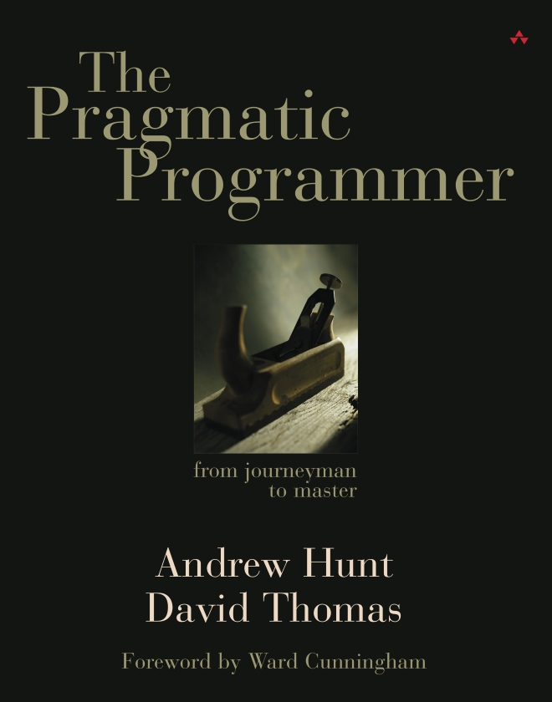

The literature on testing
Test Your Software,
or Your Users Will
Automate the running
of your tests through
a makefile or similar tool

Slide 4
What?
What: Travis CI is a continuous integration service
Why: Because tests should be automated
Expert use: Configure Travis CI to test as much as possible

Slide 5
Overview
Activate Travis
Configure Travis file
Push to GitHub

Slide 6
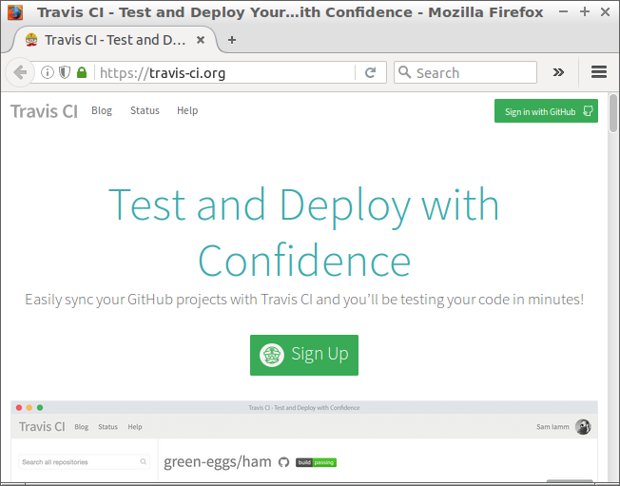
Activate Travis
Go to https://travis-ci.org
Notes:
After having signed on GitHub, click 'Sign in with GitHub'

Slide 7
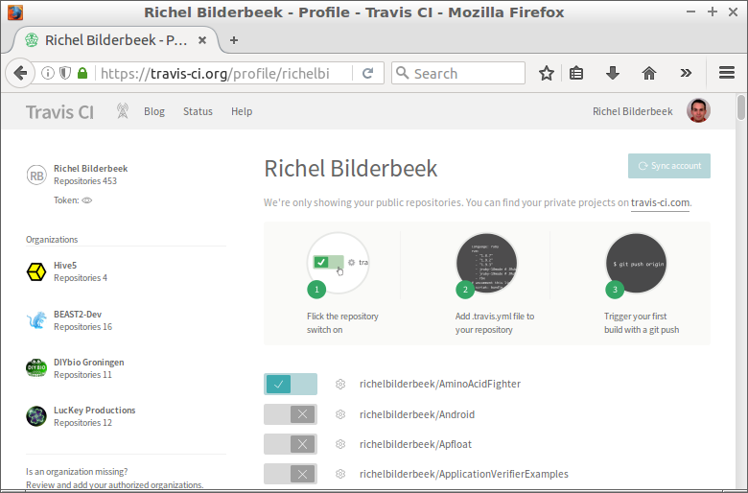
Activate accounts
Notes:
Activate your GitHubs here

Slide 8
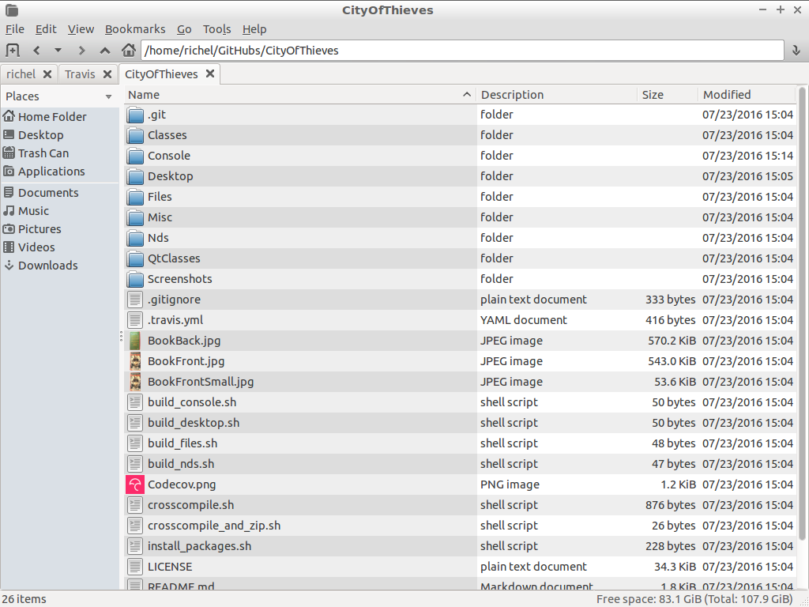
Configure Travis files
Notes:
Travis configuration file is called '.travis.yml' (yes, the filename starts with a dot)

Slide 9
.travis.yml
'Yet another Markup Language'
Just use the bash scripts you would use

Slide 10
Example .travis.yml
script:
- echo "Hello"
- ls

Slide 11
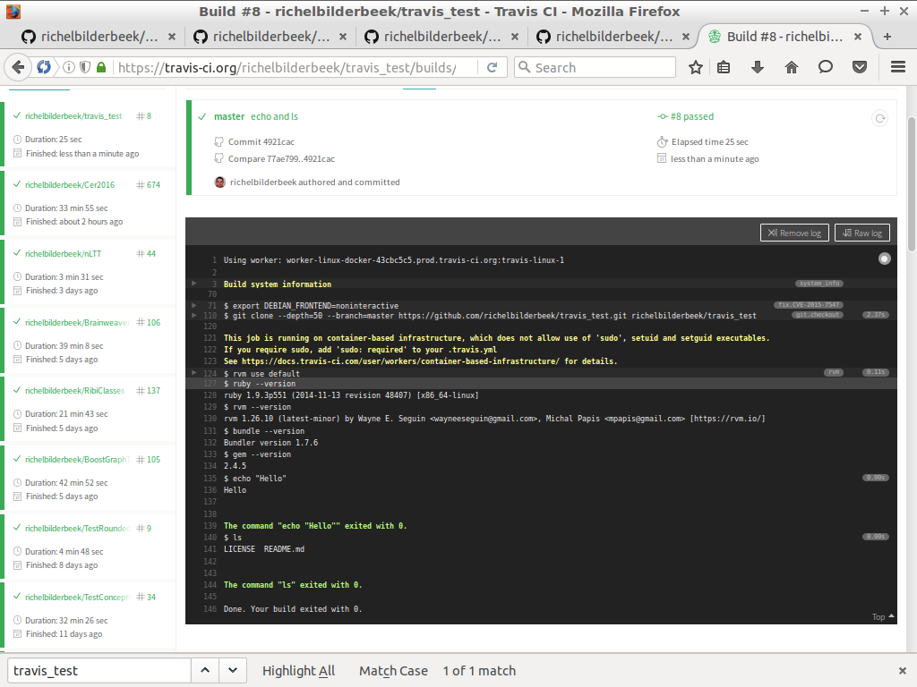
Result

Slide 12
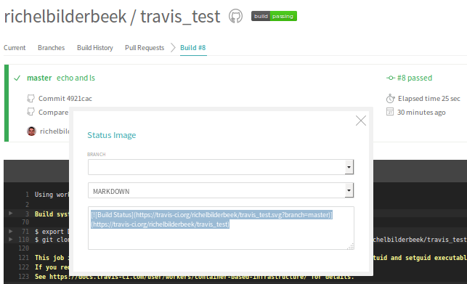
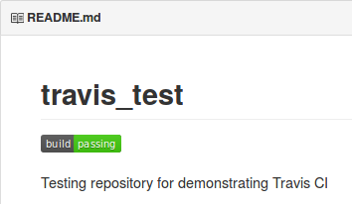
Badge

Slide 13
How to get a more complex .travis.yml file
Go to
  https://github.com
  /richelbilderbeek
  /travis_cpp_tutorial
Copy the best fitting Travis configuration file

Slide 14

SFML example
C++
Simple and Fast Media Library
Test if the code build successfully

Slide 15
Example .travis.yml
^{language: cpp}
^{compiler: gcc}
^{sudo: true}
^{before_install:}
- sudo apt-add-repository ppa:sonkun/sfml-development --yes
^{- sudo apt-get update -qq}
^{install:}
- sudo apt-get install libsfml-dev
^{script:}
^{- qmake}
^{- make}

Slide 16

R example
Building a package
Running a lot of tests

Slide 17
Example .travis.yml
^{language: r}
^{cache: packages}
^{after_success:}
- Rscript -e 'lintr::lint_package()'
^{- Rscript -e 'covr::codecov()'}
- Rscript -e 'goodpractice::gp()'

Slide 18
Conclusion
Travis CI can be used to
  Reproduce a build process
  Improve code quality
  Education

