Slide 1



Boost.Test
© 2016 Richel Bilderbeek
www.github.com/richelbilderbeek/CppPresentations

Slide 2
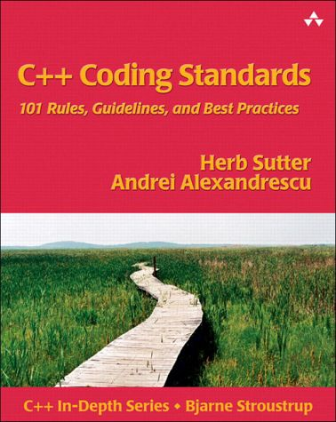
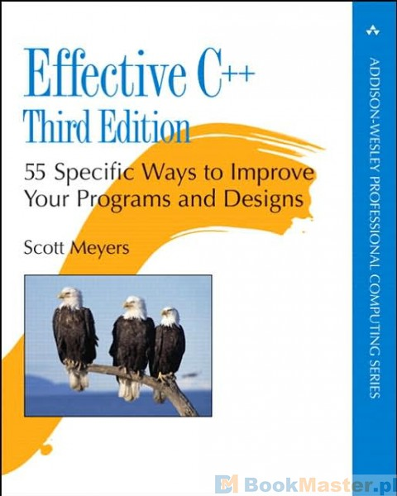

About Boost
...one of the most highly regarded
and expertly designed C++ library projects
in the world.
Item 55:
Familiarize yourself with Boost
The obvious solution for most
programmers is to use a library
that provides an elegant and efficient
platform independent to needed
services. Examples are Boost… [1]
[1] Bjarne Stroustrup, Abstraction, libraries, and efficiency in C++

Slide 3
Boost.Test
What: a testing framework
Why:
  measure that your code is correct
  improve your software architecture
  use an expertly designed testing framework
Mastery:
  write tests with high code coverage run by a continuous integration service
  use other testing frameworks when those fit better, e.g. Qtest when using Qt

Slide 4
This presentation
First example: ‘add’
Testing for exceptions: ‘divide’
Add Travis CI

Slide 5
First example
Function ‘add’ that adds two integers
‘add’ is used in a main
‘add’ is tested by Boost.Test

Slide 6
Setup
adder.pro
adder_test.pro
my_functions.h
my_functions_test.cpp
my_functions.cpp
main.cpp
main_test.cpp

Slide 7
main.cpp
#include "my_functions.h"
#include <iostream>
int main()
{
std::cout << add(40, 2) << '\n';
}

Slide 8
my_functions.h
#ifndef MY_FUNCTIONS_H
#define MY_FUNCTIONS_H
int add(const int i, const int j);
#endif // MY_FUNCTIONS_H

Slide 9
my_functions.cpp
#include "my_functions.h"
int add(const int i, const int j)
{
return i + j;
}

Slide 10
main_test.cpp
#define BOOST_TEST_DYN_LINK
#define BOOST_TEST_MODULE my_functions_test_module
#include <boost/test/unit_test.hpp>
//No main needed, BOOST_TEST_DYN_LINK creates it

Slide 11
my_functions_test.cpp
#include <boost/test/unit_test.hpp>
#include "my_functions.h"
BOOST_AUTO_TEST_CASE(add_works)
{
BOOST_CHECK(add(1, 1) == 2);
BOOST_CHECK(add(1, 2) == 3);
BOOST_CHECK(add(1, 3) == 4);
BOOST_CHECK(add(1, 4) == 5);
}

Slide 12
Output
Running 1 test case...
*** No errors detected

Slide 13
Testing for exceptions
#include <stdexcept>
double divide(const double n, const double d)
{
if (d == 0.0)
{
throw std::invalid_argument(
"divide: denominator cannot be zero"
);
}
return n / d;
}

Slide 14
Testing for exceptions
BOOST_AUTO_TEST_CASE(divide_use)
{
{
const double measured = divide(1.0, 1.0);
const double expected = 1.0;
const double error = std::abs(measured - expected);
const double tolerance = 0.01;
BOOST_CHECK(error < tolerance);
}
{
const double measured = divide(1.0, 2.0);
const double expected = 0.5;
const double error = std::abs(measured - expected);
const double tolerance = 0.01;
BOOST_CHECK(error < tolerance);
}
}

Slide 15
Testing for exceptions
BOOST_AUTO_TEST_CASE(divide_abuse) {
try {
divide(0.0, 0.0);
BOOST_CHECK(!"Should not get here");
}
catch (std::invalid_argument& e) {
const std::string expected
= "divide: denominator cannot be zero";
BOOST_CHECK(e.what() == expected);
}
}

Slide 16


Add Travis CI
Will do whatever you want after a ‘git push’
Plays well with GitHub
Free for FOSS
Automate the running
of your tests through
a makefile or similar tool

Slide 17
.travis.yml
sudo: true
language: cpp
compiler: gcc
addons:
apt:
packages: libboost-all-dev
script:
- ./build.sh
- ./build_test.sh

Slide 18
build.sh
#!/bin/bash
qmake adder.pro
make
./adder

Slide 19
build_test.sh
#!/bin/bash
qmake adder_test.pro
make
./adder_test

Slide 20
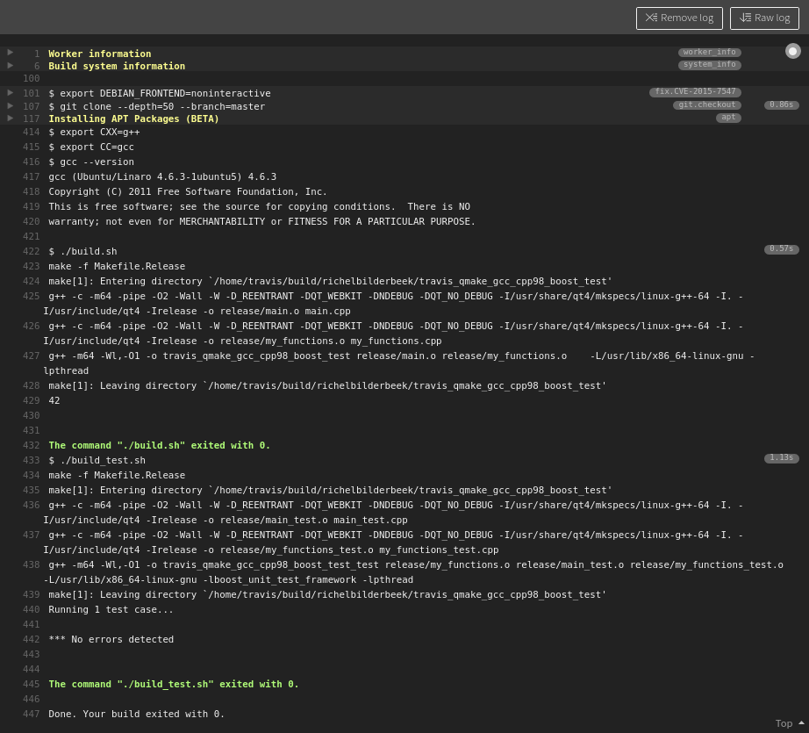

Slide 21
Conclusion
Boost.Test is a testing framework, that
  Makes it easy to add new tests
  Makes it hard to forget adding tests
  Has cumbersome exception testing
  Can easily be used by Travis CI

