Slide 1


Git_instead_of_31_rev_41_final_5.txt
Introduction to version control
with git and GitHub
© 2015-2016 Richel Bilderbeek
www.github.com/richelbilderbeek/CppPresentations

Slide 2
What?
git and GitHub allow you to do version control on your files on multiple computers (connected to the internet)

Slide 3


Why?
Tip 23: Always Use
Source Code Control
Chapter 3.
Use a version control system

Slide 4
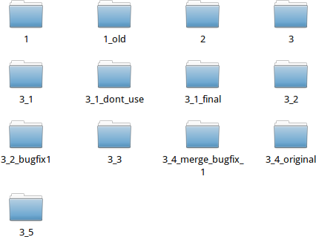
Why?
Because this feels stupid
Notes:
1
1_old
2
3
3_1
3_1_dont_use
3_1_final
3_2
3_2_bugfix_1
3_3
3_4_original
3_4_merge_bugfix_1
3_5

Slide 5
An expert git and GitHub user...
does version control in a smart way
has no/less loss of data
is easy to collaborate with
prefers plain-text files over binary files

Slide 6

git and GitHub
git is a program program to do version control on your local computer
GitHub is a website to host your git repository

Slide 7

Why git?
Free (as in freedom) and open source
Emphasis on speed and data integrity
Widely used
Alternatives: mercurial, SVN, etc.

Slide 8





Why GitHub?
Free (as in beer) for open source development
Promotes collaboration
Most used: 9M users, 21M repositories
Alternatives: BitBucket, GNU Savannah, Google Code, SourceForge, etc.
Linus
Torvalds
Bjarne
Stroustrup
Herb
Sutter
Sean
Parent
Andrei
Alexandrescu

Slide 9
Main workflow
push
clone
pull
Local files
Staged
files
Committed
files
add
commit

Slide 10
Main workflow
Update newest code
git pull
Change code
Stage and commit the change
git add –-all :/
git commit -m 'Fixed bug'
Upload code
git push

Slide 11
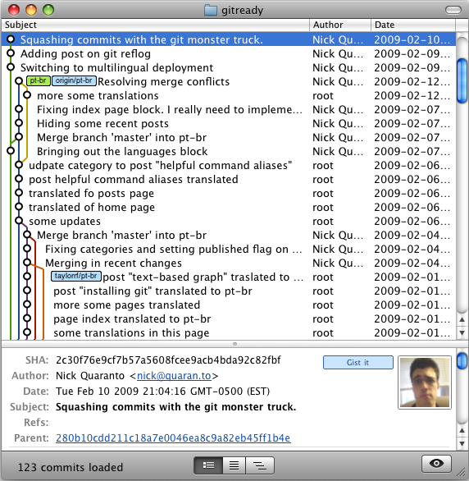
Command line?
There are also free graphical versions for all platforms
Also GitHub has a graphical interface

Slide 12
Demos
Online collaboration
Undo incorrect commit
Fixing merge conflicts

Slide 13
Demo: collaboration
1
plans.txt
B will add text, commit and push
A will pull
A will add text, commit and push
View the online history
1
plans.txt
1
2
plans.txt
A
B

Slide 14
Demo: collaboration
git pull
echo '1' > plans.txt
git add --all :/
git commit -m 'Set 1'
git push
git pull
echo '2' >> plans.txt
git add --all :/
git commit -m 'Added 2'
git push
View history

Slide 15
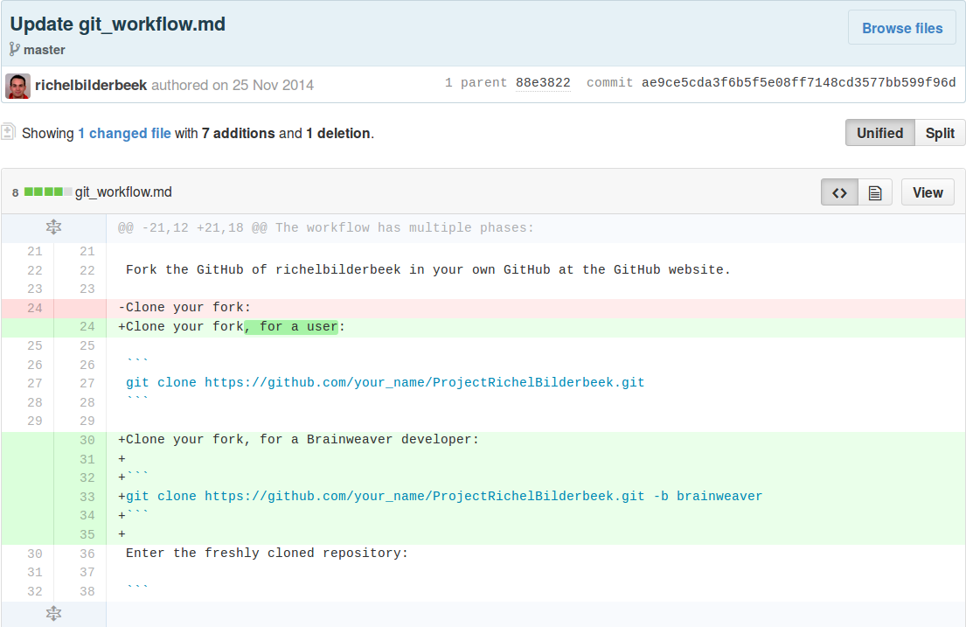
View history

Slide 16
Demo: undo error
1
2
plans.txt
B will delete everything
B will commit and push this
A will go back one commit
A will push this
1
2
plans.txt
1
2
plans.txt

Slide 17
Demo: undo error
File deleted
by accident
git pull
rm plans.txt
git add --all :/
git commit -m 'Removed errors'
git push

Slide 18
Demo: undo error
!
git pull
git checkout HEAD~1 .
git add --all :/
git commit -m 'Added files again'
git push

Slide 19
Demo: merge conflict
© B&A
© A&B
B will modify a file
B will commit and push this
A will modify the same file
A will commit and push this, this will fail!
A will resolve the merge conflict
A will commit and push this
plans.txt
plans.txt
Merge
conflict
© CFR
plans.txt

Slide 20
Demo: merge conflict
git pull
echo '(C) B & A' > plans.txt
git add --all :/
git commit -m 'Added copyright'
git push
No 'git pull'
echo '(C) A & B' > plans.txt
git add --all :/
git commit -m 'Added copyright'
git push

Slide 21
Demo: merge conflict
git pull
echo '(C) Team CFR' > plans.txt
git add --all :/
git commit -m 'Fixed merge conflicts'
git push

Slide 22
Creating a new repository
Create online repository is easy
  Name
  Open/private
  License
Clone repository to local harddisc

Slide 23
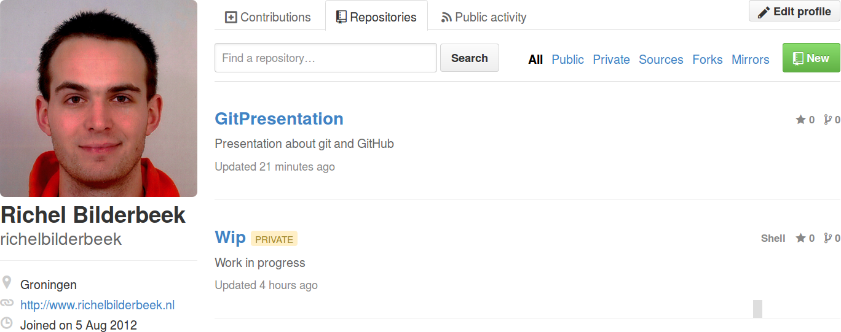
Create online repository

Slide 24
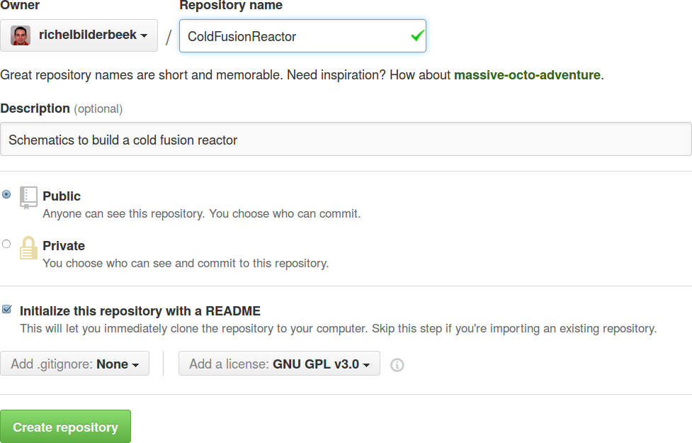
Create online repository

Slide 25
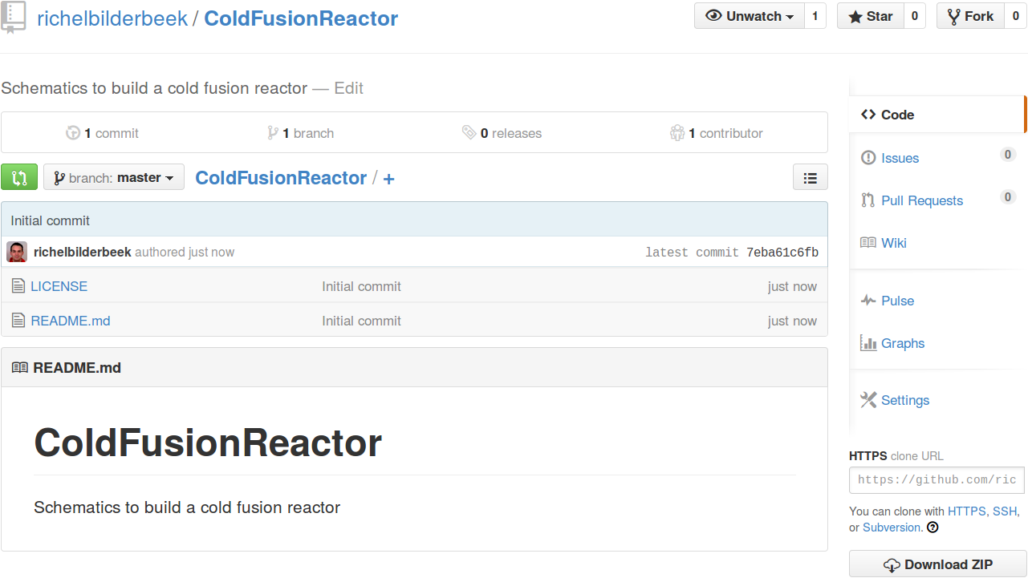
Create online repository

Slide 26
Create repository
Clone repository to harddisc
git clone
https://github.com
/richelbilderbeek
/ColdFusionReactor

Slide 27
More GitHub options
Keep track of issues
  Bug reports
  Feature requests
  Notes to self
Wiki
Webpage
Collaborate with other projects

Slide 28
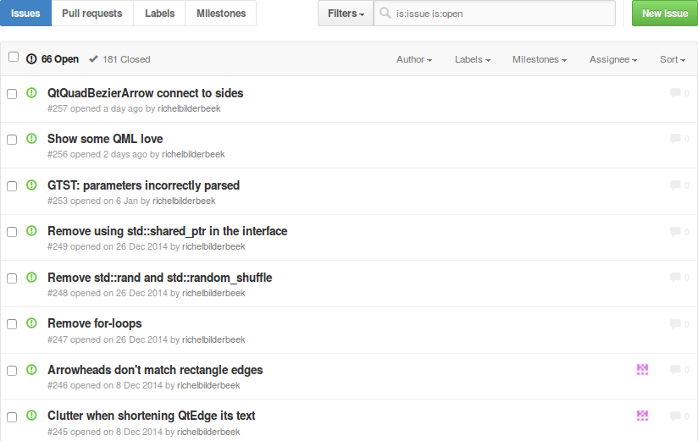
Add issue

Slide 29
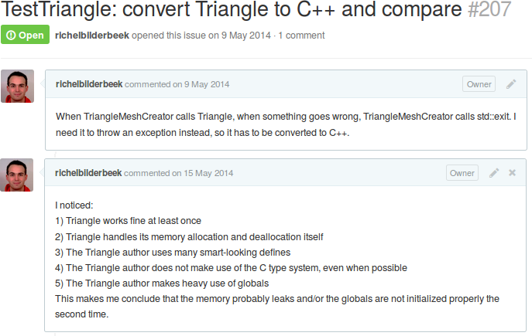
Comment on issue

Slide 30
Collaboration
As collaborator:
  Push files to shared repository
  Incorrect changes can be undone
As outsider:
  Fork main repository
  Commit your changes
  Issue a pull request
  Pull requests can be rejected

Slide 31
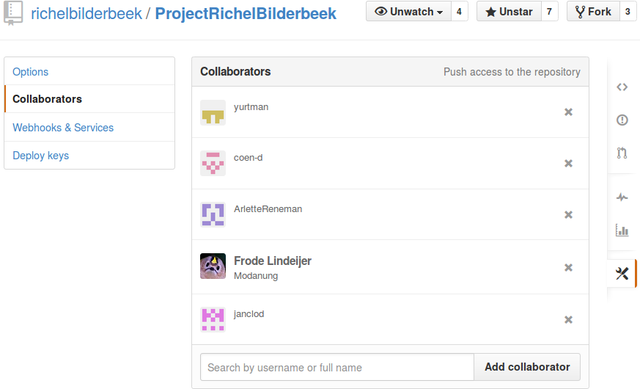
Collaborators

Slide 32
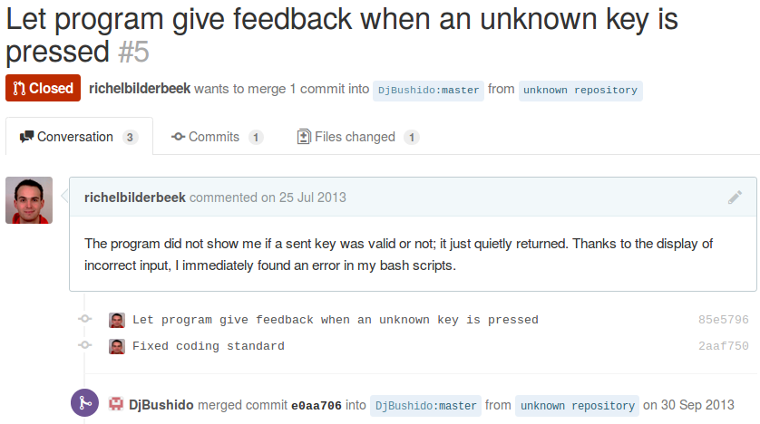
Pull request

Slide 33
Why version control?
 Version your data
 View history of data
 Prevent loss of data
 Improve collaboration

Slide 34
Conclusions
git and GitHub are one of many tools for a version control system
Both tools are easy to get started
  You never lose data
  Command-line and GUI tools
  Big communities to ask questions
  Book: https://github.com/progit/progit

Slide 35
Questions?
Notes:
From http://xkcd.com/1296

