Slide 1



Introduction to Travis CI
with git and GitHub
with a focus on developing a software pipeline
© 2015-2017 Richel Bilderbeek
www.github.com/richelbilderbeek/CppPresentations

Slide 2


Continuous worries
I saw your GitHub Issue
and I’ve submitted a Pull Request
with a fix.
haxxorsid
Mr Worry by Roger Hargreaves

Slide 3

Continuous worries
I cannot get your code to run.
I think it is broken.
Please help!
N00bG1rl
Mr Worry by Roger Hargreaves

Slide 4



Continuous worries
Can I do it more efficient?
Do I really
need to do this
every time?
Mr Rush,
by Roger Hargreaves
Yes, I should
Mr Perfect,
by Roger Hargreaves
Mr Lazy,
by Roger Hargreaves

Slide 5
Continuous solution
I can do all bash commands you like
every time you push
Test if nothing breaks
Test if pipeline works
Gather diagnostics
Other goodies

Slide 6
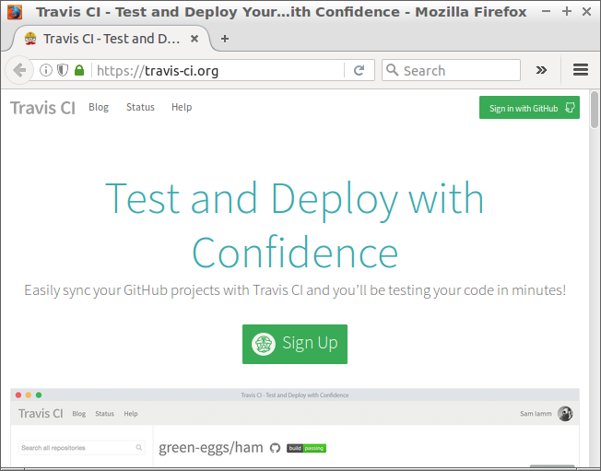
Activate Travis
Go to https://travis-ci.org
Notes:
After having signed on GitHub, click 'Sign in with GitHub'

Slide 7
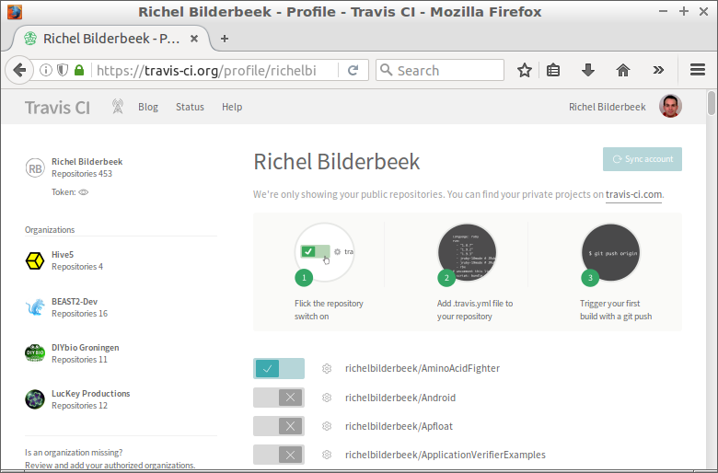
Activate accounts
Notes:
Activate your GitHubs here

Slide 8
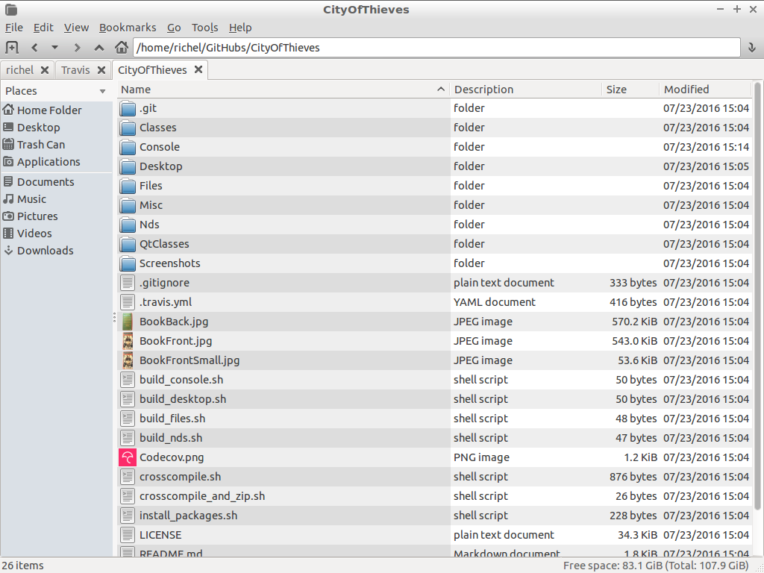
Configure Travis files
Notes:
Travis configuration file is called '.travis.yml' (yes, the filename starts with a dot)

Slide 9
.travis.yml
'Yet another Markup Language'
Just use the bash scripts you would use in the ‘script’ section

Slide 10
Example .travis.yml
script:
- echo "Hello"
- ls

Slide 11
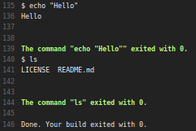
Result

Slide 12
How to get a more complex .travis.yml file
Go to
  https://github.com
  /richelbilderbeek
  /travis_cpp_tutorial
Copy the best fitting Travis configuration file

Slide 13
More examples
proselint
cowsay
convert
pipeline example 1: convert image to cowfile

Slide 14

proselint
Python tool that tests prose for style errors
Put prose in file called ‘my_prose.md’
From https://github.com/richelbilderbeek/travis_proselint
Notes:
From https://upload.wikimedia.org/wikipedia/en/2/22/Elements_of_Style_cover.jpg

Slide 15
my_prose.md
I do not want this poem to go too deep. It's premature, and love's too far away. But there are things I feel the need to say rather than more days of silence keep. I hope for you it's not too great a leap to hear me talking to you in this way. My fears sometimes my sentiments betray, telling me to put my thoughts to sleep. Ever since we met I've thought of you as something more than just a passing friend. You seem so lovely, like a melody that haunts me with the wisp of something true. You haunt me still, and so I won't pretend: I tell you this that you might think of me.
From https://www.poemsforfree.com/idono2.html

Slide 16
.travis.yml
^{sudo: require}
^{install:}
^{- sudo pip install proselint}
^{script:}
^{- proselint my_prose.md}

Slide 17
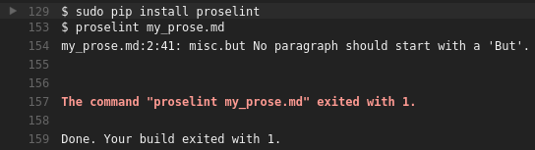
Result

Slide 18
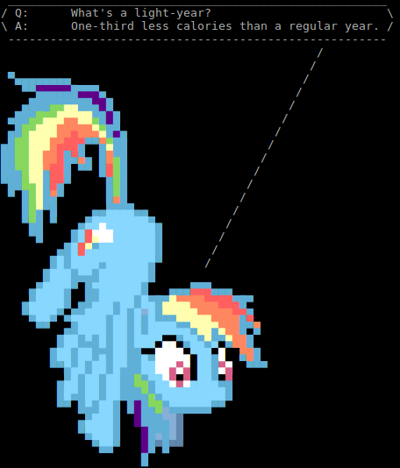
cowsay
Command-line tool to let a cow (or other ASCII art) say someting
From https://github.com/richelbilderbeek/travis_cowsay
fortune | ponysay

Slide 19
.travis.yml
^{sudo: require}
^{install:}
^{- sudo apt-get install cowsay}
- export PATH=/usr/bin:/bin:/usr/games
^{script:}
- cowsay "Howdy" | cowsay -n -f stegosaurus

Slide 20
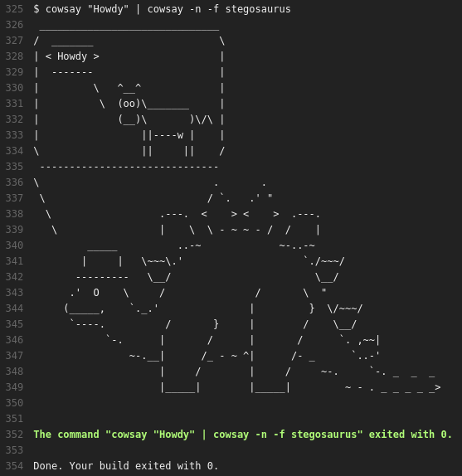
Result

Slide 21
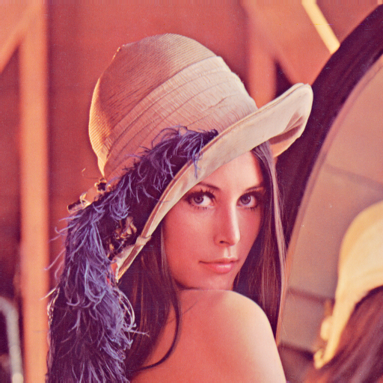
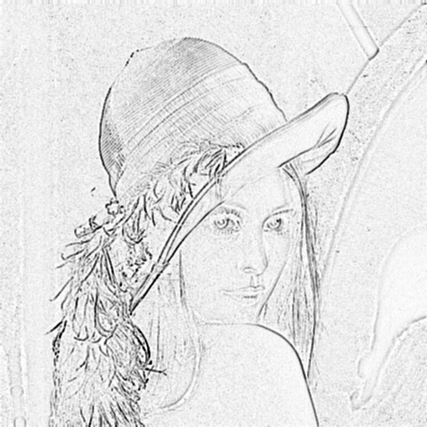
convert
Part of Imagemagick
Command-line tool to work on images
From https://github.com/richelbilderbeek/travis_convert
Charcoal filter
Lenna, from https://upload.wikimedia.org/wikipedia/en/2/24/Lenna.png

Slide 22
.travis.yml
run
^{script:}
^{- rm *.png}
^{- ./run}
^{- ls *.png}
^{#!/bin/bash}
wget https://upload.wikimedia.org/wikipedia/en/2/24/Lenna.png
convert Lenna.png -charcoal 1 Edge.png

Slide 23
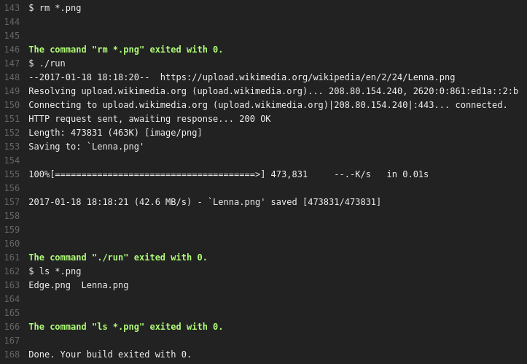
Result

Slide 24
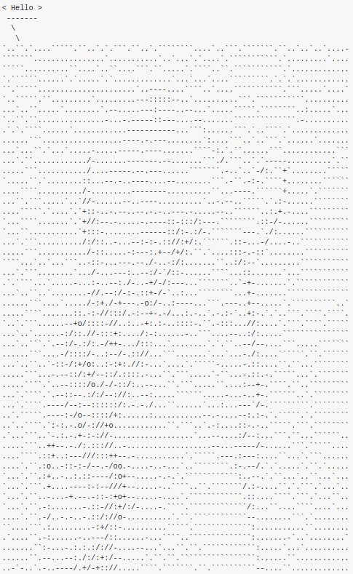
Pipeline example 1
Convert image to cowfile
From https://github.com/richelbilderbeek/travis_example_pipeline
Lenna, from https://upload.wikimedia.org/wikipedia/en/2/24/Lenna.png

Slide 25
.travis.yml 1/2
^{sudo: require}
^{dist: trusty}
^{# Boost}
^{addons:}
^{apt:}
^{packages: libboost-all-dev}
^{before_install:}
^{# C++14}
- sudo add-apt-repository --yes ppa:ubuntu-toolchain-r/test
^{- sudo apt-get update -qq}

Slide 26
.travis.yml 2/2
^{install:}
^{# C++14}
- sudo apt-get install -qq g++-5
^{# Cowsay}
^{- sudo apt-get install cowsay}
- export PATH=/usr/bin:/bin:/usr/games
^{script:}
^{- ./run}

Slide 27
run 1/3
^{#!/bin/bash}
^{# Download Lenna.png}
wget https://upload.wikimedia.org/wikipedia/en/2/24/Lenna.png
# Convert to edge detected version
convert Lenna.png -charcoal 1 Edge.png
^{# Download prerequisites}
git clone https://github.com/richelbilderbeek/AsciiArter
git clone https://github.com/richelbilderbeek/DotMatrix
git clone https://github.com/richelbilderbeek/RibiClasses
git clone https://github.com/richelbilderbeek/RibiLibraries

Slide 28
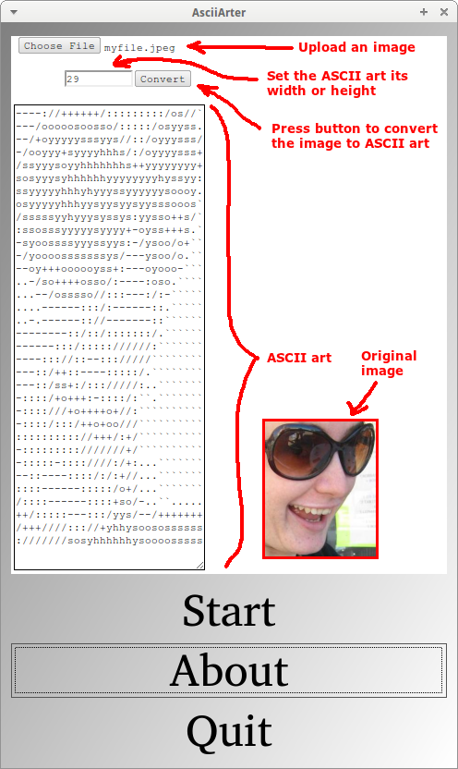
run 2/3
^{# Build AsciiArter}
^{cd AsciiArter}
^{qmake AsciiArterConsole.pro}
^{make debug}
^{cp AsciiArterConsole ../}
^{cd ..}
^{# Convert Edge to ascii art}
./AsciiArterConsole Edge.png art.txt 78
AsciiArter GUI menu, from https://github.com/richelbilderbeek/AsciiArter

Slide 29
run 3/3
^{# Create cowfile}
echo "\$the_cow = <<\"EOC\";" > art.cow
^{echo " \$thoughts" >> art.cow}
echo " \$thoughts" >> art.cow
^{cat art.txt >> art.cow}
^{echo "EOC" >> art.cow}
^{# Use cowfile}
^{cowsay -f ./art.cow "Hello!"}

Slide 30
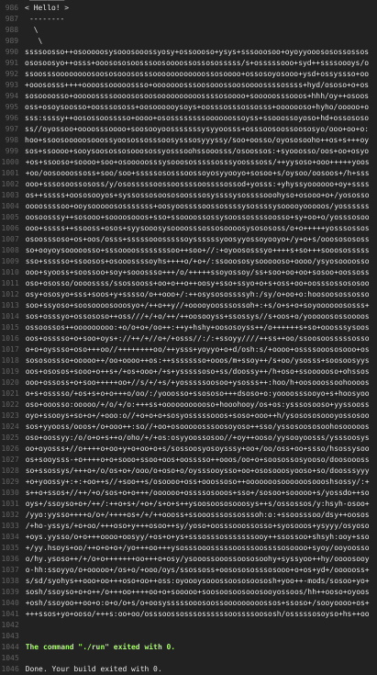
Result

Slide 31
Other uses

Slide 32
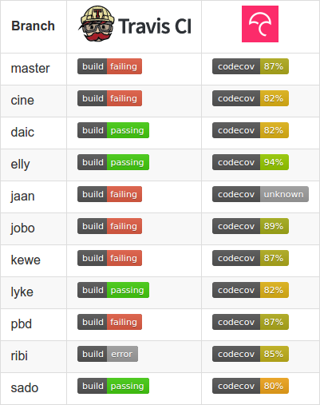
Project health

Slide 33
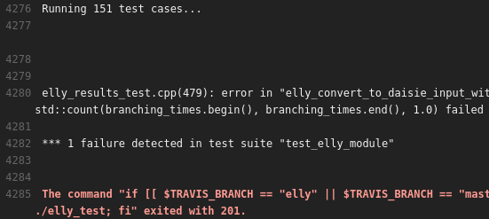
Testing

Slide 34
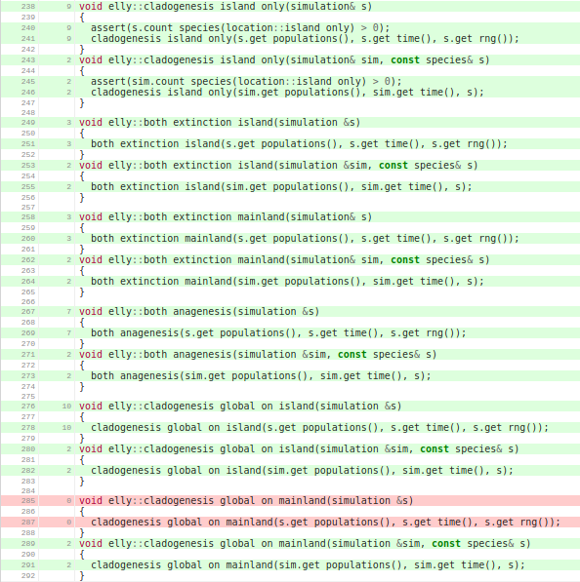
Code cover-age

Slide 35
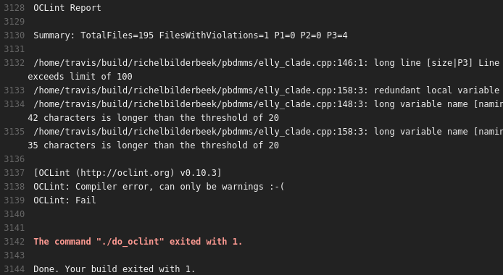
Style checking

Slide 36
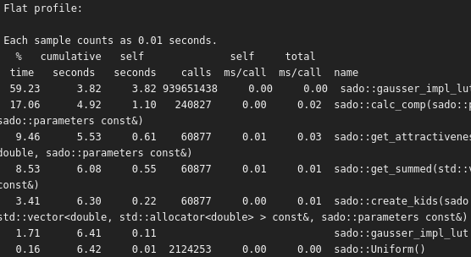
Profile

Slide 37
Other uses
Memory leak detection
Data race detection
Undefined behavior sanitizer
To not forget how to do something

Slide 38
Conclusion
Travis CI can be used to automate everything you can do from a terminal
Travis CI results in a reproducible build/pipeline
Set up once, profit every push

