Slide 1
Phylogenies
Richel Bilderbeek
Notes:
http://www.cs.us.es/~fran/students/julian/phylogenetics/phylogenetics.html

Slide 2
Overview
History

Slide 3
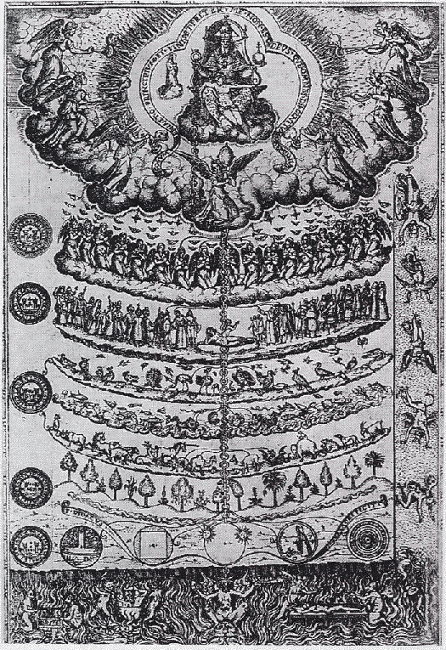
Great chain of being
Hierarchical ordering from God to minerals based on insights by monks
  For example, St. Thomas Aquinas (1225-1274) classified the 9 angelic beings
Didacus Valades, 1579, Rhetorica Christiana

Slide 4
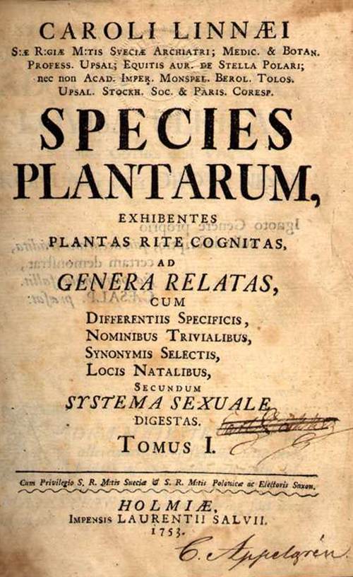
1753: Linnaean taxonomy
Classification of species based on morphology
Introduction of taxonomic ranks
Linnaeus, 1753, Species planetarium

Slide 5
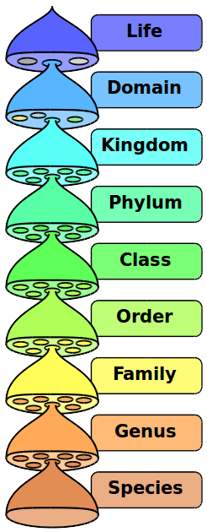
1753: Linnaean taxonomy
Highest taxonomic rank: kingdom (animals, plants, minerals)
One-but lowest level: genus
  e.g. Homo
Lowest level: species
  e.g. sapiens
Contemporary taxonomic ranks

Slide 6
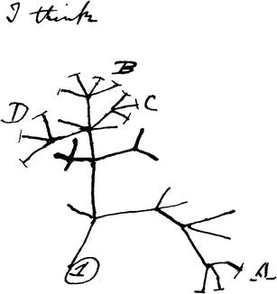
1837: first species tree
Shows the relatedness between hypothetical species
Species C and B closely related
Species A and B far related
Shows species that go extinct
Darwin, 1837, notebook
Notes:
I think case must be that one generation should have as many living as now. To do this and to have as many species in same genus (as is) requires extinction . Thus between A + B the immense gap of relation. C + B the finest gradation. B+D rather greater distinction. Thus genera would be formed. Bearing relation" (next page begins) "to ancient types with several extinct forms"

Slide 7
1837: first species tree
Tree type: unclear, can be:
  Rooted: assumes a common ancestor
  Unrooted: does not make this assumption
Darwin, 1837, notebook
Notes:
I think case must be that one generation should have as many living as now. To do this and to have as many species in same genus (as is) requires extinction . Thus between A + B the immense gap of relation. C + B the finest gradation. B+D rather greater distinction. Thus genera would be formed. Bearing relation" (next page begins) "to ancient types with several extinct forms"

Slide 8
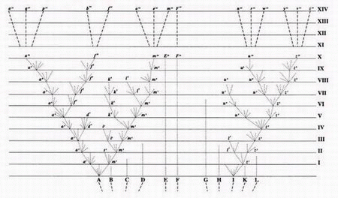
1859: Tree of life
Shows the connection of hypothetical species
Shows which species go extinct
Darwin, 1859, On The Origin of species

Slide 9
1859: Tree of life
Tree type: rooted, common ancestors at the bottom
Branch length: one generation
Darwin, 1859, On The Origin of species

Slide 10
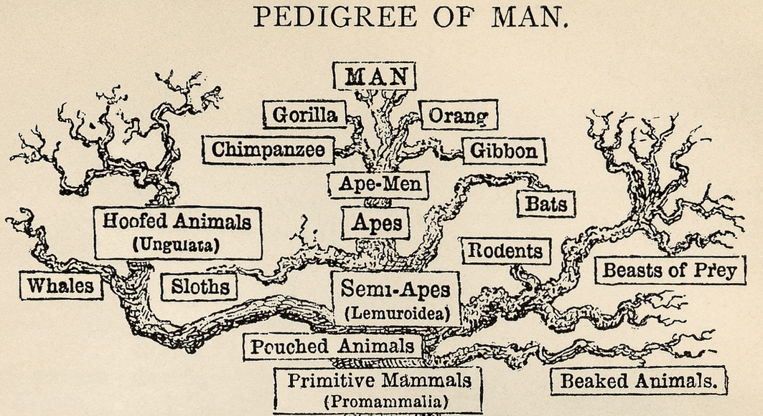
1879: Haeckel's Tree of life
Shows the connection of species based on morphology
Does not show which species go extinct
Rooted tree: least complex organism at the bottom
Haeckel, 1879, The Evolution of Man

Slide 11
1879: Haeckel's Tree of life
Tree type: rooted, least complex organism at the bottom
Branch lengths: unknown
Haeckel, 1879, The Evolution of Man

Slide 12
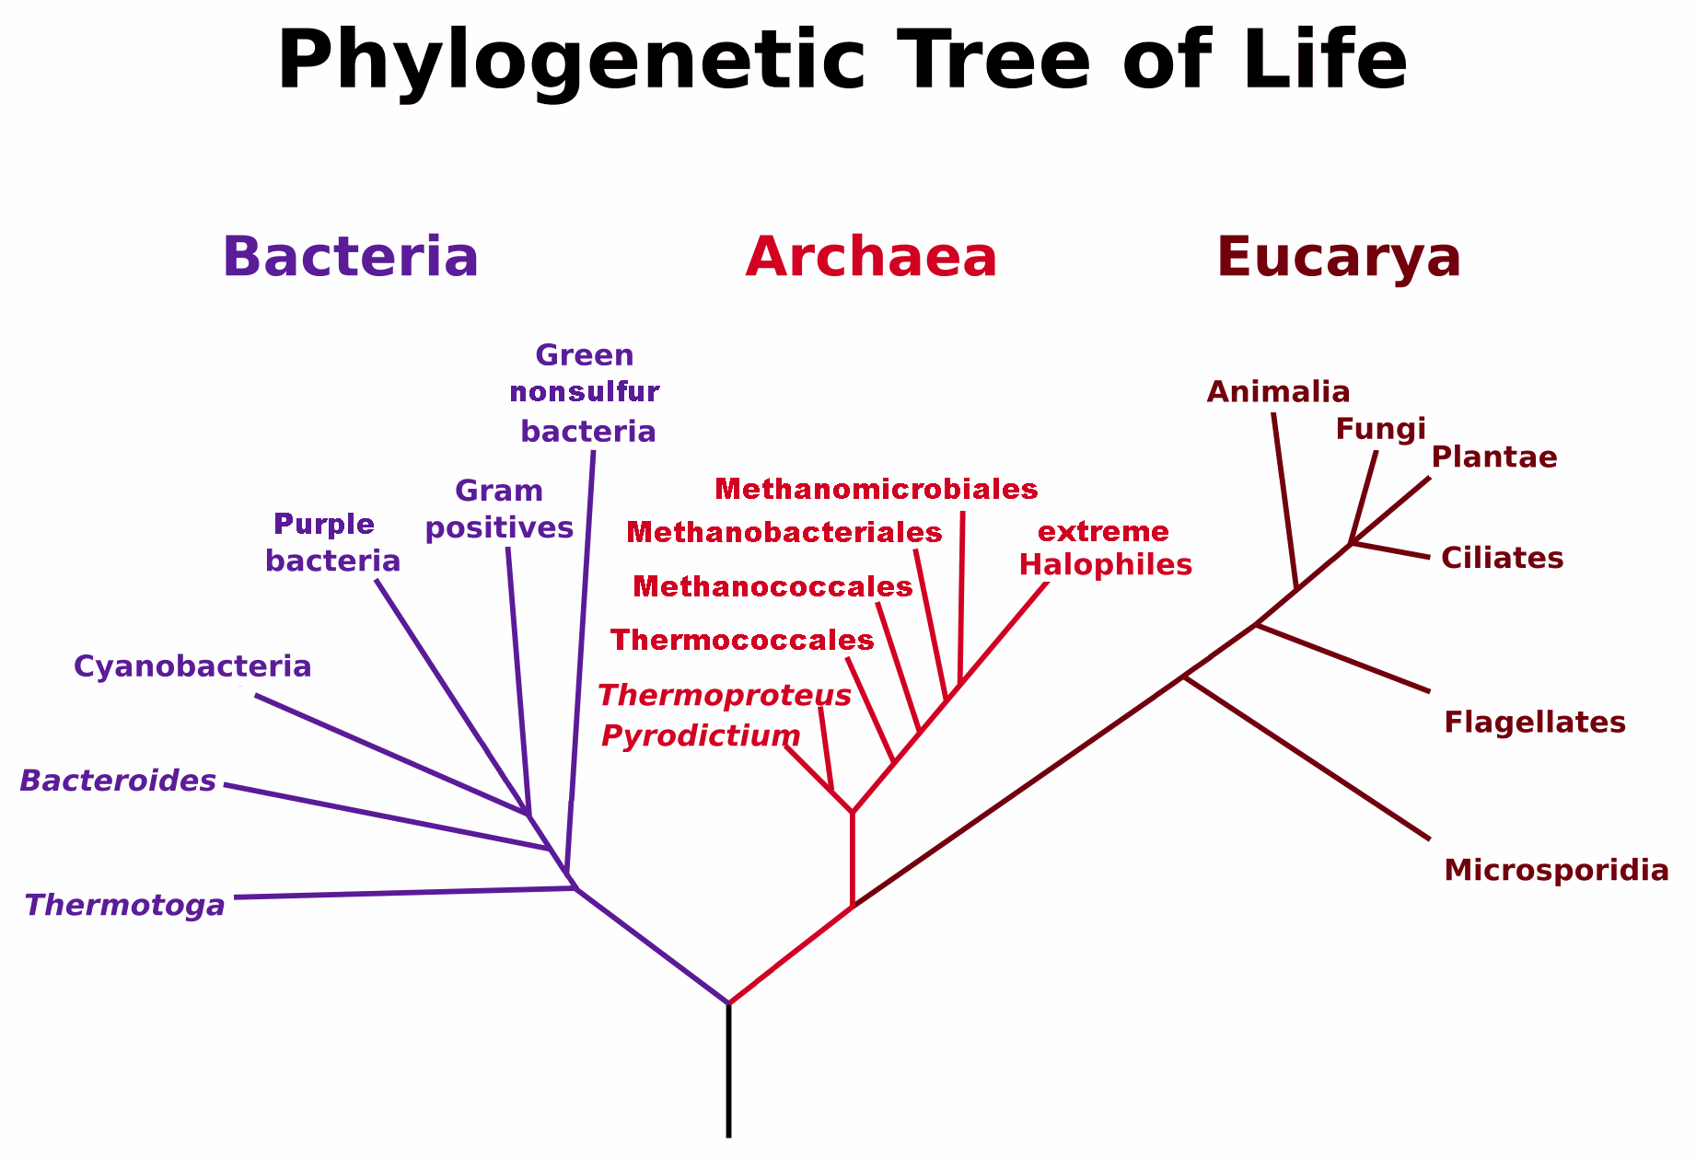
1990: 16S rRNA Tree of life
Shows the relatedness of species based on 16S rRNA
16S rRNA: present in all organisms
Woese et al, 1990, PNAS

Slide 13
1990: 16S rRNA Tree of life
Tree type: rooted, ancestor at the bottom
Branch length: difference in sequence
Woese et al, 1990, PNAS

Slide 14
Conclusion
Multiple attempts have been made to group all organisms
16S rRNA of all organisms can be compared (unlike morphology)

Slide 15
How to create a phylogeny?
Morphology
DNA
Others

Slide 16
Why create a phylogeny?

Slide 17
How to create a phylogeny?
Morphology
DNA
Others

Slide 18
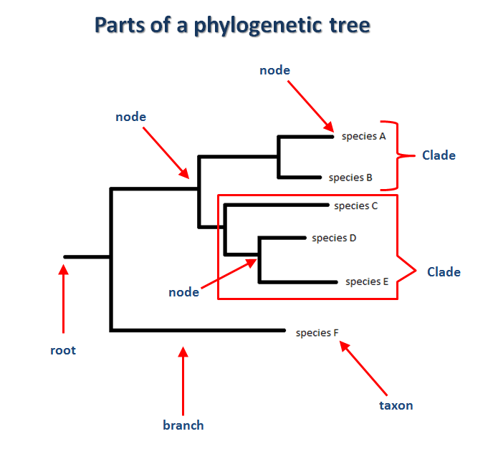
Parts of a phylogenetic tree
http://www.cs.us.es/~fran/students/julian/phylogenetics/phylogenetics.html
Notes:
http://ww.cs.us.es/~fran/students/julian/phylogenetics/phylogenetics.html

Slide 19
How to create a phylogeny from DNA sequences

Slide 20
Bootstrapping

Slide 21
Pitfalls
Not all gene trees are species tree
Not all taxa are sampled
A phylogeny may change
Difficult to recognize trees under neutral selection
Sentiment in trees

Slide 22
Not all gene trees are species tree
Most phylogenies are based on 16S rRNA
That does not mean all genes follow the same species

Slide 23
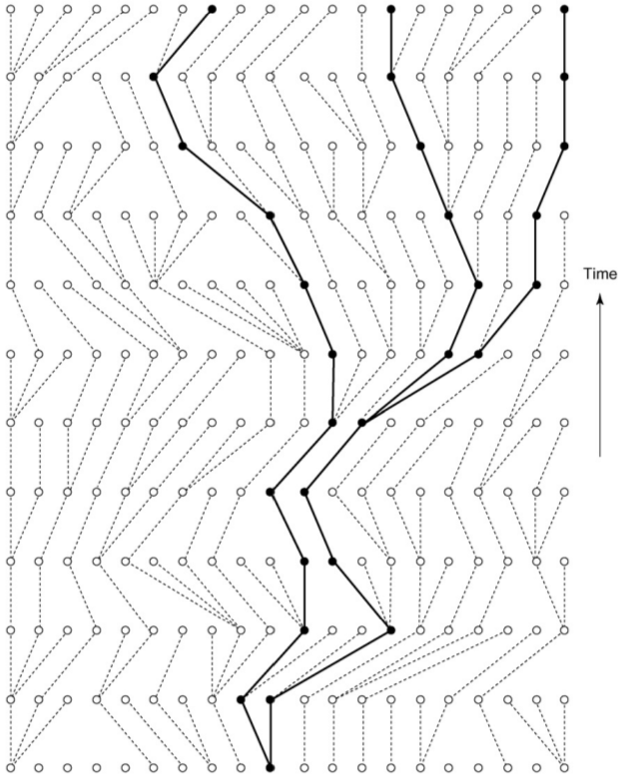
Not all taxa are sampled
Most resolution is lost at the most recent level

Slide 24
Not all taxa are sampled
This is not a very big problem

Slide 25
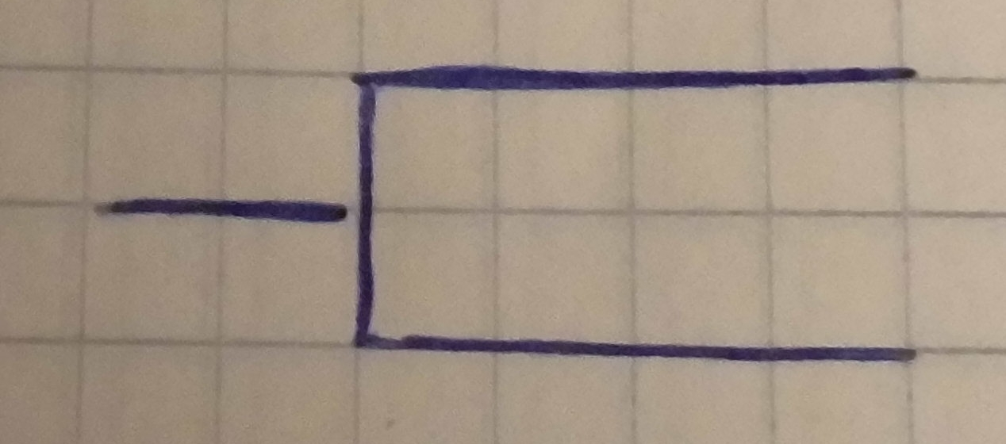
Phylogeny today
Today this is measured:
  Two species
Nothing going on?

Slide 26
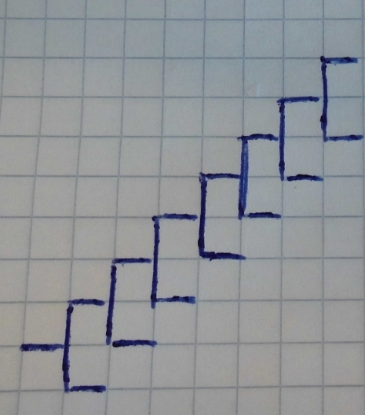
Phylogeny today and before
If also the time before also has been sampled, a dynamic pattern can be seen
There appears to be some selection going on

Slide 28
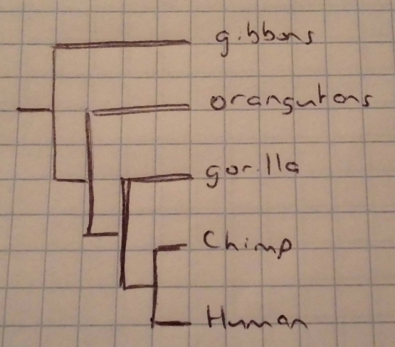
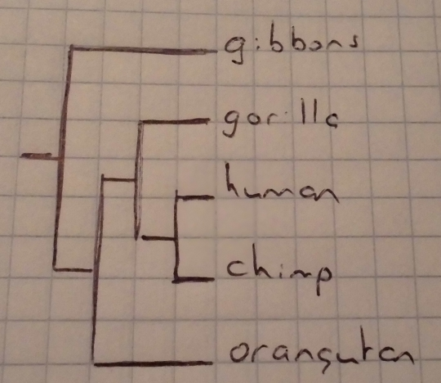
Sentiment in trees
Trees can give different sentiments
Great order of things
Just one of the hominids

Slide 29
What can learn from phylogenies?
Change in population size
Detecting selection on a gene

Slide 30
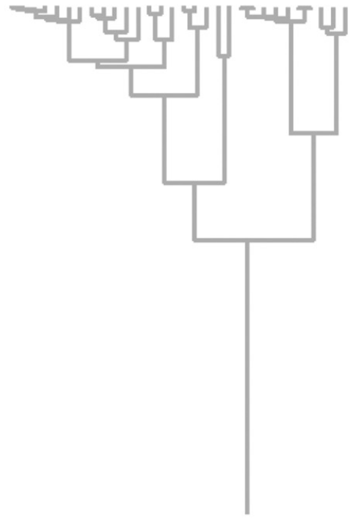
Change in population size
In silico experiment
Neutral selection
Constant population size
Kuhner, 2008, Trends in Ecology and Evolution

Slide 31
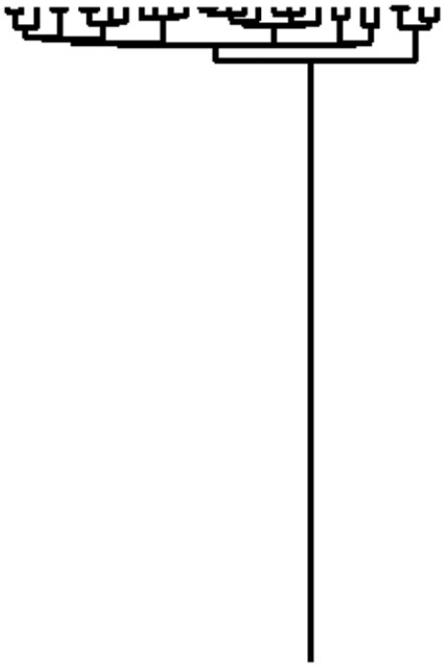
Exponentially growing
Kuhner, 2008, Trends in Ecology and Evolution

Slide 32
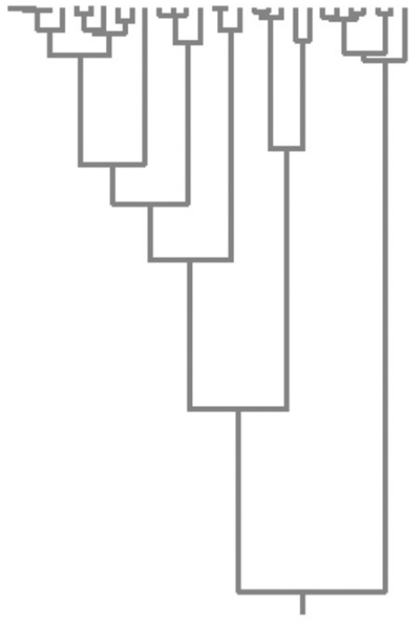
Exponentially shrinking
Kuhner, 2008, Trends in Ecology and Evolution

Slide 33
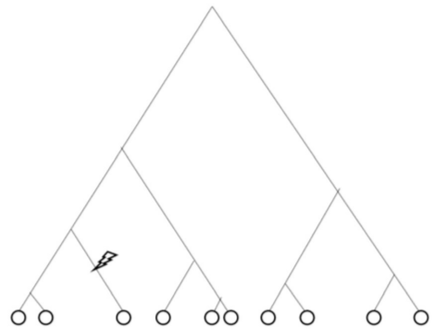
Detecting selection on a gene
In silico
Neutral selection
Ezawa et al., 2013, BMC Genetics

