Slide 1
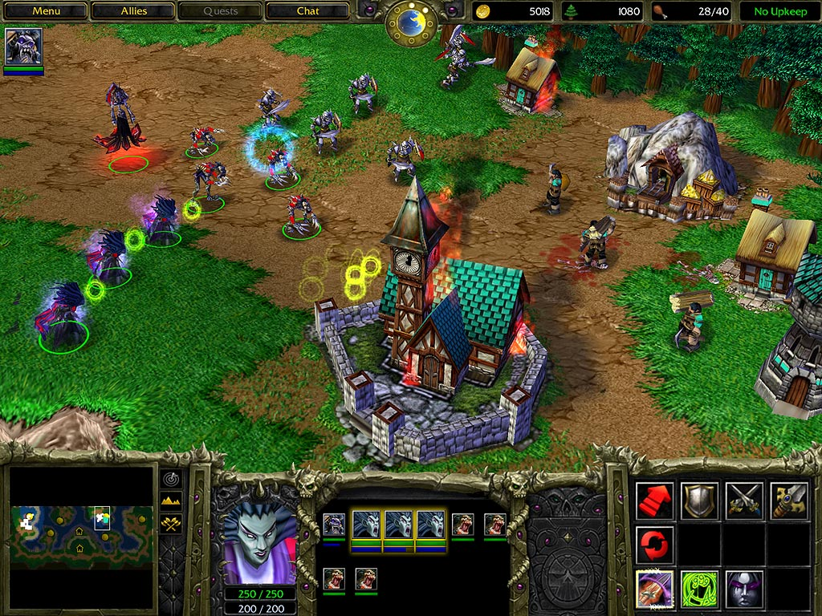
Eukaryote
the cellular top-view
strategy game

Slide 2
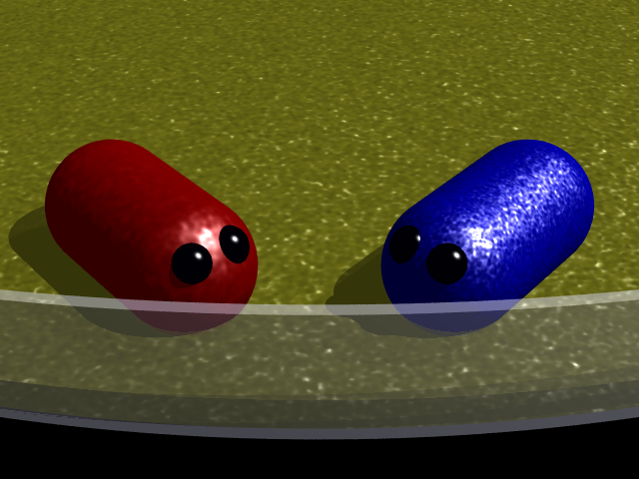
Eukaryote
survival of the fittest
Evolve,divide and outcompete
Locations
  microscope slide
  petri dish
  primordial sea
  etcetera

Slide 3
Objective
You and the opponent(s) start with a single cell
You must destroy the other's cell by destroying it with
  toxines,
  porines
  depletion of resources
  macrophagy
  etcetera

Slide 4
Objective
Your cell is your 'base'
You can
  Divide
  Upgrade organelles ('evolution')
  Differentiate
  Evolve new genes
  Synthesize proteins

Slide 5
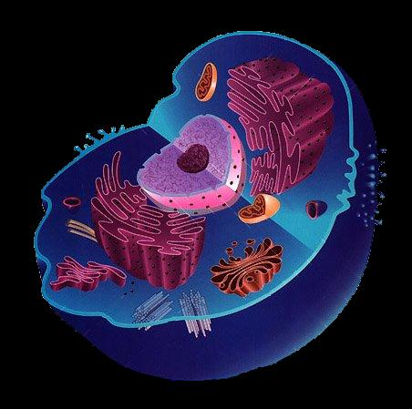
Your base
Nucleus: evolve new genes
Endoplasmatic reticulum: synthesize proteins
Mitochondria: produce energy
Golgi: secrete vesicles
Cytoskeleton: locomotion

Slide 6
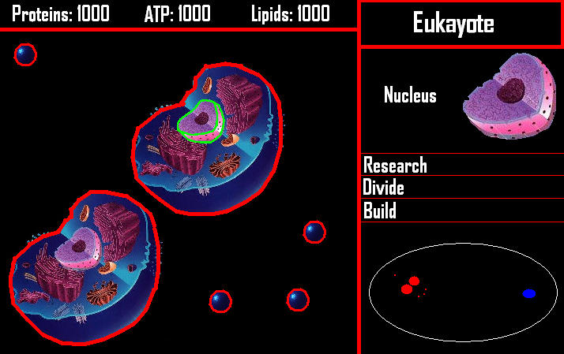
Sketch screenshot

Slide 7
Proteins
Acquire metabolic pathways
Optimize existing pathways
Transport nutrients
Toxine biosynthesis
Toxine resistance
Flagellum

Slide 8
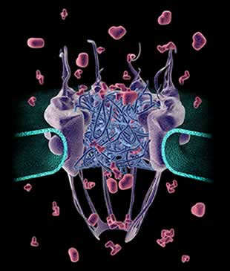
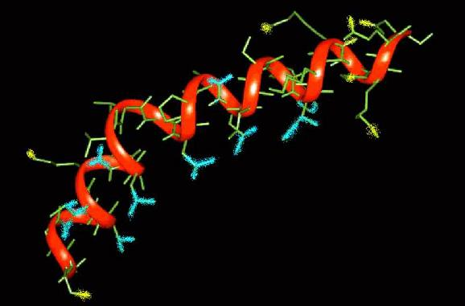
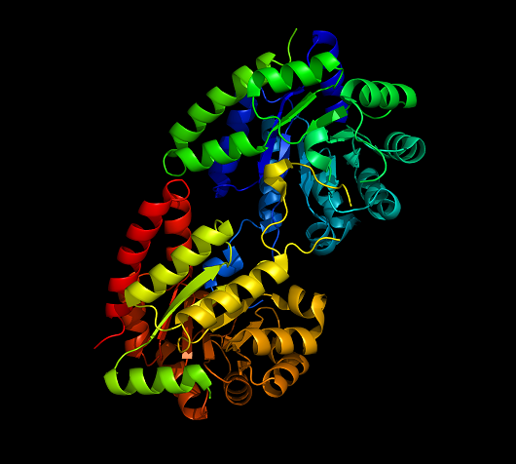
Nucleopore complex: passive nutrient import
Melittin: toxin
Trypophane synthase: metabolic pathway

Slide 9
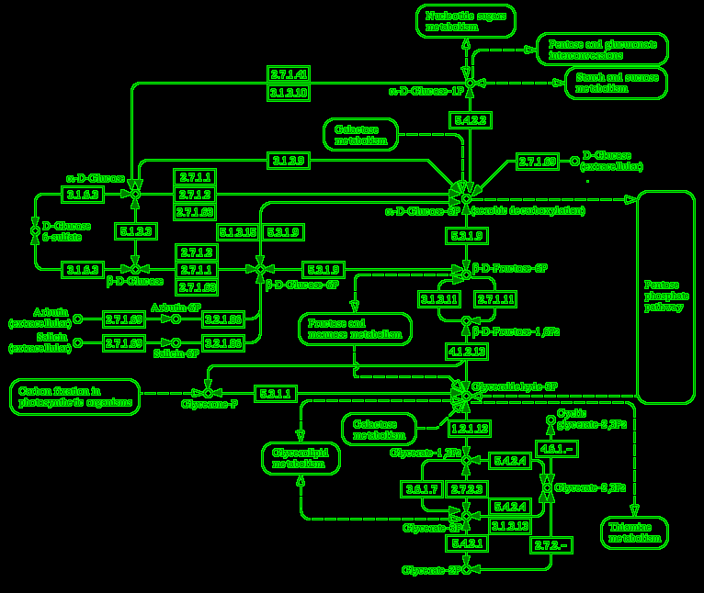
Metabolic pathways

Slide 10
Learning goals
The principles of evolution
All organelles and their functions
DNA -> RNA -> Protein
Metabolic pathways
Proteins
  Key metabolic proteins
  Key biosynthetic proteins
  Key membrane proteins (e.g. transporters)

Slide 11
GAME OVER

