Slide 1
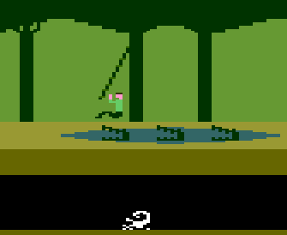



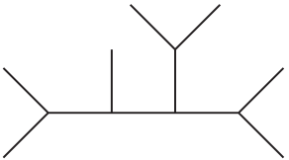
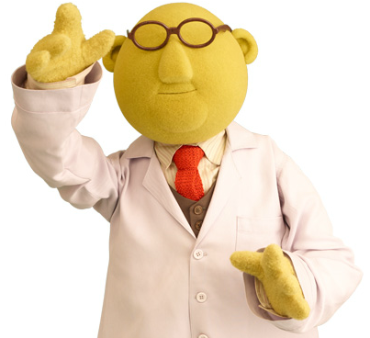
Workflow
Ecology
Molecular data
Alignment
Phylogeny
Parameter estimates
Lambda = ?
Lambda = 0.5

Slide 2
Multi-step
Ecology
Molecular data
Alignment
Phylogeny
Parameter estimates
Lambda = ?
Use best
Use best
Use best
Lambda = 0.5 +- 0.01

Slide 3



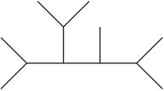

Joint inference
Ecology
Molecular data
Alignments
Phylogenies
Parameter estimates
Lambda = ?
This alignment, this phylogeny
and lambda = 0.5 have a 90% probability

