Slide 1
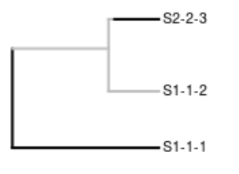


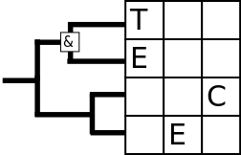
Sampling incipient trees
© 2018 Richel Bilderbeek
www.github.com/richelbilderbeek/Science

Slide 2
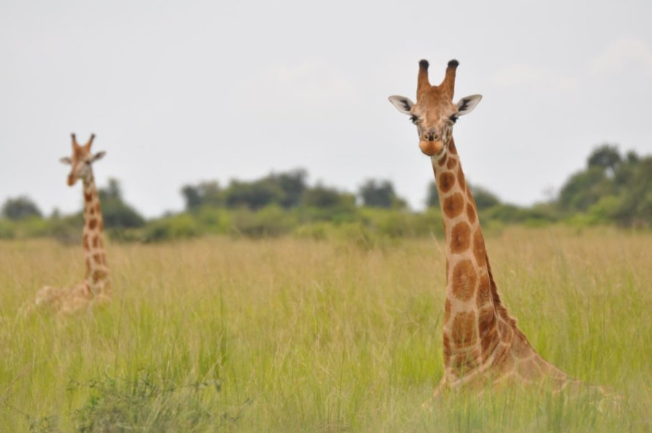
Speciation takes time
Fennessy, Julian, et al. "Multi-locus analyses reveal four giraffe species instead of one." Current Biology 26.18 (2016): 2543-2549.

Slide 3
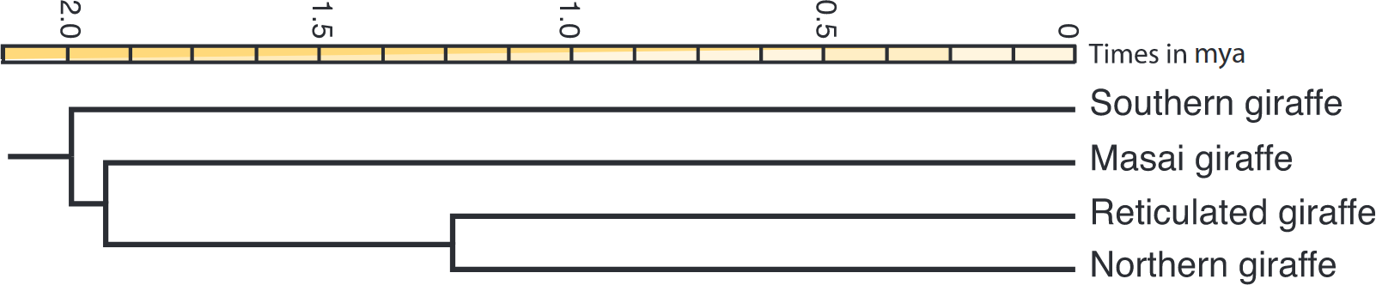
Speciation takes time
Fennessy, Julian, et al. "Multi-locus analyses reveal four giraffe species instead of one." Current Biology 26.18 (2016): 2543-2549.

Slide 4
Speciation takes time
Giraffe
Giraffe
Giraffe

Slide 5
Goal
Share my naivety and insights
I will:
  Describe how incipient species trees are sampled
  When the behavior is as I expected
  When the behavior appeared unexpected
  Suggest a new sampling method

Slide 6
Sampling
An algorithm to pick an incipient species to represent a species
Three ways:
  1) oldest
  2) random
  3) youngest
Can result in different species trees

Slide 7
My naive branch length expectations
youngest ≤ oldest
youngest ≤ random ≤ oldest

Slide 8
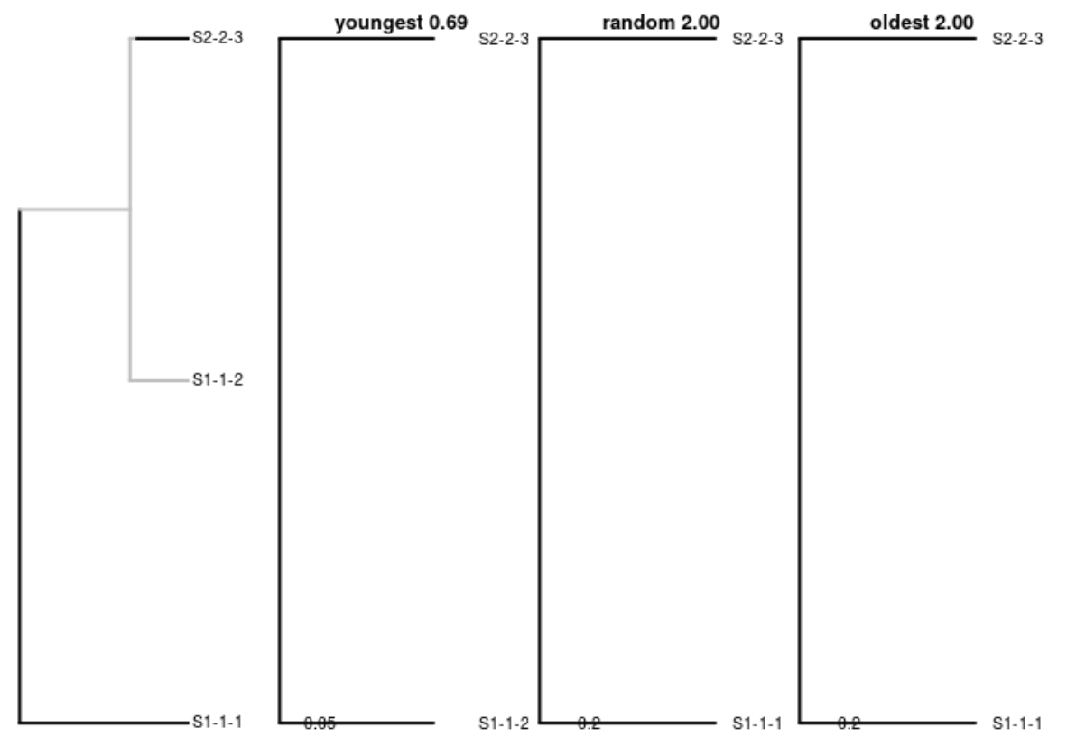
Expected #1
youngest ≤ random ≤ oldest
2-3
2-3
2-3
2-3
1-2
1-1
1-2
1-1
1-1
1-1
0.69 ≤ 2.0 ≤ 2.0

Slide 9
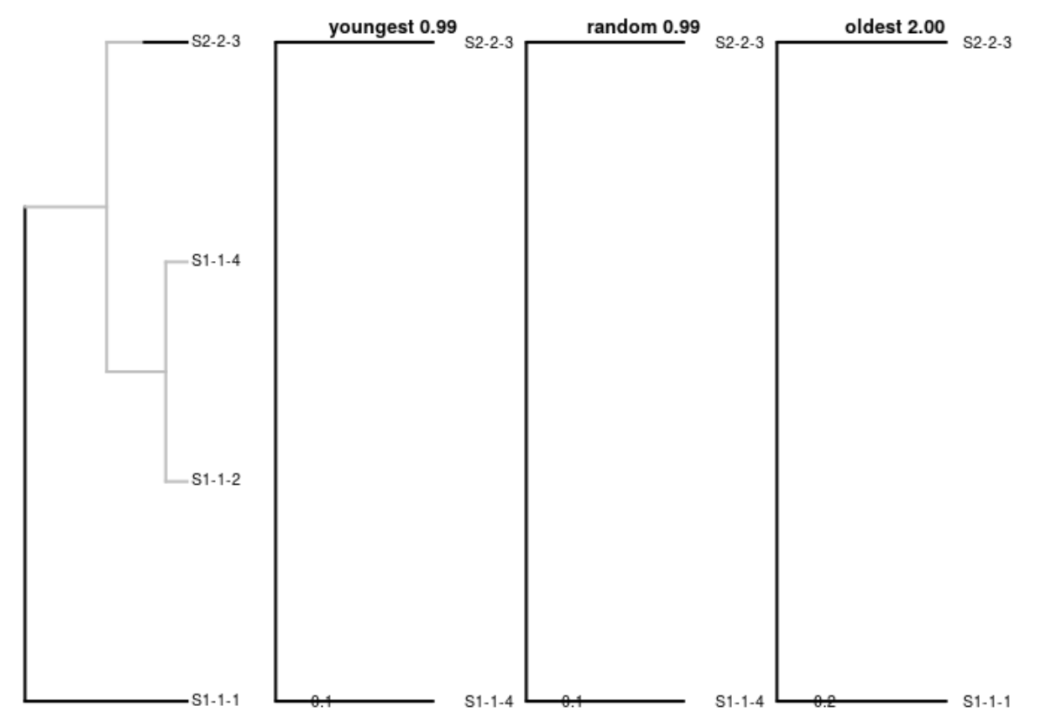
Expected #2
youngest ≤ random ≤ oldest
2-3
2-3
2-3
2-3
1-4
1-1
1-4
1-4
1-1
0.99 ≤ 0.99 ≤ 2.0

Slide 10
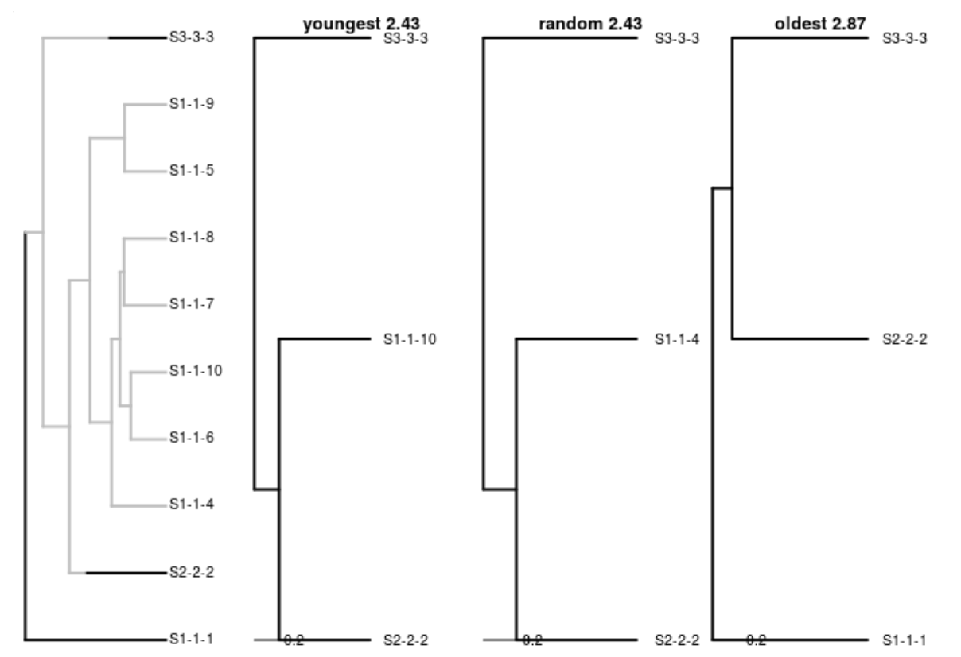
Expected #3
youngest ≤ random ≤ oldest
3-3
3-3
3-3
1-10
1-4
2-2
1-10
1-4
2-2
1-1
2-2
2-2
1-1
2.43 ≤ 2.43 ≤ 2.87

Slide 11
My naive branch length expectations
youngest ≤ oldest
youngest ≤ random ≤ oldest

Slide 12
My naive branch length expectations
youngest ≤ oldest
youngest ≤ random ≤ oldest

Slide 13
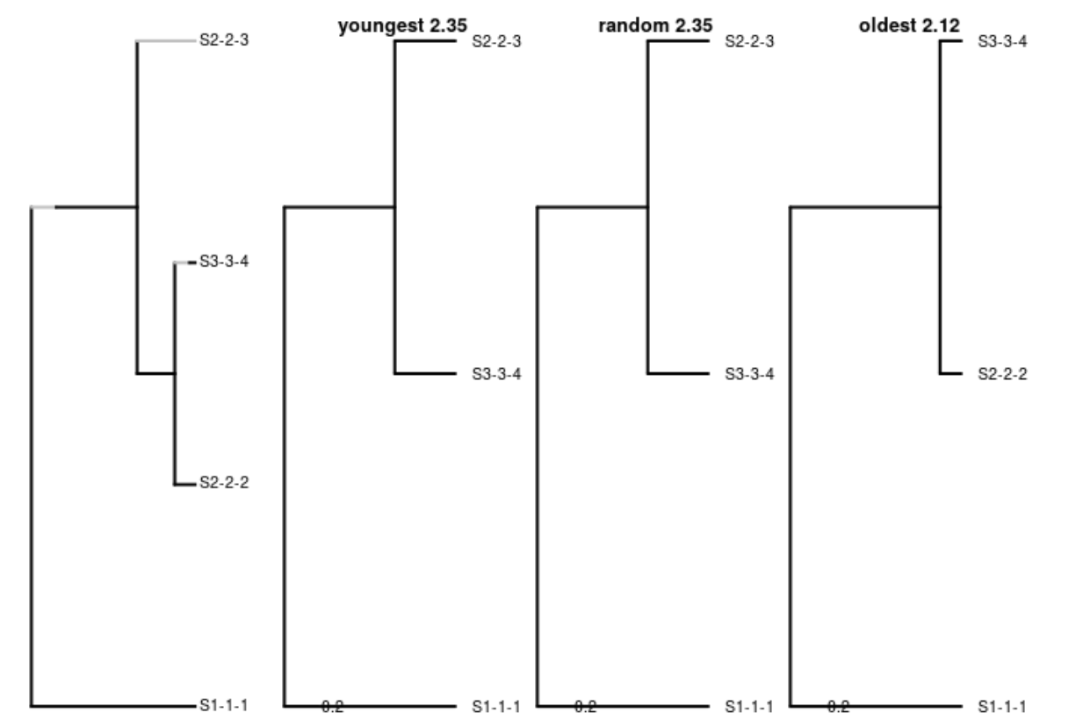
oldest ≤ youngest
2-3
2-3
3-4
3-4
3-4
2-2
2-2
1-1
1-1
1-1
2.35 ≤ 2.12

Slide 14
My naive branch length expectations
youngest ≤ oldest
youngest ≤ random ≤ oldest

Slide 15
My naive branch length expectations
youngest ≤ oldest
youngest ≤ random ≤ oldest

Slide 16
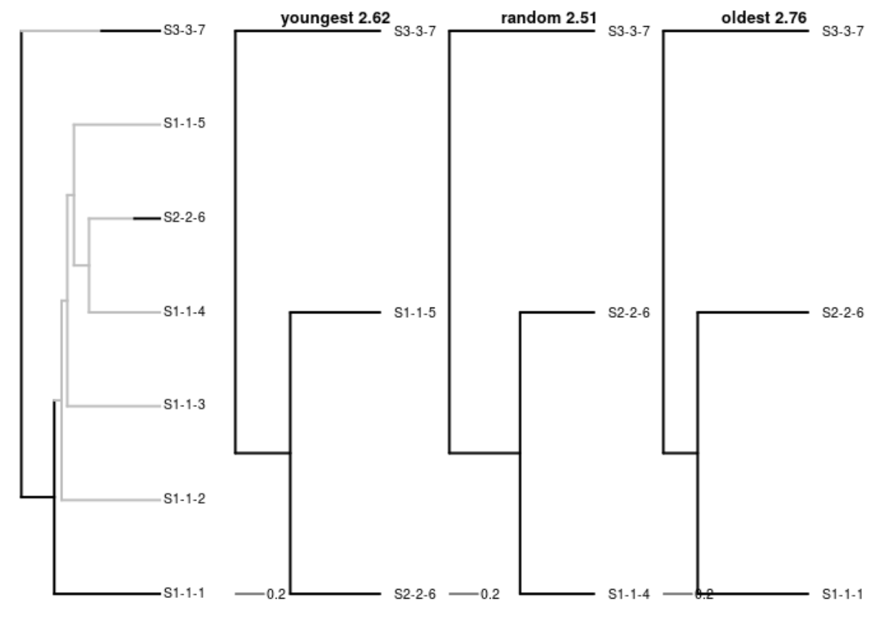
random ≤ youngest
3-7
3-7
3-7
1-5
2-6
1-4
1-5
2-6
2-6
1-4
2.62 ≤ 2.51

Slide 17
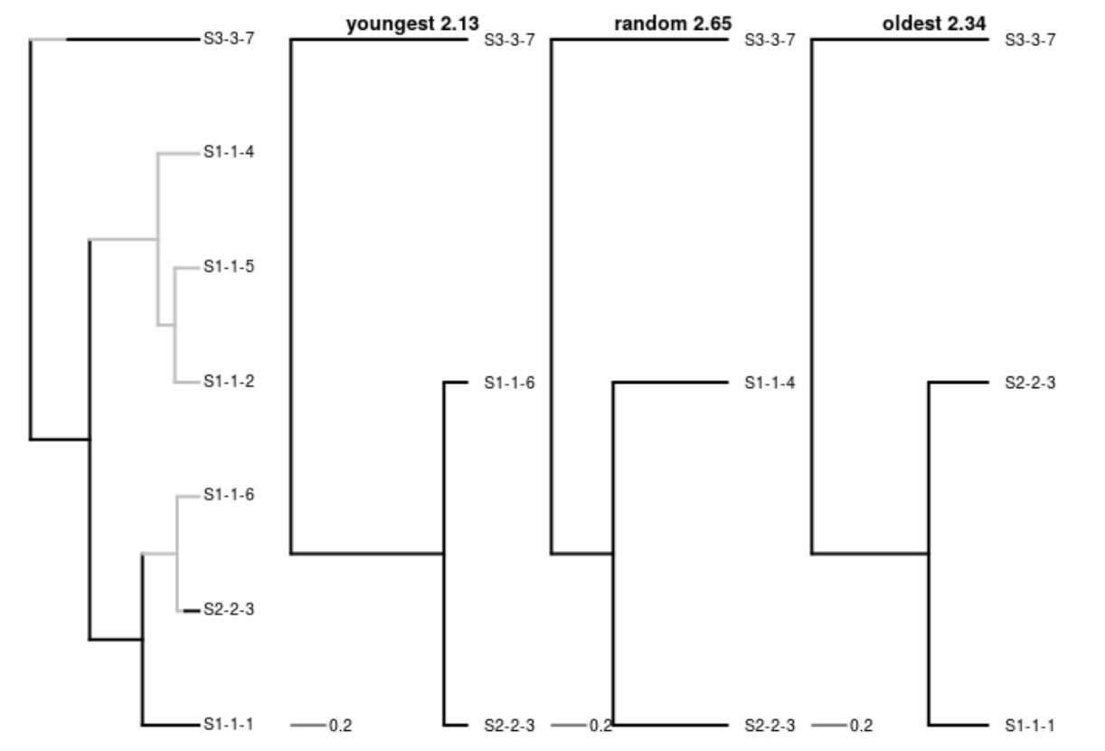
oldest ≤ random
3-7
3-7
3-7
1-4
1-4
2-3
2-3
1-2
1-1
1-1
2-3
2.65 ≤ 2.34

Slide 18
My naive branch length expectations
youngest ≤ oldest
youngest ≤ random ≤ oldest

Slide 19
Conclusions
The names ‘youngest’ and ‘oldest’ misled me:
  ‘youngest’ does not give shortest branch lengths
  ‘oldest’ does not give longest branch lengths
  ‘random’ does not give intermediate branch lengths
youngest ≤ random ≤ oldest

Slide 20
Conclusions
Suggest to add ‘shortest’ and ‘longest’
  ‘shortest’ gives shortest branch lengths
  ‘longest’ gives longest branch lengths
  ‘random’ gives intermediate branch lengths
shortest ≤ random ≤ longest

Slide 21
Questions?
Redo out these calculations by running the vignette ‘pbd_sampling’ from:
https://github.com/richelbilderbeek/raket
devtools::install_package("richelbilderbeek/raket")
git clone https://github.com/richelbilderbeek/raket

