Slide 1







Professional R development
using git, GitHub, Travis CI, testthat, lintr, covr, Codecov and goodpractice
© 2016 Richel Bilderbeek
http://www.github.com/richelbilderbeek/PresentationsAboutR

Slide 2
What? Why? Mastery?
What: follow all good practices by default
Why: proven to pay off
Mastery: set up tools to follow all good practices by default

Slide 3
Not about ...
How to create a package
  See the talk 'How to develop a package'
Why to test a package
  See the talk 'Test-driven development'
Extending a package
  See the talk 'Test-driven development'

Slide 4

Setup
Version control
Code hosting
Continuous integration
Testing framework
Coding standard
Code coverage
Static code analysis

Slide 5
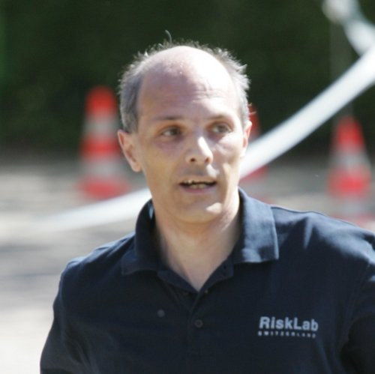
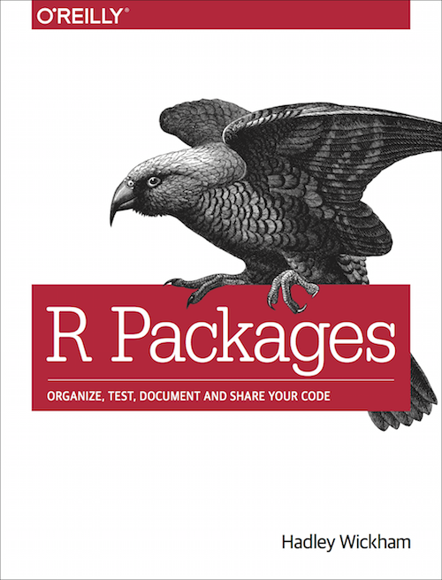
Version control
Keeps a history of code
Rule 9:
Do source code
management
Keynote Speech at useR!, 2014
If you are serious
about software development,
you need to learn about git
Chapter 13: git and GitHub

Slide 6
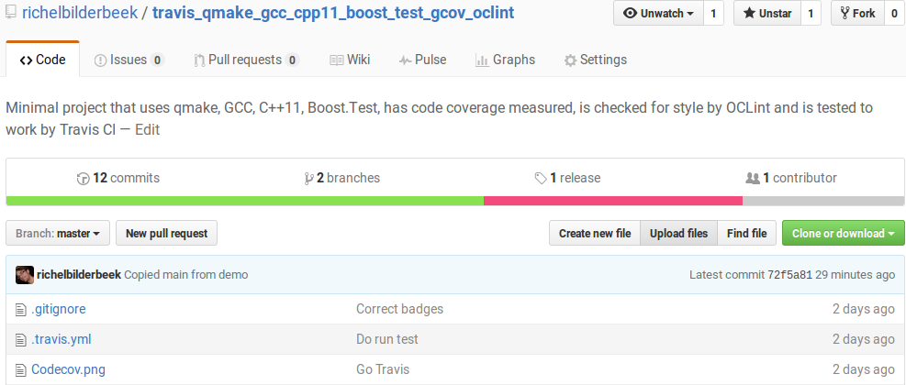
Code hosting
Host your (version controlled) code
Using GitHub is good practice [1]
[1] Perez-Riverol, Yasset, et al. "Ten Simple Rules for Taking Advantage of git and GitHub." bioRxiv (2016): 048744.

Slide 7
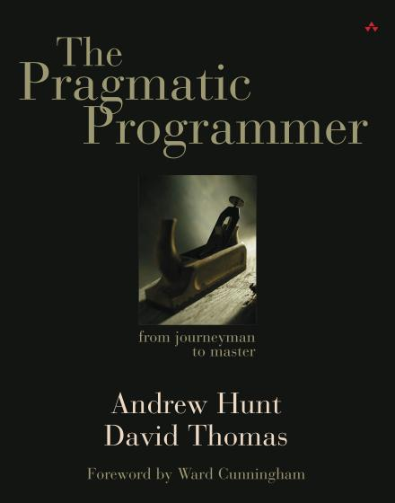
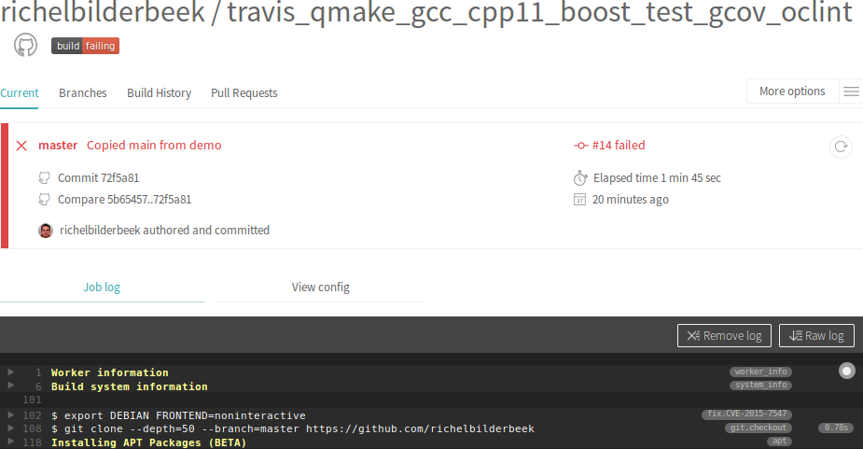
Continuous integration
Run scripts upon pushing new code
Tip 61: Don’t Use
Manual Procedures

Slide 8
Testing framework
To test your code
Tip 62: Test Early.
Test Often. Test Automatically
Testing is a vital part of
package development
Fewer bugs
Better code structure
Easier restarts
Robust code
Chapter 7: Testing

Slide 9
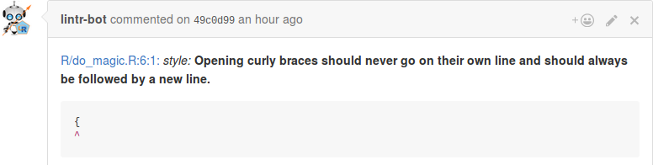
Coding standard
Use a coding standard [1]
I strongly recommend
that you use a
consistent style
Chapter 3, paragraph 'Code Style'
Johnson, Paul E. "R Style. An Rchaeological Commentary." (2016).

Slide 10
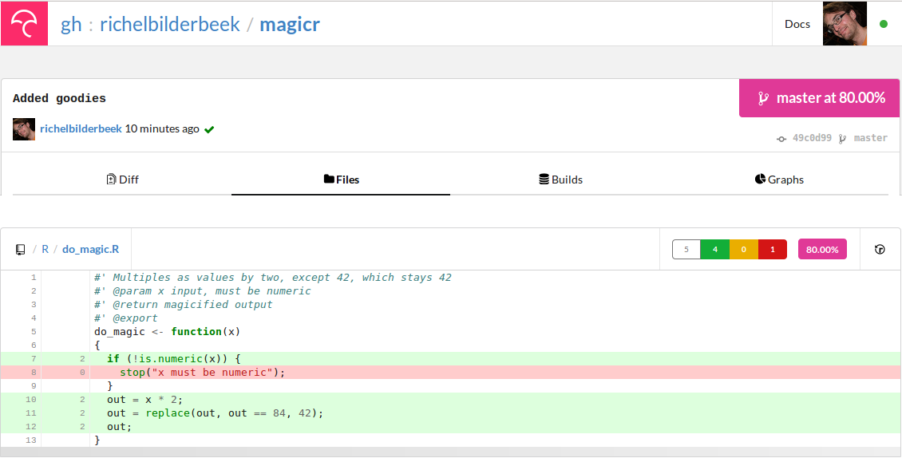
Code coverage
Measures code that is actually used
Correlates with quality [1]
[1] Del Frate, Fabio, et al. "On the correlation between code coverage and software reliability." Software Reliability Engineering, 1995. Proceedings., Sixth International Symposium on. IEEE, 1995.

Slide 11

Test for good practices
Checks code beyond the interpreter and lintr
  Coding style
  Functions that have a superior alternative
  Cyclomatic complexity

Slide 12
This presentation
Introduce the package 'magicr'
  Code that can be improved
  https://github.com/richelbilderbeek/prde
Put it on GitHub
Activate Travis CI
Activate other tools

Slide 13
do_magic.R
#' Multiples all values by two,
#' except 42, which stays 42
#' @param x input, must be numeric
#' @return magicified output
#' @export
do_magic <- function(x)
{
if (!is.numeric(x)) {
stop("x must be numeric");
}
out = x * 2;
out = replace(out, out == 84, 42);
out;
}

Slide 14
test-do_magic.R
context("do_magic")
test_that("do_magic: use", {
expect_equal(do_magic(42), 42)
expect_equal(do_magic(1), 2)
})

Slide 15
Output
> devtools::check()
Updating prde documentation
Loading prde
[...]
* checking tests ...
Running ‘testthat.R’
OK
* DONE
Status: OK
R CMD check results
0 errors | 0 warnings | 0 notes

Slide 16
Demo
Show that the package builds

Slide 17
Next steps
Create a GitHub repository
Clone it to the local computer
Put your code in that folder
Upload the code

Slide 18
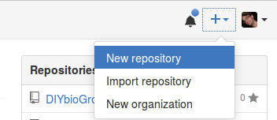
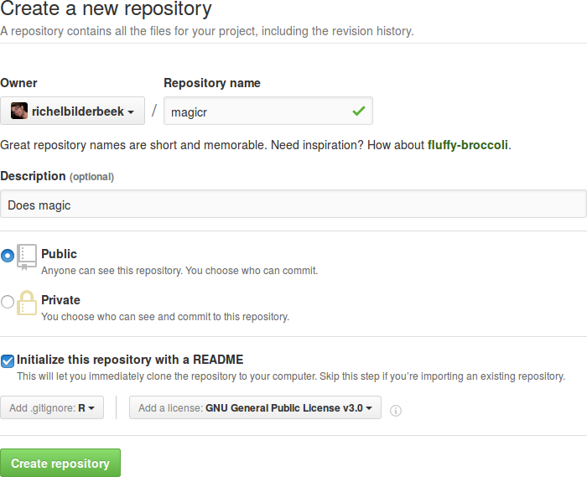
Create a GitHub repository
Create a new repository

Slide 19
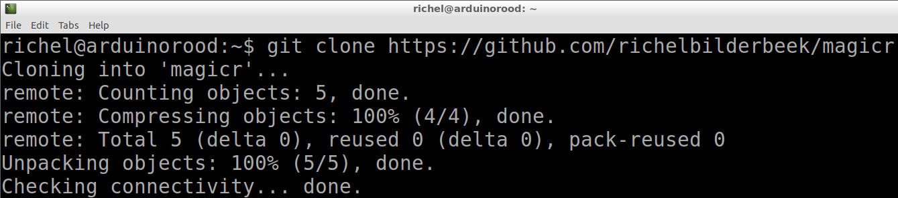
Clone it to the local computer
git clone https://github.com/[username]/[repository name]
(Wouldn't it be nice if this step could also be done from R studio?)

Slide 20
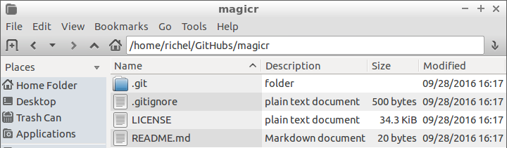
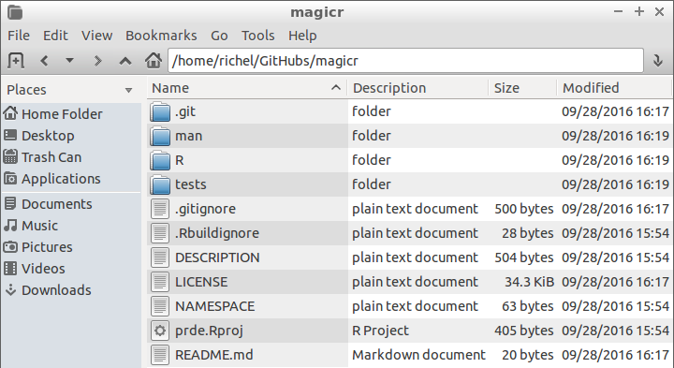
Put your code in that folder

Slide 21
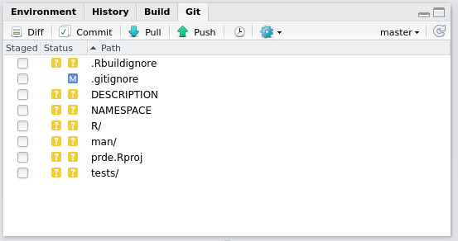
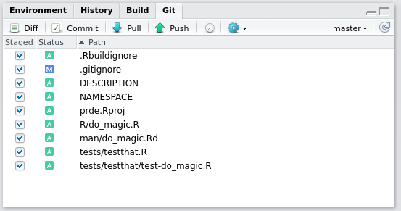
Upload to GitHub
Stage
Commit

Slide 22
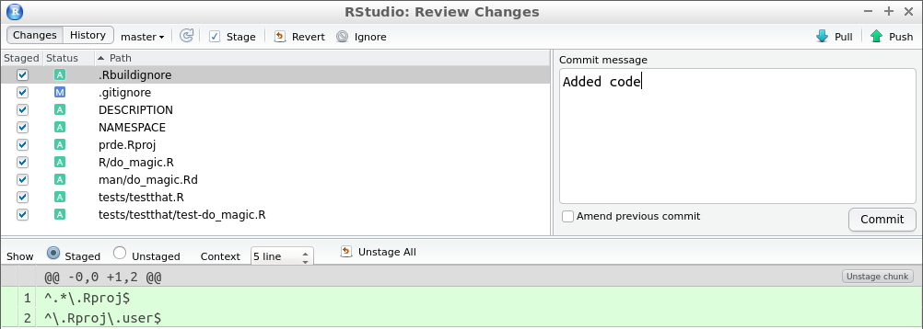
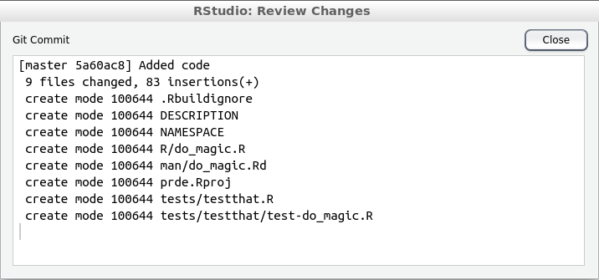
Push to GitHub
then push!

Slide 23
Demo
Put the package on GitHub

Slide 24
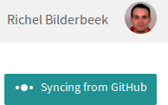


Activate Travis CI
https://travis-ci.org/

Slide 25
Add file .travis.yml to root of package
language: r
cache: packages
Then push to GitHub
Then wait ...

Slide 26
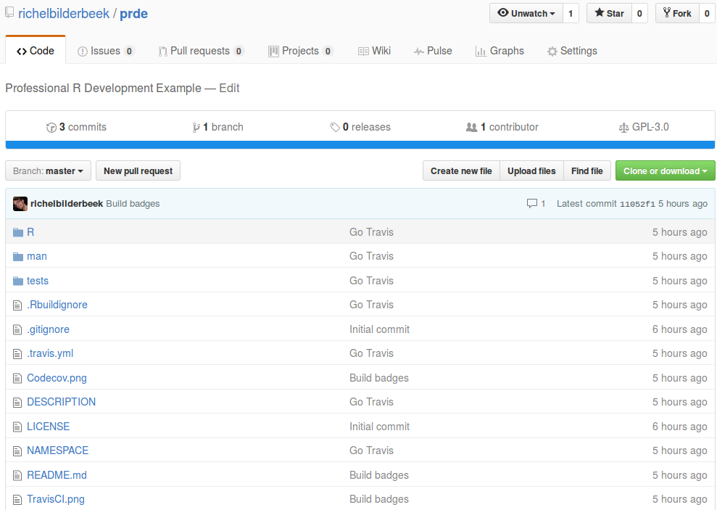
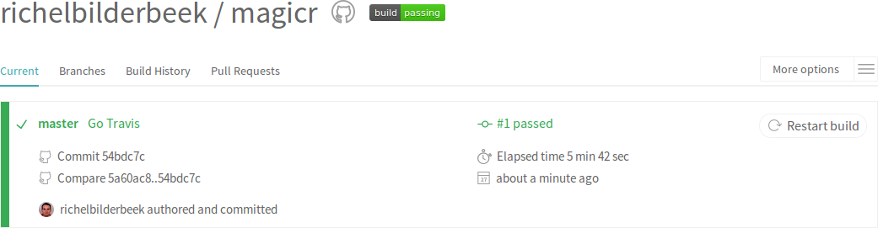
Success

Slide 27
Demo
Activate Travis CI
(do not wait until the build has finished)

Slide 28
Activate other tools
language: r
cache: packages
r_github_packages:
- jimhester/lintr
- jimhester/covr
- MangoTheCat/goodpractice
after_success:
- Rscript -e 'lintr::lint_package()'
- Rscript -e 'library(covr); codecov()'
- Rscript -e 'library(goodpractice); gp()'
Then push to GitHub
Then wait ...

Slide 29
Demo
Modify .travis.yml
Push
(do not wait until Travis CI is finished)

Slide 30
Results: code coverage
https://codecov.io/

Slide 31
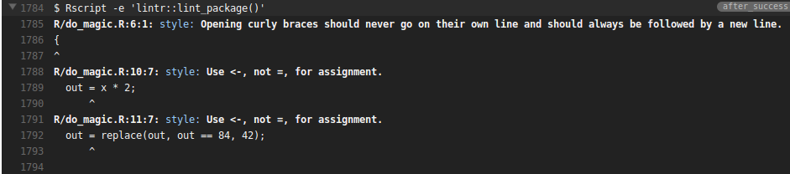
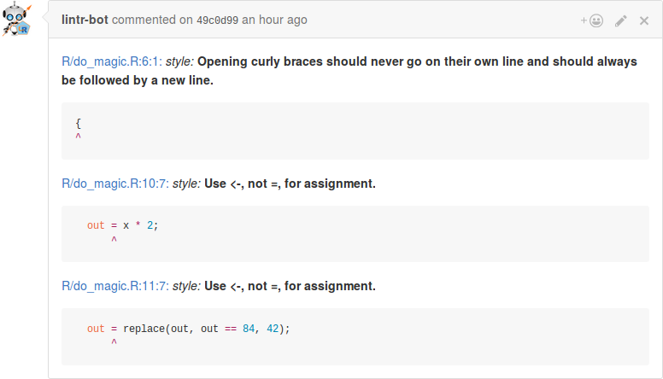
Results: lintr

Slide 32
Results: code coverage

Slide 33
Results: goodpractice

Slide 34
My experiences
Due to this setup, I have
  Responded to bugs faster
  Found and removed dead code
  Learned a professional R coding standard
  Reduced complexity of working code
  Learned new things
  Indirectly teach collaborators/students the same lessons

Slide 35
Conclusion
It is doable to follow all good practices in three Good Steps:
  Follow a package structure
  Put that package on GitHub
  Add Travis CI and other tools
I think this setup is useful for
  R newbies
  R pros

Slide 37
Professional R development
Richel Bilderbeek
http://www.github.com/richelbilderbeek/PresentationsAboutR

