Slide 1
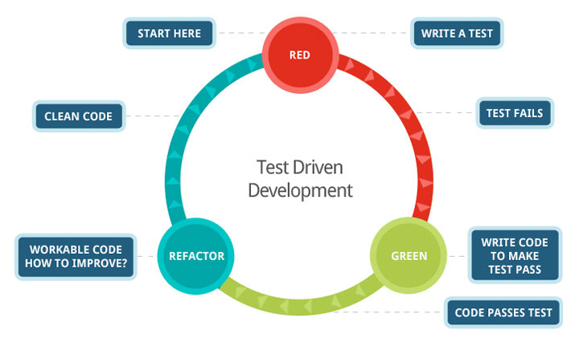

Test-driven development
Richèl Bilderbeek
http://github.com/richelbilderbeek/PresentationsAboutR

Slide 2
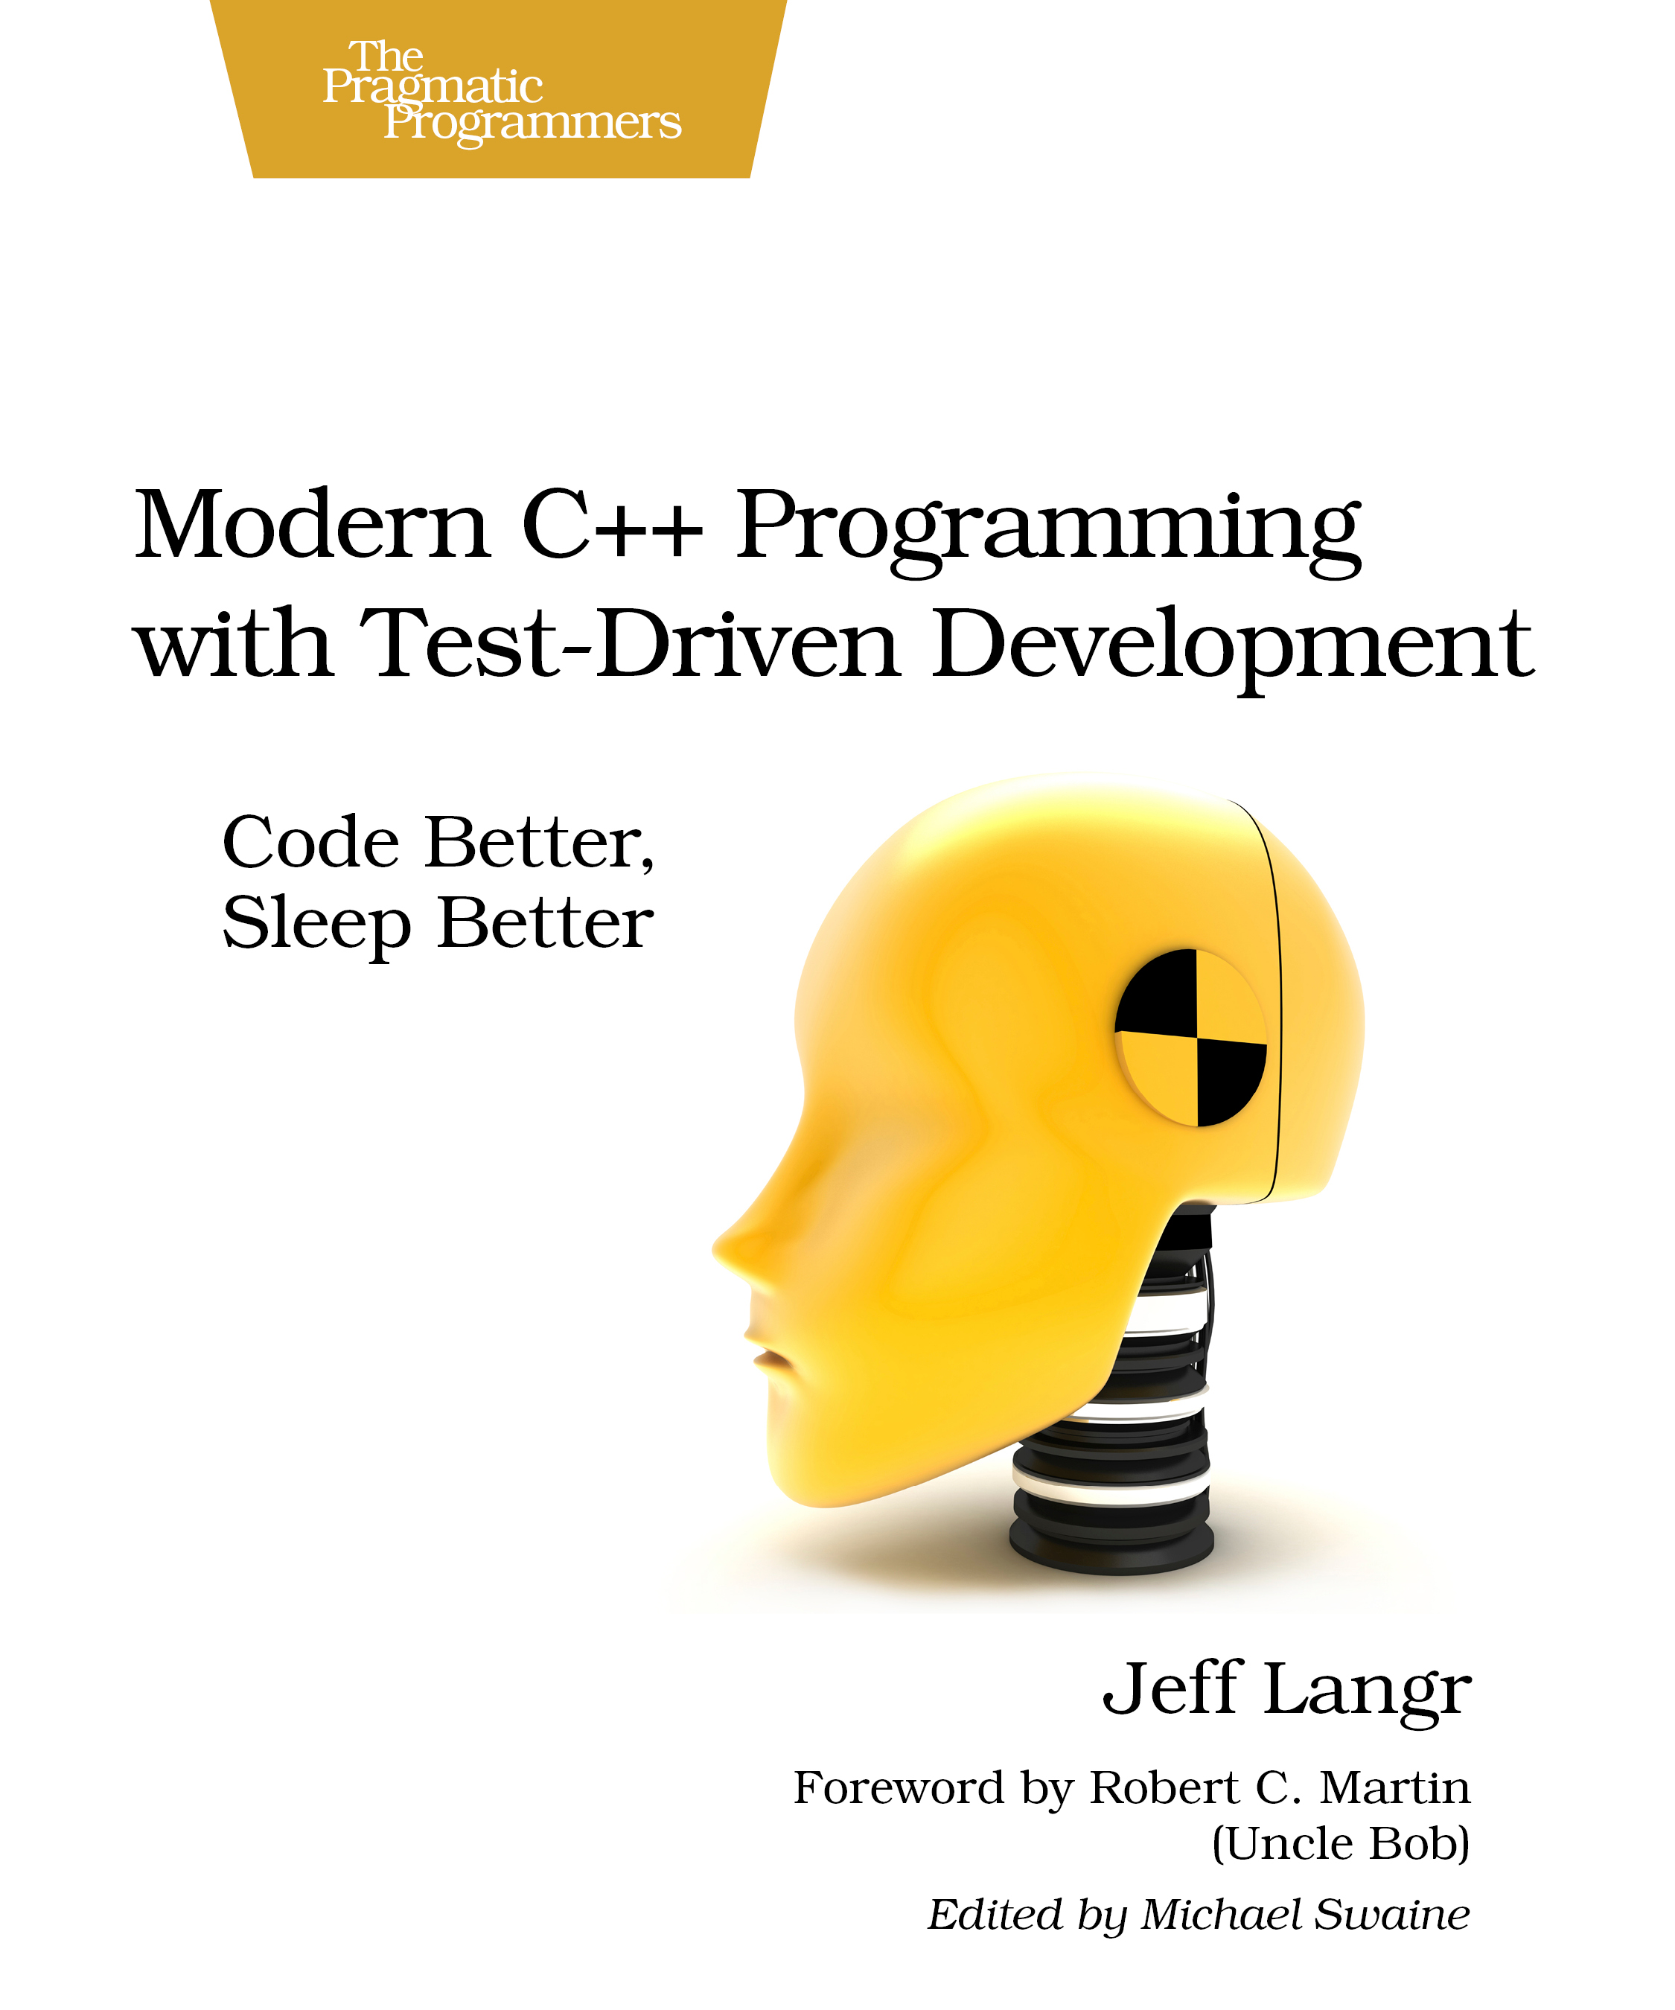
What is test-driven development?
A workflow for growing high-quality code

Slide 3

Why tests?
Goal: high-quality (bug-free) code
Measure your code is correct
Allowing for tests improves your software design
Tests are a form of documentation
A common language for collaboration

Slide 4
Examples
is_prime <- function(x) {
# check input arguments
# calculation
# return TRUE or FALSE
}

Slide 5
Developing is_prime
Cycle test-driven development:
  Red: write a test that fails
  Green: pass the test
  Refactor: improve the new code, clean up mess, check in code

Slide 6

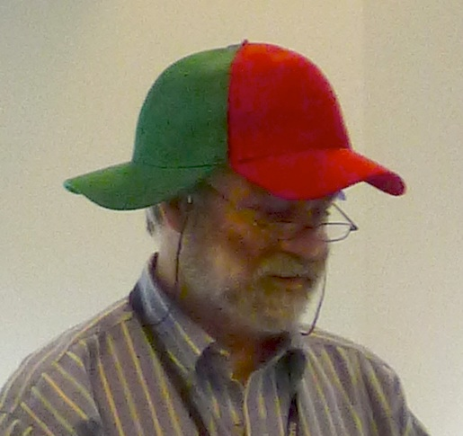
Development is_prime
As small steps as possible
One step at a time

Slide 7
Testing environment
library(testit)
assert(
# something
)

Slide 8
Red: write a test that fails
library(testit)
assert(IsPrime(2))

Slide 9
Green: pass the test
library(testit)
IsPrime <- function(x) {
return (TRUE)
}
assert(IsPrime(2))

Slide 10

Refactor
Checking in
git add --all :/
git commit -m
“IsPrime: 2 is prime”

Slide 11
Red: write a test that fails
# Previous code
assert(!IsPrime(4))

Slide 12
Green: pass the test
IsPrime <- function(x)
{
if (x == 2) return (TRUE)
for (i in seq(2,x-1))
{
if (x %% i == 0) return (FALSE);
}
return (TRUE)
}

Slide 13
Refactor
Check in
git add --all :/
git commit -m
“IsPrime: 4 is not prime”

Slide 14
Red: write a test that fails
assert(!IsPrime(“Two”))

Slide 15
Green: pass the test
is_integer <- function(N){
!grepl(
"[^[:digit:]]",
format(N, digits = 20, scientific = FALSE)
)
}
IsPrime <- function(x)
{
if (!is_integer(x)) return (FALSE)
# Rest of code
}

Slide 16
Refactor
Check in
git add --all :/
git commit -m
“IsPrime: words are not prime”

Slide 17
IsPrime end result
library(testit)
is_integer <- function(N) {
!grepl("[^[:digit:]]", format(N, digits = 20, scientific = FALSE))
}
IsPrime <- function(x)
{
if (!is_integer(x)) return (FALSE)
if (x == 2) return (TRUE)
for (i in seq(2,x-1))
{
if (x %% i == 0) return (FALSE);
}
return (TRUE)
}

Slide 18
All IsPrime tests
assert(IsPrime(2))
assert(!IsPrime(4))
assert(!IsPrime(“Two”))

Slide 19
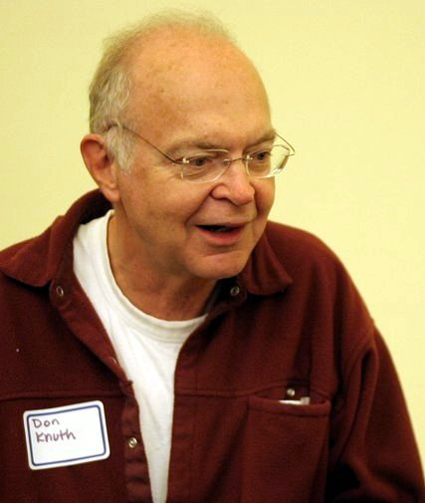
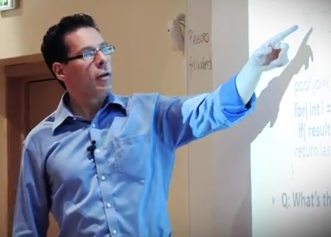

Run-time speed
Premature optimization
is the root of all evil
Donald Knuth
It is far easier
to make correct code fast
than to make fast code correct
Herb Sutter
He who sacrifices
correctness for speed,
deserves neither
You can test if your new function is faster and gives the same correct results
Hadley Wickham

Slide 20
Benchmarks

Slide 21

Collaboration
Tests can be used as a mean to let others contribute
Example:
  I implemented a Wilcoxon's signed rank test, especially a function to get the rank of each value, following Heath
  Later, Senbong G contacted me and helped us fix my function
In this example, syntax is not important

Slide 22
C++ tests
values = { 10.0, 20.0, 30.0 };
expected = { 1.0, 2.0, 3.0 };
results = GetRanks(values);
assert(expected == results);
values = { 30.0, 10.0, 20.0 };
expected = { 3.0, 1.0, 2.0 };
results = GetRanks(values);
assert(expected == results);

Slide 23
C++ tests
//From Heath, page 263
values = { 0.6, 1.4, 4.0, 13.0, 14.5, 9.4, 11.4, 12.6, 4.0 };
expected = { 1.0, 2.0, 3.5, 8.0, 9.0, 5.0, 6.0, 7.0, 3.5 };
results = GetRanks(values);
// Heath, page 263, no zero value
assert(expected == results);
//From Heath, page 263, now with zero added
values = { 0.6, 1.4, 0.0, 4.0, 13.0, 14.5, 9.4, 11.4, 12.6, 4.0 };
expected = { 1.0, 2.0, 0.0, 3.5, 8.0, 9.0, 5.0, 6.0, 7.0, 3.5 };
results = GetRanks(values);
// Heath, page 263, with zero value
assert(expected == results);

Slide 24
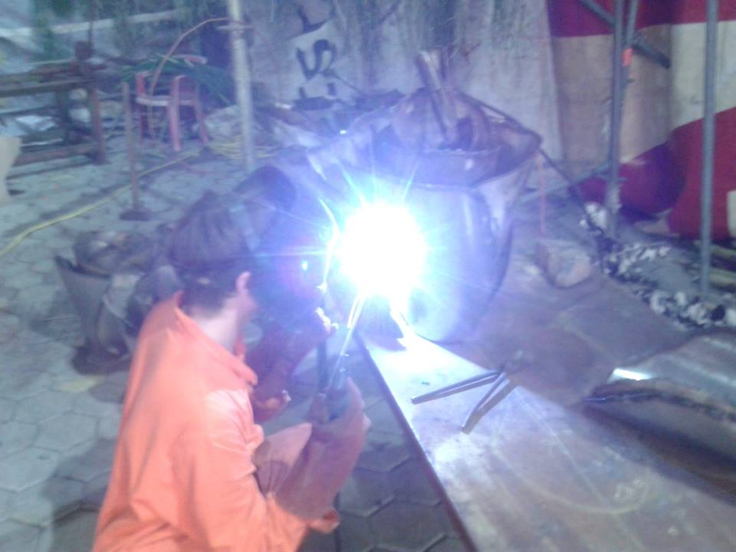

Email from Senbong G
I think I found a bug
How can that be?
Can you convince me with a test?
Sure, the tests on the
next slide all fail
Richel Bilderbeek
Senbong G

Slide 25
C++ tests
values = { 1.0, 1.0, 1.0, 2.0, 2.0, 3.0, 3.0, 3.0};
expected = { 2.0, 2.0, 2.0, 4.5, 4.5, 7.0, 7.0, 7.0};
results = GetRanks(values);
assert(expected == results);
values = { 0.0, 0.0, 0.0 };
expected = { 0.0, 0.0, 0.0 };
results = GetRanks(values);
assert(expected == results);

Slide 26
Email from Senbong G
Blimey, you're right!
I'll fix it within a week
No need to,
I already did,
here is the code
Thanks!
Richel Bilderbeek
Senbong G

Slide 27
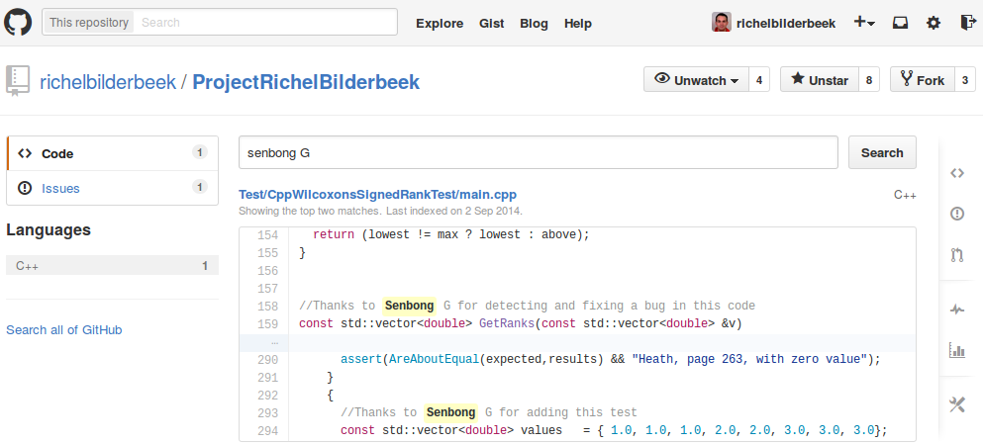
Eternal glory

Slide 28
Conclusion
Test-driven development
  uses a systematic approach
  delivers testable code
  delivers code that has been tested to be correct
  does not test more than needed
  facilitates collaboration

