Slide 1
Package development

Slide 2
Create an R package

Slide 3
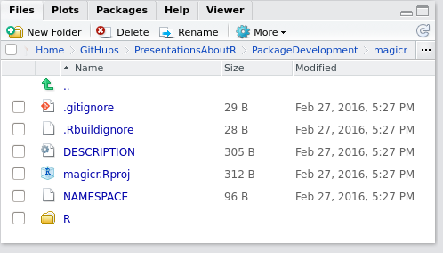
Create a package folder structure
library(devtools)
devtools::create()

