Slide 1
KnokFighter
The storyline
© 2004 Richel Bilderbeek and Joost van den Bogaart

Slide 2
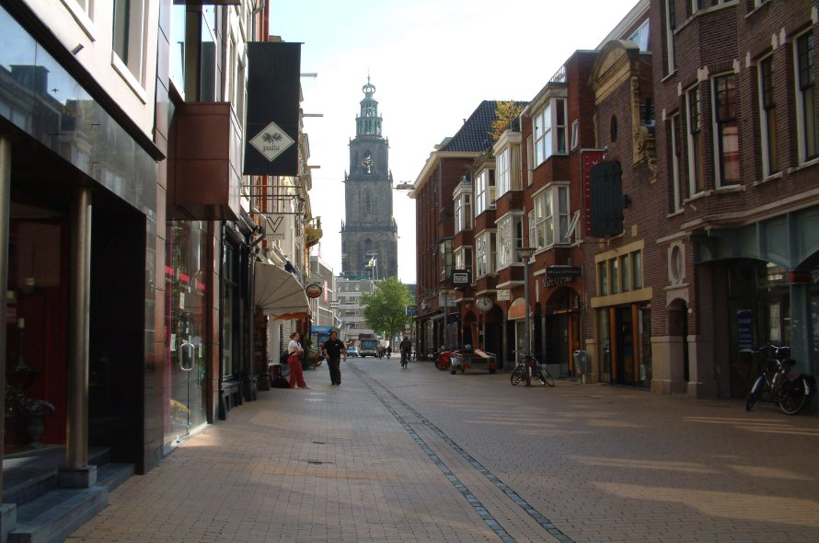
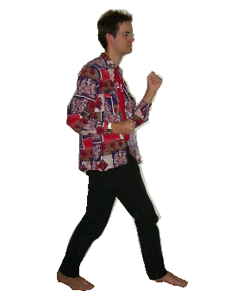
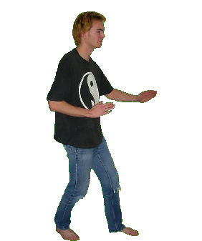
Once upon a time…
Our two heroes walked on the street

Slide 3
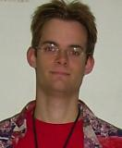
Hey, what happens to the street?

Slide 4

Our two heroes walked on a strange rainbow colored street

Slide 5
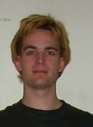
I think we are in a parallel dimension!

Slide 6
How did we get here? I’ve seen no wormhole

Slide 7
I think something transported us over here

Slide 8
Now, then let’s check out this dimension!

Slide 9
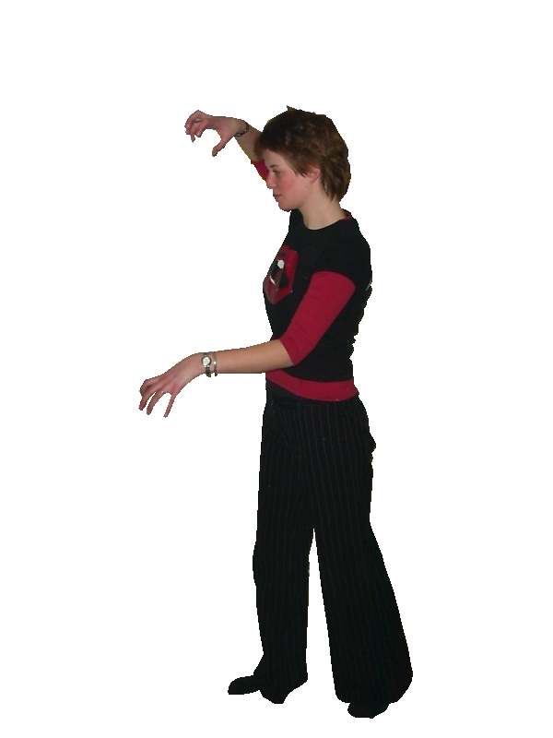
Our two heroes then met…

Slide 10
Hey, it’s my girlfriend! How did she get here?

Slide 11
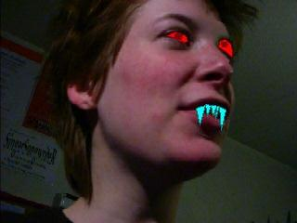
Annerike looked different…

Slide 12
Hey Richel, she looks kind of different!

Slide 13
The thing you see is parellel-dimension crossing love!

Slide 14
Then…

Slide 15
AAAAHHH! She bit me!

Slide 16
I think that in this dimension, she is some kind of monster!

Slide 17
AAAAHHH! She bites me again!

Slide 18
I will kill her for you!

Slide 19
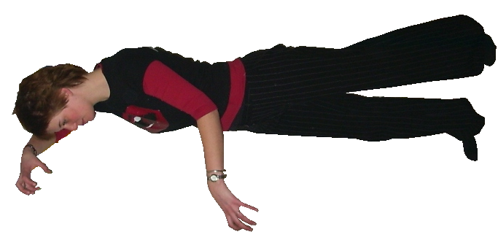
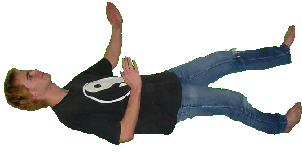
Joost kills her…

Slide 20
Thanks!

Slide 21
I think we just met this dimension’s EVIL!

Slide 22
Yes. Evil certainly is mighty in this dimension!

Slide 23
Would have we been mere Earthlings, she would have killed us!

Slide 24
Yes! It really pays off to be as strong as we are!

Slide 25
So, because we are strong and EVIL is strong, lets join EVIL!

Slide 26
Good idea! That certainly is relaxed!

Slide 27
Now, then lets go contact the emperor of EVIL!

Slide 28
On the way killing some good guys!

Slide 29
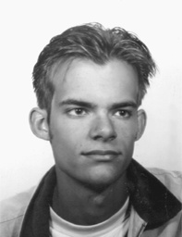
Then…

Slide 30
OH NO! It is Geert, my twin brother!

Slide 31
Shit! Look what happens to him!

Slide 32
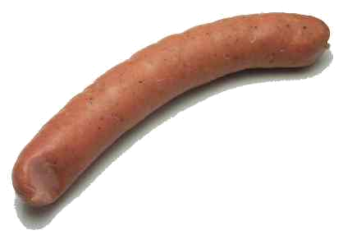
A monster comes out of Geert

Slide 33
OH NO! My brother has died because of EVIL!

Slide 34
Let’s destroy EVIL in this dimension to avenge ourselves!

Slide 35
YES! We will destroy EVIL to the utterly root!

Slide 36
Later in the game…

Slide 37
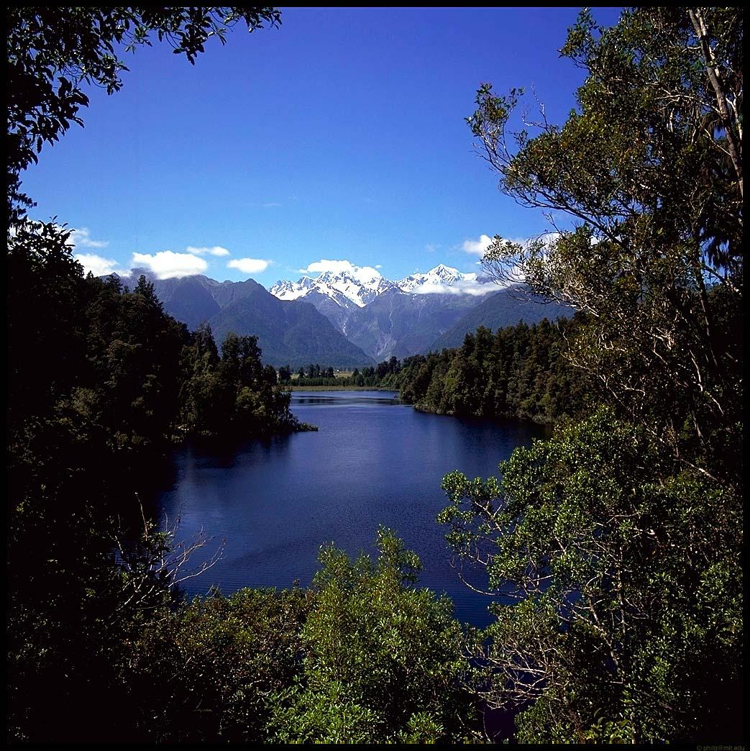
Our heroes met a girl in the forest

Slide 38
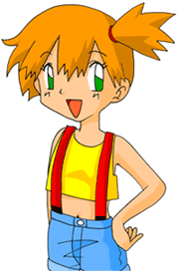
She rose out of the lake, but her hair was not wet, nor were her pants….

Slide 39
I will give you a magic armor!

Slide 40
Why would I need one?

Slide 41
To protect you from EVIL!

Slide 42
O yes, I forgot!

Slide 43
But why would I need one?

Slide 44
To protect you from EVIL!

Slide 45
Huh??

Slide 46
To make you more attractive to women who fancy men carrying magic armors!

Slide 47
O yes, I forgot!

Slide 48
Our heroes received their magic armors

Slide 49
I bless you to succeed in your quest to destroy EVIL!

Slide 50
How?

Slide 51
With these magic words!

Slide 52
Which magic words?

Slide 53
Yes, I did not hear you say something like UYKLFROLH

Slide 54
I have the power to bless people without saying UYKLFROLH!

Slide 55
Thanks for your blessing!

Slide 56
Thanks a lot!

Slide 57
That you may kill many monsters serving EVIL!

Slide 58
Later in the game…

Slide 59
Huh? Who’s that?

Slide 60
It is I, Geert! Your brother!

Slide 61
Geert? Are you the EMPEROR OF EVIL?

Slide 62
Yes I am the ultimate EVIL that caused all shitty things!

Slide 63
But you died!

Slide 64
Yes! We saw a bratwurst coming out of you head!

Slide 65
That was not me, but a clone of me!

Slide 66
Huh?

Slide 67
I let a clone of me die, attempting to kill Joost!

Slide 68
How would Joost die if you let a clone die?

Slide 69
I thought that Joost would cry himself to death!

Slide 70
Luckily I survived this vile assassination!

Slide 71
Yes! Instead it let Joost swear to destroy EVIL to the utterly root!

Slide 72
Yes! Because of your ‘death’, I sweared to destroy you!

Slide 73
Not if I destroy you first!

Slide 74
Not if I destroy you first!

Slide 75
Not if I destroy you first!

Slide 76
Not if I destroy you first!

Slide 77
Not if I destroy you first!

Slide 78
Not if I destroy you first!

Slide 79
The final battle begins…

