Slide 1
Project Richel Bilderbeek
Richel Bilderbeek's work
http://www.richelbilderbeek.nl/ProjectRichelBilderbeek.nl
© 2010 Richel Bilderbeek

Slide 2
Goal
To bundle all Richel Bilderbeek's code in three executables
  Console
  Desktop
  Web application

Slide 3
Why?
Programming for different GUI's improves class design
Encourages same idiom for classes with similar function
Test if a code edit did not break other programs
Get an overview of my own work
Will be the starting point of some future tools

Slide 4
Menu structure
Menu must be created dynamically, from all derived classes of RichelBilderbeek::Program
Program dialog constructor must be called when the user wants to start it (use Lazy_init class)

Slide 5
Menu structure
Programs must be grouped
  Classes
  Games
  Projects
  Tools
Additional menu items:
  Welcome
  About
    About Bep
    About this program
    Gallery

Slide 6
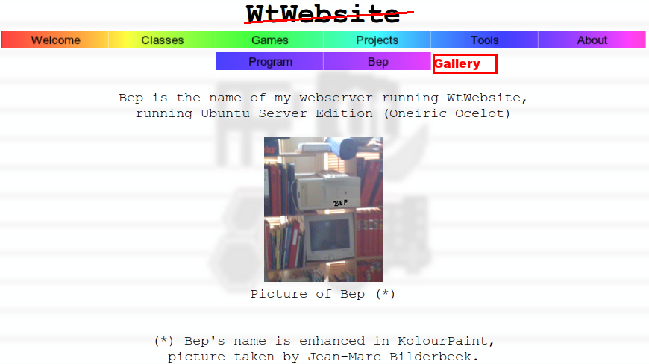
Menu structure for desktop application

Slide 7
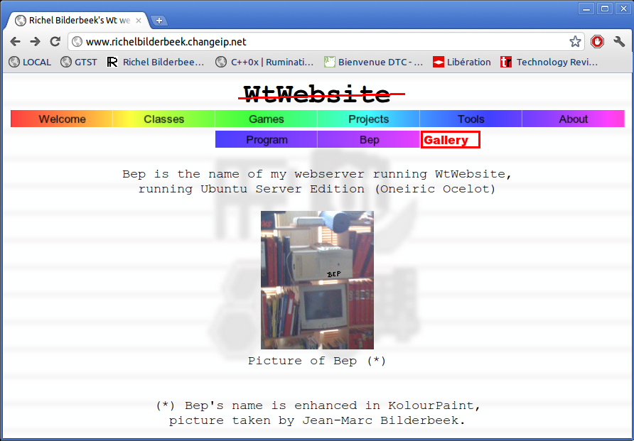
Menu structure for web version

Slide 8
Gallery
Goal: to view the status and screenshot(s) of each application
A table contains all statuses gives an overview
Hovering over a status with the mouse displays a screenshot when possible

Slide 9
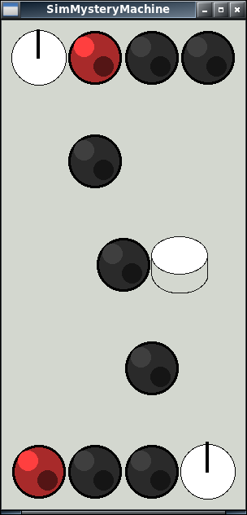
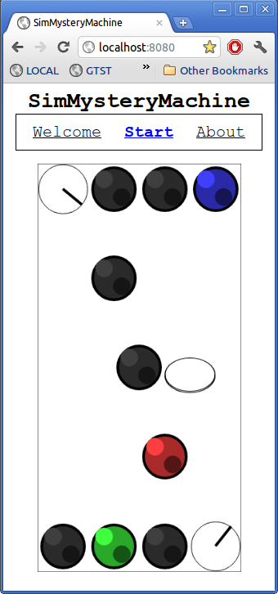
Gallery
Name
SimMysteryMachine

Slide 10
Gallery
Header row
Name
SimMysteryMachine
Scrollable rows, max five rows visible
Plenty of room for a screenshot!

