Slide 1
TestChess
http://www.richelbilderbeek.nl/ToolTestChess.htm
© Richel Bilderbeek

Slide 2
Selection
Move with red cursor
After selection a piece that can be moved
  Piece becomes big with a green background
  Cursor remains red
  Where piece can be moved to gets a blue background

Slide 3







TestChess selection: no piece selected

Slide 4
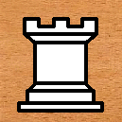

TestChess selection: before selecting knight

Slide 5


TestChess selection: knight selected

Slide 6


TestChess selection: selecting target square

