Slide 1


Using BEAST2
© 2016 Richel Bilderbeek
www.github.com/richelbilderbeek/Science

Slide 2
What, why, mastery
What: Bayesian Evolutionary Analysis by Sampling Trees
Why: Bayesion phylogenetic inference includes uncertainty
Mastery: understand Bayesian analysis and BEAST2 priors

Slide 3
Parts
Usage
Details

Slide 4
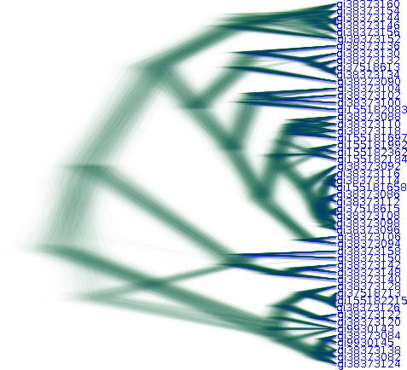

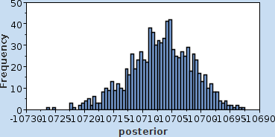
Usage
Alignment
I think
it works
like this
Priors
Posterior

Slide 5
Demo

Slide 6
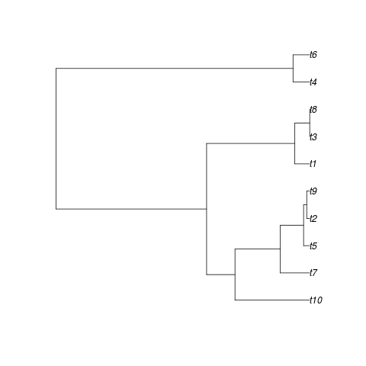
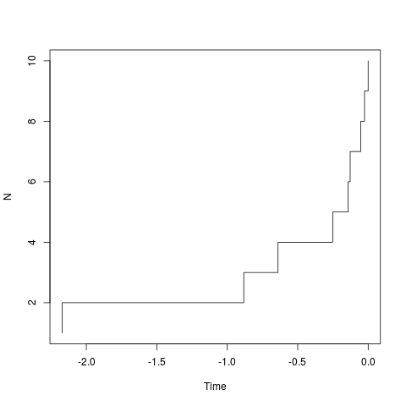
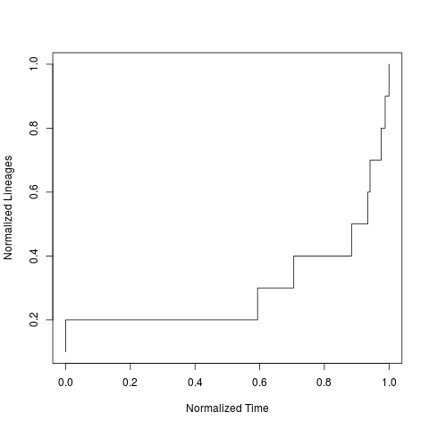
Analysis
Posterior phylogenies
Lineages-Through-Time (LTT)
Normalized LTT (nLTT)
Posterior parameters

Slide 7
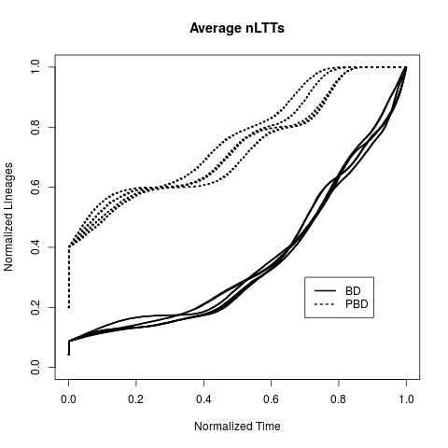
Use cases
Do two treatments give differently-shaped phylogenies?
The BD treatment
results in an
exponential increase
in lineages:
in 'tippy' trees
The PBD treatment
does not have this
exponential increase: it
produces more 'stemmy' trees

Slide 8
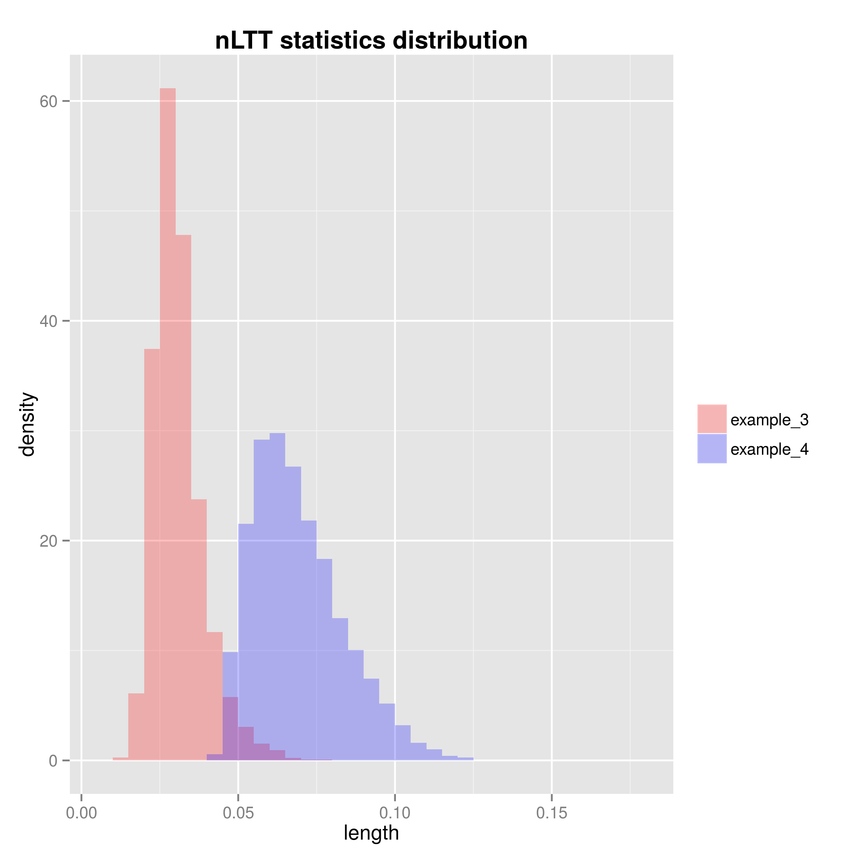
Use cases
How good are two treatments at re-inferring a known phylogeny?
The treatment of
example 3
can reproduce
phylogenies with
less error

Slide 9
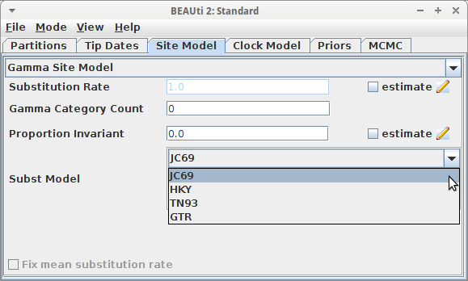
BEAST2 substitution models
JC69
HKY
TN93
GTR

Slide 10
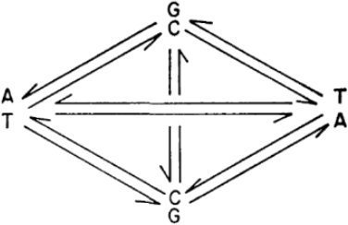
JC69
Equal base frequencies
Equal mutation rates
 | A | C | G | T
A | * | 1 | 1 | 1
C | 1 | * | 1 | 1
G | 1 | 1 | * | 1
T | 1 | 1 | 1 | *
Jukes, Thomas H., and Charles R. Cantor. "Evolution of protein molecules.", 1969

Slide 11
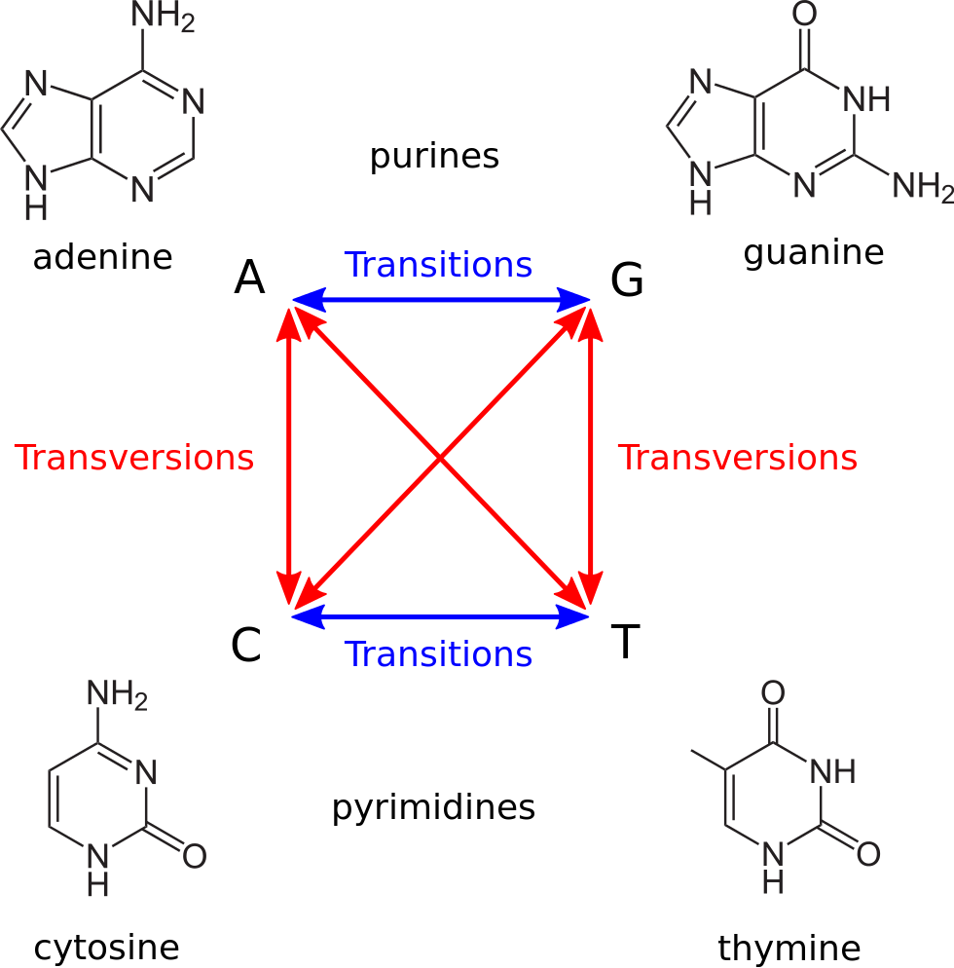
HKY
Transitions ≠ transversions (κ)
π_{A} ≠ π_{C} ≠ π_{G} ≠ π_{T}
"Transitions-transversions-v4" by Petulda
 | A | C | G | T
A | * | π_{C} | π_{G}κ | π_{T}
C | π_{A} | * | π_{G} | π_{T}κ
G | π_{A}κ | π_{C} | * | π_{T}
T | π_{A} | π_{C}κ | π_{G} | *
Hasegawa M, Kishino H, Yano T (1985). "Dating of human-ape splitting by a molecular clock of mitochondrial DNA"
Notes:
"Transitions-transversions-v4" by Petulda - Own work. Licensed under CC BY-SA 4.0 via Commons - https://commons.wikimedia.org/wiki/File:Transitions-transversions-v4.svg#/media/File:Transitions-transversions-v4.svg

Slide 12
Details
What is this Bayesian inference?
How does the MCMC algorithm work?
Which priors should I choose?
How do I check my results?
How do I analyse my results?

Slide 13
Bayesian inference
P(H|E) = P(E|H) . P(H) / P(E)
P(H|E): posterior distribution
P(E|H): likelihood
P(H): prior distribution
P(E): marginal likelihood

Slide 14
Example from [1]
Elvis Presley had a twin brother who died at birth. What is the probability that Elvis had an identical twin? Assume 8% of all twins are monozygous.
[1] MacKay, David JC. Information theory, inference and learning algorithms. 2003.

Slide 15
Bayesian inference
P(H|E) = P(E|H) . P(H) / P(E)
H: Elvis had an identical twin
E: A male sibling
P(H|E): 14.8148148%
P(E|H): 100%
P(H): 8%
P(E): (100% * 8%) + (0.5 * 92%) = 0.54

Slide 16
Bayesian inference
P(H|E) = P(E|H) . P(H) / P(E)
H: Elvis's had a fraternal twin
E: A male sibling
P(H|E): 85.1851852%
P(E|H): 50%
P(H): 92%
P(E): (100% * 8%) + (50% * 92%) = 0.54

Slide 17
Sibling is male | Brother: 50% | Sister: 50%
Monozygous: 8% if gender is identical | 4 | 0
dizygous | 46 | 50

Slide 18
Bayesian inference
f(θ|D) = Pr(D|θ) . f(θ) / Pr(D)
f(θ|D): posterior distribution
Pr(D|θ): likelihood
f(θ): prior distribution
Pr(D): marginal likelihood
D: the sequence data
Θ: model parameters including the tree

Slide 19
MCMC algorithm
What: Markov-Chain Monte-Carlo
  King Markov [1]
  Phylogenetic inference
Why: get a representative sample
Mastery: understand its stochasticity
[1] Example from Richard McElreath, 'Statistical Rethinking'

Slide 20
King Markov and the Chain Islands
Visit
your
subjects
representatively
1/1
2/3
1/1
1/3
1/1
N 1 2 3 4 5 6

Slide 21
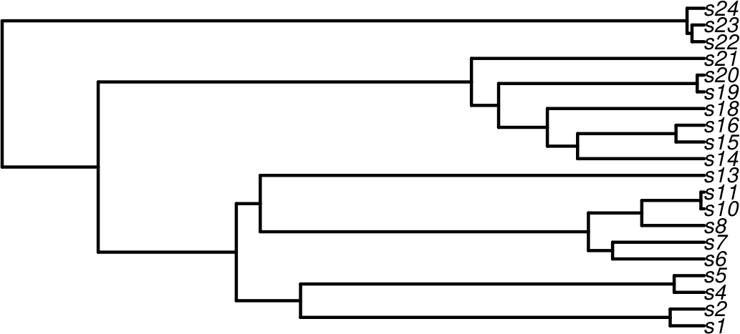
Phylogenies
Samples
the parameters
(including tree)
representatively
?
?
?
?
?
?
?
Pr(D₁|θ)
Pr(D₂|θ)
Pr(D₃|θ)
Pr(D₄|θ)
Pr(D₅|θ)
Pr(D₆|θ)

Slide 22
Phylogenies
Samples
the parameters
(including tree)
representatively
?
?
?
?
?
Pr(D₁|θ)
Pr(D₂|θ)
Pr(D₃|θ)
Pr(D₄|θ)
Pr(D₅|θ)
Pr(D₆|θ)

Slide 23
Metropolis-Hasting
Chance of acceptance going from 1 to 2
Pr(D₂|θ)
q(1→2)
α =
min
1,
Pr(D₁|θ)
q(2→1)
Pr(D₁|θ)
Pr(D₂|θ)

