Slide 1

PhD project overview
TECE meeting 2016-09-26
© 2016 Richel Bilderbeek
www.github.com/richelbilderbeek/Science

Slide 2
PhD project question
What if reproductive isolation takes time to establish?
In the context of phylogenetics
What errors do our current tools make?
How good are existing lineage-based models?
Can we make mechanistic models?

Slide 3
Project 1: BD on PBD
If reproductive isolation takes time to establish, what is the error made today in inferring a phylogeny?
Under which conditions does it hurt?
Are these conditions relevant and/or realistic?
Tool used: BEAST2, assumes speciation is instantaneous

Slide 4
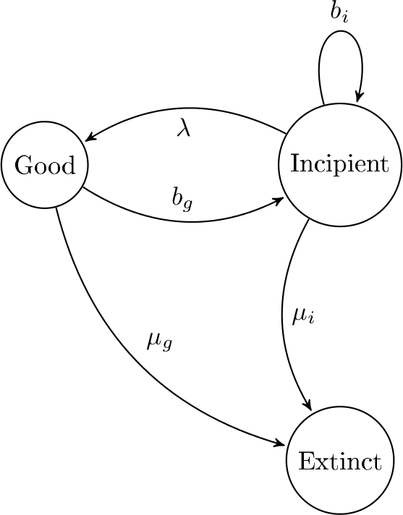
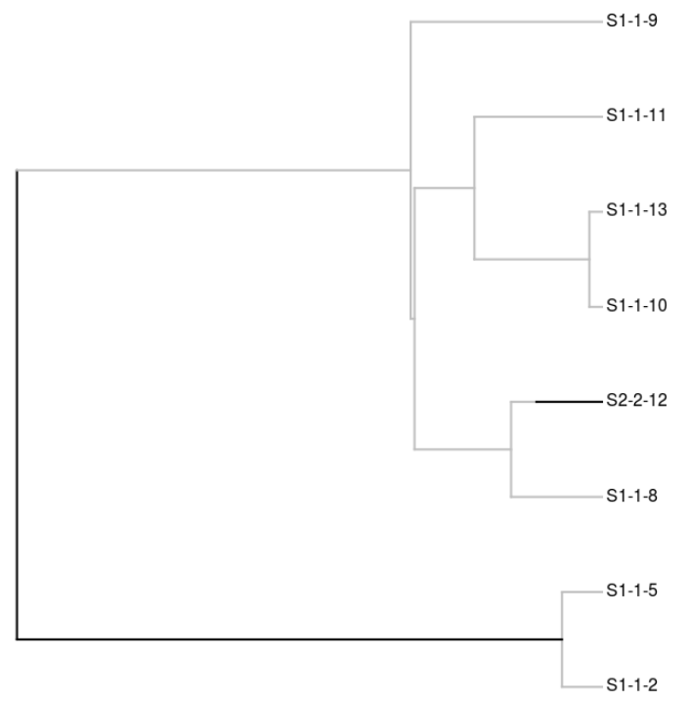
PBD model
Etienne, Rampal S., and James Rosindell. "Prolonging the past counteracts the pull of the present: protracted speciation can explain observed slowdowns in diversification." Systematic Biology (2011): syr091.

Slide 5
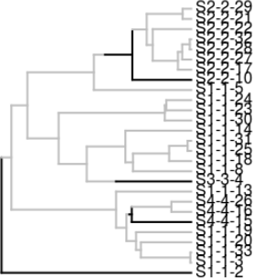
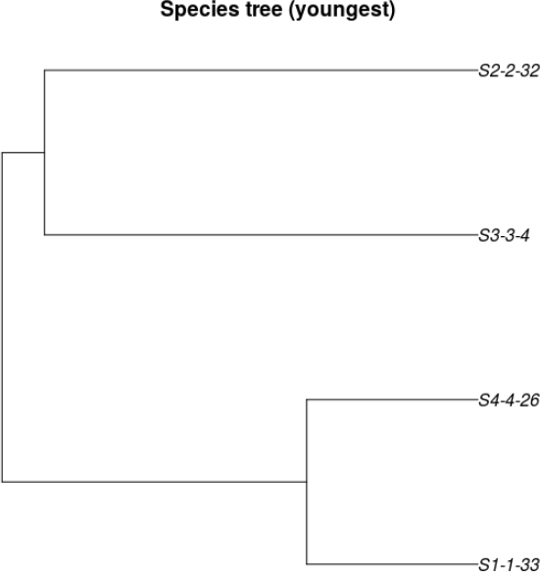
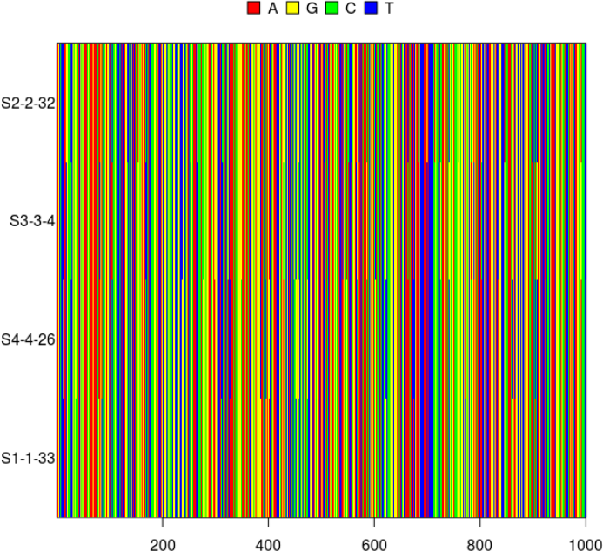
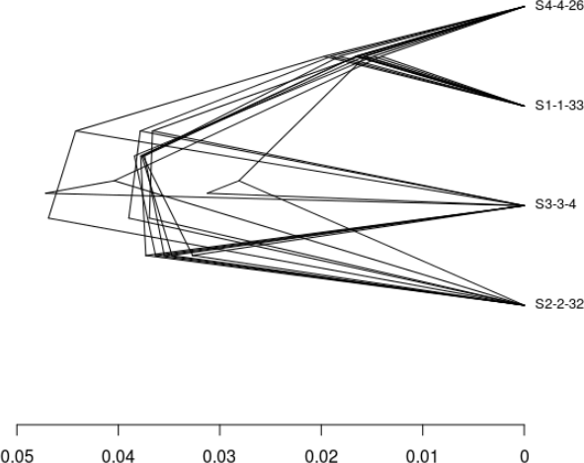

Approach
Simulate an incipient species tree
Sample species trees
Simulate DNA alignments
Infer species tree posterior
Measure difference/error
Notes:
Parameter space: http://www.mymodernmet.com/profiles/blogs/numen-for-use-string-prototype

Slide 6
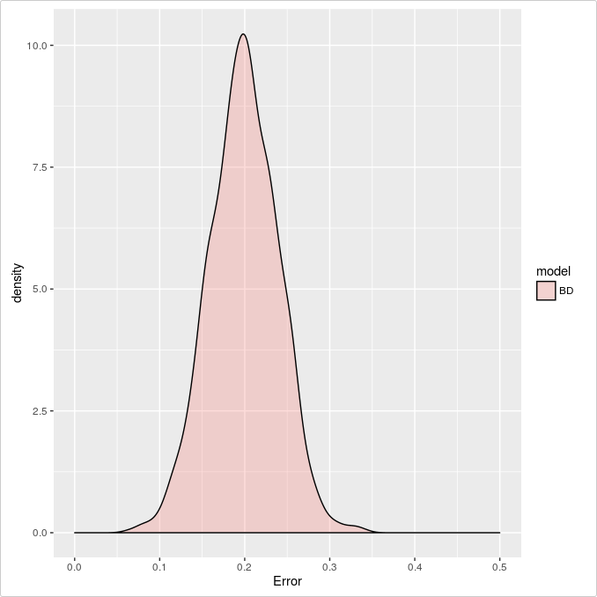

Goal

Slide 7
Predictions
Strong
protracted-
ness
Weak
input
data
Biologically
relevant?
Strong
input
data
Weak
protracted-
ness
Parameter
space

Slide 8
Project 2: phylogenesis
If reproductive isolation in nature takes time to establish, what kind of phylogenies do we expect?
Lineage-based
Mechanistic

Slide 9
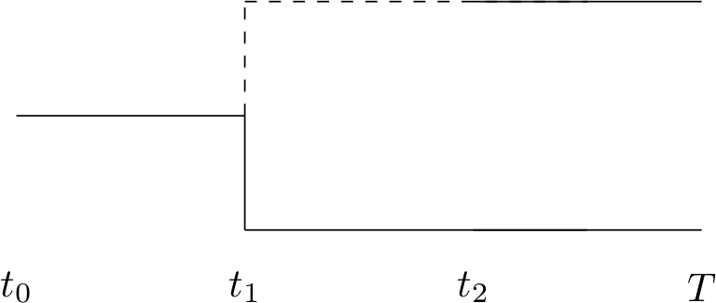
Interesting phylogenies
Allopatric, peripatric, sympatric?
What happens at t1 and t2?

Slide 10
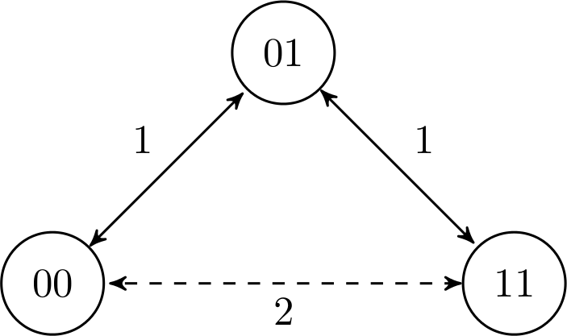
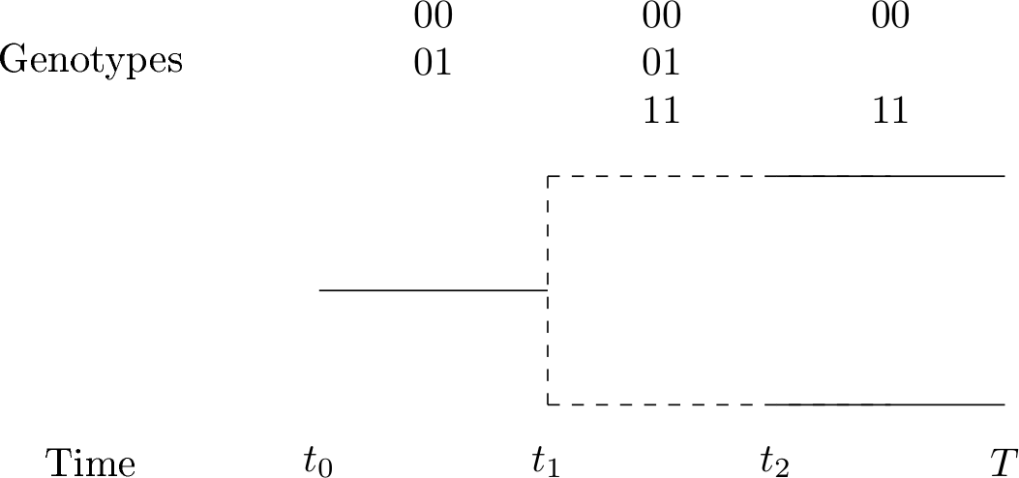
Mallet J (2008) A species definition for the Modern Synthesis. Trends Ecol Evol 10: 294–299.

Slide 11
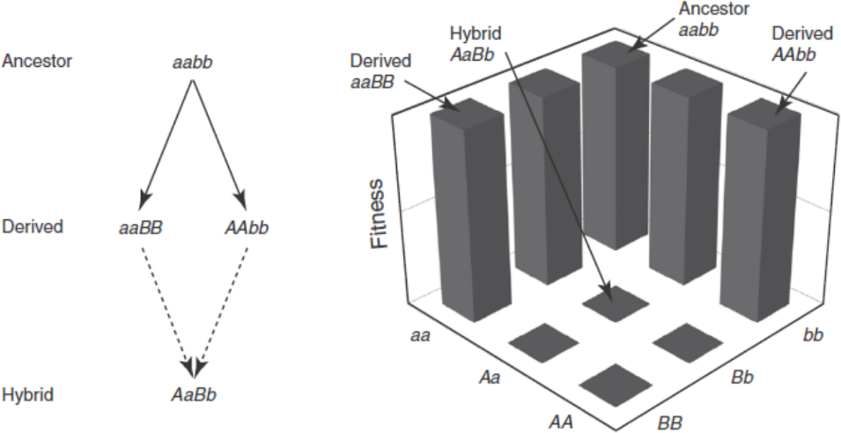
aabb
aaBB
aabb
aaBB
AAbb
aaBB
AAbb
Gavrilets, Sergey. Fitness landscapes and the origin of species (MPB-41). Princeton, NJ: Princeton University Press, 2004. Part 2: 'The Bateson-Dobzhansky-Muller Model'

Slide 12
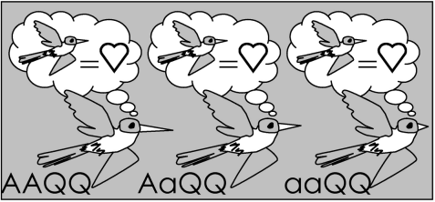
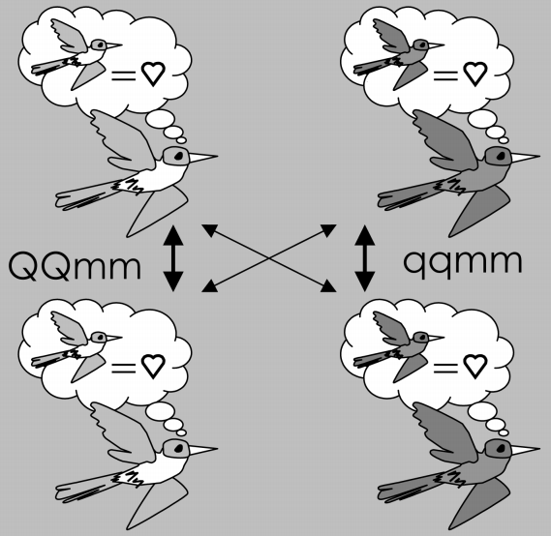
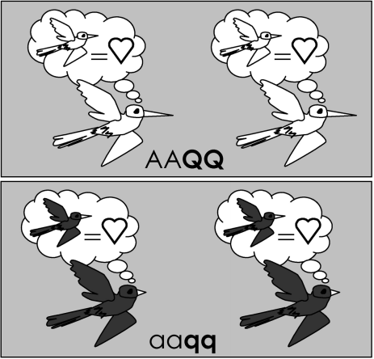
Van Doorn, G. S., & Weissing, F. J. (2001). "Ecological versus sexual selection models of sympatric speciation." Selection, 2, 17 - 40.

Slide 13
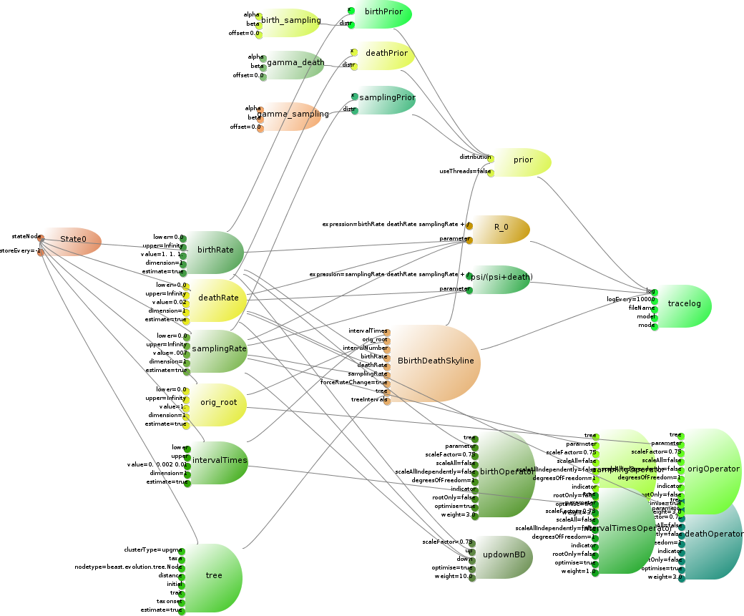
Project 3: time
If reproductive isolation in nature takes time to establish, how well can we infer it?
Put PBD model in phylogenetic tool
BEAST 2: A Software Platform for Bayesian Evolutionary AnalysisBouckaert, R., Heled, J., Kühnert, D., Vaughan, T., Wu, C-H., Xie, D., Suchard, MA., Rambaut, A., & Drummond, A. J. (2014). BEAST 2: A Software Platform for Bayesian Evolutionary Analysis. PLoS Computational Biology, 10(4), e1003537. doi:10.1371/journal.pcbi.1003537

Slide 14
Project 4: question
If reproductive isolation in nature takes time to establish, what could be a fourth research question?
Unknown

