Slide 1

PhD project overview
TECE meeting 2016-11-03
© 2016 Richel Bilderbeek
www.github.com/richelbilderbeek/Science

Slide 2
Project 1: BD on PBD
If reproductive isolation takes time to establish, what is the error made today in inferring a phylogeny?
Under which conditions does it hurt?
Are these conditions relevant and/or realistic?
Tool used: BEAST2, assumes speciation is instantaneous

Slide 3
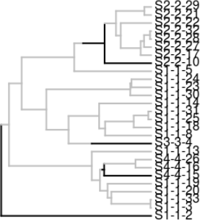
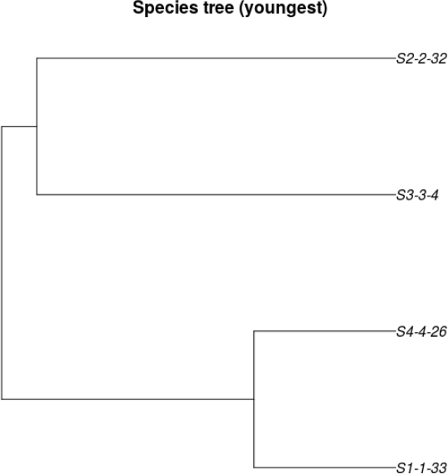
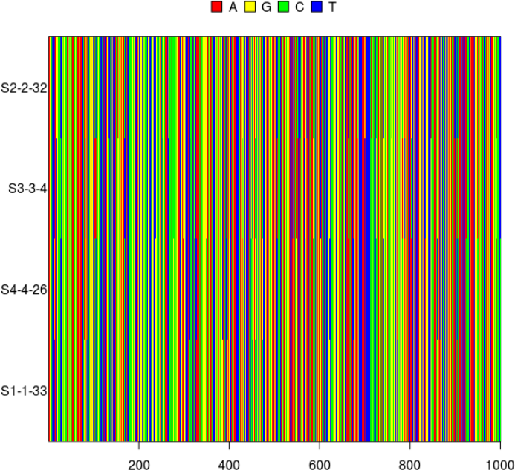
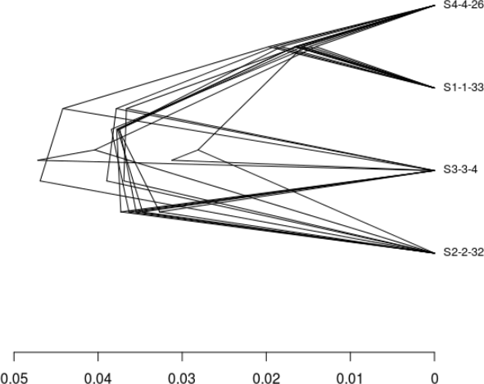

Approach
Simulate an incipient species tree
Sample species trees
Simulate DNA alignments
Infer species tree posterior
Measure difference/error
Notes:
Parameter space: http://www.mymodernmet.com/profiles/blogs/numen-for-use-string-prototype

Slide 4
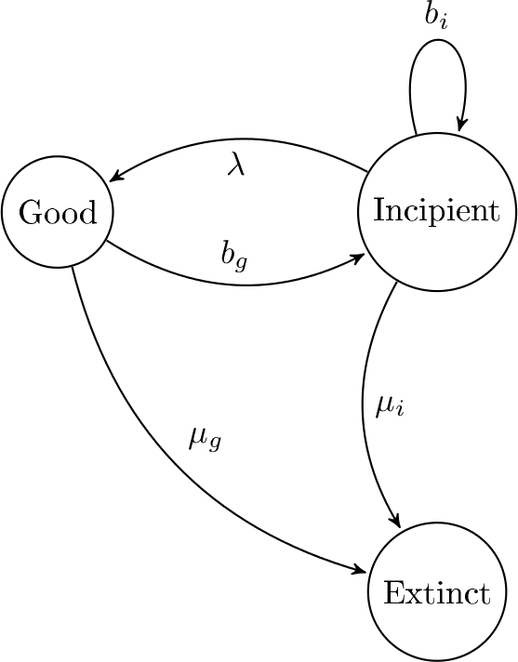
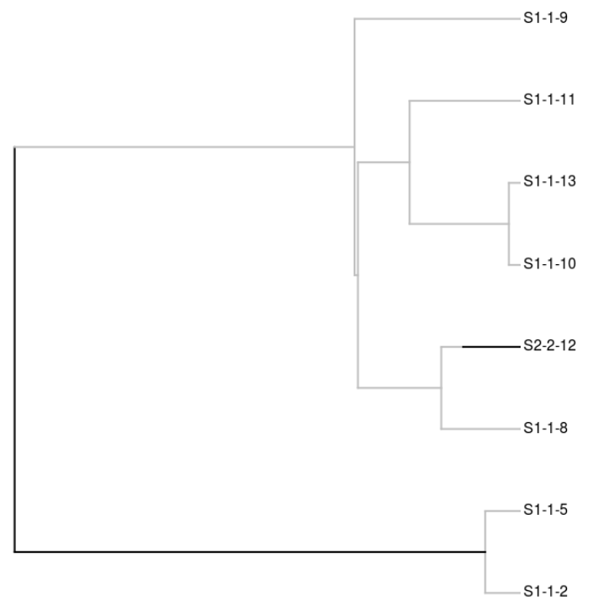
PBD model
Etienne, Rampal S., and James Rosindell. "Prolonging the past counteracts the pull of the present: protracted speciation can explain observed slowdowns in diversification." Systematic Biology (2011): syr091.

Slide 5
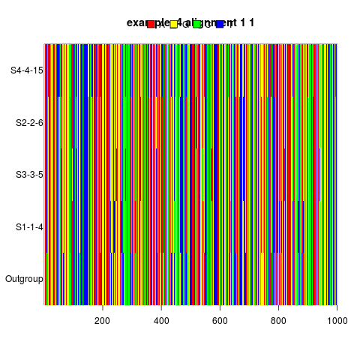
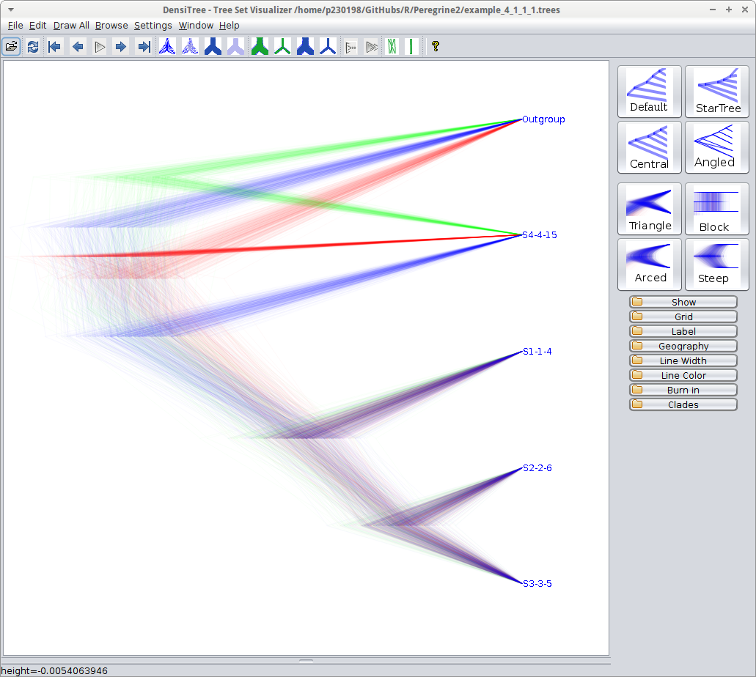
Parameter space
#
#
#

Slide 6
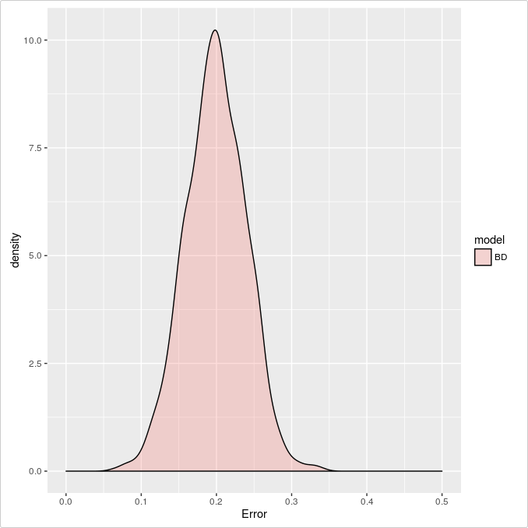

Idealized predictions

Slide 7
Predictions
Strong
protracted-
ness
Weak
input
data
Biologically
relevant?
Strong
input
data
Weak
protracted-
ness
Parameter
space

Slide 8
Predictions
Strong
protracted-
ness
Weak
input
data
Biologically
relevant?
Strong
input
data
Weak
protracted-
ness
Parameter
space

Slide 9
Quick
What is the effect of the speciation completion rate on the nLTT distribution?
  Low value: long incipient stage
  High value: short incipient stage
  Infinite: no infinite stage

Slide 10
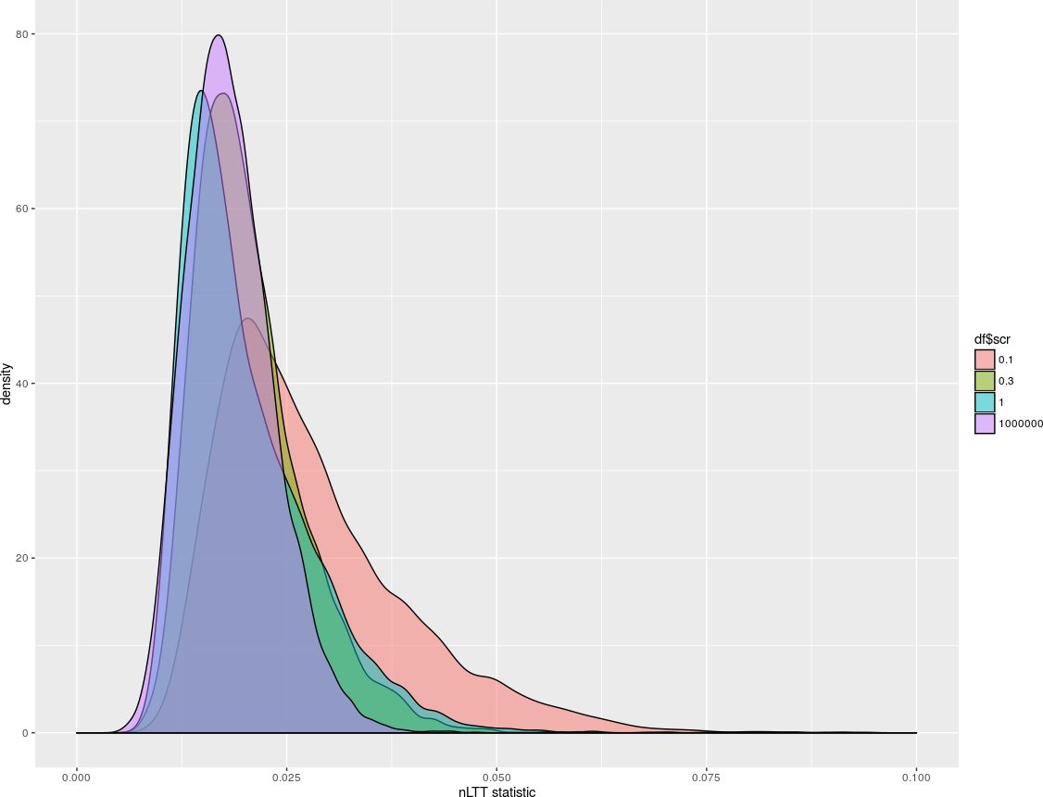
The effect of the speciation completion rate on the nLTT distribution
Max PBD
BD

Slide 11
Predictions
Strong
protracted-
ness
Weak
input
data
Biologically
relevant?
Strong
input
data
Weak
protracted-
ness
Parameter
space

Slide 12
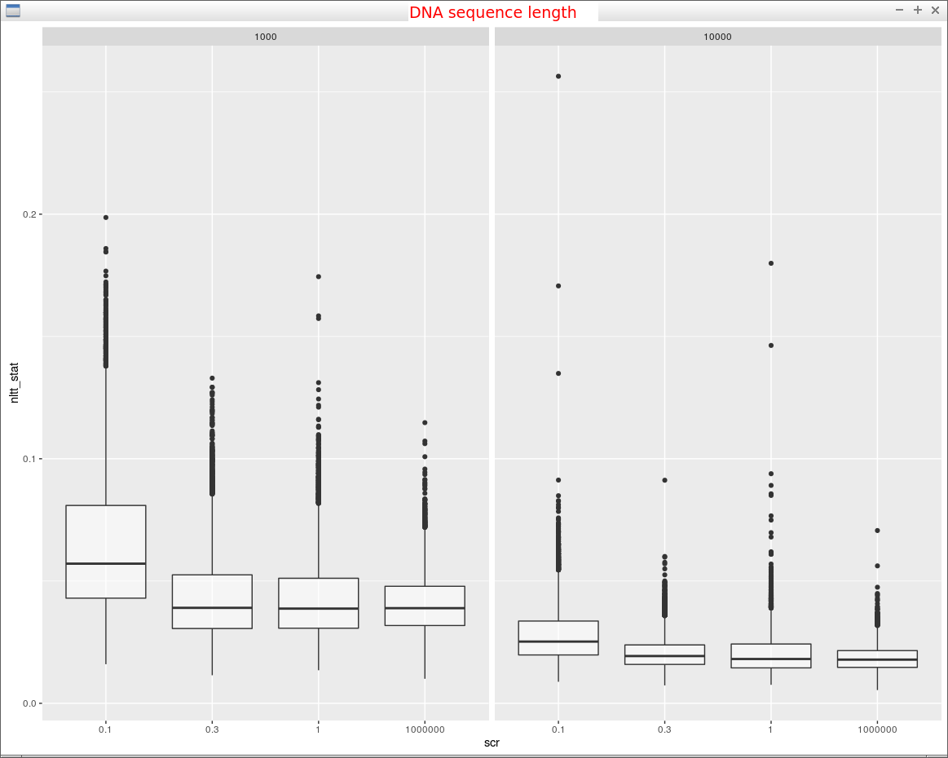
Max PBD
Weak
input
data
Strong
input
data
BD
Max PBD
BD

Slide 13
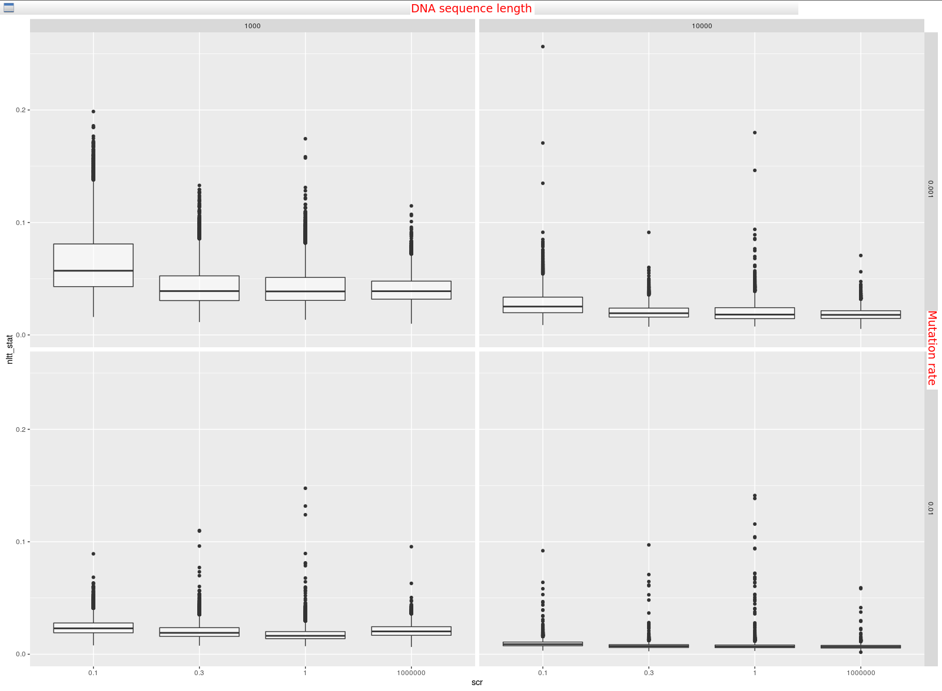
Weak
input
data
Max PBD
BD
Strong
input
data

Slide 14
Sure
But how do the nLTT statistic distributions look like?

Slide 15
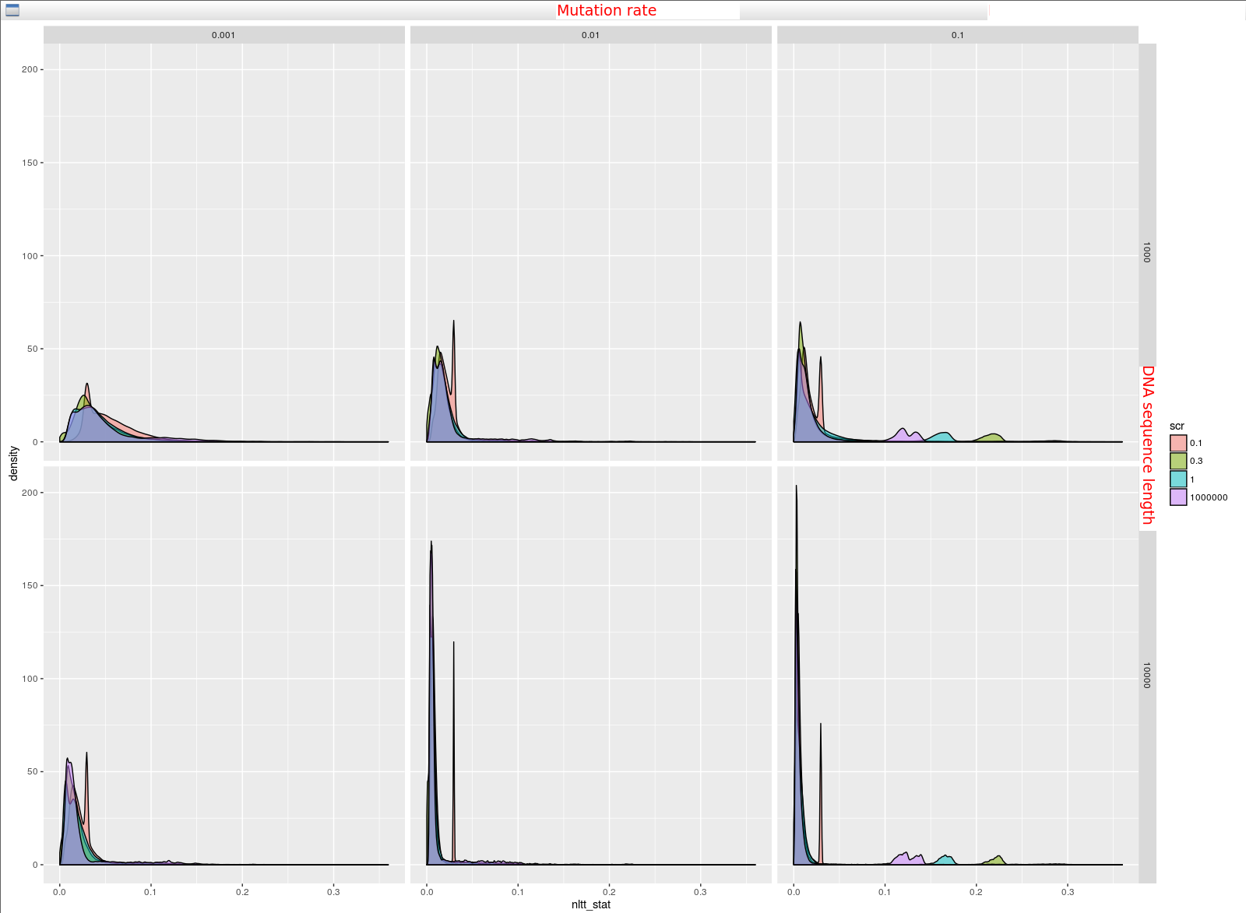
Max PBD
BD

Slide 16
Conclusion
Everything is in line with expectations
Need more replicates to see if bumps are artefacts
Replicates have run, analysis is running

