Slide 1
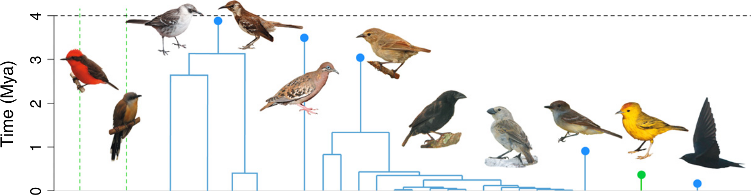
Why the Galápagos is a bad illustration of DAISIE...
Richel J.C. Bilderbeek

Slide 2
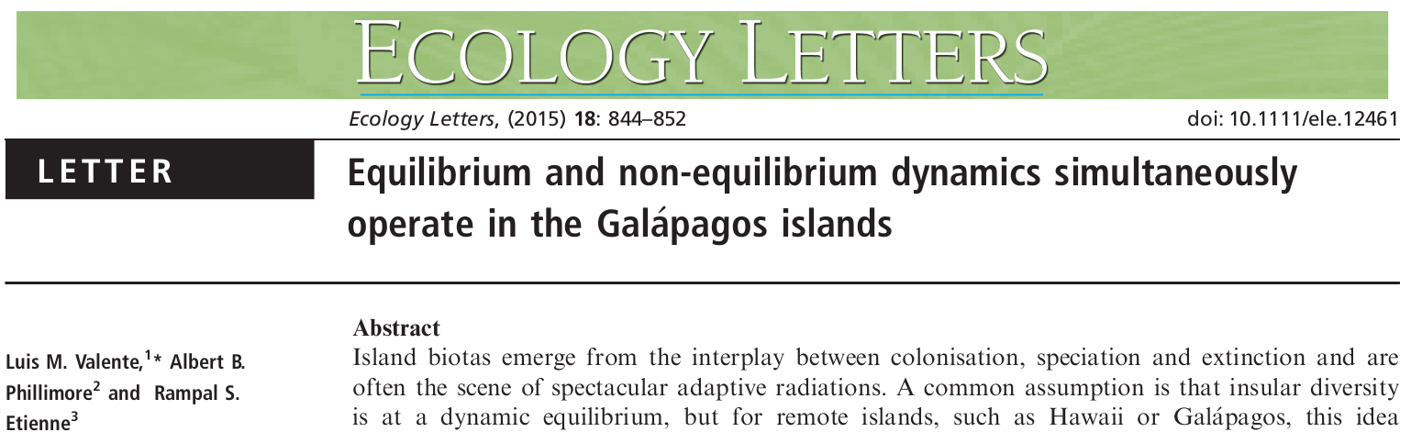
DAISIE
Valente et al. (2015)

Slide 3

DAISIE
“Here, we develop DAISIE (Dynamic Assembly of Islands through Speciation, Immigration and Extinction), a likelihood-based phylogenetic method that unifies the island biogeography framework of MacArthur & Wilson with the phylogenetic birth-death models popularised by Nee et al.”
DAISIE unifies
island biogeography
with
birth-death models
Valente et al. (2015)

Slide 4
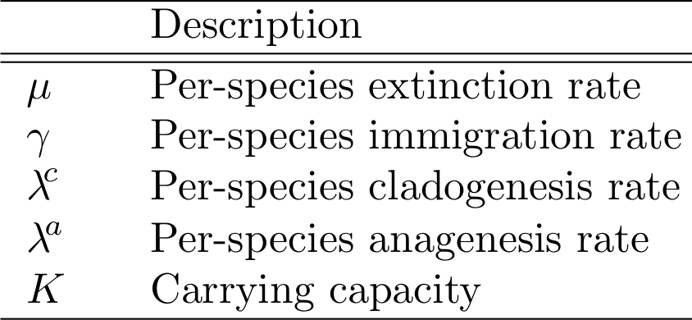
DAISIE
DAISIE unifies
island biogeography
with
birth-death models
Valente et al. (2015)

Slide 5
Figure 1
25 species, 8 clades
Valente et al. (2015)

Slide 6
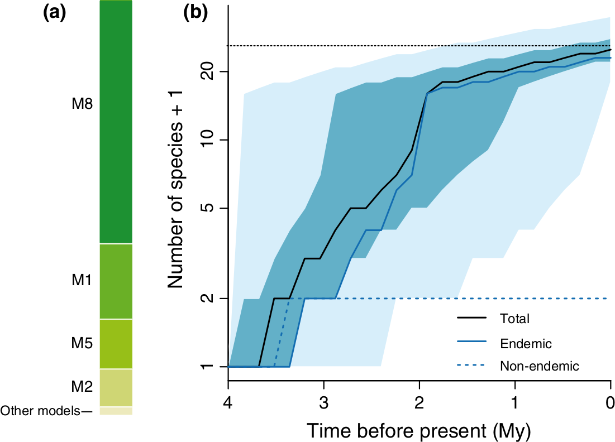
Figure 2
“According to the most strongly supported DAISIE model, the avifauna of the Galapagos islands does not tend towards a diversity steady state”
Valente et al. (2015)

Slide 7
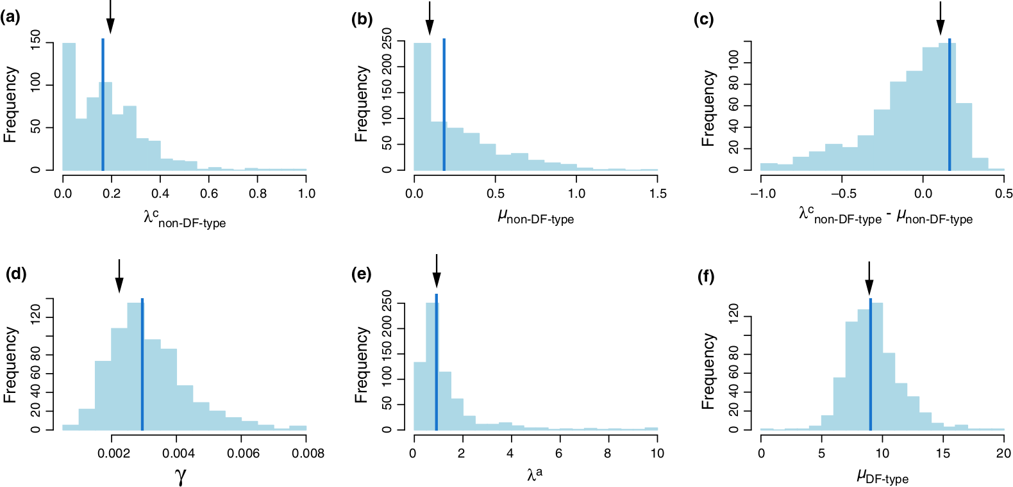
Figure 3
Valente et al. (2015)

Slide 8
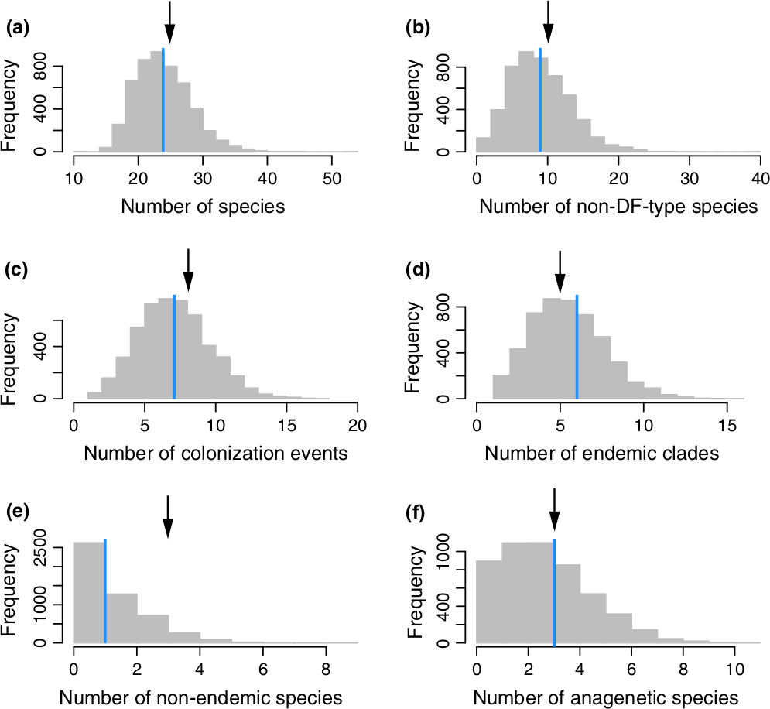
Figure 4
Valente et al. (2015)

Slide 9
My claim
The Galapagos are a bad illustration of DAISIE, because (1) the final result is weak, and (2) the figures oversell the story

Slide 10
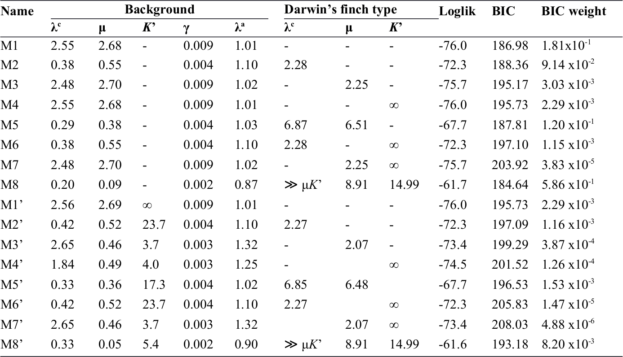
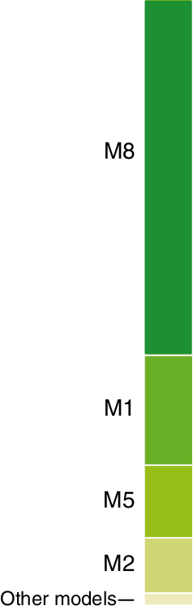
The result
Valente et al. (2015)

Slide 11
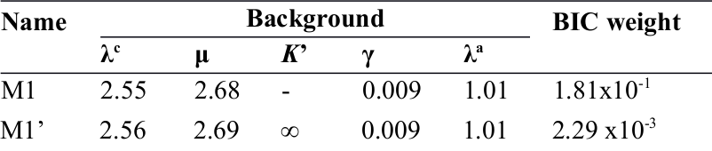
The results without DF
Valente et al. (2015)

Slide 12
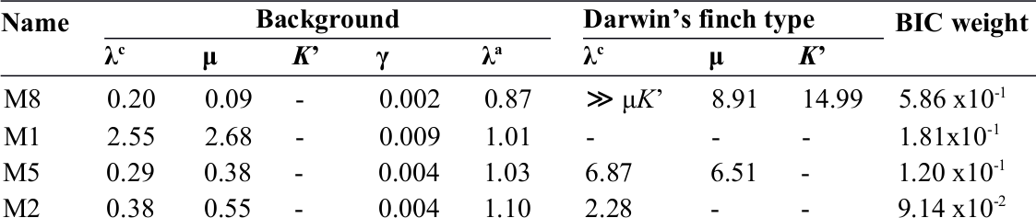
Top results
Valente et al. (2015)

Slide 13
What does the result work on?
Pretty birds, 25 species, 8 clades
Valente et al. (2015)

Slide 14
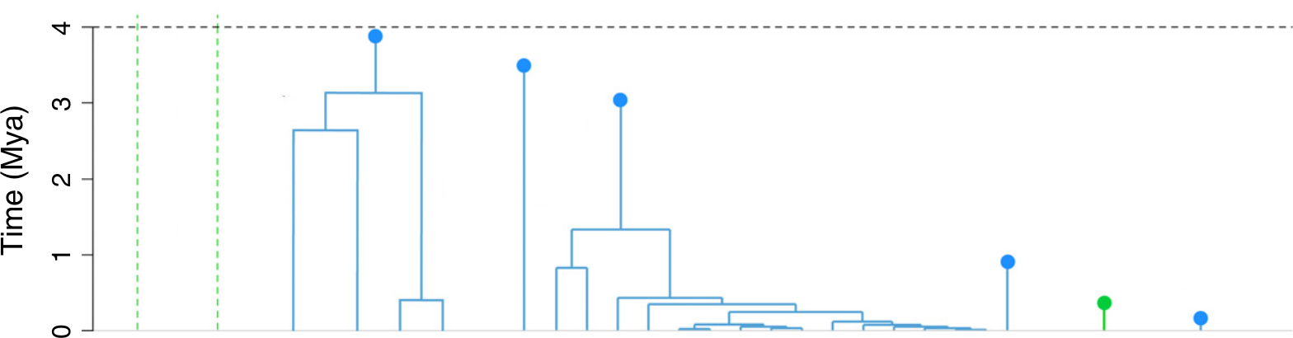
What does the result work on?
25 species, 8 clades
Modified from Valente et al. (2015)

Slide 15
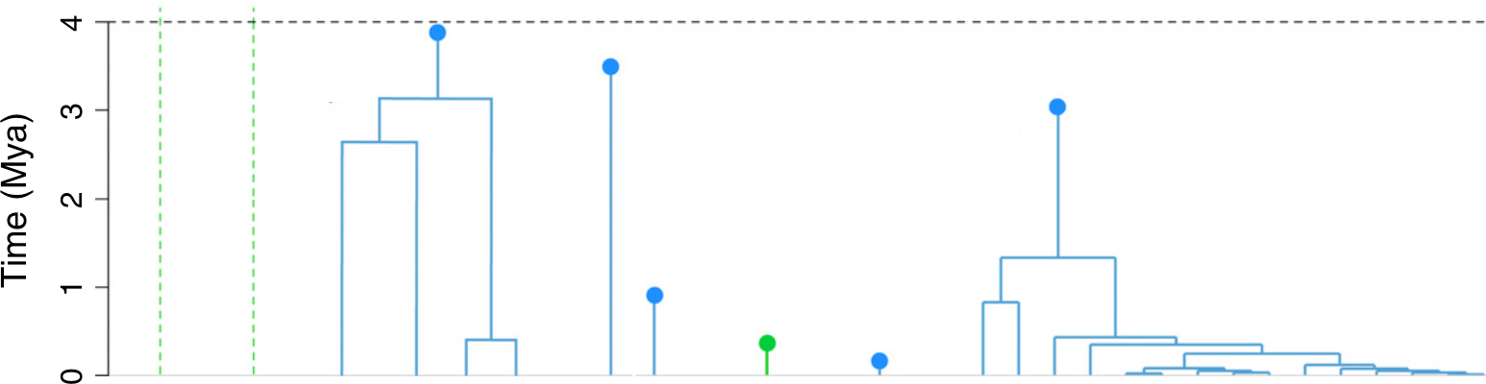
What does the result work on?
7 clades with 10 species
1 clade with 15 species
Modified from Valente et al. (2015)

Slide 16
What does the result work on?
7 clades with 10 species, speciation low
1 clade with 15 species, speciation rich
Modified from Valente et al. (2015)

Slide 17
My claim
The Galapagos are a bad illustration of DAISIE, because (1) the final result is weak, and (2) the figures oversell the story
(1) there is no unification

Slide 18
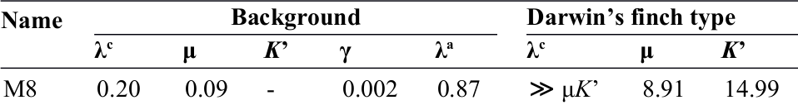
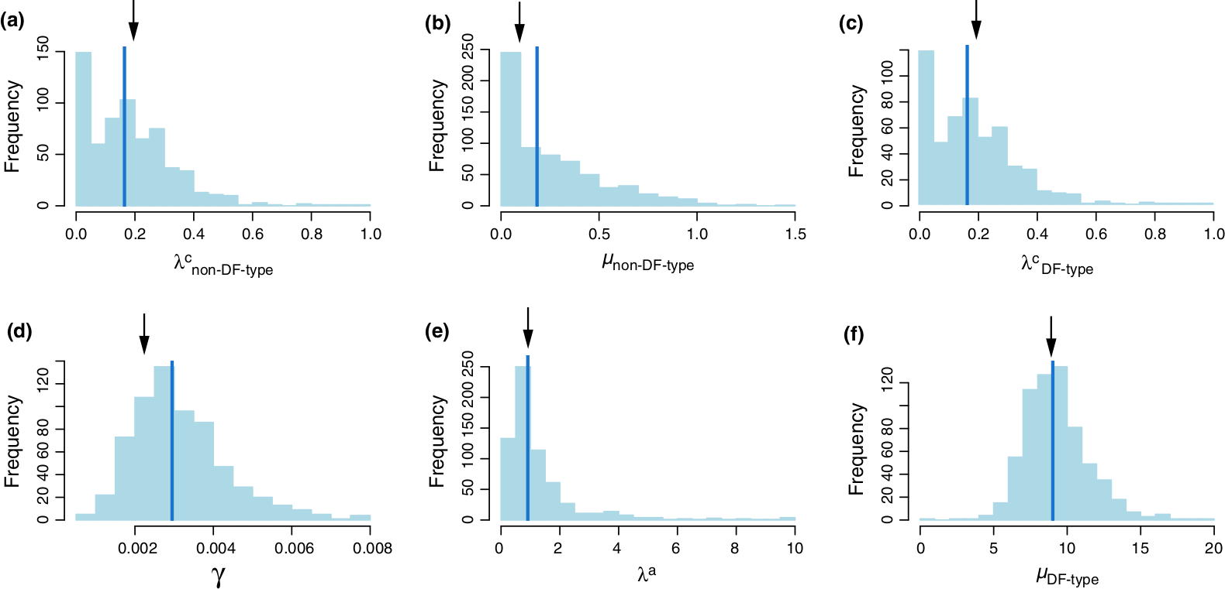
Figures, expected
Modified from Valente et al. (2015)

Slide 19
Figures
Valente et al. (2015)

Slide 20
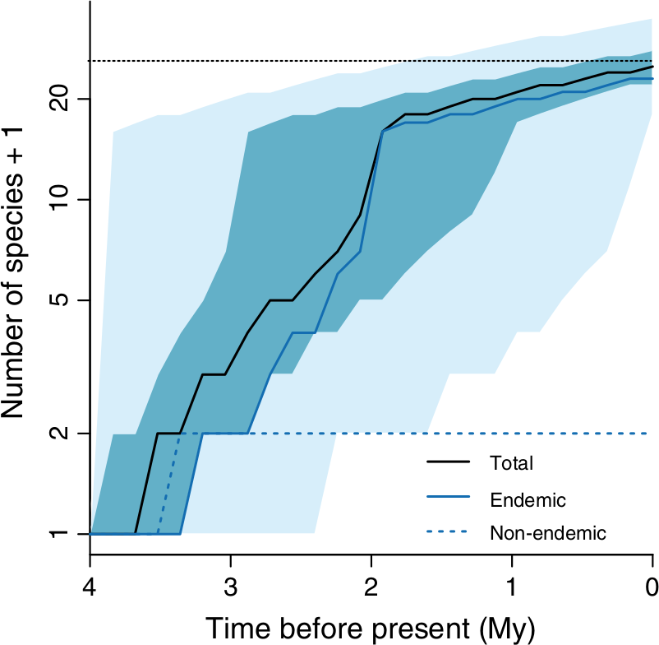
Figures
“According to the most strongly supported DAISIE model, the avifauna of the Galapagos islands does not tend towards a diversity steady state”
Valente et al. (2015)

Slide 21
Figures
Valente et al. (2015)

Slide 22
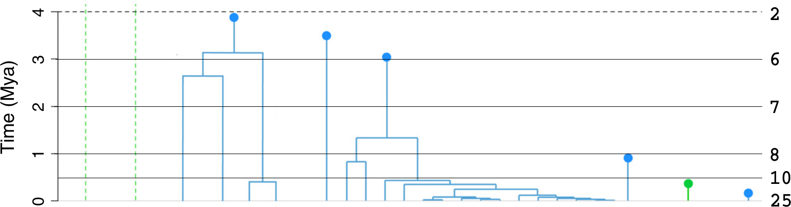
Figures
Modified from Valente et al. (2015)

Slide 23
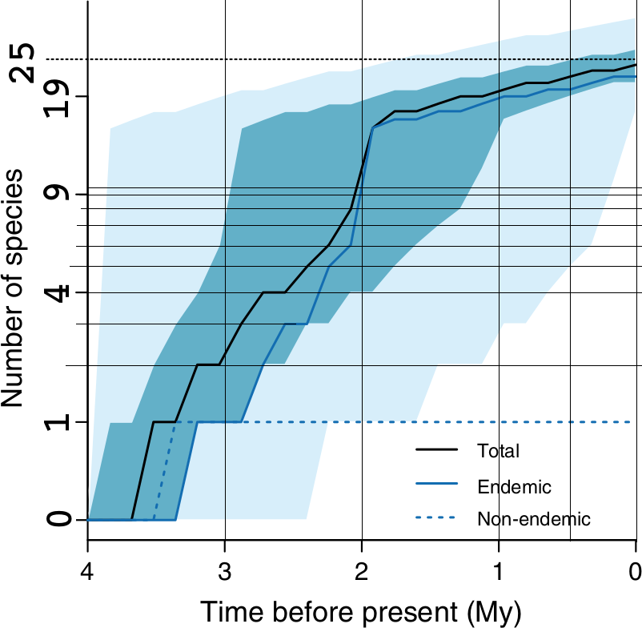
Figures
Modified from Valente et al. (2015)

Slide 24
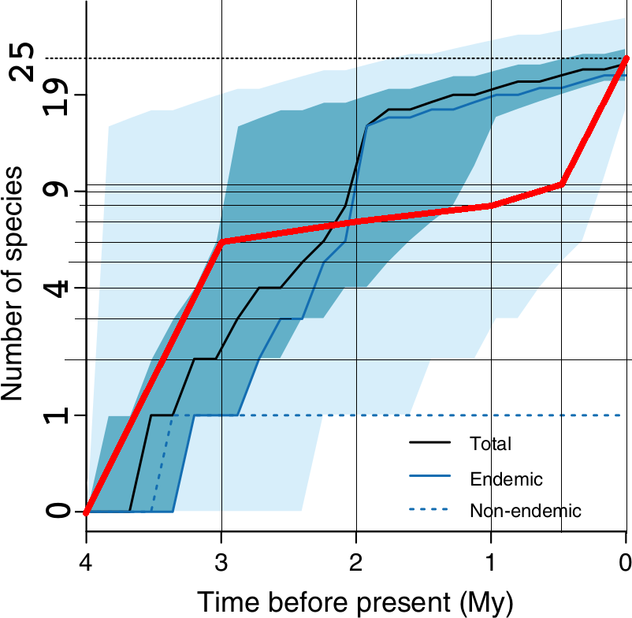
Figures
Modified from Valente et al. (2015)

Slide 25
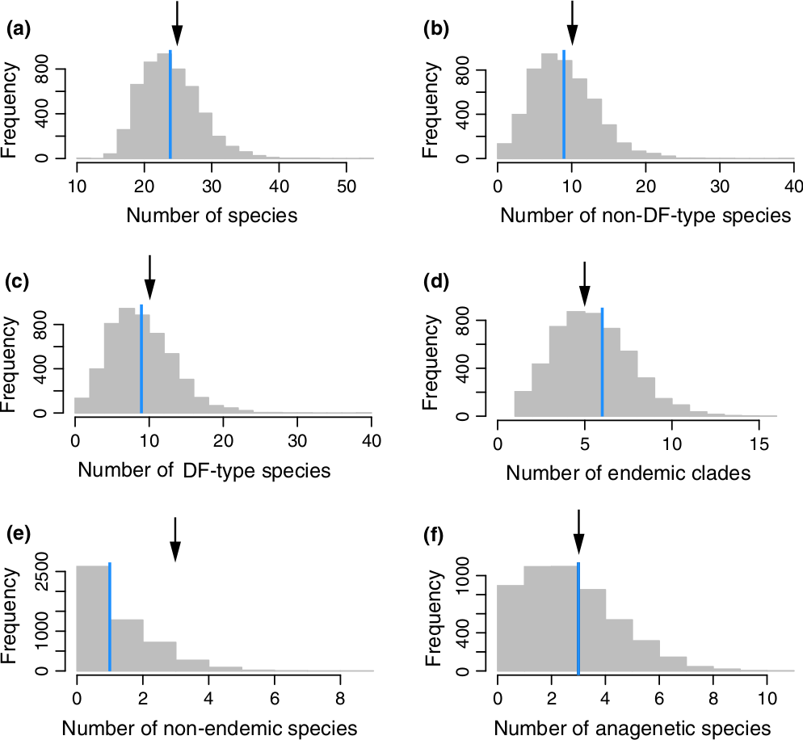
Figures
Modified from Valente et al. (2015)

Slide 26
Figures
Valente et al. (2015)

Slide 27
My claim
The Galapagos are a bad illustration of DAISIE, because (1) the final result is weak, and (2) the figures oversell the story
(1) there is no unification
(2) ugly results are omitted

Slide 28
Questions
What do you think?

