Slide 1

Progress
TECE meeting 2016-08-18
© 2016 Richel Bilderbeek
www.github.com/richelbilderbeek/Science

Slide 2
Research question
If speciation in nature takes time, what is the error made in inferring a phylogeny?
Under which conditions does it hurt?
Are these conditions relevant and/or realistic?
Tool used: BEAST2, assumes speciation is instantaneous

Slide 3
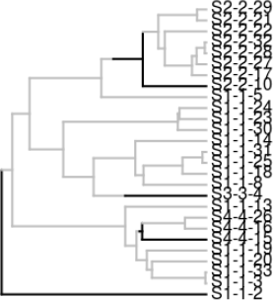
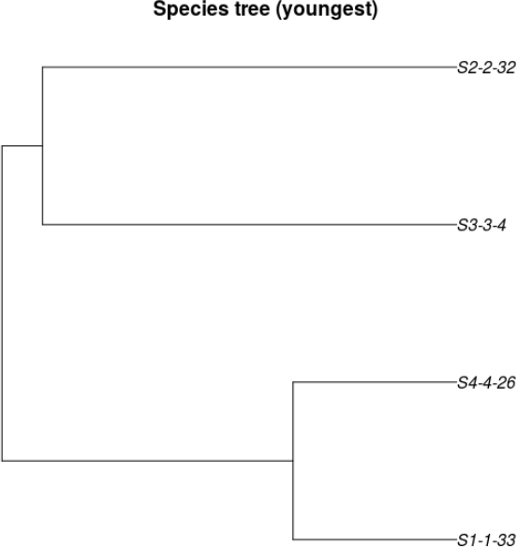
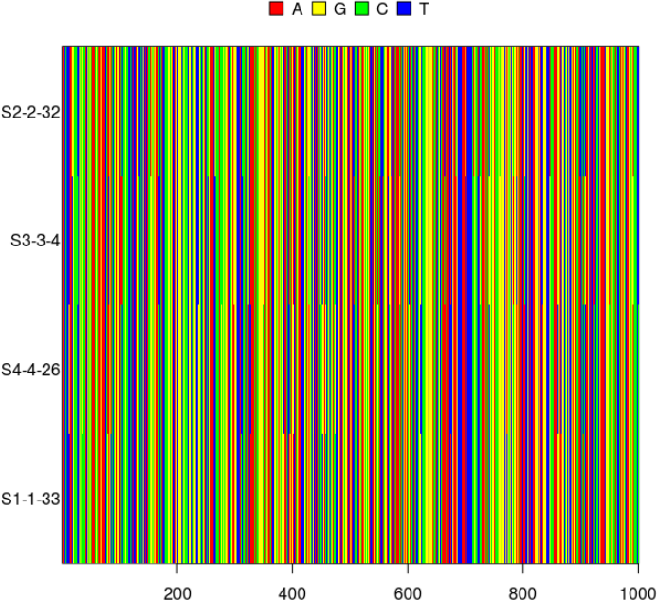
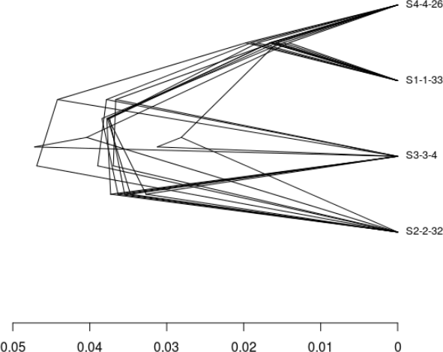

Approach
Simulate an incipient species tree
Sample species trees
Simulate DNA alignments
Infer species tree posterior
Measure difference/error
Notes:
Parameter space: http://www.mymodernmet.com/profiles/blogs/numen-for-use-string-prototype

Slide 4

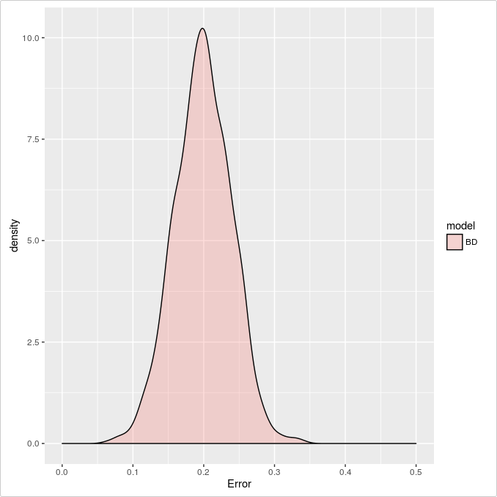
Goal

Slide 5
Work in progress
Under which parameters can I simulate?
Measure the nLTT statistics for those parameters
Finish article

Slide 6
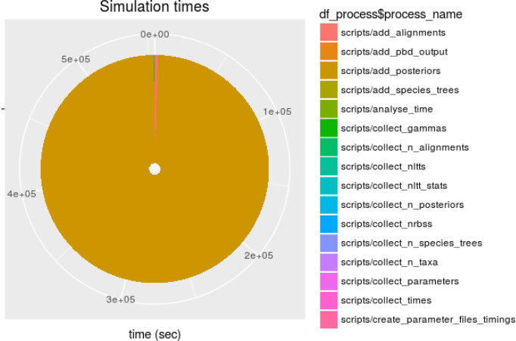
Under which parameters can I simulate?
?

Slide 7

Under which parameters can I simulate?
Premature optimization is
the root of all evil
(or at least most of it)
in programming
Donald Knuth
Notes:
Picture from https://commons.wikimedia.org/wiki/File:KnuthAtOpenContentAlliance.jpg

Slide 8
Under which parameters can I simulate?

Slide 9
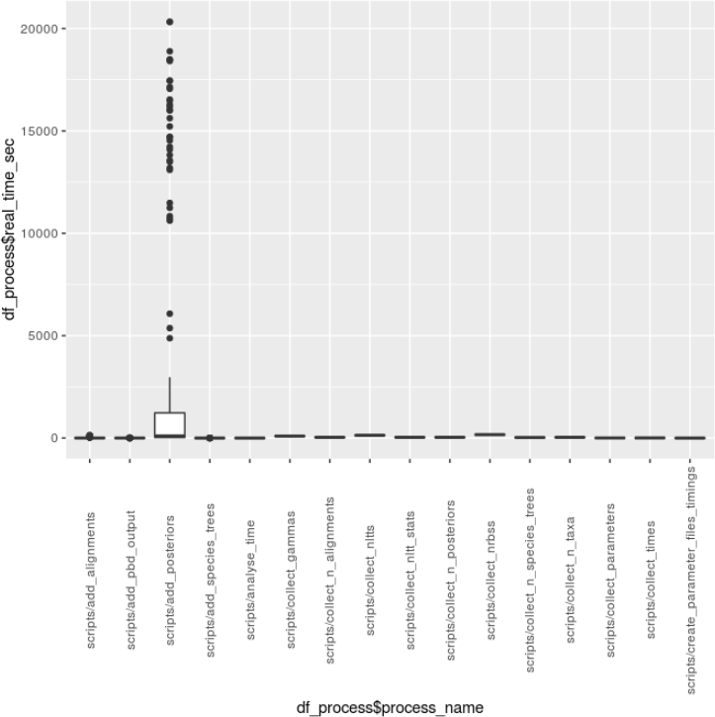
Under which parameters can I simulate?

Slide 10
add_posteriors
Runtime speed determined by
  Alignment length?
  Number of taxa?
Simulate DNA alignments
Infer species tree posterior

Slide 11
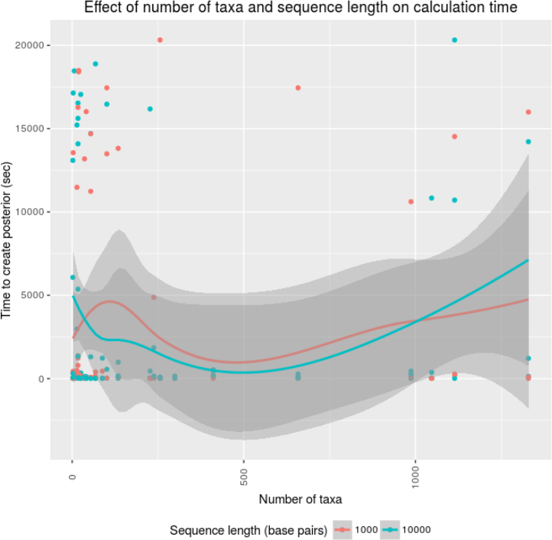
Under which parameters can I simulate?
What else
could effect
runtime speed?

Slide 12
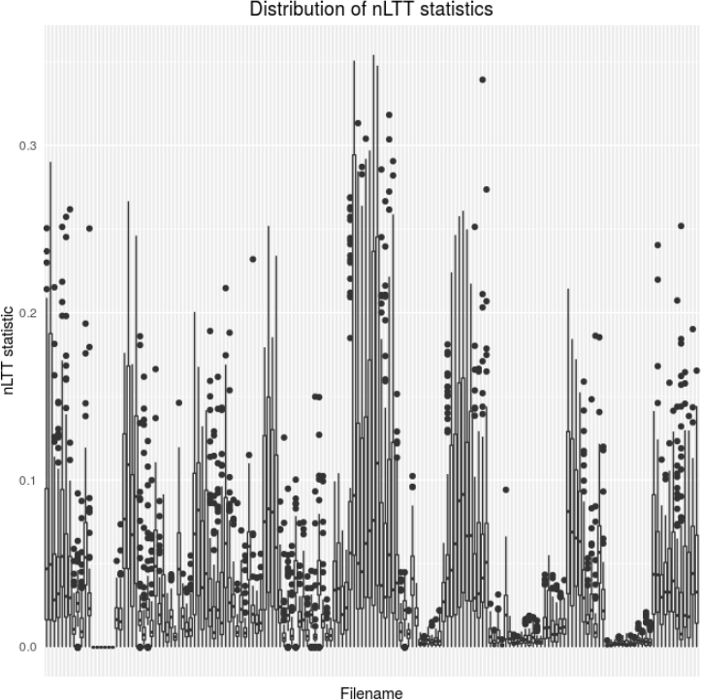
Measure the nLTT statistics for those parameters

Slide 13
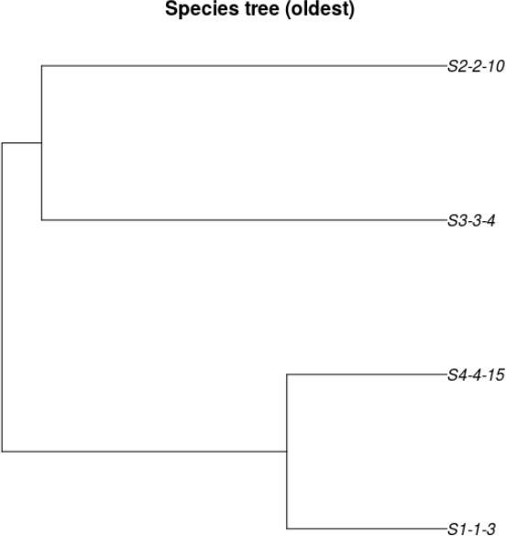
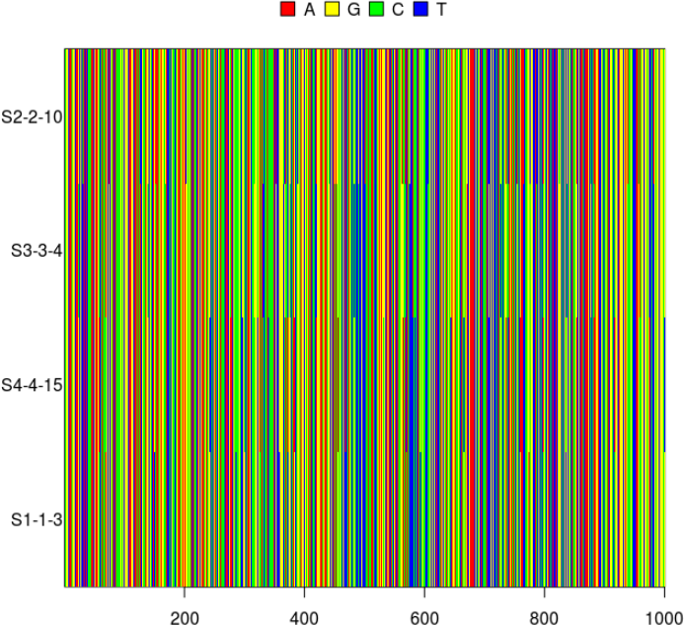
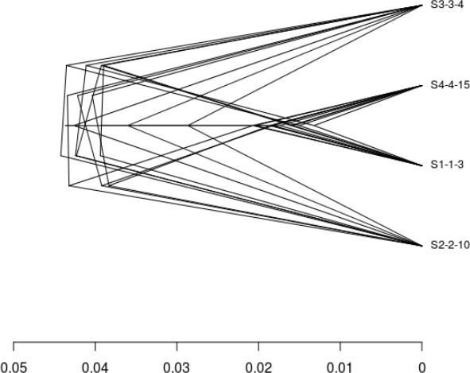
Measure the nLTT statistics for those parameters

Slide 14
Goal
There was no/a difference
in nLTT statistics distributions between
so we reduced/kept
the number of replicates
sampled species trees
simulated alignments
BEAST2 runs

Slide 15
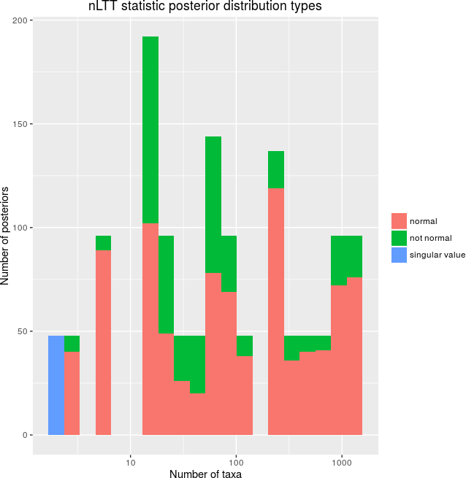
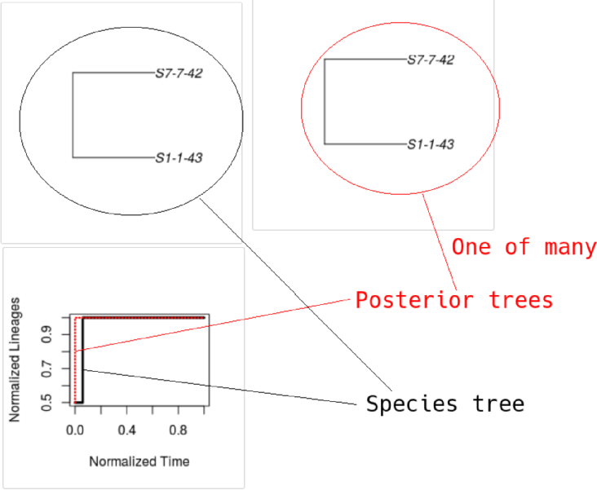

nLTT statistic distribution

Slide 16
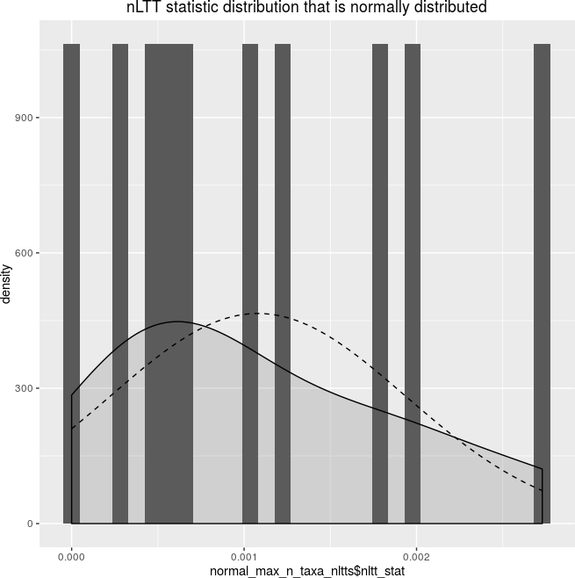
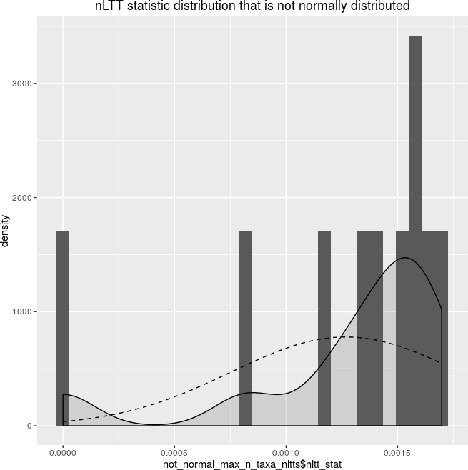
nLTT statistic distributions
Use a test that does not assume normality

Slide 17
NEW: Two-sample trimmed t [1]
Recommended by [2]
  Removes (‘trims’) the extreme values
  Statistical power similar for normally distributed data
  More robust when distribution is long-tailed
[1] Yuen, Karen K. "The two-sample trimmed t for unequal population variances." Biometrika 61.1 (1974): 165-170.
[2] Field, A. Miles. "J. & Field, Z.(2012)." Discovering statistics using R.

Slide 18
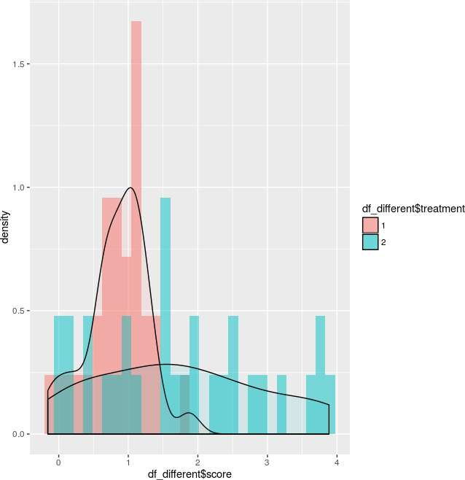
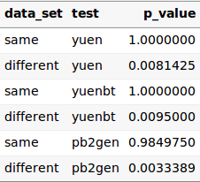
Example
1: rnorm(n = 30, mean = 1, sd = 0.5)
2: runif(n = 30, min = 0, max = 4)

Slide 19
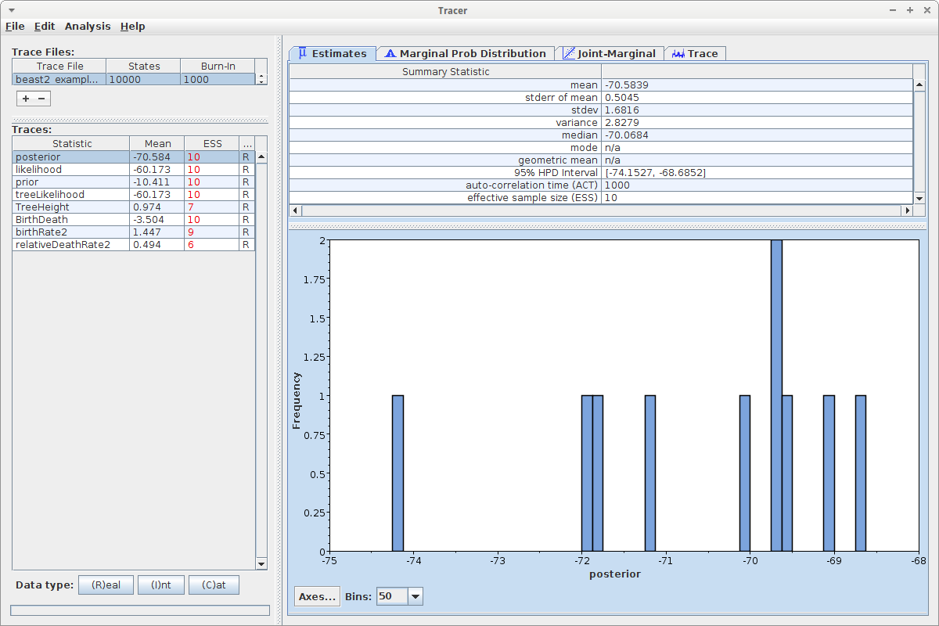
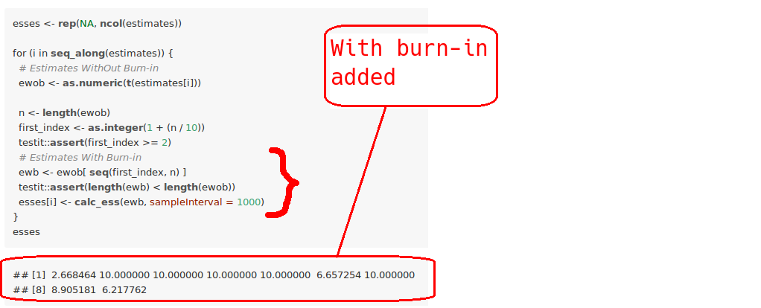
NEW: measure ESS
RBeast::calc_ess

Slide 20
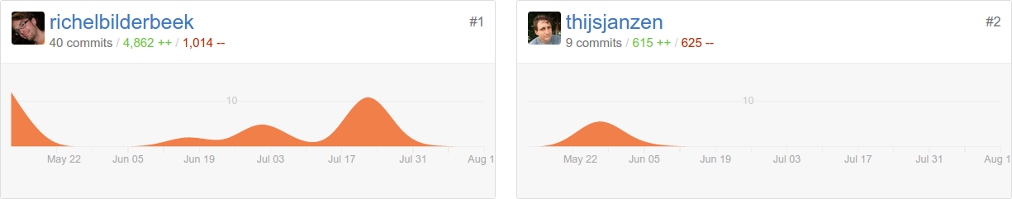

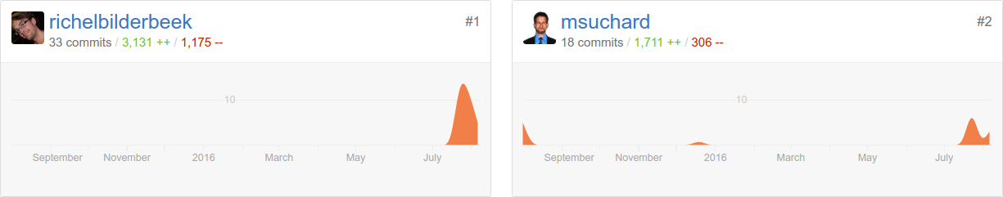

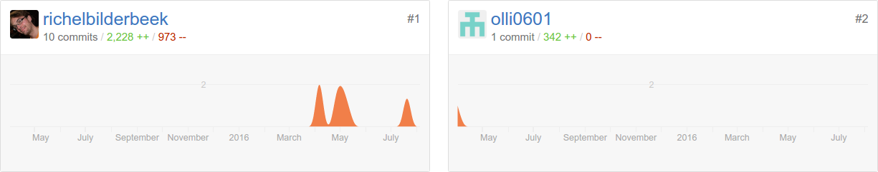

Collaborations
https://github.com/richelbilderbeek/nLTT
Thijs Janzen
https://github.com/beast-dev/RBeast
Marc Suchard
https://github.com/olli0601/rBeast
Oliver Ratmann

Slide 21
Work in progress
Under which parameters can I simulate (1) within 10 days (2) for an ESS > 200?
Draw conclusions from the nLTT statistics
Finish article

