Slide 1


Modeling Macro-evolutionary Processes
Biological Diversity Models
Freek de Haas
19/2/2014
Supervisor
Rampal Etienne
Notes:
Welcome to my lecture on modeling macro-evolutionary processes; my name is Freek de Haas
And I am here to talk to you about Biological Diversity and to tell you a little bit about the modeling side of diversity.
How has modeling helped us in understanding biological diversity throughout history.

Slide 2
Presentation Lay-Out
Modeling empirical data
    Assumptions
Modeling biological diversity
    Empirical Data
    Model
Discuss Papers
    Overview: Daniel Moen and Helene Morlon
    Etienne et al; 2012
    Etienne & Rosindell; 2011
Notes:
Like to start talking to you about modeling in general. Modeling is the core of science. It is the place you go to check your hypothesis. To see test your views on the world. Modeling is the way to go in science. Also talk about the downside.
How far we are in modeling biological diversity over evolutionary time
Empirical data that we have or think we have
The model hypothesis
Discuss 2 papers from Etienne. Both papers propose a different model and incorporate different parameters. But we will come to that later.

Slide 3
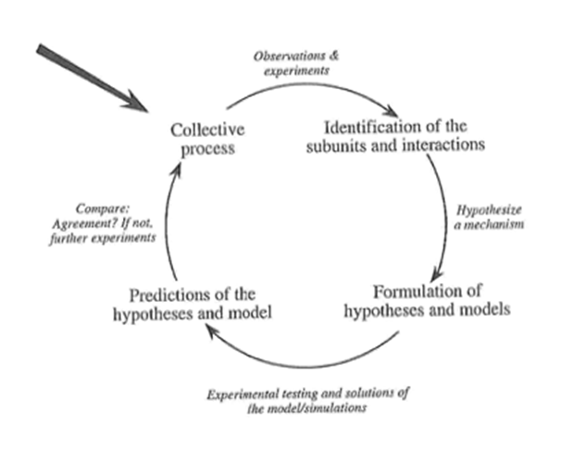

Modeling Cycle
Camazine et al; 2002
Notes:
Collective process: Collect data of Carbon-14 over Carbon-13 ratio
Observations & Experiments: What is this ratio linked to, which variables affected it
Identification of the sub: Find a pattern that correlates with it
Hypothesize a mechanism: Decay happens over time (reason)
Formulation of hypothesis: Decay of C-14 happens at a constant rate over time
Experimental testing: Create the model and test this by extrapolating
Predictions of the hypothesis and model: what are the predictions of the model based on the assumptions

Slide 4
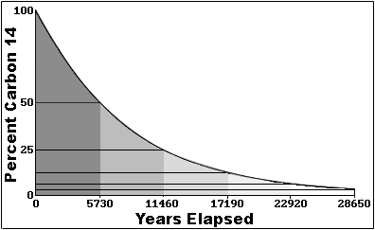

Model & Assumptions
Constant radioactive decay over time?
Notes:
Be careful with your assumptions. Problem with model making is that you don’t know how far you can stretch your assumptions…
When talking about millions of years ago, it is like talking about the weather a million years ago. I take it with extreme caution.

Slide 5
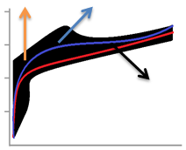


Use of models & degrees of freedom
Multiple factors
More flexibility
More variables → prediction power
Degrees of freedom
Akaike information criterion
df
maximized likelihood
Preferred model is minimum AIC value
Notes:
Everyone can make models through some datapoints. Can you make a model with 2 paramters through 4 datapoints.

Slide 6

Biological Diversity
Response Variable

Slide 7
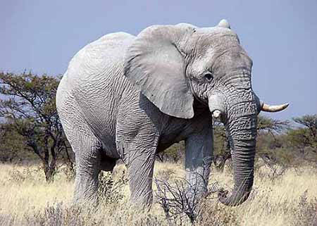
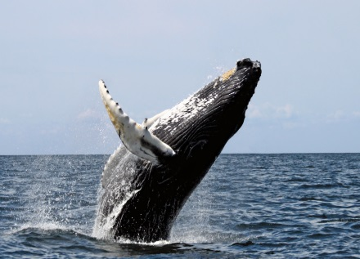
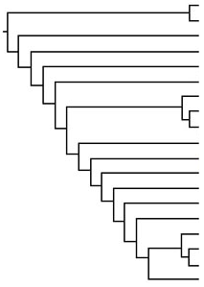

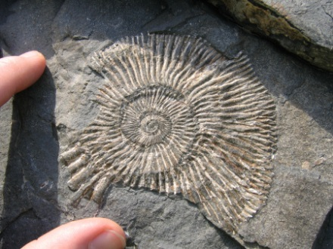

Relevance
Speciation Rate
(Parameter estimation)
Extrapolate &
Correlations
Fossil vs. Molecular
Notes:
Why is the rate of speciation different in certain clades?
Many animal phyla with small number of species
What is the discrepancy between fossil ages of major radiations and their molecular ages
Speciation rate & Extinction rate
IF you can extrapolate, you do it over large scale biological history → highly biology relevant assumptions

Slide 8


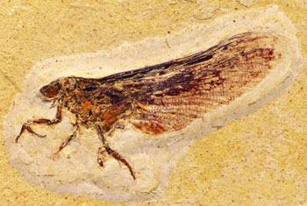

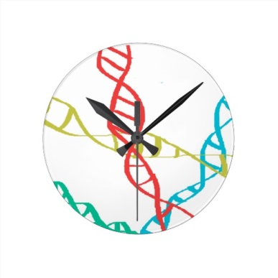
Empirical data
Molecular data
  DNA comparison
Fossil records
  Radiocarbon dating
Empirical Data ?
Notes:
Empirical data is hard to measure
Need very flexible assumptions

Slide 9
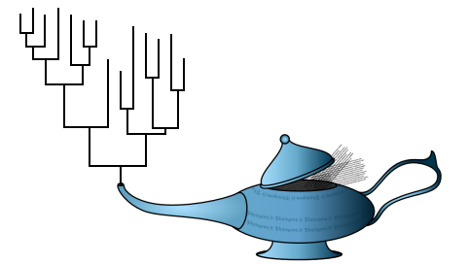
Phylogeny model
OUTPUT
INPUT
Variables:
- Speciation
Extinction
etc
Time
Model
Notes:
Assumptions not so much come from empirical data, but more that the assumptions are based on a theory which we like to fit the few data points that we have.
Keep excluding until you have no other options left.

Slide 10
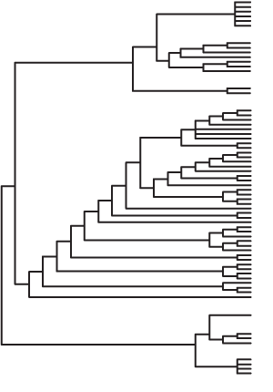
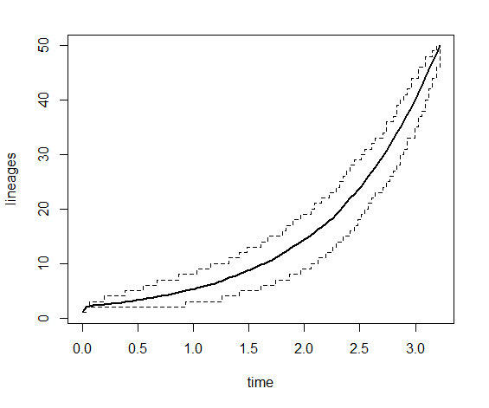
Model Assumptions & Predictions
Lineages Through Time

Slide 11
Phylogeny model
OUTPUT
INPUT
Variables:
- Speciation
Extinction
etc
Time
Model
Notes:
Assumptions not so much come from empirical data, but more that the assumptions are based on a theory which we like to fit the few data points that we have.
Keep excluding until you have no other options left.

Slide 12
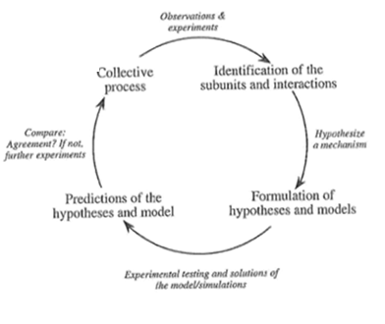
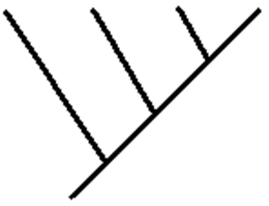

Evaluation
Empirical phylogenies
Modeled Phylogenies

Slide 13

Different Parameters Speciation
Time Constant
Homogenous
Instantaneous
Time
Vary Through Time
Vary Through Lineages
Protracted
Model
Notes:
Speciation!

Slide 14
Different Parameters Speciation
Time Constant
Homogenous
Instantaneous
Vary Through Time
Vary Through Lineages
Protracted
Pure birth models
Birth-death models
Density dependent
Time-dependent
Protracted speciation
Waxing & Waning
Etc…
Changing the model
Find a reason and change the model
Change the model and find a reason
Notes:
Speciation!

Slide 15
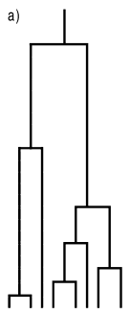
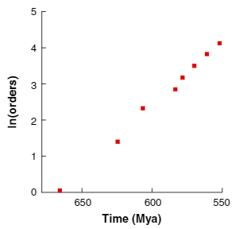

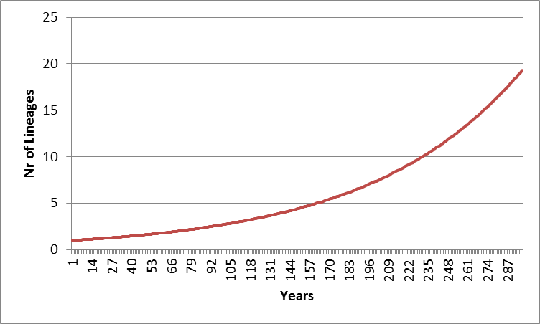
Pure Birth Model
Assumptions Model
  Only Speciation drives Biological Diversity
  Common Ancestor
  Speciation is constant over time
N(0) – Nr of species at time 0
b – P[speciation event]

Slide 16
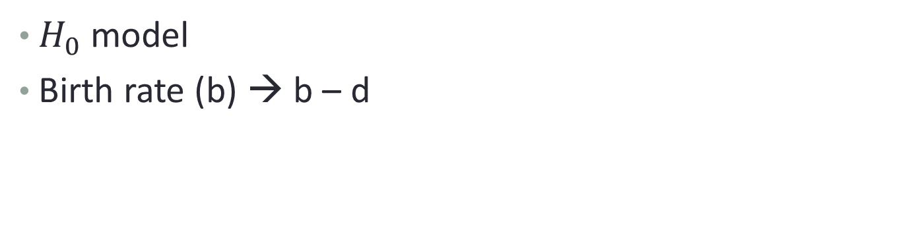
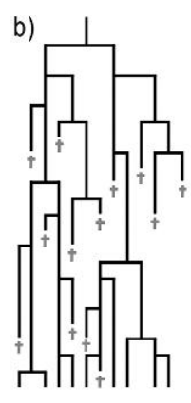
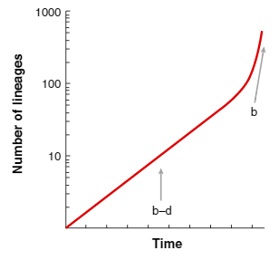
Birth-Death Model
Molecular Phylogenies
Pull of the Present
Extinction rate
Notes:
Pull of the present: purely theoretical phenomenon

Slide 17
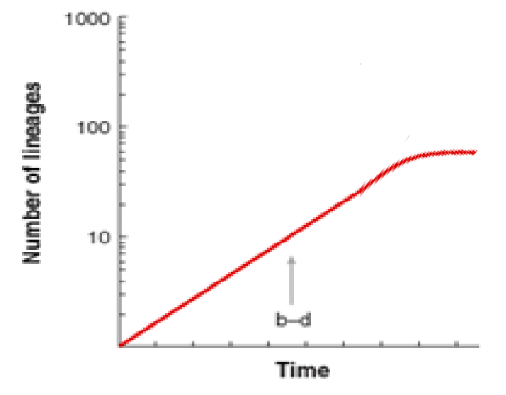
Empirical Data
Molecular empirical data is not in line with “pull of the present”
Most show a slow down of diversification towards the present
Extinction = 0 / Speciation goes down
Not in line with the fossil records

Slide 18
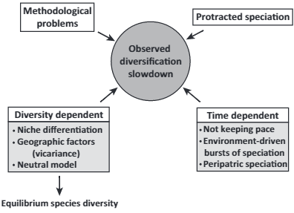
Diversification Slowdown
Speciation rates change through time (external)
Speciation rates depend on diversity (internal)
Daniel Moen and Helene Morlon; 2014
Notes:
Diversification slowdown…
Methodological biases can lead to such results and need to be controlled (Box 2). However, recent studies have avoided many biases and have still found strong support for slowdowns (e.g., [3,4,8]).
Biological explanations → niche differentiation
Adaptive radiation and ecological limits to diversity.
Competition for limited resources
Model: Diversity dependent model
Alternative explanations:
Geographic context of diversification
Environment-driven bursts of speciation
Failure to keep pace with changing environment
Protracted speciation

Slide 19
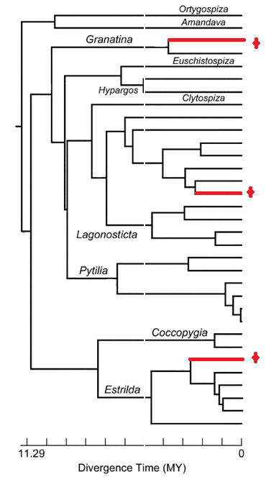
Methodological Biases
Empirical
  Taxonomic sampling
  Large phylogenies can show slowdowns by chance
---------------------------------------------------------------------
Model
  Inaccurate estimation from DNA sequences
    Scaling molecular branch lengths into units of time
    Node-density effect

Slide 20
Methodological Biases
Empirical
  Taxonomic sampling
    Large phylogenies can show slowdowns by chance
---------------------------------------------------------------------
Model
  Inaccurate estimation from DNA sequences
    Scaling molecular branch lengths into units of time
Notes:
Model 1) Downstream biases

Slide 21
Diversification Slowdown
Speciation rates change through time (external)
Speciation rates depend on diversity (internal)
Notes:
Diversification slowdown…
Methodological biases can lead to such results and need to be controlled (Box 2). However, recent studies have avoided many biases and have still found strong support for slowdowns (e.g., [3,4,8]).
Biological explanations → niche differentiation
Adaptive radiation and ecological limits to diversity.
Competition for limited resources
Model: Diversity dependent model
Alternative explanations:
Geographic context of diversification
Environment-driven bursts of speciation
Failure to keep pace with changing environment
Protracted speciation

Slide 22
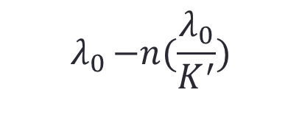

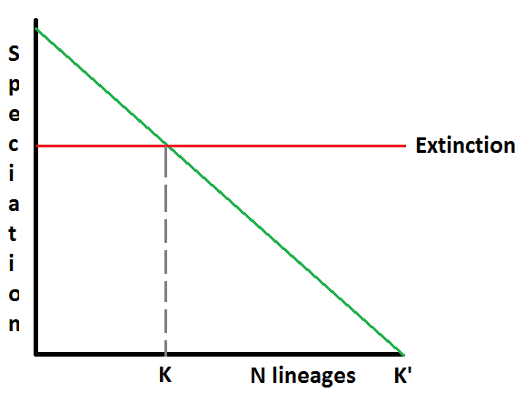

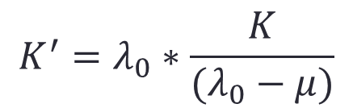
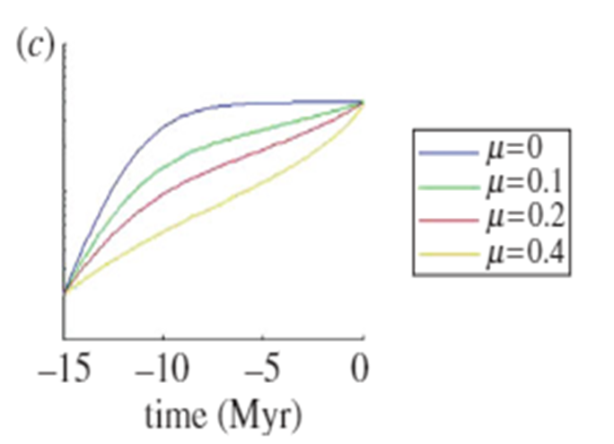
Diversity-dependence brings molecular phylogenies closer to agreement with the fossil record (Etienne et al; 2012)
Birth-Death Model
Internal feedback
Notes:
speciation can fill any one of the K0 niches with
equal probability and that the ecological dynamics (population
growth) of a newly arisen species are much faster
than the evolutionary dynamics of diversification

Slide 23
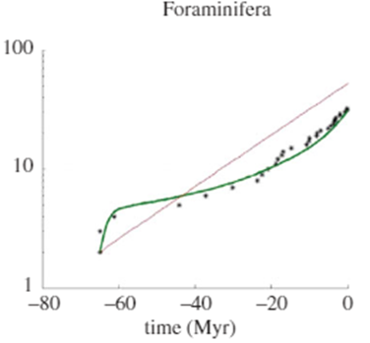
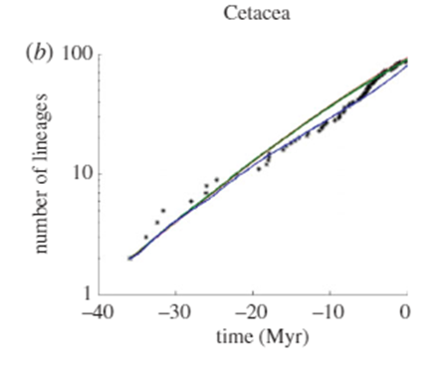
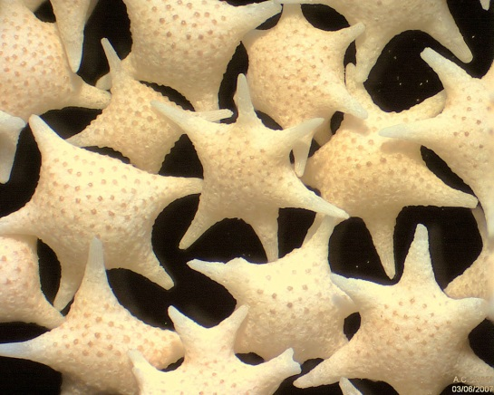
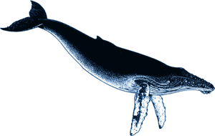
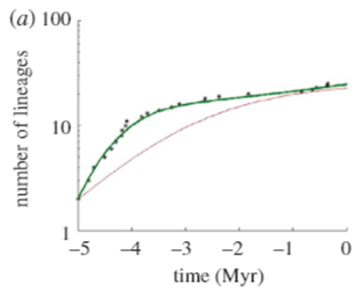
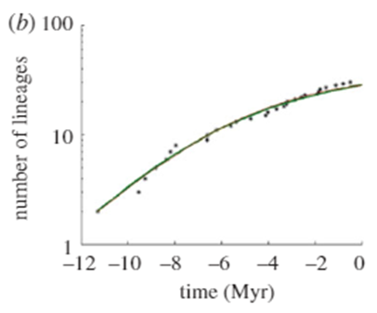
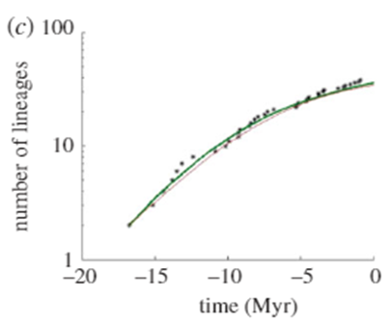
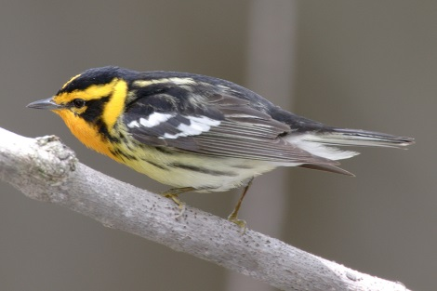
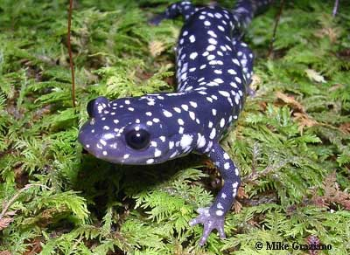
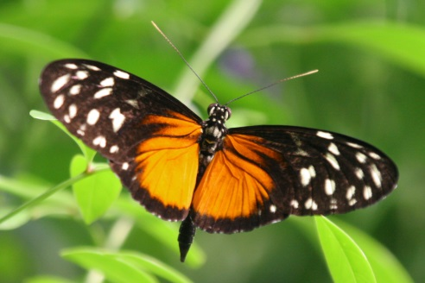
Empirical Data
Foraminifera
Cetacea
Dendroica Warblers
Glutinosus
Heliconius
Notes:
80% Foraminifera → 1 Million Years
Molecular Information → All three show slowdowns at the end (instead of pull of the present which is expected from birth death models)
Dendroica & Heliconius → Adaptive radiation
Glutinosus → not so much, more ecological geographical replacement

Slide 24
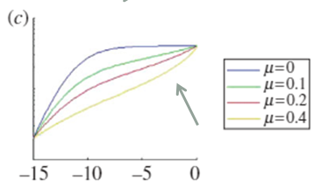
Hidden Markov Model
Likelihood computation -> Hidden Markov Model
  Compute likelihood of phylogeny for different parameters
Parameters:
- Speciation
- Extinction
a + b = c
Time
Model
Notes:
Low crown age, not very acurate

Slide 25
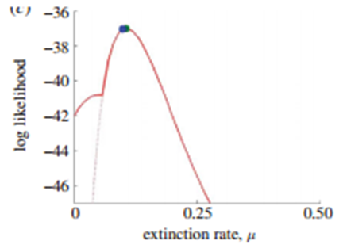
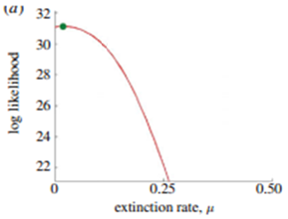
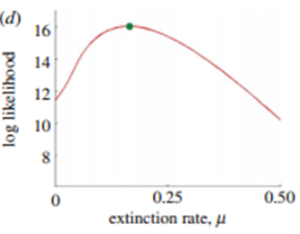
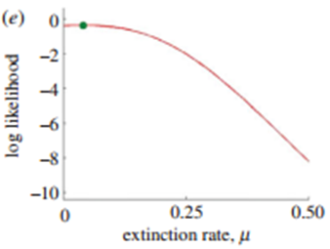
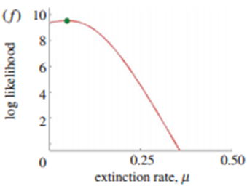
Likelihood Extinction Rate
Foraminifera
Cetacea
Dendroica Warblers
Glutinosus
Heliconius
Notes:
80% Foraminifera → 1 Million Years
Molecular Information → All three show slowdowns at the end (instead of pull of the present which is expected from birth death models)
Dendroica & Heliconius → Adaptive radiation
Glutinosus → not so much, more ecological geographical replacement

Slide 26
Likelihood Speciation Rate
Likelihood of extinction ~ Likelihood of speciation

Slide 27
Discussion
Parameters are in line with fossil records
  Extinction in model
Better fit to the data
Ezard et al. used complete fossil phylogeny Foraminifera (extinct & extant), estimate similar extinction rates.
Diversity Dependent Models
  New species - New niches?
Mechanisms are still unclear
Diversification slowdown at present
  K reached always at present?
Meta-analysis of early burst 2 out of 88
Notes:
DDL + E model - Birth-death model
DDL + E model -> H0 model
Incorporate protracted speciation
Higher extinction rates
Many phylogenies show diversification slowdown
Caring Capacity always reached in the present…
Meta-analysis of an array of animal clades found support for an early burst model in only two out of 88 data sets.
Radiation / niche saturation on smaller islands should be at or near ecological equilibrium →Is “not” the case: island comparisons.

Slide 28
Diversification Slowdown
Speciation rates change through time (external)
Speciation rates depend on diversity (internal)
Notes:
Diversification slowdown…
Methodological biases can lead to such results and need to be controlled (Box 2). However, recent studies have avoided many biases and have still found strong support for slowdowns (e.g., [3,4,8]).
Biological explanations → niche differentiation
Adaptive radiation and ecological limits to diversity.
Competition for limited resources
Model: Diversity dependent model
Alternative explanations:
Geographic context of diversification
Environment-driven bursts of speciation
Failure to keep pace with changing environment
Protracted speciation

Slide 29
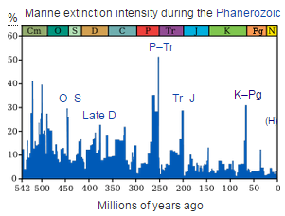
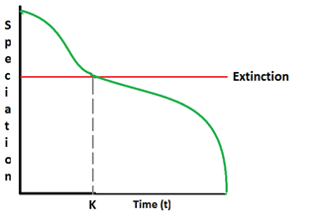

Time dependent model
Environmental drivers
    Abiotic
      Geographical
      Climatic
    Biotic
      Access to food
      Predator intensity
Diversification slowdowns
External feedback

Slide 30
Diversification Slowdown
Notes:
Diversification slowdown…
Methodological biases can lead to such results and need to be controlled (Box 2). However, recent studies have avoided many biases and have still found strong support for slowdowns (e.g., [3,4,8]).
Biological explanations → niche differentiation
Adaptive radiation and ecological limits to diversity.
Competition for limited resources
Model: Diversity dependent model
Alternative explanations:
Geographic context of diversification
Environment-driven bursts of speciation
Failure to keep pace with changing environment
Protracted speciation

Slide 31
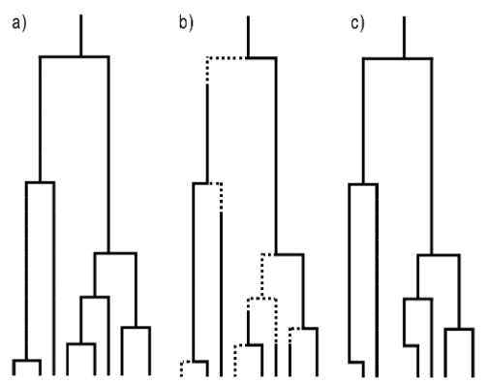
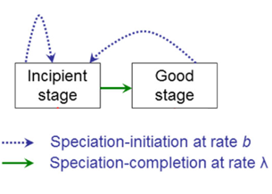
Protracted Speciation
Pure Birth Model (no extinction)
Notes:
Clear evidence that a considerable amount of time may be needed to create the genetic distance required to distinguish two ‘good’ species.
Do not assume mechanism
Well, Extinction takes time.. So does Speciation.
There is clear
evidence that a considerable amount of time may be
needed to create the genetic distance required to distinguish
two ‘good’ species

Slide 32
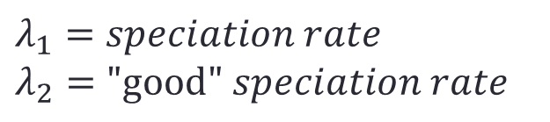

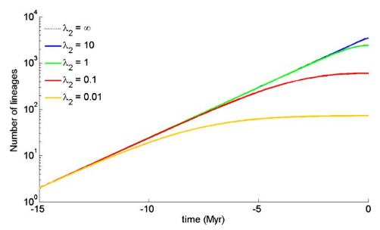
Protracted Speciation Model - E

Slide 33
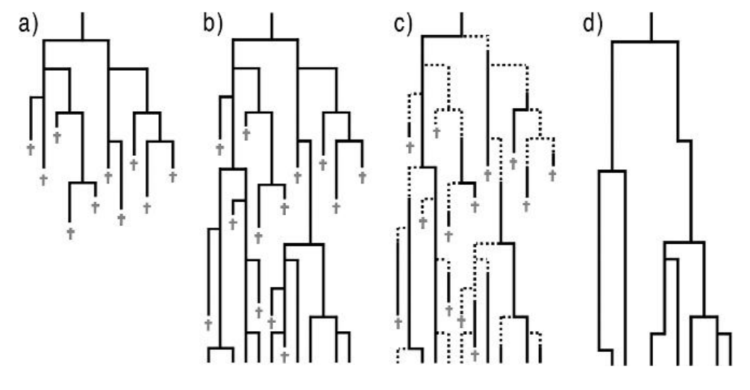

Protracted Speciation Model + E
Notes:
The parameter
μ
2
is
the extinction rate of incipient
species. It can be argued that incipient species are more
likely to become extinct (and hence have higher
μ
2
val-
ues)
because of smaller population size or because gene
flow causes the incipient species to merge with its par-
ent (McPeek 2008) . However,
one could also argue that
incipient species have a lower extinction rate because
they are likely to fill a new niche in which there is less
competition.

Slide 34




Protracted Speciation Model + E

Slide 35






Model Fitting
Notes:
Species:
slowdown must be clearly visible
no missing species.
Parameters non reliable
Extinction rate did not show change
Speciation initiation and completion depend on extinction rate

Slide 36
Discussion
Explain slowdowns
Predict more imbalanced trees λ3 < λ1
Not by chance slowdown in present
Speciation takes time – Extinction takes time
Parameter estimation not accurate
  speciation vs extinction <- Analytically

Slide 37

New model

Slide 38
Questions?
Notes:
I am happy to take any questions

